Slide 1
Network Security
CS3403
Lab 3
TCP Sockets between WSL and Windows
Mouli Sankaran
Note: Mac users can do WSL experiments on their own machines
and work with other classmates for Windows related activities or
If you have any VM installed try the same between Mac and the VM

Slide 2
Lab 3: Focus
WSL Explained
Server and Client Interactions
  Using TCP Connection between WSL and Windows
  Connection Establishment Explained
Analyze the TCP Segments: Wireshark
Experiments to be done in the Lab
  Exp 1 and Exp 2
Python IDE used on Windows: Thonny
Course page where the course materials will be posted
as the course progresses:

Slide 3
WSL Explained

Slide 4
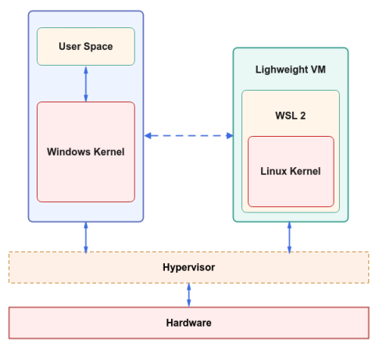
WSL: Explained
Ref: Intro to WSL 2
The Windows Subsystem for Linux (WSL) allows users to run Linux applications and command-line tools on Windows.
WSL works by translating Linux system calls into Windows system calls.
WSL allows Linux binaries to run on Windows without the need for a virtual machine or dual booting.
WSL manages the Linux file system, network, and process execution.
WSL creates a Virtual Hard Disk (VHD) to store files for each Linux distribution. In our case Ubuntu.
(Type 1)

Slide 5
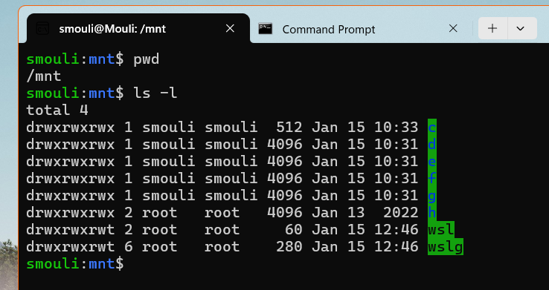
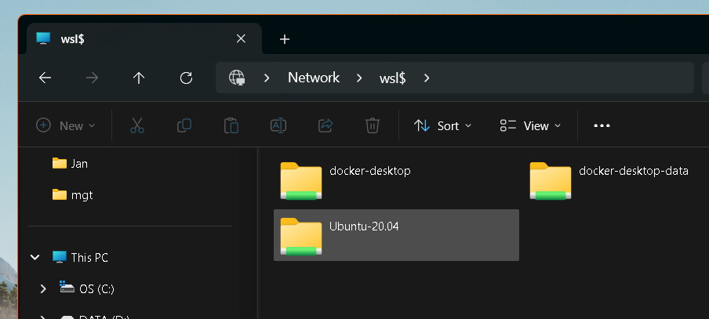
WSL: Explained
The Lightweight Utility VM has been optimized to load the Linux kernel into the VM's address space without going through any Boot Loader process, thereby achieving fast startup time
WSL supports only x64 and Arm CPUs.
Using your mounted drives, you can edit code in, for example, C:\dev\myproj\ using Visual Studio or VS Code, and build/test that code in Linux by accessing the same files via /mnt/c/dev/myproj
Accessing Linux filesystem (WSL) from Windows: \\wsl$
Enter \\wsl$ in the File Explorer address bar
to view the filesystem of Linux distribution on WSL
Ref link.
Accessing Windows filesystem from WSL: /mnt

Slide 6
Server and Client Interactions
Reference: Ref1: TCP/IP Illustrated-Volume 1:
Chapter 13: TCP Connection Establishment and Termination

Slide 7
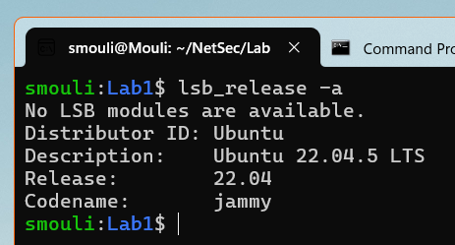
Exp: System Diagram
(sample Python code shared)
Windows Machine
Windows
WSL (Ubuntu 22.04)
Client
Server
NW
Stack
NW
Stack
TCP
Port
65432
On WSL
Exp 0: Run the below python programs
  On WSL: Lab1_exp0_server_WSL.py - this should be run first
  On Windows: Lab1_exp0_client_Win.py – this should be run next

Slide 8
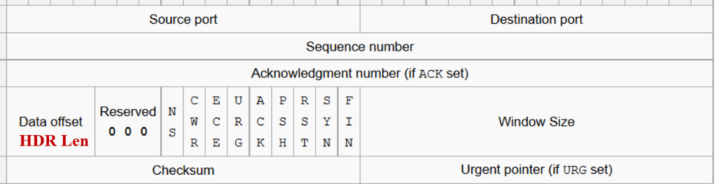
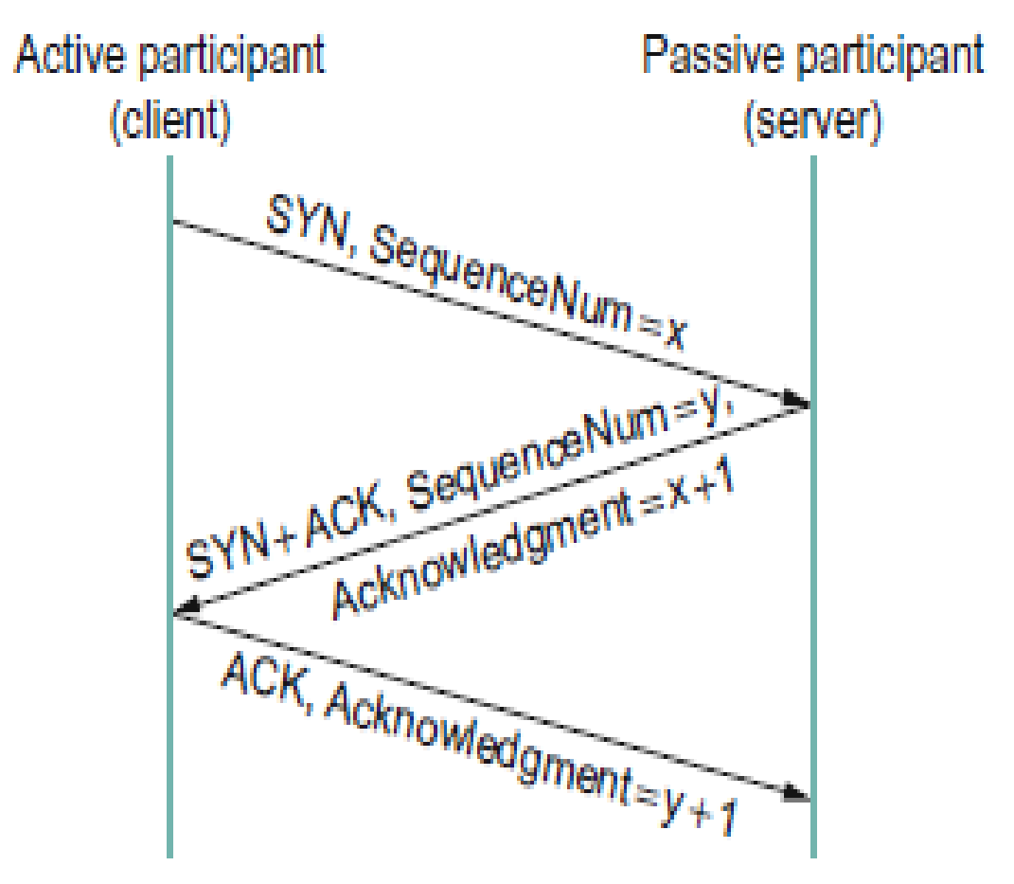
Connection Establishment: Explained
A connection typically goes through three phases:
Setup,
Data transfer (called established), and
Teardown (closing).
SYN: Synch or Synchronization
FIN: Final segment of a TCP connection.

Slide 9
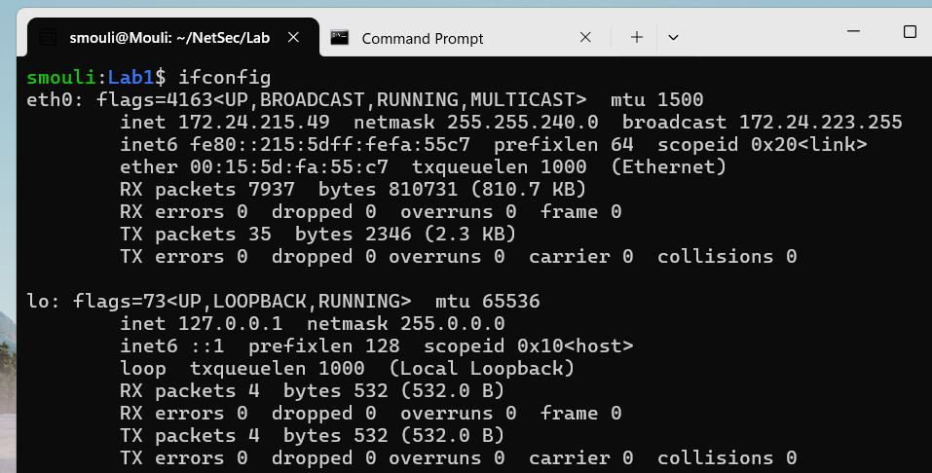
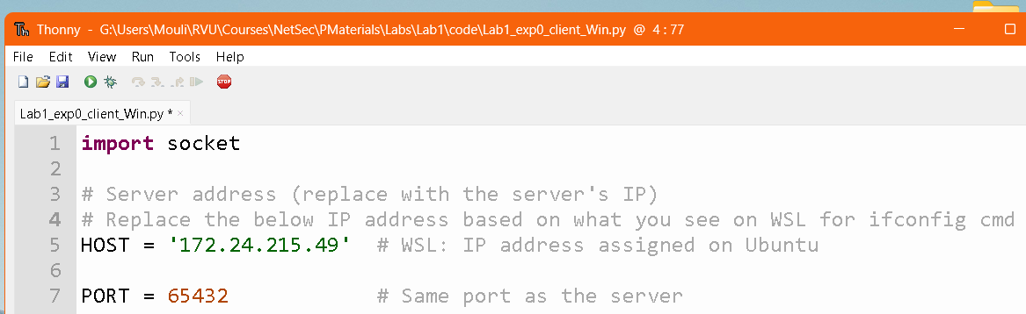
IP address: WSL
(file name: Lab1_WSL.py )
IP address of the Server running on WSL: HOST = 172.24.215.49
inet 172.24.215.49
netmask 255.255.240.0
Note: Choose the IP addresses
based on what you see in your machine.
Change the HOST value (IP addr)
as shown below

Slide 10
Exp 3a : Server (WSL) 🡨🡪 Client (Windows)
(file names: Lab3a_server_WSL.py & Lab3a_client_Win.py )
Run the server code of Exp0 on WSL and Client code of Exp0 on Windows
python3 Lab3a_server_WSL.py
py Lab3a_client_Win.py
Server on WSL
Client on Windows

Slide 11
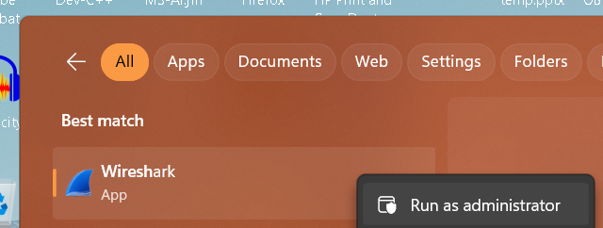
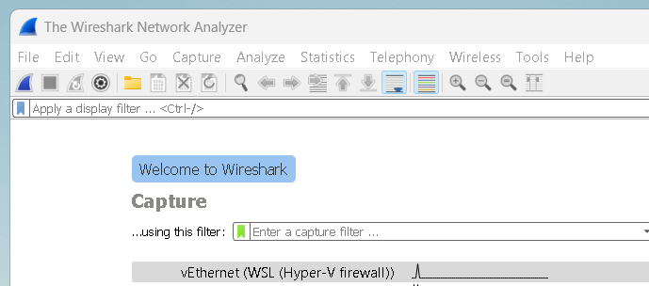
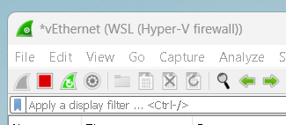
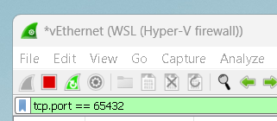
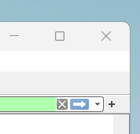
Analyze the TCP Segments: Wireshark
(exchanged between the Server and Client)
Run the Wireshark in Administrator mode and capture the packets on the virtual Interface between the WSL and Windows
Choose: Capture vEthernet Interface
Apply a display filter: Type the filter cmd
  tcp.port == 65432
  Click on the right arrow at the right side
Run the Server code on WSL first and then the Client code on the Windows side.
You can observe TCP segments exchanged between the Server and the Client on Wireshark.

Slide 12
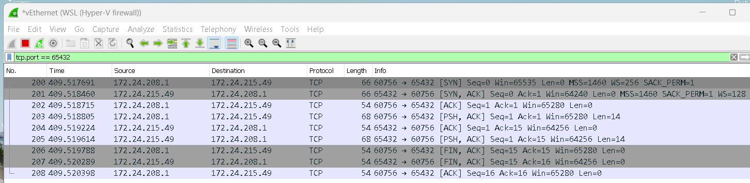
Analyze Each TCP Segment Exchanged
The first three segments seen above are related to connection establishment between the Server waiting on the port # 65432
The next three segments are exchanging data between the Server and the Client
The last three segments are closing the connection between them, with the Client initiating the closure of connection

Slide 13
Experimentes to be Done in the Lab

Slide 14
Exp 3b: Server (Win) and Client (WSL)[Interchange Client & Server]
Copy the given Exp0 files of both Server and the Client, as Exp1 files and change the Exp1 Client file according to your IP address observed on Windows
  Exchanging files between the WSL and Windows seamless, use the method shown on Slide #5.
Now, run the Exp1 Server on Windows first and run the Exp1 Client code from the WSL side and observe the segments exchanged between the WSL and Windows using the Wireshark.
Observe the exchange of segments between the server running Windows and the client running on WSL on Wireshark, by setting up the display filter as “tcp.port == 65432”

Slide 15
Lab 3: Summary
WSL Explained
Server and Client Interactions
  Using TCP Connection between WSL and Windows
  Connection Establishment Explained
Analyze the TCP Segments: Wireshark

