Slide 1
Design and Verification of DMA controller(8237A)
Team Members:
Sri Harsha Doppalapudi
Shivanand Reddy Gujjula
Jayasree Bodavula
Sameer Shaik

Slide 2
Contents
Intro. to DMA controller
Operation of DMA controller
Scope of the project
Design of DMA controller
Priority logic
Timing and Control
Datapath
Test Plan
Unit Testing
System testing
Assertions used
References

Slide 3
Intro. to DMA controller
DMA Controller is used for transfer of data between memory and I/O devices at faster rates without intervention of processor.
DMA Controller temporarily borrows address, data and control bus from processor and transfers data directly.
As the transfer is completely handled by hardware, transfer is much faster than transfer using program instructions.
DMA controller also does memory to memory transfers.
Though DMA controller transfer’s data without intervention of processor, it is controlled by processor.

Slide 4
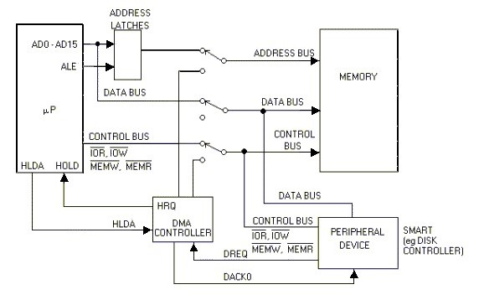
Operation of DMA controller

Slide 5
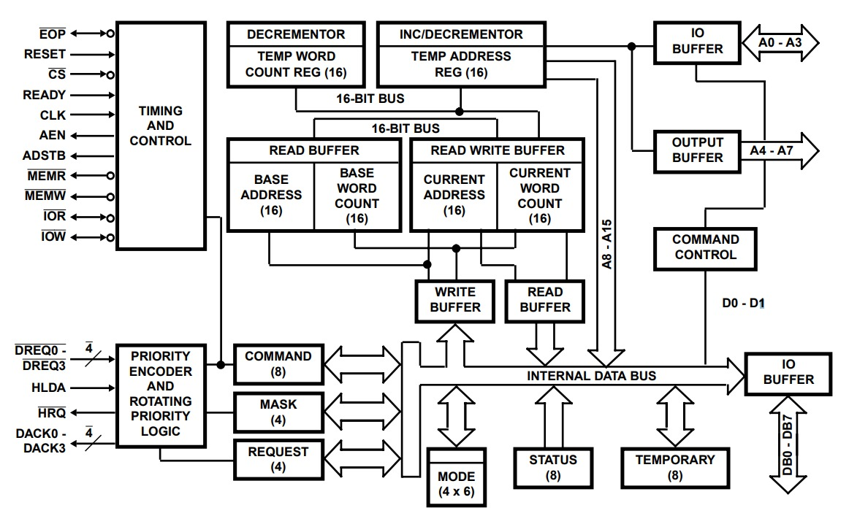
Contd..

Slide 6
Contd..
DMA operates in two cycles:
IDLE: Configuration of DMA by processor, also called slave mode
ACTIVE: Transfer of data, also called master mode
Transfer Modes:
1.Single Transfer mode
2.Block Transfer mode
3.Demand Transfer mode
4.Cascade mode

Slide 7
Scope of the project
Configuration of DMA controller:
Fixed Priority and Rotating priority
DACK, DREQ Sense (Active low and Active High)
Read transfer (I/O to Memory)
write transfer (Memory to I/O)
Address counter increment and decrement
Auto initialization enable and disable
Transfer Modes:
Single Transfer Mode
Block Transfer Mode

Slide 8
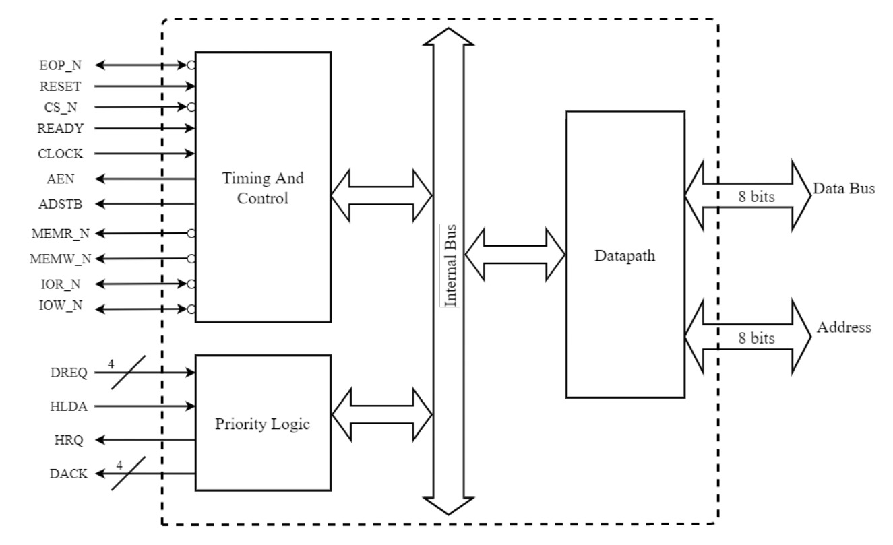
Design of DMA controller

Slide 9
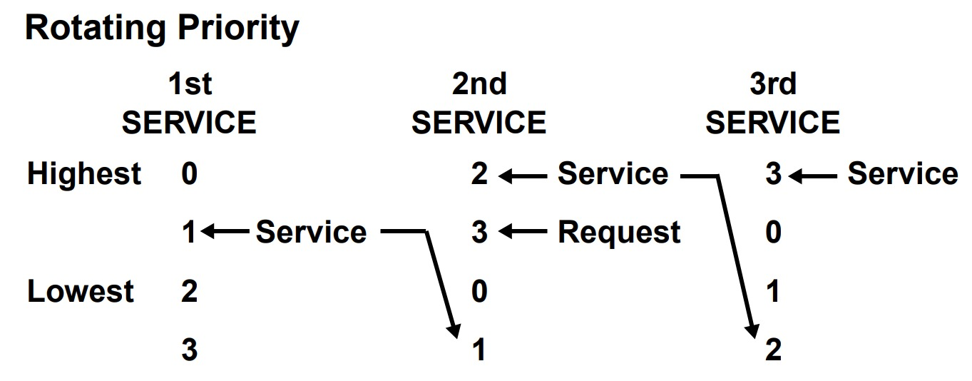
Priority Logic
Fixed priority:
Channel 0 has highest priority and Channel 3 has the least priority.
Chances of channel 0 monopolizing.
Rotating priority:

Slide 10
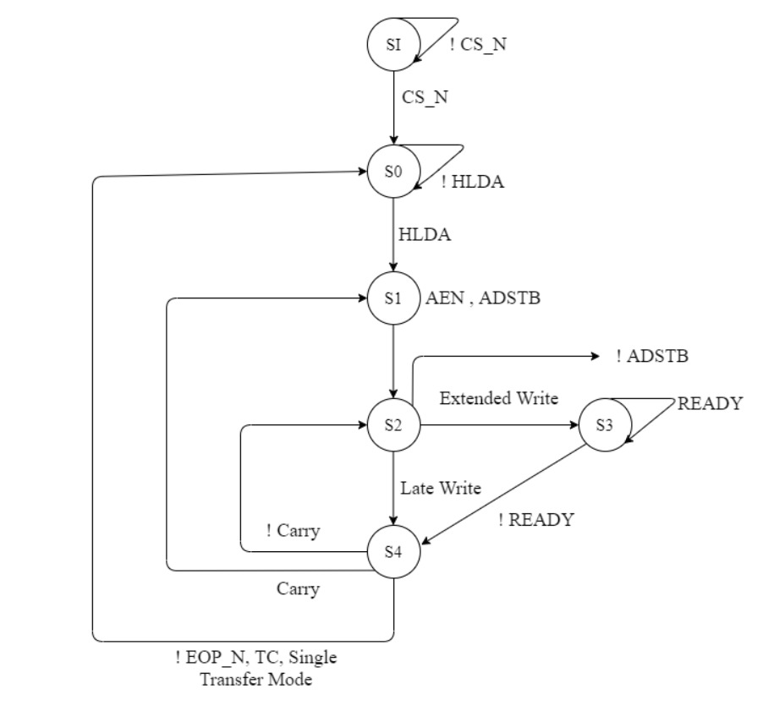
Timing and Control
Note: On External EOP transits to SI state

Slide 11
Datapath
Contains all internal registers of DMA controller.
Internal flipflop, set to known state (for byte select) during read/write of Address, Wordcount registers.
Updates Internal Registers (Address, Wordcount, Command, Mask, Mode and Request) during program mode.
Increment/Decrement temporary address in transfer mode.
Decrement temporary wordcount in transfer mode.
Generate internal signals based on contents in command and mode registers.

Slide 12
VERIFICATION

Slide 13
Test Strategy
Unit Testing:
Priority Logic – Exhaustive stimulus, self-checking (Fixed priority)
Timing and Control, Datapath – Directive stimulus, Assertion based verification
System Testing:
Constrained Randomized stimulus, Assertion based verification

Slide 14
Unit Testing

Slide 15
Test Plan
Priority Logic
Driving DREQ signals and mask/unmask channels
Drive CPU Acknowledgment with Random delay
Testing for HRQ and DACK signals based on priority
Datapath and Timing and Control Logic
Provide chip select (program mode/Transfer mode)
Write command, Mode, Mask, Request Address and Wordcount registers.
Check for internal registers after write by binding Datapath module.
Read Address, Status, registers.

Slide 16
Test plan (Contd..)
In transfer mode provide HLDA with random delay.
Check for increment/Decrement of temporary, current address and wordcount registers using assertions and binding Datapath module.
Check for status register on transfer complete using assertions.
Check for outputs IOR, IOW, EOP, AEN, ADSTB, ADDRESS, DATABUS using assertions.

Slide 17
Test cases
Priority Logic:
Fixed priority is tested exhaustively.
Rotating priority is tested with Constant DREQ inputs(1111, 1110, 1100, 1000, 0000) and check for all channels get a grant for service.
Timing and Control, Datapath :
Reset, Clear Byte pointer, Master clear, clear Mask bits.
Read and write all internal Registers with unique values.
Single transfer mode, Auto initialize enable, address increment, write Transfer, wordcount large enough to change higher byte of address for channel 0.
Block transfer mode,Auto initialize disable, address decrement, write Transfer, wordcount zero for channel 1.

Slide 18
Test cases (Contd..)
Single transfer mode, Auto initialize disable, address decrement, Read transfer, wordcount zero for channel 2.
Block transfer mode, Auto initialize enable, address increment, Read transfer, wordcount large enough to change higher byte of address for channel 3.

Slide 19
Assertions Used (Contd..)
Timing and Control
Check for AEN high after HLDA till transfer completes(TC/EOP).
Read(IOR) and Write(IOW) signals not low at same time.
Read signal is not asserted low during write transfer and viceversa.
ADSTB high only for one cycle.
Check for proper transition of states .
Check for Address bus valid throughout transfer.
Check for EOP pulse on transfer complete.
Check for unknowns in read write signals throughout transfer.
Check for Read and Write signals in tri state during program mode.

Slide 20
Assertions Used
Datapath
Check for default value of registers on reset or master clear.
Read and write signals cannot be low at same time in program mode(problem in driving inputs).
On read or write operation Address and data bus should have valid data.
Check for Bytelow zero on ClearBytePointer signal.
Check for correct write operation by binding internal registers.
Base Address and wordcount registers does not change during transfer mode
Status register should be updated on transfer complete.

Slide 21
System Testing

Slide 22
Test Plan
Configuring DMA controller(program mode)
Configuring Command, Mask, Request, Mode, Address and Wordcount registers
Driving request signals ( DREQ )
Randomizing the DREQ signal
Driving processor ack (HLDA) with random delay.
Randomizing CPU Acknowledgement delay
Check for output signals
AEN, ADSTB, IOR, IOW,DACK,EOP using assertions
Check for generated address (Transfer Mode)

Slide 23
Test cases (contd..)
DREQ , DACK – Sense
Mask / Unmask channels
Fixed and Rotating priority
Read transfer
Write transfer
Single Transfer Mode
Block Transfer Mode

Slide 24
Assertions Used (contd..)
Transfer Mode:
HRQ received or not depending on channel request
AEN should be high until transfer is completed (until EOP is received)
ADSTB should be high only one cycle during transfer
Can occur more than once (until EOP is received)
IOR,IOW should be valid during transfer
IOR or IOW should go active low 4 cycles later after receiving HLDA
IOR , IOW should be active low for only one cycle
IOR,IOW should be not be active low at the same time
IOR , IOW should be high impedance as long as EOP is active low
DACK received as per the priority order

Slide 25
Assertions(Contd..)
DACK received as per the priority order or not
DACK One hot or not
ADDRESSBUS should be valid during the transfer (from AEN asserted)
DATABUS should be valid when ADSTB is asserted
Program Mode:
IOR , IOW should be valid during slave mode and only one can be active low at a time
ADDRESS should be valid during read or write of program mode
DATABUS should be valid during read or write of slave mode (from same cycle during write and one cycle later during read)

Slide 26
References
Intel 8237A Data sheet
Microprocessors and Interfacing : Programming and Hardware by Douglas V Hall
Lecture slides ECE 571 – Prof. Mark Faust

Slide 27
Q & A

Slide 28
Thank You

