Slide 1

Dealer Distributor System
Sem: 4 Div: C​ Team No: 1
Name | Roll No | USN
Pruthvi M | 312 | 01FE24BCS070
Kempanna K | 327 | 01FE24BCS163
Nivrutti | 332 | 01FE24BCS168
Bhagyashri B | 334 | 01FE24BCS170
Shreya P | 335 | 01FE24BCS171
Under the guidance of : Dr. P G Sunitha Hiremath &
Prof. Soundarya B H

Slide 2
Table of Contents
Title | Page No.
Introduction | 3
Problem Statement | 4
Existing Websites | 5
Block Diagram | 6
Functional Requirements | 7
Non-Functional Requirements | 10
Scrum Roles | 11
Sprint Planning and User Stories | 12
Scrum Table | 13
Sustainable Development Goals | 14
Home Page and Layout Design | 15

Slide 3
Introduction
Nowadays, most businesses are going digital, but in the plumbing and construction field, many distributors and dealers still depend on phone calls to manage orders and product details. Because of this, the process becomes slow, confusing, and sometimes leads to mistakes.
Dealers often struggle to check products or place orders quickly, and delivery agencies have to depend on updates from distributors, which makes things even less efficient.
To improve this, this project introduces a web-based system where distributors, dealers, and delivery agencies can work together on one platform. It makes it easier to manage products, place orders, and track deliveries, helping save time and making the whole process smoother and more organized.

Slide 4
Problem Statement
Design and develop a web-based system that helps distributors, dealers, and delivery agencies easily manage products, handle orders, and coordinate deliveries on one simple platform.
Objectives
To create a web platform where distributors can easily display and manage their products.
To help dealers quickly search for products and place orders without confusion.
To make it easier for travel agencies to handle and track deliveries.
To reduce dependency on phone calls and manual communication.
To improve coordination between distributors, dealers, and delivery agencies.
To make the overall process faster, smoother, and more organized.

Slide 5
Existing Websites
Application | Features | Technologies | Performance | Drawbacks
Alibaba | A huge global marketplace. Enables search of products, buy in bulk, and chat directly with suppliers. | Uses modern web technology, mobile apps, and AI to suggest products. | Fast and handles a lot of users smoothly. Searching is easy. | Too many sellers, so it’s hard to trust everyone. Product quality may differ.
IndiaMART | Connects buyers and sellers mainly within India. One can view products, send inquiries, and even get calls from sellers. | Basic web tech, mobile app, simple interface | Decent speed, works well for local use | Not very global. You may get too many spam calls or messages.
ThomasNet | Focus on US suppliers, detailed company info, industrial products | Strong database system, clean website design | Reliable and accurate info, smooth browsing | Mostly US only, fewer products than Alibaba, not for small buyers
Notes:
Sprint 1 – User Authentication & Basic Package Viewing
Duration: 1 week (Week 1) Goal: Enable user registration, login, secure session handling, and basic package browsing.

Slide 6
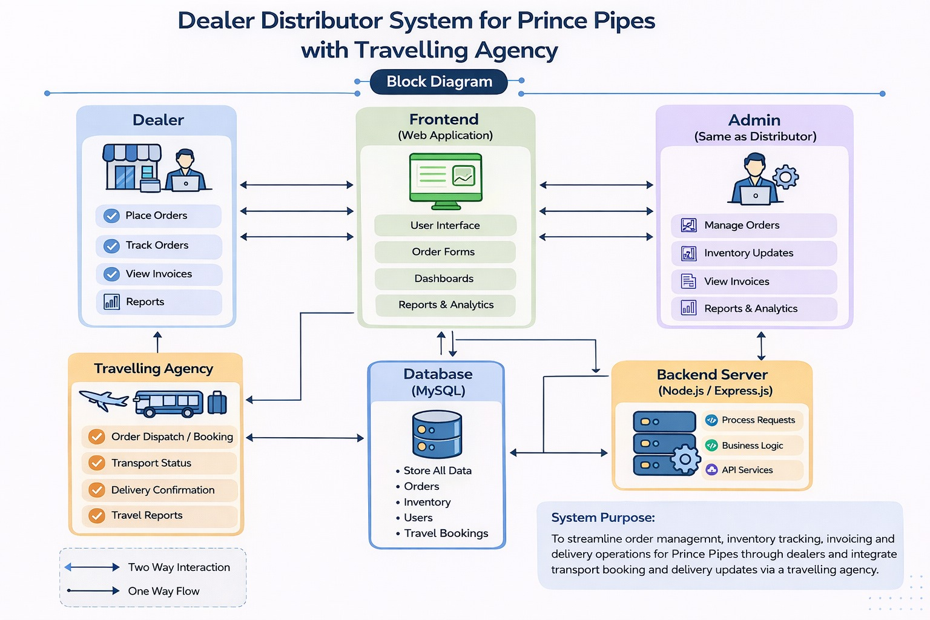
Block Diagram

Slide 7
Functional Requirements
Dealer Panel Requirements
The system shall make it easy for dealers to look through products and filter them by category or brand.
The system shall let dealers place orders quickly and easily.
The system shall help dealers track their orders in real time and see delivery updates.
The system shall allow dealers to manage and update their profile and shop information

Slide 8
Distributor Panel Requirements
The system shall let distributors add, view, update, and delete product and brand information.
The system shall allow distributors to see incoming orders and approve or reject them from one dashboard.
The system shall help distributors manage dealer accounts, including approving new registrations.
The system shall let distributors assign confirmed orders to travel agencies for delivery.

Slide 9
Travel Agency / Driver Panel Requirements
The system shall notify travel agencies and drivers about new delivery requests.
The system shall let drivers see delivery details and choose orders based on their availability.
The system shall allow drivers to update delivery status (picked up, in transit, delivered).
The system shall help travel agencies manage driver details, vehicle information, and availability.

Slide 10
Non-Functional Requirements
Security
The system shall securely store user data by encrypting passwords.
The system shall ensure that only authorized users (such as admins) can access sensitive features using role-based access control.

Slide 11
Scrum Roles
Name | Scrum Role | Responsibilities
Nagaraj B M | Product Owner | Defines the project vision and sets priorities
Dr P G Sunitha Hiremath | Scrum Master | Facilitates sprint activates and ensures smooth co-ordination among team
Team Members
Bhagyashri B | UI/UX Designer | Designs user and admin interface
Kempanna K | Frontend Developer | Implements UI components such as Request Form, Admin Dashboard
Shreya P | System Architecture | Chooses suitable technologies and tools
Nivrutti | Backend Developer | Develops Backend using MongoDB, Express and Node.js
Pruthvi M | Tester | Conducts testing of all modules functional, integration, and system-level validation

Slide 12
Spring Planning and User Stories
Epic 1: Authentication and Catalog
Sprint 1: User Authentication
User Story | Feature | Points | Acceptance Criteria
As a dealer, I want to create an account so that I can access the portal. | User Authentication | 5 | Given a new dealer visits the portal, when they click registration, then form is displayed. Given valid details, when submitted, then account is created. Given invalid details, then error messages are shown.
As a dealer, I want to log in so that I can access my dashboard. | User Authentication | 5 | Given a registered dealer is on login page, when correct credentials are entered, then redirect to dashboard. Given incorrect credentials, then error is shown.
As a user, I want to see validation messages so that I can correct errors. | User Authentication | 3 | Given invalid input, when form is submitted, then validation errors are displayed. Given empty fields, then system prompts to fill them.
Notes:
Sprint 1 – User Authentication & Basic Package Viewing
Duration: 1 week (Week 1) Goal: Enable user registration, login, secure session handling, and basic package browsing.

Slide 13
Scrum Table
To Do | In Progress | Done
Product Listing Product Categorization Product Detail View |  | Dealer Registration Dealer Login Input Validation & Error Handling
Search by Name Search by Brand Filter by Category
Enquiry Form Order Submission Request Dashboard
Add Product Edit Product Delete Product
Notes:
Sprint 1 – User Authentication & Basic Package Viewing
Duration: 1 week (Week 1) Goal: Enable user registration, login, secure session handling, and basic package browsing.

Slide 14


Sustainable Development Goals
SDG 8: Decent Work and Economic Growth
Reduces manual effort and saves time
Makes work faster and easier for dealers and distributors
Helps small businesses grow
Improves overall productivity
SDG 9: Industry, Innovation and Infrastructure
Brings digital technology to a manual system
Replaces phone calls with an online platform
Improves communication between users
Supports modern business operations

Slide 15
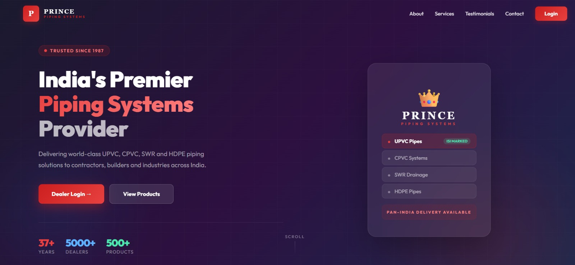
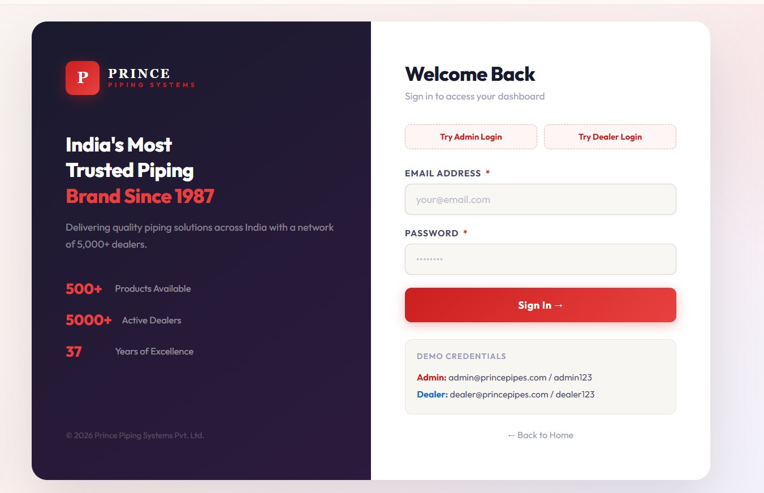
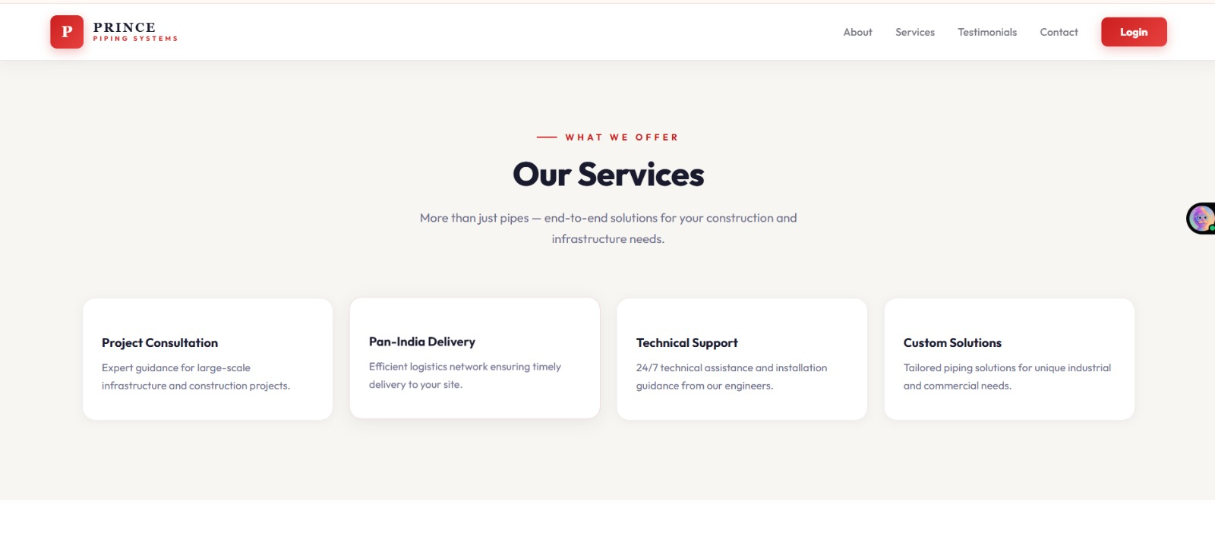
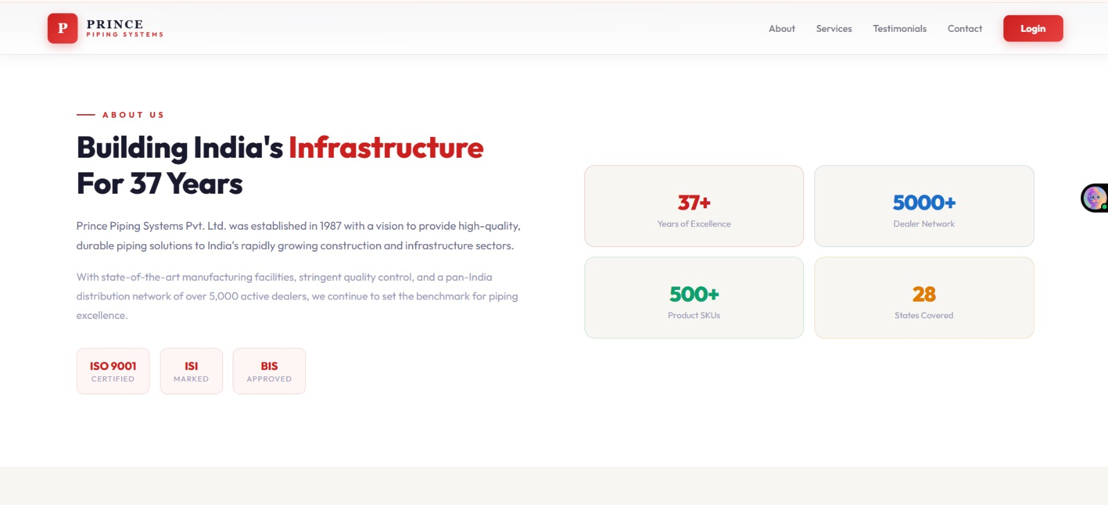
Home Page and Layout Designs

