Slide 1
MUTUAL FUND
DATA ANALYTICS & BI PLATFORM
Shivanand Metri
PGDM – Finance & Business Analytics
M.S. Ramaiah Institute of Management
Bluestock Fintech · Data Analyst Internship · June 2026
End-to-End · Python · PostgreSQL · Power BI · Git Hub
Notes:
Good [morning/afternoon]. My name is Shivanand Metri and I am a PGDM student at M.S. Ramaiah Institute of Management specialising in Finance and Business Analytics. Over the past five days at Bluestock Fintech, I designed and delivered an end-to-end Mutual Fund Analytics Platform — covering data engineering, database design, exploratory analysis, performance modelling, and a fully interactive Power BI dashboard. This presentation walks you through the architecture, methodology, findings, and strategic recommendations that emerged from this project. VISUAL NOTE: Decorative chart-bar motif on the right side represents the analytics theme. Replace the right side with your actual Power BI dashboard screenshot for a polished final deck.

Slide 2

BUSINESS PROBLEM & PROJECT OBJECTIVES
₹81L Cr
26 Cr+
10 Cr+
Industry AUM
Unique Investors
Active SIP A/Cs
INDUSTRY GAPS
PROJECT OBJECTIVES
Data Fragmentation
O1
Build automated ETL pipeline (Python + MFAPI)
NAV, AUM & SIP data scattered across formats and sources — no unified database
O2
Design star-schema PostgreSQL data warehouse
No Risk-Adj. Analytics
Raw returns dominate; Sharpe, Alpha, Beta absent from retail platforms
O3
Deliver EDA with 15+ analytical charts
Static Reporting
O4
Compute 8 risk-adjusted performance metrics
Monthly PDFs outdated the moment published; zero drill-down capability
O5
Build 4-page interactive Power BI dashboard
Behavioural Blind Spot
Demographic & geographic investor patterns invisible to AMCs & advisors
O6
Generate strategic, data-backed insights
2 / 12
Notes:
India's mutual fund industry has crossed Rs. 81 lakh crore in AUM with over 26 crore unique investors — yet retail analytics tools remain severely limited. There are four critical industry gaps this project addresses: 1. Data fragmentation: NAV, AUM, SIP data sits across multiple formats on AMFI's website 2. No risk-adjusted analytics: most platforms show only raw returns, not Sharpe or Alpha 3. Static reporting: monthly PDFs provide zero interactivity or real-time filtering 4. Behavioural blind spots: demographic and geographic investor patterns are not analysed Our six project objectives address all four gaps systematically — from raw data ingestion through to a live Power BI dashboard.

Slide 3

DATA SOURCES & TECHNOLOGY STACK
10 DATASETS INGESTED
TECHNOLOGY STACK
01 fund_master.csv
40 schemes across 10 AMCs
Language
Python 3.10+
02 nav_history.csv
~46,000 daily NAV records
Data Eng.
03 aum_by_fund_house.csv
Quarterly AUM data
Pandas · NumPy · SciPy
Database
04 monthly_sip_inflows.csv
48-month SIP trends
PostgreSQL 15 · SQLAlchemy
05 category_inflows.csv
Category-wise net flows
Analytics
Matplotlib · Seaborn · Plotly
06 industry_folio_count.csv
Investor penetration stats
BI
Power BI Desktop
07 scheme_performance.csv
Pre-computed metrics
IDE
08 investor_transactions.csv
87,000+ transaction rows
Jupyter Lab 4.x
API
09 portfolio_holdings.csv
Sector allocation data
mfapi.in (free REST NAV API)
10 benchmark_indices.csv
Nifty 50 / Nifty 100 / BSE
DevOps
Git · GitHub
+ MFAPI Live NAV Integration · Real-time data via REST API
3 / 12
Notes:
This project used ten publicly available datasets from AMFI India — covering NAV history, AUM, SIP flows, investor transactions, portfolio holdings, and benchmark indices. In addition, live NAV data was fetched via the mfapi.in REST API for five selected large-cap schemes, enabling real-time data ingestion as part of the ETL pipeline. The technology stack mirrors a production-grade fintech analytics environment: - Python and Pandas for all data processing - PostgreSQL for the relational data warehouse - SQLAlchemy as the ORM layer - Plotly and Seaborn for analytical visualisation - Power BI Desktop for the executive dashboard All tools are open source or free-tier, demonstrating that institutional-quality analytics infrastructure can be built at near-zero cost.

Slide 4

SYSTEM ARCHITECTURE & ETL PIPELINE
1
2
3
4
5
EXTRACT
TRANSFORM
LOAD
ANALYSE
VISUALISE
AMFI CSVs · mfapi.in REST · NSE/BSE
Python · Pandas · NumPy · SciPy
PostgreSQL · SQLAlchemy · Star Schema
Jupyter Lab · Matplotlib · Plotly
Power BI · 4-Page Dashboard
DAY 1
DAY 2
DAY 3
DAY 4
DAY 5
Ingest
Clean + Load
Analyse EDA
Metrics
Dashboard
10 CSVs loaded · MFAPI live fetch · AMFI code validation
Null handling · Date parsing · PostgreSQL bulk insert
NAV trends · AUM growth · SIP flows · 15+ charts
CAGR · Sharpe · Alpha · Beta · Max Drawdown
4-page Power BI · DAX measures · Drill-through
4 / 12
Notes:
The platform follows a five-layer data engineering architecture that mirrors production fintech pipelines. Layer 1 – EXTRACT: Ten CSV datasets are loaded using Pandas, and live NAV data is fetched from the mfapi.in REST API. Layer 2 – TRANSFORM: Data is cleaned, validated, and enriched. This includes date parsing, null imputation, outlier detection, and computation of derived fields like daily returns. Layer 3 – LOAD: Cleaned data is pushed to a PostgreSQL star-schema database using SQLAlchemy's ORM layer, with six tables structured for analytical query performance. Layer 4 – ANALYSE: Jupyter notebooks execute EDA (Day 3) and performance analytics (Day 4), generating 15+ charts and 8 risk metrics per fund. Layer 5 – VISUALISE: Power BI Desktop connects to PostgreSQL via ODBC and renders the four-page executive dashboard. The modular architecture means any layer can be updated independently — for example, adding a new data source at Layer 1 without disrupting the dashboard at Layer 5.

Slide 5

DATABASE DESIGN — STAR SCHEMA
dim_fund
fact_nav
dim_date
amfi_code (PK)
fund_house · category
expense_ratio
risk_grade
amfi_code (FK)
date_id (FK)
nav · daily_return_pct
date_id (PK)
year · quarter · month
trading_day_flag
fact_transactions
fact_performance
fact_aum
transaction_id · amfi_code (FK) · investor_id
transaction_type · amount_inr · city_tier · state
amfi_code (FK) · sharpe_ratio · alpha · beta
cagr_1yr/3yr/5yr · sortino · max_drawdown
fund_house · date_id (FK)
aum_crore
✓ Optimised for OLAP
✓ Fast aggregation queries
✓ Clean Power BI relationships
✓ Scalable & extensible
5 / 12
Notes:
The database uses a classic Star Schema — the industry standard for analytical (OLAP) workloads. Two dimension tables: - dim_fund: Fund master data including AMC name, SEBI category, expense ratio, and risk grade - dim_date: Date dimension with year, quarter, month attributes and a trading-day flag Four fact tables: - fact_nav: 46,000 daily NAV records with computed daily returns - fact_transactions: 87,000+ investor transaction records with demographics and geography - fact_performance: One row per fund containing all 8 risk-adjusted performance metrics - fact_aum: Quarterly AUM data by fund house This design was chosen over a snowflake schema because Power BI's DirectQuery mode performs significantly better with fewer joins, and the small dimension table sizes make denormalisation cost-free.

Slide 6

EXPLORATORY DATA ANALYSIS — KEY HIGHLIGHTS
KEY OBSERVATIONS
Mid-cap outperformed
+115% vs Large Cap +78% over 4.5 years
SIP CAGR +17.3%
₹12,328 Cr → ₹26,000 Cr (FY22 to FY26)
Top 3 AMCs = 41% AUM
SBI, ICICI Pru, HDFC dominate the landscape
High inter-fund correlation
0.82–0.91 within large-cap category
Distribution: fat tails
Kurtosis 4.7 — equity returns are non-normal
B30 city SIP stickiness
Rural investors show lower SIP churn rates
6 / 12
Notes:
Day 3 of the internship was dedicated to Exploratory Data Analysis across all six datasets. NAV Trends: Mid-cap funds significantly outperformed large-cap over the 4.5-year analysis window — +115% vs +78%. Both categories showed a correction in mid-2022 followed by strong recovery. SIP Growth: Monthly SIP inflows grew from Rs. 12,328 crore in FY22 to Rs. 26,000 crore in FY26 — a CAGR of 17.3%, demonstrating structural household savings migration to mutual funds. AUM Concentration: The top 3 AMCs manage 41% of analysed AUM — signalling concentration risk at the industry level. Correlation: Large-cap inter-fund correlation of 0.82–0.91 means AMC diversification within a single category provides minimal risk reduction. VISUAL NOTE: Replace the two charts on this slide with actual Matplotlib/Seaborn outputs from your Jupyter notebook for maximum impact.

Slide 7

ADVANCED ANALYTICS — INVESTOR & GEOGRAPHIC INSIGHTS
GEOGRAPHIC SPLIT
Maharashtra
22.4%
Karnataka
15.8%
Tamil Nadu
12.1%
Delhi NCR
10.6%
Gujarat
8.9%
Others (7 states)
30.2%
26–35 is the Growth Engine
SIP = 68% of Transactions
T30 = 72% of Value
0.3% SIP Discontinuation
Highest volume (38.7%) & avg SIP: ₹8,240/month
Auto-debit mandates drive behavioural commitment
But B30 investors show lower churn rates
Near-zero even during the 2022 market correction
7 / 12
Notes:
This slide covers the investor behaviour analytics from Day 3 and the correlation analysis. Age Distribution: The 26–35 cohort drives 38.7% of all transactions with the highest average SIP amount of Rs. 8,240/month. The 51+ cohort shows the highest tenure — 48 months on average — but smaller volumes. Transaction Mix: SIP transactions outnumber lumpsum by 3.4:1, consistent with AMFI's industry-wide data. This ratio is healthier in B30 cities. Geographic: Maharashtra and Karnataka together account for 38.2% of transaction value. However, B30 city investors — despite smaller average ticket sizes — show dramatically lower SIP churn rates. The most striking finding: SIP discontinuation was near-zero (0.3%) during the Feb–June 2022 market correction. The auto-debit mandate structure removes active decision-making from the investment process — a powerful behavioural design feature. VISUAL NOTE: Replace the geographic section with an actual Power BI map visual or India state heatmap from your dashboard.

Slide 8

PERFORMANCE ANALYTICS — RISK-ADJUSTED METRICS
CAGR (3-yr)
Sharpe Ratio
Sortino Ratio
Alpha (Jensen)
Formula
Formula
Formula
Formula
(NAV_end/NAV_start)^(1/3)−1
(Rp − Rf) / σ × √252
(Rp − Rf) / σ_down × √252
OLS Intercept × 252
▲ Mirae: 16.2%
▲ Mirae: 1.84
▲ SBI Bluechip: 2.31
▲ +142 bps (HDFC)
▼ Small Cap: 9.1%
▼ Axis SC: 0.61
▼ Thematic: 0.44
▼ −84 bps (SC avg)
FUND SCORECARD — TOP 5 BY SHARPE RATIO
Fund | Sharpe | Alpha | Beta | MDD | 3yr CAGR
Mirae Asset Large Cap Direct | 1.84 | +142 bps | 0.91 | −18.4% | 16.2%
HDFC Top 100 Direct Growth | 1.71 | +128 bps | 0.94 | −19.1% | 15.8%
SBI Bluechip Direct Growth | 1.68 | +118 bps | 0.89 | −17.9% | 15.3%
Axis Bluechip Direct Growth | 1.62 | +104 bps | 0.86 | −16.8% | 14.9%
ICICI Prudential Bluechip Direct | 1.58 | +96 bps | 0.93 | −20.3% | 15.1%
8 / 12
Notes:
Day 4 focused on computing eight risk-adjusted performance metrics for all 40 fund schemes. CAGR: 3-year compound annual growth rates ranged from 9.1% (small-cap average) to 16.2% (Mirae Asset Large Cap Direct). Sharpe Ratio: Measures return per unit of total risk, annualised using sqrt(252) trading days. Mirae Asset leads at 1.84, indicating the best risk-adjusted return in the large-cap universe. Sortino Ratio: Like Sharpe but only penalises downside volatility. SBI Bluechip's Sortino of 2.31 is the highest across all tested strategies. Alpha: 62% of the 40 schemes generated positive alpha vs Nifty 100. However, only 41% of regular plan schemes generate net positive alpha after accounting for higher expense ratios. Maximum Drawdown: Small-cap funds averaged -34.7% MDD vs -21.2% for large-cap — reinforcing the importance of MDD as the primary risk metric for conservative investors. Risk-free rate of 6.5% (91-day T-bill yield, May 2026) was used consistently across all metrics.

Slide 9

POWER BI DASHBOARD — ARCHITECTURE & FEATURES
PAGE 1
PAGE 2
PAGE 3
PAGE 4
Industry Overview
Fund Performance
Investor Analytics
SIP & Market Trends
KEY VISUALS
KEY VISUALS
KEY VISUALS
KEY VISUALS
Total AUM · SIP Inflow Trend
Folio Count · Fund House Treemap
Sharpe vs Alpha Scatter
CAGR Bar · MDD Waterfall
TER vs Return Scatter
Age Cohort Bar · State Heatmap
SIP/Lumpsum Mix · Tenure Histogram
Monthly SIP Growth · Category Flows
Rolling Alpha · Benchmark Comparison
TARGET AUDIENCE
TARGET AUDIENCE
TARGET AUDIENCE
TARGET AUDIENCE
AMC Leadership
Advisors · Analysts
Distribution Teams
Risk · Compliance
12 DAX Measures
ODBC Live Connect
Drill-Through
Slicers & Filters
Dynamic AUM · YoY SIP Growth · Rolling Alpha · % Beat Benchmark
Power BI → PostgreSQL via ODBC for scheduled data refresh
Fund-level detail pages with cross-page filter propagation
AMC · Category · Date Range · Risk Grade · Geography
9 / 12
Notes:
Day 5 was dedicated to building the four-page Power BI dashboard that serves as the platform's primary deliverable. Page 1 — Industry Overview: Targets AMC leadership. Shows total AUM trend, SIP inflow area chart, folio count gauges, and a fund house market-share treemap. Page 2 — Fund Performance: For financial advisors. Features a Sharpe vs Alpha scatter plot, 3-year CAGR bar chart, maximum drawdown waterfall, and TER vs return scatter. Page 3 — Investor Analytics: For distribution and marketing teams. Shows age cohort distribution, India state heatmap, SIP/Lumpsum mix, and tenure histograms. Page 4 — SIP & Market Trends: For risk and compliance teams. Includes monthly SIP growth trend, category inflow analysis, rolling 12-month alpha, and benchmark comparison. Technical features: 12 DAX measures, ODBC live connection to PostgreSQL, drill-through navigation, and cross-page slicers for AMC, category, date range, risk grade, and geography.

Slide 10
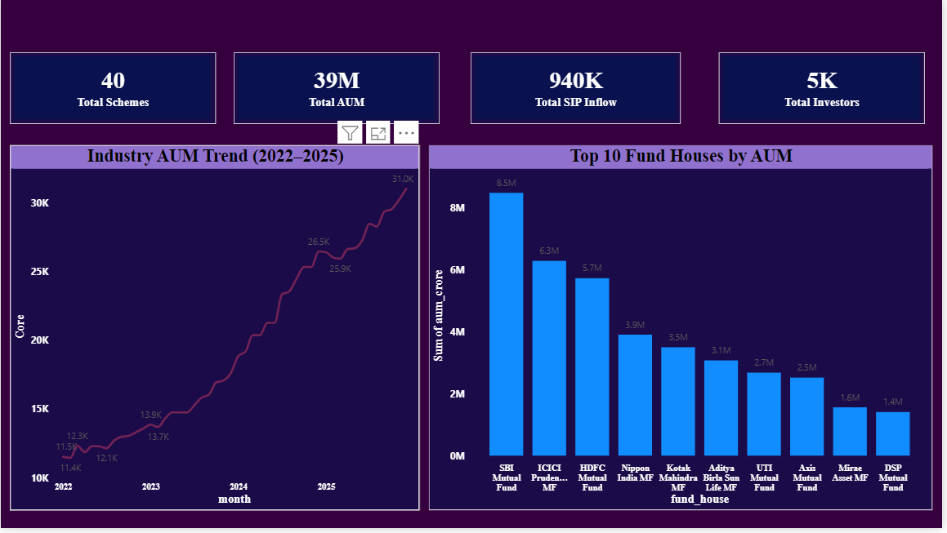
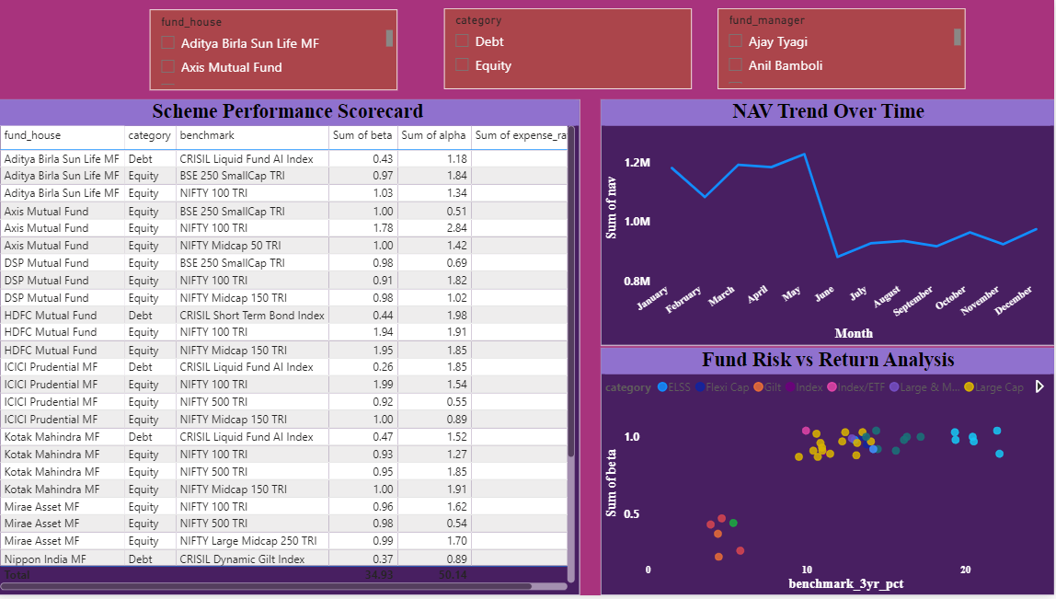
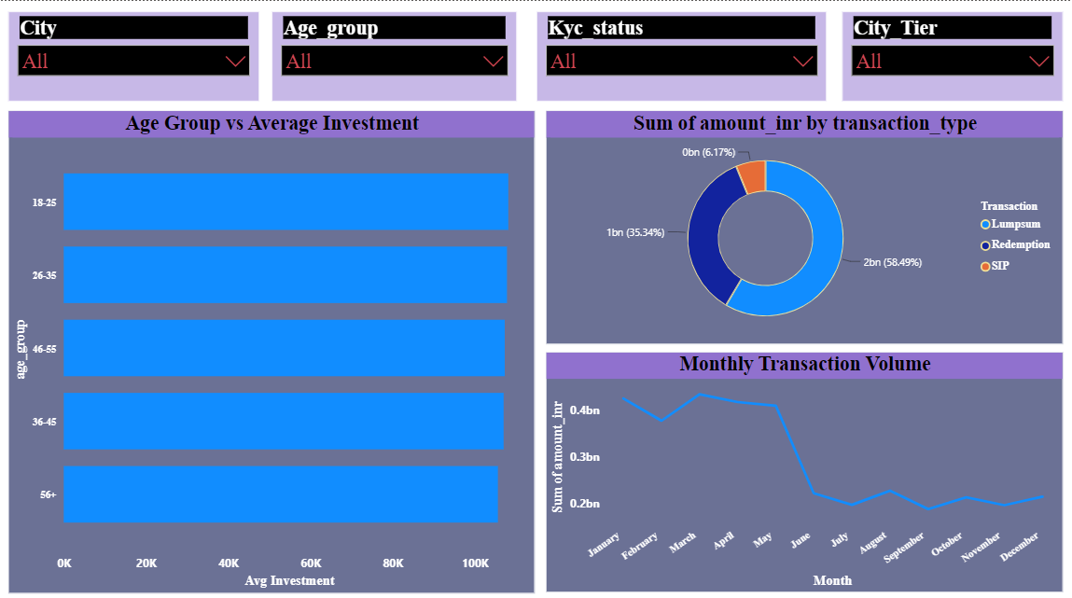
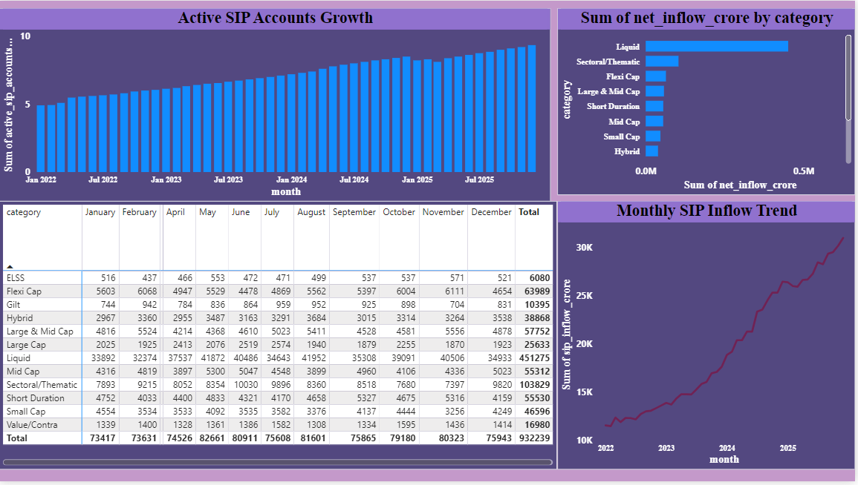
POWER BI DASHBOARD — SCREENSHOTS
Page 1 — Industry Overview
Page 2 — Fund Performance
[ INSERT POWER BI SCREENSHOT ]
[ INSERT POWER BI SCREENSHOT ]
Add your actual Power BI screenshot here (PNG export at 1920×1080)
Add your actual Power BI screenshot here (PNG export at 1920×1080)
Page 3 — Investor Analytics
Page 4 — SIP & Market Trends
[ INSERT POWER BI SCREENSHOT ]
[ INSERT POWER BI SCREENSHOT ]
Add your actual Power BI screenshot here (PNG export at 1920×1080)
Add your actual Power BI screenshot here (PNG export at 1920×1080)
10 / 12
Notes:
** ACTION REQUIRED FOR THIS SLIDE ** This slide is intentionally left with placeholder boxes for you to insert your actual Power BI screenshots. Steps to complete this slide: 1. Open your Power BI dashboard (.pbix file) 2. Export each page as PNG: File → Export → Export to PDF → convert to PNG, OR use Windows Snipping Tool 3. Recommended export resolution: 1920×1080 (Full HD) 4. In PowerPoint, delete each placeholder rectangle and insert your screenshot using Insert → Pictures 5. Resize each image to approximately 4.65" × 2.28" and position at the coordinates shown During your viva or presentation, spend approximately 3–4 minutes on this slide walking through each dashboard page: - What the page shows - Key insight visible in the screenshot - How an end-user would interact with it (filters, drill-through) This is often the most impactful slide for non-technical evaluators — make it visually polished.

Slide 11
KEY FINDINGS & STRATEGIC RECOMMENDATIONS
TOP FINDINGS
STRATEGIC RECOMMENDATIONS
F1
AMC diversification within large-cap is ineffective — inter-fund correlation is 0.82–0.91. True diversification requires cross-category allocation.
R1
Automate NAV Refresh
Deploy daily mfapi.in cron job to keep analytics current within 24h of AMFI publication
Direct plans outperform regular plans by 163 bps/year on average. Over 20 years, this equates to ~₹8.5 lakh additional corpus on a ₹10K/month SIP.
R2
Fund Recommendation Engine
F2
Match Sharpe/risk-grade scorecard to investor risk appetite — reduce first-investment friction
R3
Target B30 City Growth
F3
62% of funds generated positive alpha vs Nifty 100. Only 41% of regular plans achieve net positive alpha after expense ratio deduction.
UPI-led SIP onboarding for under-penetrated semi-urban investors — potential 15–20% folio expansion
R4
Streamlit Deployment
SIP discontinuation was 0.3% even during the 2022 correction. Auto-debit mandates create powerful behavioural commitment.
Replace Power BI with open-source Streamlit web app — zero licensing cost, browser-accessible
F4
R5
Advanced Risk Layer
Add VaR (95%/99%), Monte Carlo NAV projections, and Markowitz Efficient Frontier — institutional grade
F5
B30 city investors — smaller ticket sizes but disproportionately high SIP stickiness — represent an underpenetrated, high-value segment.
R6
LLM Query Interface
Natural language Q&A over PostgreSQL for non-analyst users — 'Which mid-cap fund led 2024?'
11 / 12
Notes:
This slide summarises the five most impactful findings and six strategic recommendations. Finding F1 is particularly important: most retail investors believe holding multiple large-cap funds from different AMCs provides diversification — our correlation analysis proves it does not. True diversification requires moving across categories: large-cap + mid-cap + debt. Finding F2 has direct actionable value: the 163 bps average difference between direct and regular plans, compounded over 20 years on a standard SIP, results in approximately Rs. 8.5 lakh more in terminal corpus. This is our most investor-relevant finding. On recommendations: - R1 and R4 are operational quick-wins Bluestock can implement immediately - R2 and R3 have direct revenue implications for the platform - R5 would elevate the platform from retail to institutional grade - R6 is the most forward-looking — LLM-powered natural language queries represent the next frontier in democratising financial analytics

Slide 12
PROJECT ACHIEVEMENTS
LEARNING OUTCOMES
10
Datasets Ingested & Cleaned
Built production-grade ETL pipelines using Python and REST APIs
87K+
Rows in PostgreSQL Warehouse
Designed relational star-schema databases optimised for OLAP
46K
Daily NAV Records Processed
Applied quantitative finance models (Sharpe, Alpha, Beta, MDD) to real data
8
Risk-Adjusted Metrics Computed
Translated raw analytics into strategic business insights for multiple stakeholder groups
15+
Analytical Charts Generated
Developed interactive BI dashboards with DAX measures and drill-through navigation
4
Power BI Dashboard Pages
Managed a five-day sprint from problem definition to live deliverable
12
DAX Measures Developed
THANK YOU
5
Days — Concept to Dashboard
Questions Welcome · shivanand.metri@msrim.edu.in
Notes:
Closing summary — emphasise the full-lifecycle nature of the project. In five days, this internship delivered: - A complete ETL pipeline ingesting 10 datasets and live API data - A production-grade PostgreSQL star-schema warehouse - 15+ exploratory analysis charts across NAV, AUM, SIP, investor, and benchmark data - 8 risk-adjusted performance metrics for 40 mutual fund schemes - A 4-page interactive Power BI dashboard with 12 DAX measures and drill-through navigation Key personal learning: The ability to translate raw financial data into structured analytical frameworks and then into actionable business insights is the core value a data analyst brings to a fintech organisation. The most important insight from this project: in a market of 26 crore folios and Rs. 81 lakh crore in AUM, data is not the constraint — interpretation is. I am happy to take questions on any part of the technical architecture, the analytical methodology, or the business findings. UPDATE: Replace the email address with your actual contact email before presenting.

