Slide 1
Working with C++
-Shivanand Naik

Slide 2
Agenda
C++ background and C++ v/s C
C++ Storage Classes
Compiling, linking, loading and running a C++ program.
C++ Identifiers
C++ Flow Control
SOLID principles

Slide 3
C++ background and C++ vs C
Developed at AT&T Bell labs by Bjarne Stroustrup in early 1980
Merger of C syntax and SIMULA-67 class
Powerful with machine level interaction as well as Enterprise usage for complex applications
Superset of C
Procedural v/s Object Oriented
Shared data v/s Encapsulated data. Pros and Cons
Notes:
Procedural -> focussed on applying algorithm to data which is fed as input parameter or shared data
Object Oriented -> focussed on modelling data into classes and providing interfaces to modify data. No shared data in Good OO Class
Pros and Cons
Procedural -> change in global data has avalanche effect, not in OO
Object Oriented -> Mode difficult to implement, requires change in thinking. Procedural languages are there for decades.

Slide 4
Agenda
C++ background and C++ v/s C
C++ Storage Classes
Compiling, linking, loading and running a C++ program.
C++ Identifiers
C++ Flow Control
SOLID principles

Slide 5
C++ Storage Classes
auto - automatic storage duration <new meaning for C++11>
register - automatic storage duration. Also hints to the compiler to place the object in the processor's register <deprecated>
static - static or thread storage duration and internal linkage
extern - static or thread storage duration and external linkage
thread_local - Not now, for later point of time.

Slide 6
auto storage
class Auto
{
public:
Auto() { cout <<"Constructor of auto called \n"; }
~Auto() { cout <<"Destructor of auto called \n"; }
};
int main()
{
//demonstration of auto types
{
auto Auto obj;
}
}
Notes:
auto storage is applicable to scoped varibles, function parameters. This is default

Slide 7
register storage
Only hint to the compiler
Address cannot be taken in “C”
Address can be taken in C++ but then it becomes auto
Used for counters
Lets check the example.
Notes:
clock_t start, end;
double cpu_time_used;
start = clock();
int counter = 100000000;
for (register int i = 0; i<counter; ++i)
{
//do nothing
}
end = clock();
cpu_time_used = ((double) (end - start)) / CLOCKS_PER_SEC;
cout <<"Time taken by register counter is " << cpu_time_used <<"\n";
start = clock();
for (int t = 0; t<counter; ++t)
{
//do nothing
}
end = clock();
cpu_time_used = ((double) (end - start)) / CLOCKS_PER_SEC;
cout <<"Time taken by auto counter is " << cpu_time_used <<"\n";

Slide 8
static storage
Only used in declaration of objects except in function parameter lists
In declaration of functions except at block scope
Declaration of anonymous unions
When used for class member, it is static member
When used for object declaration, static storage duration
When used in anonymous namespace, indicates internal linkage
Lets see some examples.

Slide 9
extern storage
Declaration of functions and varibales defined in another TU
Not allowed for members and function parameters
Specifies External linkage
All extern have static or thread durations

Slide 10
Storage Duration
Automatic
Non global, non static blocked scope variables and non extern
Static – complete program
Thread – To be discussed during C++11
Dynamic – dynamic memory allocation.

Slide 11
Agenda
C++ background and C++ v/s C
C++ Storage Classes
Compiling, linking, loading and running a C++ program.
C++ Identifiers
C++ Flow Control
SOLID principles

Slide 12
Lets see examples on linux box
.

Slide 13
Agenda
C++ background and C++ v/s C
C++ Storage Classes
Compiling, linking, loading and running a C++ program.
C++ Identifiers
C++ Flow Control
SOLID principles

Slide 14
C++ identifiers
An identifier is a sequence of characters used to denote one of the following:
Object or variable name
Class, structure, or union name
Enumerated type name
Member of a class, structure, union, or enumeration
Function or class-member function
typedef name
Label name
Macro name
Macro parameter
Cannot begin with numeric
Can begin with A-Z, a-z, _
Cannot conflict with keywords ex. int float;
Cannot begin with __ or P_ (capital followed by _). Reserved

Slide 15
Agenda
C++ background and C++ v/s C
C++ Storage Classes
Compiling, linking, loading and running a C++ program.
C++ Identifiers
C++ Flow Control
SOLID principles

Slide 16
C++ Flow Control
Selection statements: if and else
Iteration statements (loops)
while (expression) statement
do statement while (condition);
for (initialization; condition; increase) statement;
for ( declaration : range ) statement;
Jump statements
The break statement
The continue statement
The goto statement
Notes:
int main ()
{
int n=10;
mylabel:
cout << n << ", "; n--;
if (n>0) goto mylabel;
cout << "liftoff!\n";
}

Slide 17
Cont… C++ Flow Control
Selection statement: switch.
switch (expression)
{
case constant1: group-of-statements-1; break;
case constant2: group-of-statements-2; break;
. . .
default: default-group-of-statements
}
Notes:
int main ()
{
int n=10;
mylabel:
cout << n << ", "; n--;
if (n>0) goto mylabel;
cout << "liftoff!\n";
}

Slide 18
Agenda
C++ background and C++ v/s C
C++ Storage Classes
Compiling, linking, loading and running a C++ program.
C++ Identifiers
C++ Flow Control
SOLID principles

Slide 19
S stands for SRP (Single responsibility principle)
One class one responsibility
O stands for OCP (Open closed principle)
Extension should be used
L stands for LSP (Liskov substitution principle)
I stands for ISP ( Interface segregation principle)
D stands for DIP ( Dependency inversion principle)

Slide 20
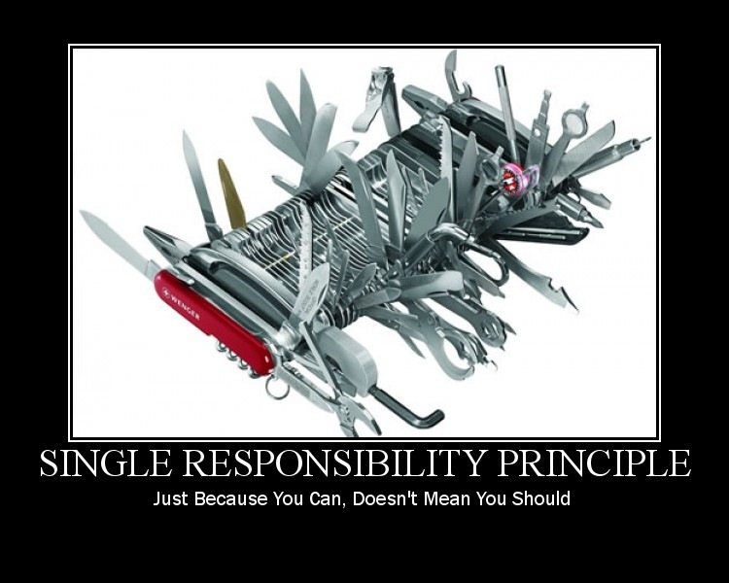
Single responsibility principle
S stands for SRP (Single responsibility principle)
One class one responsibility

Slide 21

Open closed principle
Open for extension but closed for modification

Slide 22
Liskov substitution principle
Typical example of Rectangle and Square.
Square may inherit from Rectangle, but it is not a rectangle.
Notes:
It states that, in a computer program, if S is asubtype of T, then objects of type T may be replaced with objects of type S (i.e., objects of type S may substituteobjects of type T) without altering any of the desirable properties of that program.

Slide 23
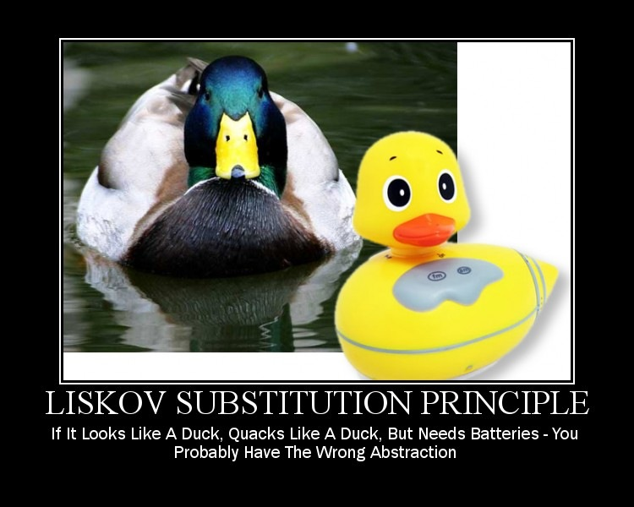
Liskov substitution principle

Slide 24
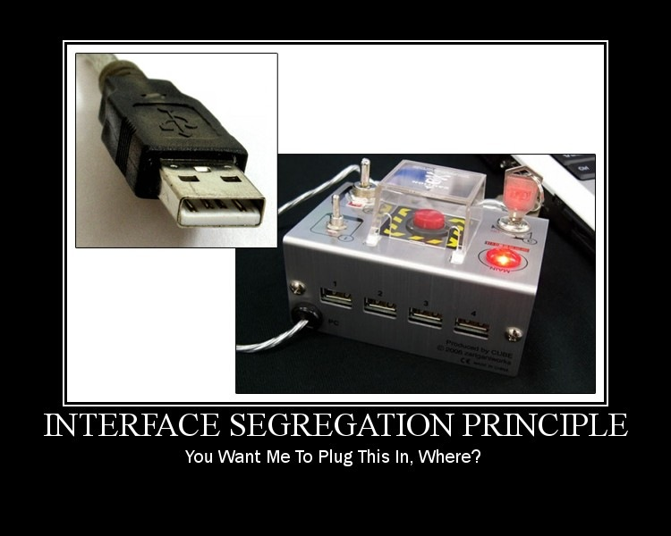
Interface segregation principle
No client should be forced to depend on methods it does not use

Slide 25
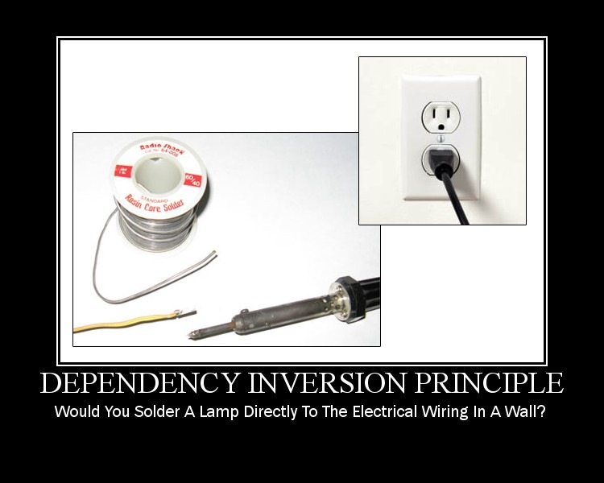
Dependency inversion principle

Slide 26
Dependency inversion principle
A. High-level modules should not depend on low-level modules. Both should depend on abstractions.
B. Abstractions should not depend on details. Details should depend on abstractions.

