Slide 1
Git Installation Guide

Slide 2
Step 1 :
Open browser and type the link given below in address bar
https://git-scm.com/downloads

Slide 3
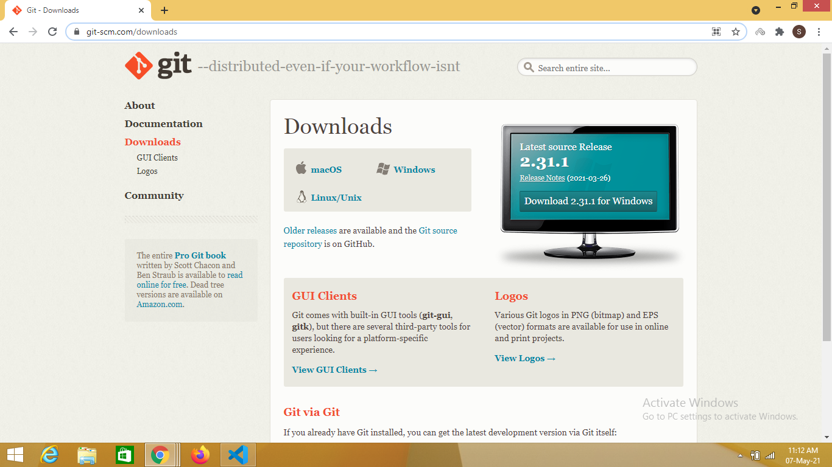
Step 2 :
Select the suitable OS accordingly

Slide 4
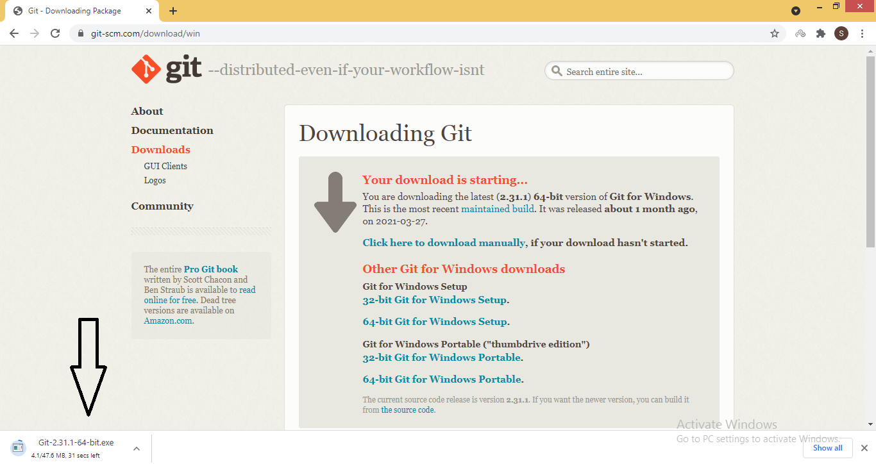
Step 3 :
Once the suitable OS is selected, downloading will start

Slide 5
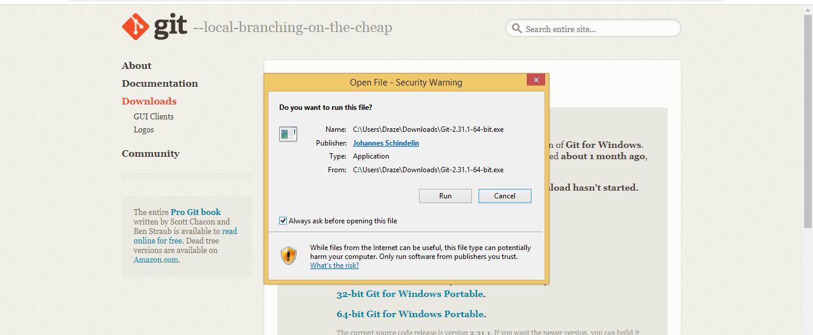
Step 4 :
Once downloaded, click on the .exe file and click on run

Slide 6
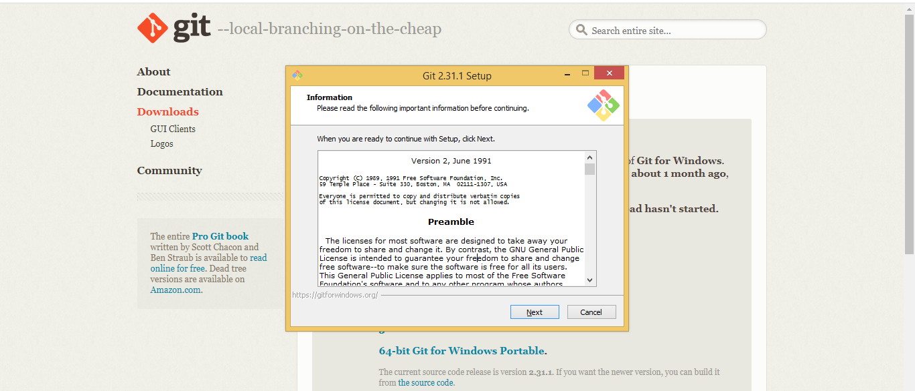
Step 5 :
After clicking on run , continue to click on the next till installation starts

Slide 7
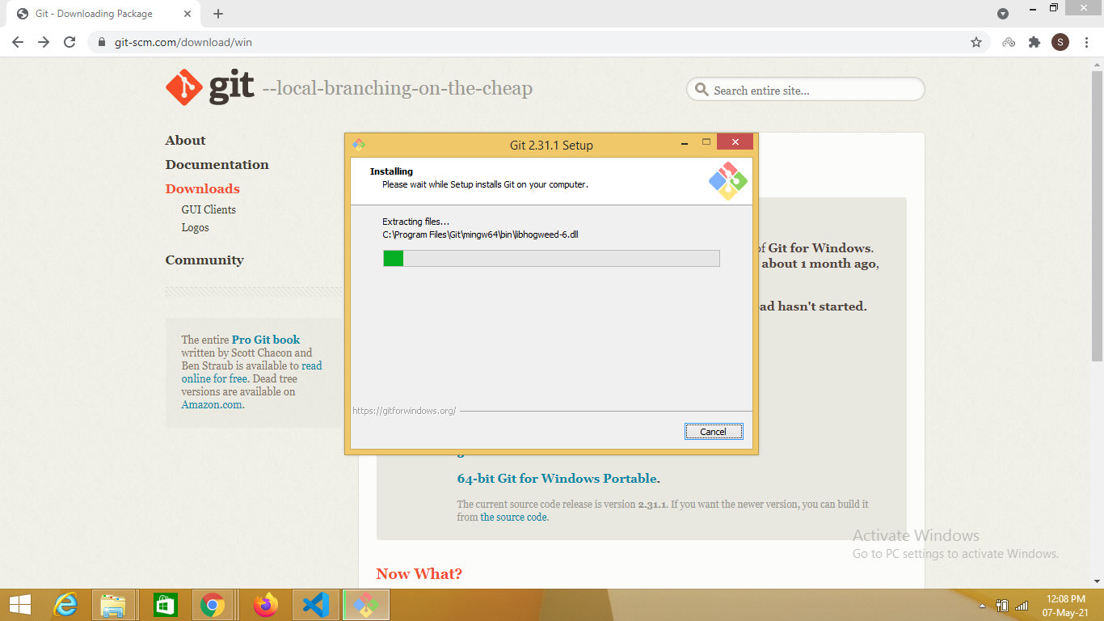
Step 6 :
After clicking on install this window will appear showing it’s installation

Slide 8
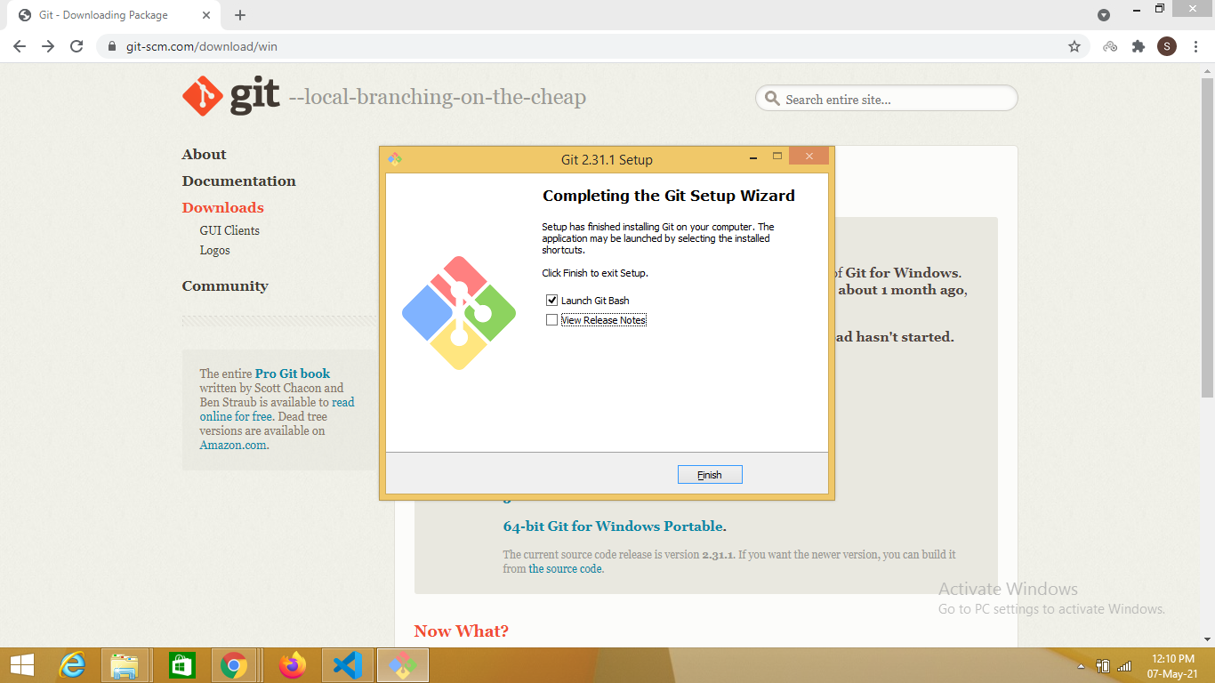
Step 7 :
Once installation is complete, just select “Launch Git Bash” and click on finish

