Slide 1
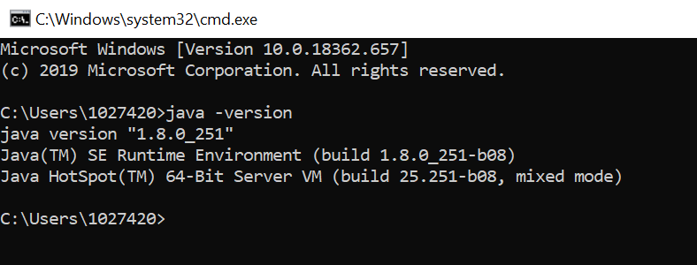
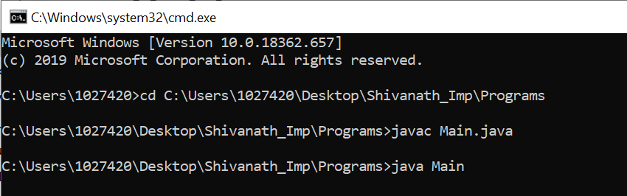

LESSON TOPIC : Selenium with Java – Interview Programs
1. Install the latest Java SDK(JDK) on your laptop.

Slide 2
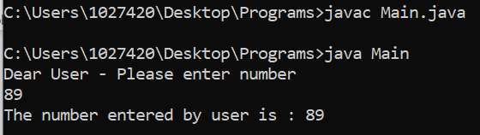
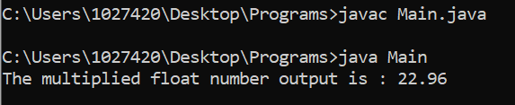
// 1. Java program to print an integer (entered by the user) ? import java.util.Scanner; public class Main{ public static void main(String[] args){ Scanner userInput = new Scanner(System.in); System.out.println("Dear User - Please enter number"); int number = userInput.nextInt(); System.out.println("The number entered by user is : " +number); } }
Output:
// 2. Java program to multiply two floating point numbers ? public class Main{ public static void main(String[] args){ float f1 = 2.8f; float f2 = 8.2f; float output = f1 * f2 ; System.out.println("The multiplied float number output is : " + output ); } }
Output:

Slide 3
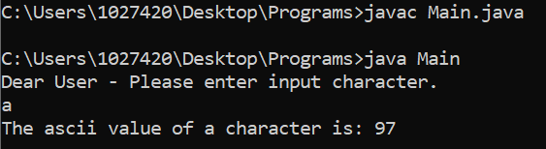
// 3. Java program to find ASCII value of a character ?
import java.util.Scanner;
public class Main{
public static void main(String[] args){
Scanner userInput = new Scanner(System.in);
System.out.println("Dear User - Please enter input character.");
char c = userInput.next().charAt(0);
// For consuming only a single character in the process.
// char c = userInput.findInLine(".").charAt(0);
int ascii = c ;
System.out.println("The ascii value of a character is: " + ascii );
}
} Output:
// 4. Java program to find ASCII value of a character ? public class Main{ public static void main(String[] args){ char c = 'a'; int ascii = c; // int ascii = (int)c ; System.out.println("The ascii value of a character is: " + ascii ); } } Output:

Slide 4
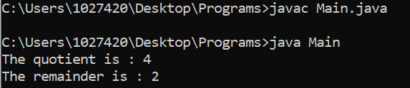
// 5. Java program to compute the quotient and remainder ?
public class Main{
public static void main(String[] args){
int dividend = 30;
int divisor = 7 ;
int quotient = dividend / divisor ;
int remainder = dividend % divisor ;
System.out.println("The quotient is : " + quotient);
System.out.println("The remainder is : " + remainder);
}
}
Output:

Slide 5
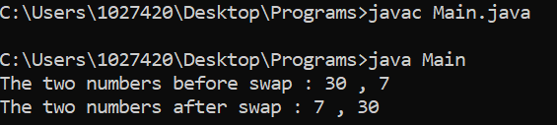
// 6. Java program to swap two numbers with temporary variable ?
public class Main{
public static void main(String[] args){
int a = 30;
int b = 7 ;
System.out.println("The two numbers before swap : " + a + " , " + b);
int temp ;
temp = a;
a = b;
b = temp ;
System.out.println("The two numbers after swap : " + a + " , " + b);
}
}
Output :

Slide 6
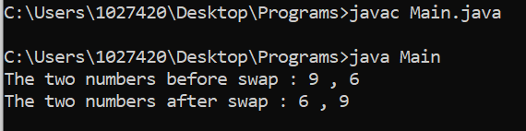
// 7. Java program to swap two numbers without temporary variable ?
public class Main{
public static void main(String[] args){
int a = 9 ;
int b = 6 ;
System.out.println("The two numbers before swap : " + a + " , " + b);
a = a - b;
b = a + b;
a = b - a;
System.out.println("The two numbers after swap : " + a + " , " + b);
}
}
Output :

Slide 7
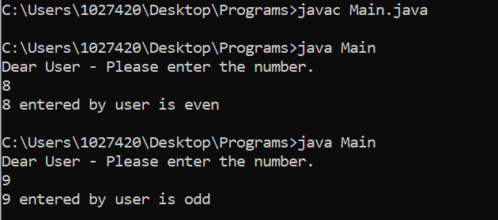
// 8. Java program to check whether a number is even or odd ?
import java.util.Scanner;
public class Main{
public static void main(String[] args){
Scanner userInput = new Scanner(System.in);
System.out.println("Dear User - Please enter the number.");
int number = userInput.nextInt();
if(number % 2 == 0)
{
System.out.println(number + " entered by user is even ");
}
else
{
System.out.println(number + " entered by user is odd ");
}
}
} Output:

Slide 8
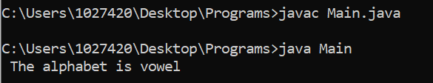
// 9. Java program to check whether an Alphabet is vowel or consonant ?
public class Main{
public static void main(String[] args){
char ch = 'u' ; // vowels are: a, e, i, o, u
if(ch == 'a' || ch == 'e' || ch == 'i' || ch == 'o' || ch == 'u')
{
System.out.println(" The alphabet is vowel");
}
else
{
System.out.println(" The alphabet is consonant");
}
}
}
Output:

Slide 9
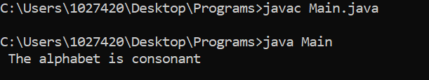
// 10. Java program to check whether an Alphabet is vowel or consonant using switch ?
public class Main{
public static void main(String[] args){
char ch = ‘v’ ; // vowels are: a, e, i, o, u
switch(ch){
case 'a' :
case 'e' :
case 'i' :
case 'o' :
case 'u' :
System.out.println(" The alphabet is vowel");
break;
default :
System.out.println(" The alphabet is consonant");
break;
}
}
} Output:

Slide 10
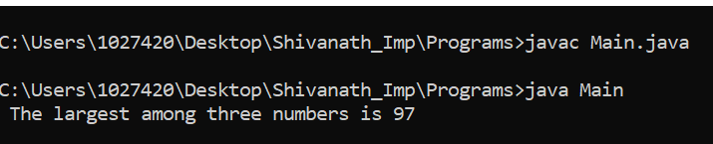
// 11. Java program to find the largest among three numbers ?
public class Main{
public static void main(String[] args){
int a = 78;
int b = 97;
int c = 67;
if( a > b && a > c){
System.out.println(" The largest among three numbers is a = " + a);
}
else if (b > c) {
System.out.println(" The largest among three numbers is b = " + b);
}
else {
System.out.println(" The largest among three numbers is c = " + c);
}
}
}
Output:

Slide 11
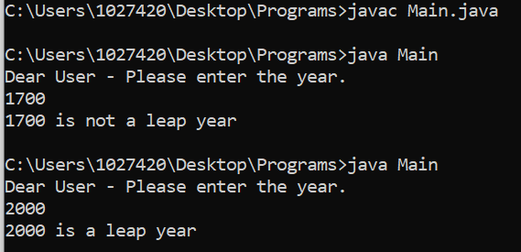
// 12. Java program to check leap year ?
/* Divisible by 4 for all the century years - ending with 00 and century year (E.g: 1600 / 2000) is leap year only when it is perfectly
divisible by 400 and 1700 / 1900 is not a leap year and 2012 is a leap year. For example:: the years 1600 and 2000 were century
leap years; the century years 1700, 1800, and 1900 were not century leap years. The next century leap year will occur in the
year 2400. Century leap years always begin on a Saturday, and February 29 always falls on a Tuesday. */
import java.util.Scanner;
public class Main{
public static void main(String[] args){
Scanner userInput = new Scanner(System.in);
System.out.println("Dear User - Please enter the year.");
int year = userInput.nextInt();
boolean leap = false;
if(year % 4 == 0){
if(year % 100 == 0){
if(year % 400 == 0){ leap = true; } else { leap = false;}
} else { leap = true;}
} else { leap = false;}
if(leap){ System.out.println(year + " is a leap year");}
else { System.out.println(year + " is not a leap year"); }
}
} Output:

Slide 12
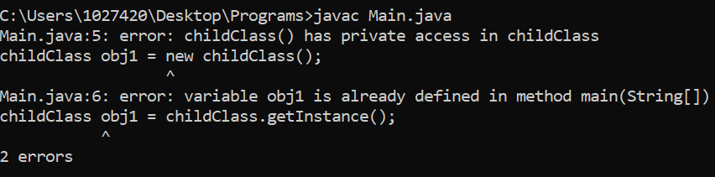
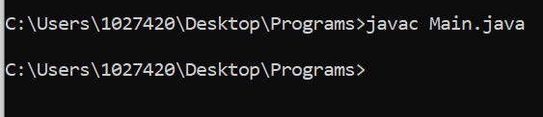
// 13. Write a program for Singleton Class(Or Singleton Design Pattern) in Java ?
public class Main{
public static void main(String[] args){
// childClass obj1 = new childClass(); //It will give an error
childClass obj1 = childClass.getInstance();
childClass obj2 = childClass.getInstance();
}
}
class childClass{
static childClass obj = new childClass();
private childClass(){ }
public static childClass getInstance()
{ return obj; }
}
Output :

Slide 13
// Java program to find first and second largest number in the given Array ? public class Main{ public static void main(String[] args){ int[] numArry = {-19, 23, 34, 56, 68, 90, 89, -34}; int firstLargest = 0; int secondLargest = 0; for(int i = 0; i<numArry.length; i++){ if( numArry[i] > firstLargest ){ secondLargest = firstLargest; firstLargest = numArry[i]; } else if( numArry[i] > secondLargest) { secondLargest = numArry[i]; } } System.out.println("The firstLargest number: " +firstLargest+" secondLargest number "+secondLargest); } }

Slide 14
LESSONS LEARNED
Most likely asked interview questions:
Explain the customization of extent reports for selenium in your project?
How to attach passed and failed steps screenshots in report ?
What is the Latest version of Extent reports ?
USEFUL Reference LINKS:
https://extentreports.com/docs/versions/4/java/
https://www.browserstack.com/guide/extent-reports-in-selenium
https://www.softwaretestinghelp.com/extent-reports-selenium-webdriver/

Slide 15

Click on Subscribe button, Like it, Share it Shivanath M Choudhary Test Automation Architect shiv.c3@gmail.com
My beliefs:
Invest time on yourself.
Learn good things a lot.
Practice good work ethics.
Plan Do Check Act.
Practice the Kaizen formula.
Don’t look up or down to people.
Don’t afraid to take any risk in life.
Be happy in life.
Be a stubborn heart for desire.
Have a feeling of thankfulness.

