Slide 1
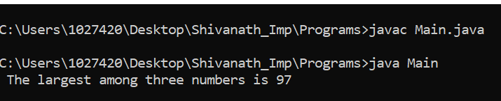

LESSON TOPIC : Selenium with Java – Interview Programs
// 11. Java program to find the largest among three numbers ?
public class Main{
public static void main(String[] args){
int a = 78;
int b = 97;
int c = 67;
if( a > b && a > c){
System.out.println(" The largest among three numbers is a = " + a);
}
else if (b > c) {
System.out.println(" The largest among three numbers is b = " + b);
}
else {
System.out.println(" The largest among three numbers is c = " + c);
}
}
} Output:

Slide 2
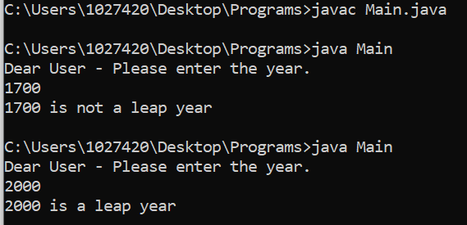
// 12. Java program to check leap year ?
/* Divisible by 4 for all the century years - ending with 00 and century year (E.g.: 1600 / 2000) is leap year only when it is perfectly
divisible by 400 and 1700 / 1900 is not a leap year and 2012 is a leap year. For example:: the years 1600 and 2000 were century
leap years; the century years 1700, 1800, and 1900 were not century leap years. The next century leap year will occur in the
year 2400. Century leap years always begin on a Saturday, and February 29 always falls on a Tuesday. */
import java.util.Scanner;
public class Main{
public static void main(String[] args){
Scanner userInput = new Scanner(System.in);
System.out.println("Dear User - Please enter the year.");
int year = userInput.nextInt();
boolean leap = false;
if(year % 4 == 0){
if(year % 100 == 0){
if(year % 400 == 0){ leap = true; } else { leap = false;}
} else { leap = true;}
} else { leap = false;}
if(leap){ System.out.println(year + " is a leap year");}
else { System.out.println(year + " is not a leap year"); }
}
} Output:

Slide 3
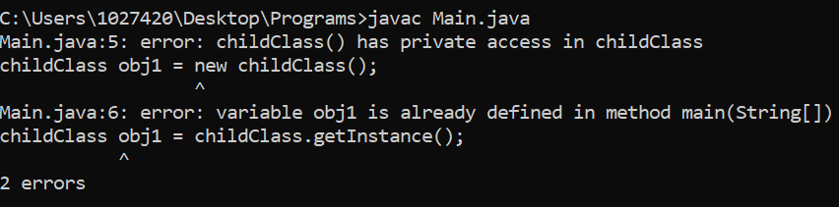
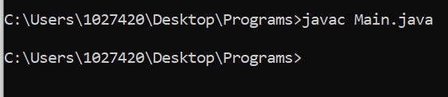
// 13. Write a program for Singleton Class(Or Singleton Design Pattern) in Java ?
public class Main{
public static void main(String[] args){
// childClass obj1 = new childClass(); //It will give an error:
childClass obj1 = childClass.getInstance();
childClass obj2 = childClass.getInstance();
}
}
class childClass{
static childClass obj = new childClass();
private childClass(){ }
public static childClass getInstance()
{ return obj; }
}
Output :

Slide 4
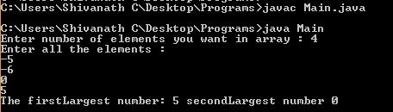
//14. Java program to find first and second largest number in the given Array ?
import java.util.Scanner;
public class Main{
public static void main(String[] args){
Scanner usrInput = new Scanner(System.in);
System.out.print("Enter number of elements you want in array : ");
int n = usrInput.nextInt();
int[] numArry = new int[n];
System.out.println("Enter all the elements : ");
for(int i = 0; i < n ; i++) { numArry[i] = usrInput.nextInt(); }
int firstLargest = 0;
int secondLargest = 0;
for(int i = 0; i<numArry.length; i++){
if( numArry[i] > firstLargest ){
secondLargest = firstLargest;
firstLargest = numArry[i];
} else if( numArry[i] > secondLargest){
secondLargest = numArry[i]; } }
System.out.println("The firstLargest number: " +firstLargest+" secondLargest number "+secondLargest);
} }

Slide 5
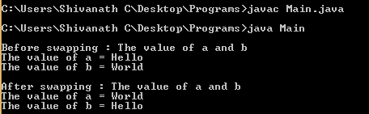
// 15. Java program to swap two strings without temporary variable ?
public class Main{
public static void main(String args[]){
String a = "Hello";
String b = "World";
System.out.println("\nBefore swapping : The value of a and b ");
System.out.println("The value of a = " +a);
System.out.println("The value of b = " +b);
a = a+b;
b = a.substring(0, (a.length() - b.length()));
a = a.substring(b.length());
System.out.println("\nAfter swapping : The value of a and b ");
System.out.println("The value of a = " +a);
System.out.println("The value of b = " +b);
}
}
Output :

Slide 6

// 16. Java program to reverse an integer ?
import java.lang.String;
public class Main{
public static void main(String args[]){
int num = 12345;
int rev = 0;
while(num != 0){
rev = rev * 10 + num % 10;
num = num /10;
}
System.out.println("The reverse integer is : " +rev);
long num1 = 12345;
System.out.println(new StringBuffer(String.valueOf(num1)).reverse());
}
}
Output :

Slide 7
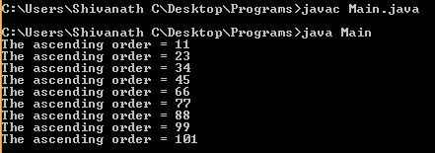
// 17. Java program to find ascending order of given number array ?
public class Main{
public static void main(String args[]){
int a[] = {99, 88, 77, 66, 45, 34, 23, 11, 101};
int temp;
for(int i =0;i<a.length;i++){
for(int j=i+1;j<a.length;j++){
if(a[i]>a[j]){
temp = a[i];
a[i] = a[j];
a[j] = temp;
}
}
System.out.println("The ascending order = "+a[i]);
}
}
}
Output :

Slide 8
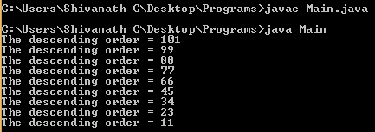
// 18. Java program to find descending order of given number array ?
public class Main{
public static void main(String args[]){
int a[] = {99, 88, 77, 66, 45, 34, 23, 11, 101};
int temp;
for(int i =0;i<a.length;i++){
for(int j=i+1;j<a.length;j++){
if(a[i]<a[j]){
temp = a[i];
a[i] = a[j];
a[j] = temp;
}
}
System.out.println("The descending order = "+a[i]);
}
}
}
Output :

Slide 9

// 19. Java program to find duplicate element in given number array ?
public class Main{
public static void main(String args[]){
int arr[] = {1 , 3, 7, 0, 3, 4 , 0, 1};
for(int i =0;i<arr.length - 1; i++){
for(int j =i+1;j<arr.length;j++){
if(arr[i] == arr[j]){
System.out.println("The duplicate element is : " +arr[j]);
}
}
}
}
}
Output :

Slide 10

// 20. Java program to replace special characters/junk from String ?
public class Main{
public static void main(String args[]){
String s = " SHIVANATH M %^%&**(*()(*)65544434iuiHQHFIOQH%$$%$";
s = s.replaceAll("[^a-zA-Z0-9]","");
System.out.println(s);
}
}
Output :

Slide 11
LESSONS LEARNED
Most likely asked interview questions:
Explain the customization of extent reports for selenium in your project?
How to attach passed and failed steps screenshots in report ?
What is the Latest version of Extent reports ?
USEFUL Reference LINKS:
https://extentreports.com/docs/versions/4/java/
https://www.browserstack.com/guide/extent-reports-in-selenium
https://www.softwaretestinghelp.com/extent-reports-selenium-webdriver/

Slide 12

Click on Subscribe button, Like it, Share it Shivanath M Choudhary Test Automation Architect shiv.c3@gmail.com
My beliefs:
Invest time on yourself.
Learn good things a lot.
Practice good work ethics.
Plan Do Check Act.
Practice the Kaizen formula.
Don’t look up or down to people.
Don’t afraid to take any risk in life.
Be happy in life.
Be a stubborn heart for desire.
Have a feeling of thankfulness.

