Slide 1
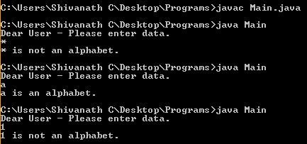

LESSON TOPIC : Selenium with Java – Interview Programs
// 21. Java program to check whether a character is alphabet or not ?
import java.util.Scanner;
public class Main{
public static void main(String[] args)
{
Scanner usrInput = new Scanner(System.in);
System.out.println("Dear User - Please enter data.");
char c = usrInput.next().charAt(0);
if( (c >= 'a' && c <= 'z') || (c >= 'A' && c <= 'Z'))
System.out.println(c + " is an alphabet.");
else
System.out.println(c + " is not an alphabet.");
}
}
Output :

Slide 2
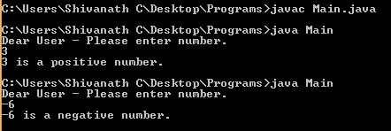
// 22. Java program to check whether a given number is Positive or Negative ?
import java.util.Scanner;
public class Main{
public static void main(String[] args)
{
Scanner usrInput = new Scanner(System.in);
System.out.println("Dear User - Please enter number.");
int num = usrInput.nextInt();
if( num >= 0)
System.out.println(num + " is a positive number.");
else
System.out.println(num + " is a negative number.");
}
}
Output :

Slide 3
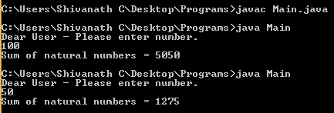
// 23. Java program to calculate the sum of natural numbers ?
The positive numbers 1, 2, 3... are known as natural numbers and its sum is the result of all numbers starting
from 1 to the given number. For n, the sum of natural numbers is:
1 + 2 + 3 + ... + n
import java.util.Scanner;
public class Main{
public static void main(String[] args)
{
int sum = 0 ;
Scanner usrInput = new Scanner(System.in);
System.out.println("Dear User - Please enter number.");
int num = usrInput.nextInt();
for(int i = 1; i<=num; i++){
//sum = sum + i;
sum += i;
}
System.out.println("Sum of natural numbers = " +sum);
}
} Output :

Slide 4
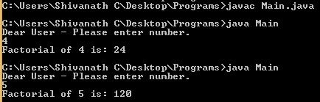
// 24. Java program to find factorial of a number ?
import java.util.Scanner;
public class Main{
public static void main(String[] args)
{
int factorial = 1 ;
Scanner usrInput = new Scanner(System.in);
System.out.println("Dear User - Please enter number.");
int number = usrInput.nextInt();
for(int i = 1; i<=number; i++){
//factorial = factorial + i;
factorial *= i;
}
System.out.println("Factorial of "+number+" is: "+factorial);
}
}
Output :

Slide 5
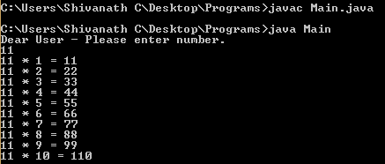
// 25. Java program to Generate Multiplication Table ?
import java.util.Scanner;
public class Main{
public static void main(String[] args)
{
Scanner usrInput = new Scanner(System.in);
System.out.println("Dear User - Please enter number.");
int num = usrInput.nextInt();
for(int i = 1; i<=10; i++){
System.out.printf("%d * %d = %d \n" , num, i, num * i);
}
}
}
Output :

Slide 6

// 26. Java program to Display Characters from A to Z using loop ?
public class Main{
public static void main(String[] args)
{
char c;
for(c = 'A'; c <= 'Z'; ++c){
System.out.print(c + " ");
}
}
}
Output :

Slide 7
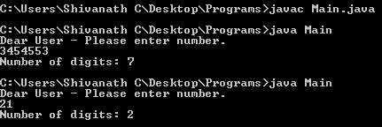
// 27. Java program to Count Number of Digits in an Integer ?
import java.util.Scanner;
public class Main{
public static void main(String[] args)
{
int count = 0;
Scanner usrInput = new Scanner(System.in);
System.out.println("Dear User - Please enter number.");
int num = usrInput.nextInt();
while(num != 0){
// num = num / 10;
num /= 10;
++count;
}
System.out.println("Number of digits: " + count);
}
} Output :

Slide 8
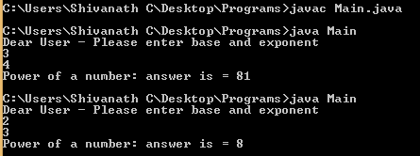
// 28. Java Program to Calculate the Power of a Number ?
In this program, you'll learn to calculate the power of a number with and without using pow() function.
import java.util.Scanner;
public class Main{
public static void main(String[] args)
{
Scanner usrInput = new Scanner(System.in);
System.out.println("Dear User - Please enter base and exponent");
int base = usrInput.nextInt();
int exponent = usrInput.nextInt();
long result = 1 ;
while(exponent != 0){
result = result * base;
--exponent;
}
System.out.println("Power of a number: answer is = " + result);
}
} Output :

Slide 9
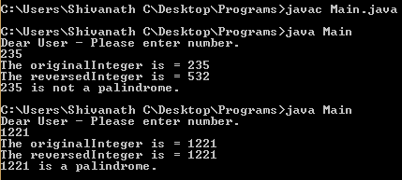
// 29. Java Program to Check Whether a Number is Palindrome or Not ?
import java.util.Scanner;
public class Main{
public static void main(String[] args) {
int reversedInteger = 0;
Scanner usrInput = new Scanner(System.in);
System.out.println("Dear User - Please enter number.");
int num = usrInput.nextInt();
int originalInteger = num ;
System.out.println("The originalInteger is = " + originalInteger);
while(num != 0){
reversedInteger = reversedInteger * 10 + num % 10;
num = num / 10; }
System.out.println("The reversedInteger is = " + reversedInteger);
// Number is palindrome if orignalInteger and reversedInteger are equal.
if (originalInteger == reversedInteger)
System.out.println(originalInteger + " is a palindrome.");
else
System.out.println(originalInteger + " is not a palindrome.");
}
} Output :

Slide 10
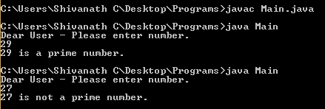
// 30. Java Program to Check Whether a Number is Prime or Not ?
The list of prime numbers between 1 and 100: 2, 3, 5, 7, 11, 13, 17, 19, 23, 29, 31, 37, 41, 43, 47, 53, 59, 61, 67, 71, 73, 79, 83, 89, and 97
import java.util.Scanner;
public class Main{
public static void main(String[] args) {
boolean isPrime = false;
Scanner usrInput = new Scanner(System.in);
System.out.println("Dear User - Please enter number.");
int num = usrInput.nextInt();
for(int i = 2; i < num / 2 ; i++){
if(num % i == 0){
// condition for nonprime number
isPrime = true;
break;
}
}
if (!isPrime)
System.out.println(num + " is a prime number.");
else
System.out.println(num + " is not a prime number.");
}
} Output :

Slide 11

Click on Subscribe button, Like it, Share it Shivanath M Choudhary Test Automation Architect shiv.c3@gmail.com
My beliefs:
Invest time on yourself.
Learn good things a lot.
Practice good work ethics.
Plan Do Check Act.
Practice the Kaizen formula.
Don’t look up or down to people.
Don’t afraid to take any risk in life.
Be happy in life.
Be a stubborn heart for desire.
Have a feeling of thankfulness.

