Slide 1

LESSON TOPIC : Selenium with Java – Interview Programs
// 31. Java Program to Display Prime Numbers Between Two Intervals.
In this program, you'll learn to display prime numbers between two given intervals (low and high).
import java.util.Scanner;
public class Main{
public static void main(String[] args) {
Scanner usrInput = new Scanner(System.in);
System.out.println("Dear User - Please enter numbers.");
int low = usrInput.nextInt();
int high = usrInput.nextInt();
}

Slide 2
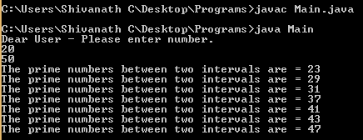
while (low < high){
boolean flag = false;
for(int i = 2; i < low / 2 ; i++){
if(low % i == 0){
flag = true;
break;
}
}
if (!flag)
System.out.println("The prime numbers between two intervals are = " + low);
++low;
}
}
Output :

Slide 3
// 32. Java Program to Check Armstrong Number ?
A positive integer is called an Armstrong number of order n if
abcd... = an + bn + cn + dn + ...
In case of an Armstrong number of 3 digits, the sum of cubes of each digits is equal to the number itself. For example:
153 = 1*1*1 + 5*5*5 + 3*3*3 // 153 is an Armstrong number.
import java.util.Scanner;
public class Main{
public static void main(String[] args)
{
int number, originalNumber, remainder, result = 0;
Scanner usrInput = new Scanner(System.in);
System.out.println("Dear User - Please enter number.");
number = usrInput.nextInt();
originalNumber = number ;

Slide 4
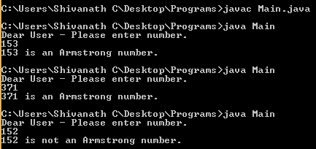
while (originalNumber != 0)
{
remainder = originalNumber % 10;
result += Math.pow(remainder, 3);
originalNumber /= 10;
}
if(result == number)
System.out.println(number + " is an Armstrong number.");
else
System.out.println(number + " is not an Armstrong number.");
}
}
Output :

Slide 5
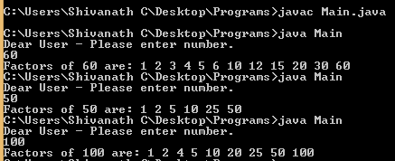
// 33. Java Program to Display Factors of a Number ??
The for loop is iterated until i <= number is false. In each iteration, whether number is exactly divisible by i is checked (condition for i to be the factor of number) and the value of i is incremented by 1.
import java.util.Scanner;
public class Main{
public static void main(String[] args)
{
Scanner usrInput = new Scanner(System.in);
System.out.println("Dear User - Please enter number.");
int number = usrInput.nextInt();
System.out.print("Factors of " + number + " are: ");
for(int i = 1; i <= number; ++i) {
if (number % i == 0) {
System.out.print(i + " ");
}
}
}
} Output :

Slide 6

Click on Subscribe button, Like it, Share it Shivanath M Choudhary Test Automation Architect shiv.c3@gmail.com
My beliefs:
Invest time on yourself.
Learn good things a lot.
Practice good work ethics.
Plan Do Check Act.
Practice the Kaizen formula.
Don’t look up or down to people.
Don’t afraid to take any risk in life.
Be happy in life.
Be a stubborn heart for desire.
Have a feeling of thankfulness.

