Slide 1

LESSON TOPIC : Selenium with Java – Interview Programs
/* 38. Write a Java program class.
Create a method in this class that takes a array of strings as the only argument.
Each string in this array will be a single word containing either alphabets a through z or
digits 0 through 9 (for example, “abcd”, “Pune”, “623”, “Mumbai”, “10”, etc.)
The method should print on standard output 2 numbers:
How many strings in the input array are numeric. ?
How many strings in the input array are non-numeric. ? */
import java.util.Scanner;
public class Main{
public static void main(String[] args)
{
// Define the length of the String Array (numeric or non-numeric)
Scanner usrInput = new Scanner(System.in);
System.out.print("How many strings in the Array ? = ");
int lengthOfArray = Integer.parseInt(usrInput.nextLine());

Slide 2
String[] numericNonNumericStringArray = new String[lengthOfArray];
//Now it will allows user to enter inputs like numeric or non-numeric strings in the Array.
for(int j = 0; j < numericNonNumericStringArray.length;j++)
{
System.out.println(j);
System.out.print("Enter string of array = ");
numericNonNumericStringArray[j] = usrInput.nextLine();
}
for (String element : numericNonNumericStringArray)
{
System.out.println(element);
}
VerifyNumericNonNumeric(numericNonNumericStringArray);
}

Slide 3
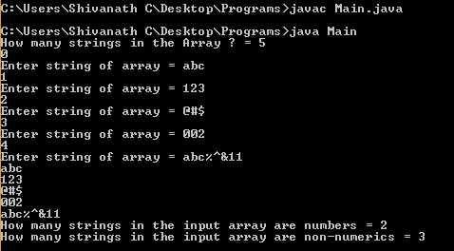
public static void VerifyNumericNonNumeric(String[] str)
{
int numeric = 0, non_numeric = 0;
for(int i = 0; i < str.length; i++)
{
try
{
Integer.parseInt(str[i]);
numeric ++;
}
catch(NumberFormatException e)
{
non_numeric ++;
}
}
System.out.println("How many strings in the input array are numbers = " + numeric) ;
System.out.println("How many strings in the input array are non-numerics = " + non_numeric) ;
}
}
Output : Look-up

Slide 4
/* 39. Write a Java program class.
Write a Java class.
Create a method in this class that takes an integer array as the only argument.
The method should process this array and return the 3rd largest number in the array. For example, if the array contains the
numbers {10, 2, 5, 4, 6, 17, 11, 22} then the method should print the number 11 and also return the same.*/
import java.util.Scanner;
import java.util.*;
public class Main{
public static void main(String[] args)
{
// Define the length of the array.
Scanner usrInput = new Scanner(System.in);
System.out.print("length of the Array ? = ");
int lengthOfArray = usrInput.nextInt();
int[] numOfArray = new int[lengthOfArray];
//Now it will allows user to enter inputs in the Array.
for(int i = 0; i < numOfArray.length;i++)
{
System.out.print("Enter data = ");
numOfArray[i] = usrInput.nextInt(); }

Slide 5
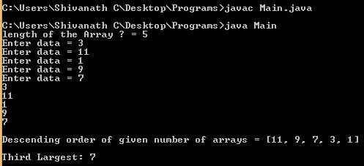
for (int nums : numOfArray)
{ System.out.println(nums); }
System.out.println("Third Largest: "+getThirdLargest(numOfArray,lengthOfArray));
}
public static int getThirdLargest(int[] numbers, int total){
int temp;
for (int i = 0; i < total; i++)
{
for (int j = i + 1; j < total; j++)
{
if (numbers[i] > numbers[j])
{
temp = numbers[i];
numbers[i] = numbers[j];
numbers[j] = temp;
}
}
}
System.out.println("\nDescending order of given number of arrays = " +Arrays.toString(numbers));
return numbers[total-3]; } }

Slide 6

Shivanath M Choudhary Test Automation Architect shiv.c3@gmail.com Click on Subscribe button, Like it, Share it
My Beliefs:
Invest time on yourself.
Learn good things a lot.
Practice good work ethics.
Plan Do Check Act.
Practice the Kaizen formula.
Don’t look up or down to people.
Don’t afraid to take any risk in life.
Be happy in life.
Be a stubborn heart for desire.
Have a feeling of thankfulness.

