Slide 1

LESSON TOPIC : Selenium with Java – Interview Programs
/* 39. Write a Java program class.
Create a method in this class that takes an integer array as the only argument.
The method should process this array and return the 3rd largest number in the array. For example, if the array contains the
numbers {10, 2, 5, 4, 6, 17, 11, 22} then the method should print the number 11 and also return the same.*/
import java.util.Scanner;
import java.util.*;
public class Main{
public static void main(String[] args)
{
// Define the length of the array.
Scanner usrInput = new Scanner(System.in);
System.out.print("length of the Array ? = ");
int lengthOfArray = usrInput.nextInt();
int[] numOfArray = new int[lengthOfArray];
//Now it will allows user to enter inputs in the Array.
for(int i = 0; i < numOfArray.length;i++)
{ System.out.print("Enter data = ");
numOfArray[i] = usrInput.nextInt(); }

Slide 2
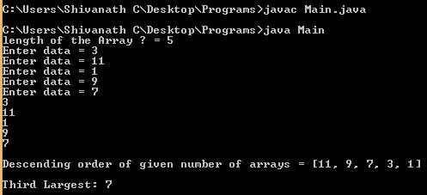
for (int nums : numOfArray)
{ System.out.println(nums); }
System.out.println("Third Largest: "+getThirdLargest(numOfArray , lengthOfArray));
}
public static int getThirdLargest(int[] numbers, int total){
int temp;
for (int i = 0; i < total; i++)
{
for (int j = i + 1; j < total; j++)
{
if (numbers[i] > numbers[j])
{
temp = numbers[i];
numbers[i] = numbers[j];
numbers[j] = temp;
}
}
}
System.out.println("\nDescending order of given number of arrays = " +Arrays.toString(numbers));
return numbers[total-3]; } }

Slide 3

Shivanath M Choudhary Test Automation Architect shiv.c3@gmail.com Click on Subscribe button, Like it, Share it
My Beliefs:
Invest time on yourself.
Learn good things a lot.
Practice good work ethics.
Plan Do Check Act.
Practice the Kaizen formula.
Don’t look up or down to people.
Don’t afraid to take any risk in life.
Be happy in life.
Be a stubborn heart for desire.
Have a feeling of thankfulness.

