Slide 1




Slide 2
Problem Statement
Organization Name:
PS Code:
Problem Statement Title:
National Institute of Design Madhya Pradesh
ST891
App/portal for tracking/finding of missing persons/children by use of Aadhaar enabled Biometric details.
Team Name: Opus Geeks
Institute: Lakshmi Narain College of Technology(LNCT), Bhopal, MP
Theme: Miscellaneous
Team Leader: Rahul Karda
Institute Code: C-36022

Slide 3
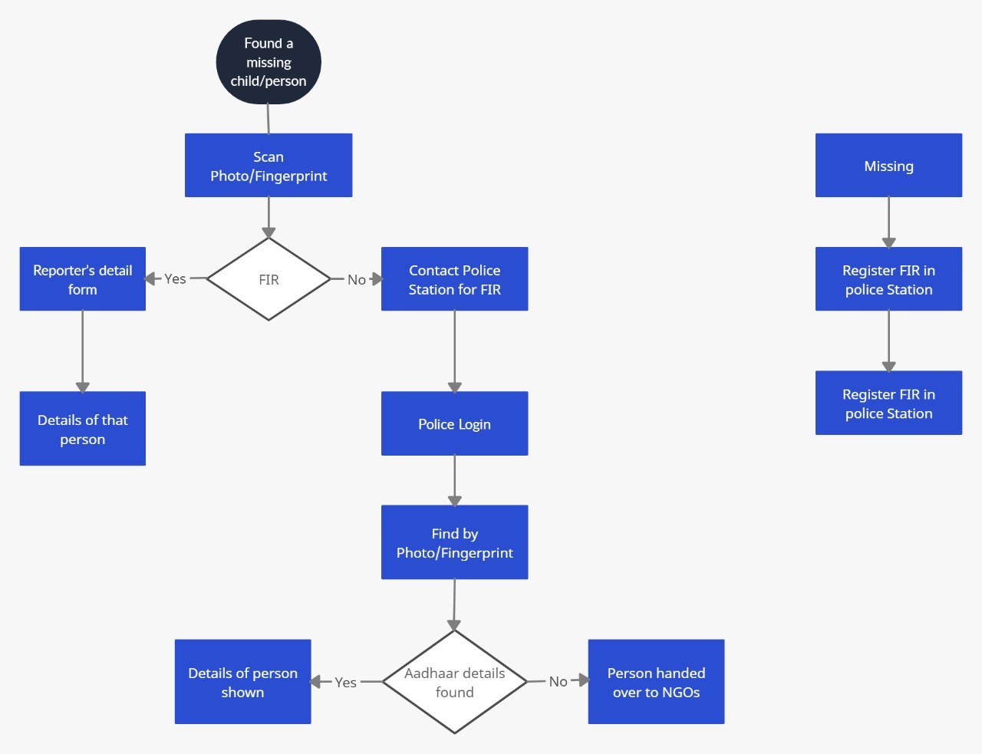
Flow of Software

Slide 4
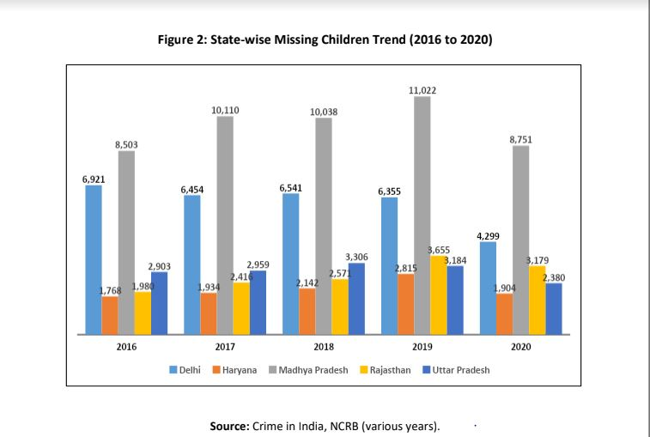
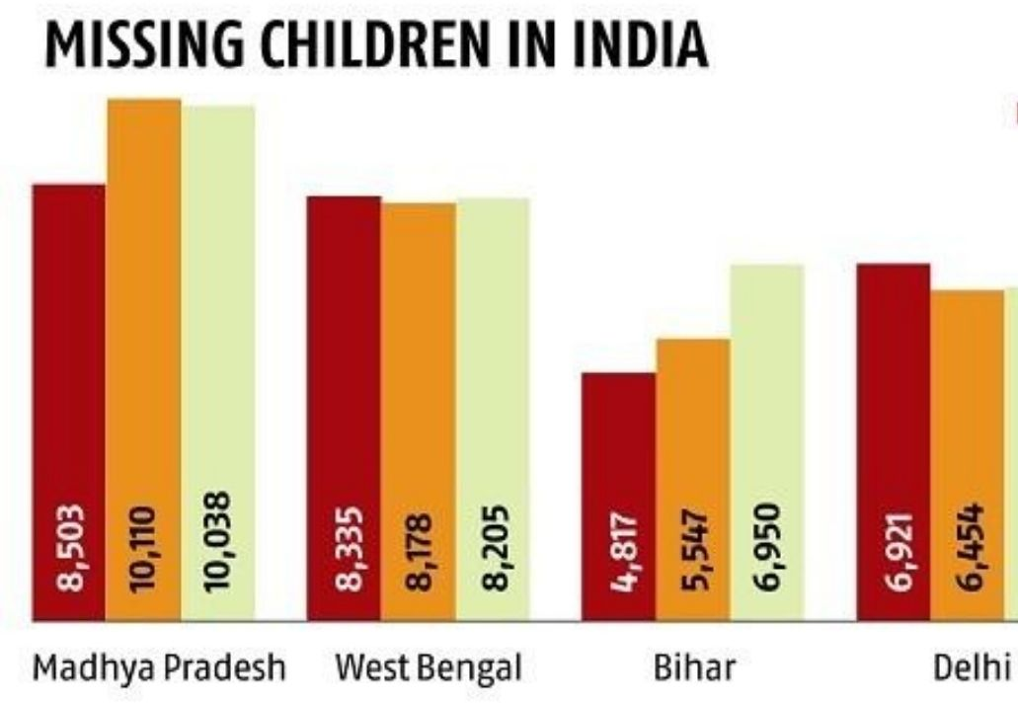
Problems to solve
To track a missing family member.
To identify and gather information about suspicious missing person.
1
3
2
To track missing people through involving general public.
4
Some Stats:

Slide 5
Our Proposed Solution
If you find someone, Open our website
Collect information like Fingerprint or image
Our portal will do the Face recognition or will given the persons detail by matching the fingerprint
Help person meet their loved ones
Key Points:
Any normal person can use the portal
2 options:
Take a picture of the victim
Use the fingerprint
Unsupervised Machine Learning Algorithm for Facial recognition
OpenCV for Fingerprint detection

Slide 6







Our Tech Stack
Machine Learning Model:
Face Recognition & Fingerprint
2. Image Processing:
Face Recognition
3. Python:
Machine Learning & Deep Learning
4. HTML/CSS/JS:
Frontend
5. SQLite 3:
Hashing & Authentication
6. MongoDB:
Database
7. Flask:
Backend

Slide 7
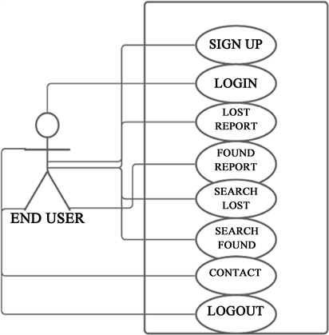
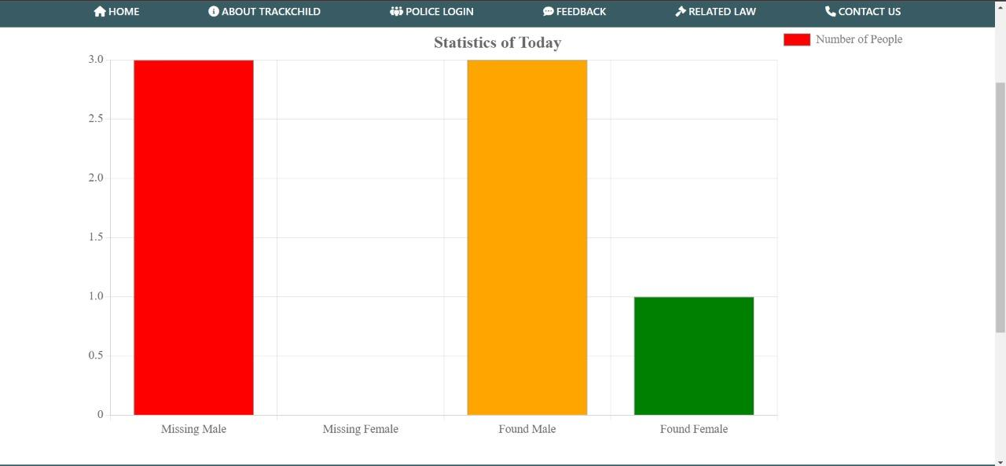
Use Case Diagram
For End Users

Slide 8
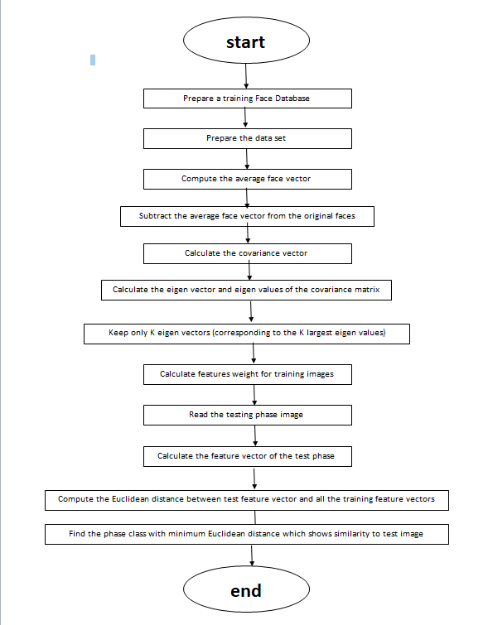
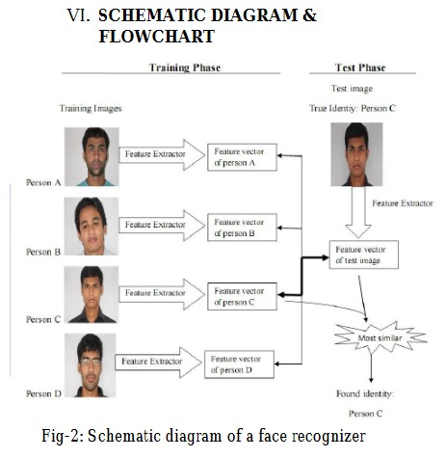
How to handle big datasets?

Slide 9
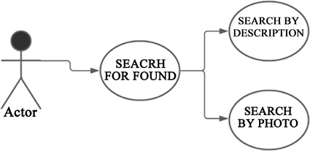

Missing and Recovered cases (Use Case Diagram)
FNGERPRINT
FNGERPRINT
Use Case diagram for Missing Case
Use Case Diagram for Recovered Case

Slide 10
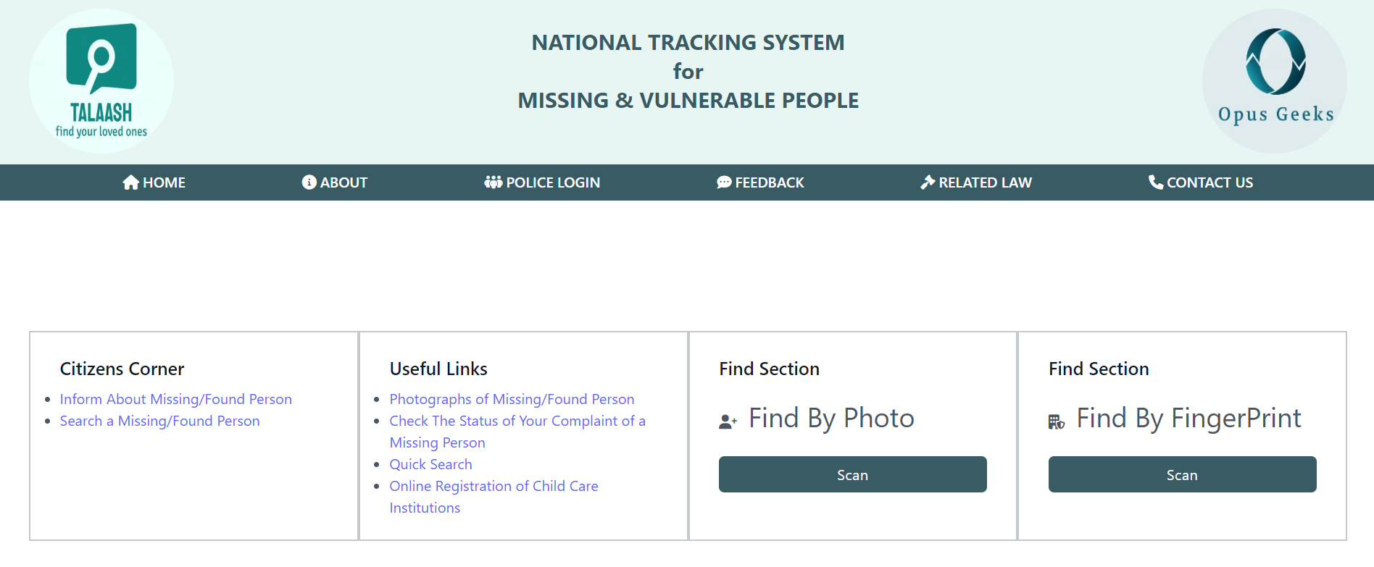
Images/Architectures of Working Project
The Main Page Of The Website

Slide 11
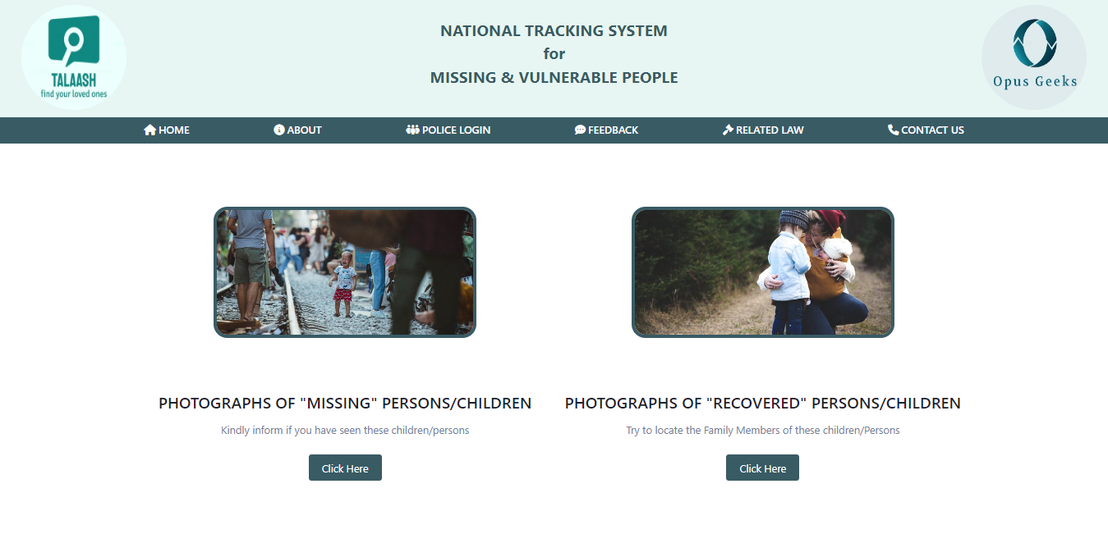
Photograph Gallery Page of Missing and Recovered cases
Photographs of Missing and Recovered People

Slide 12
Dependencies
Show Stopper
Massive data storage burden. The ML technology used in face detection requires powerful data storage.
False positives, where the algorithm matches a query image with a face from the known-faces database erroneously.
A potential breach of privacy.
Time Latency.
The process of tracking a missing person or children will be far more digitalised and smooth helping the Police and officials to track down people faster than the conventional process.
The Image Matching and the Fingerprint Scanning Methods makes the process more accurate and reliable.

Slide 13
Future Scope & Applications
Integration of our system with the Government Aadhar Database to widen the reach and use of our website.
For better reach and usability, An Android Application will also be build which will facilitate all the features of our website.
Our Website can be further extended in future to take help for finding Tracking Criminals.

Slide 14
Thank You

