Slide 1
Machine Learning – Classifiers Design
December 24, 2019
TCS Internal

Slide 2
Agenda
Machine Learning – Bias and Variance
Machine Learning – Bias –Variance Tradeoff
Machine Learning – Generative vs Discriminative Models
Machine Learning – Parametric vs Non-parametric Models
Machine Learning – Class Imbalance
TCS Internal
2

Slide 3
Machine Learning – Bias and Variance
Bias:
When an algorithm has limited flexibility to learn the true value from the dataset then model is Biased
Bias is an error from erroneous assumptions in the learning algorithm.
High bias can cause an algorithm to miss the relevant relations between features and target outputs i.e underfitting
Variance:
When to an algorithm’s sensitivity to specific sets of the training set an algorithm has limited flexibility to learn the true value from the dataset
Variance is an error from sensitivity to small fluctuations in the training set.
High variance can cause an algorithm to model the random noise in the training data, rather than the intended outputs i.e overfitting
TCS Internal
3

Slide 4
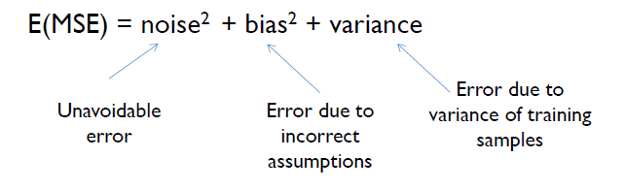
Machine Learning – Bias –Variance Tradeoff
Bias-Variance tradeoff:
A good model should not have high bias and/or high variance. This is called Bias-Variance Tradeoff
TCS Internal
4

Slide 5
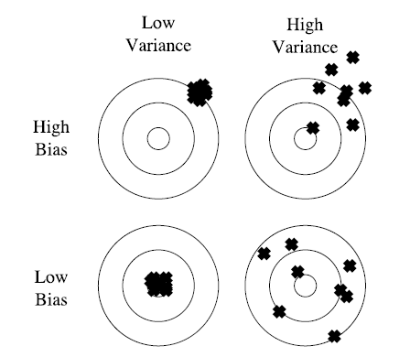
Machine Learning – Bias –Variance Tradeoff
Bias-Variance tradeoff:
TCS Internal
5

Slide 6
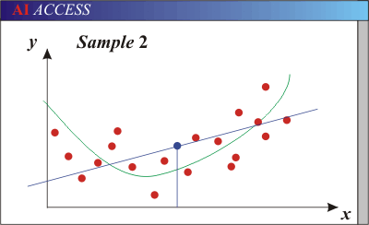
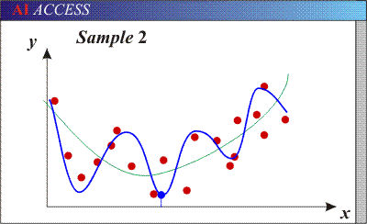
Machine Learning – Bias –Variance Tradeoff
Bias-Variance tradeoff:
Models with too few parameters are inaccurate because of a large bias (not enough flexibility)
Models with too many parameters are inaccurate because of a large variance (too much sensitivity to the sample).
TCS Internal
6

Slide 7
Generative vs Discriminative Models
Generative Model:
A Generative Model ‌explicitly models the actual distribution of each class
Assume some functional form for P(X|Y), P(Y)
Estimate parameters of P(X|Y), P(Y) directly from training data
Use Bayes rule to calculate P(Y|X=x)
This is ‘Generative’ model
  Indirect computation of P(Y|X) through Bayes rule
  But, can generate a sample of the data
Example: Naïve Bayes classifier
TCS Internal
7

Slide 8
Generative vs Discriminative Models
Discriminative Model:
A Discriminative model ‌models the decision boundary between the classes
Assume some functional form for P(Y|X)
Estimate parameters of P(Y|X) directly from training data
This is the ‘discriminative’ model
  Directly learn P(Y|X)
  But cannot sample data, because P(X) is not available
Example: SVM, Decision Trees, k-NN, Boosting, Neural Networks
TCS Internal
8

Slide 9
Parametric vs Non-parametric Models
Parametric Model:
A learning model that summarizes data with a set of parameters of fixed size (independent of the number of training examples) is called a parametric model
No matter how much data you throw at a parametric model it won’t change its mind about how many parameters it needs
Have fixed number of parameters
Make some strong assumptions about data
Example: Linear regression, Naive Bayes
TCS Internal
9

Slide 10
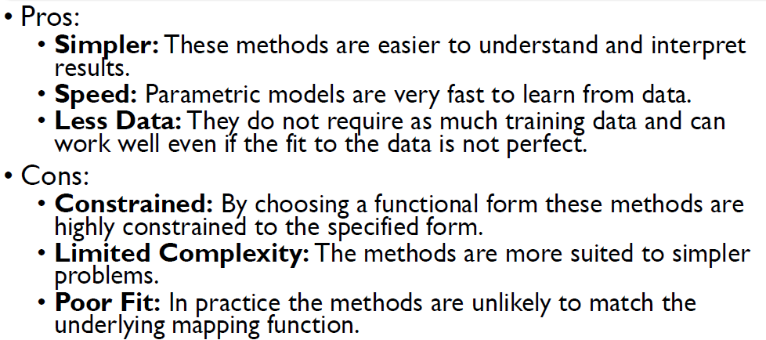
Parametric vs Non-parametric Models
Parametric Model:
TCS Internal
10

Slide 11
Parametric vs Non-parametric Models
Non-Parametric Model:
Nonparametric methods are good when you have a lot of data and no prior knowledge, and when you don’t want to worry too much about choosing just the right features
Flexible number of parameters
Number of parameters often grows with more data
Makes fewer assumptions about the data
Example: kNN, Decision Trees, SVM etc
TCS Internal
11

Slide 12
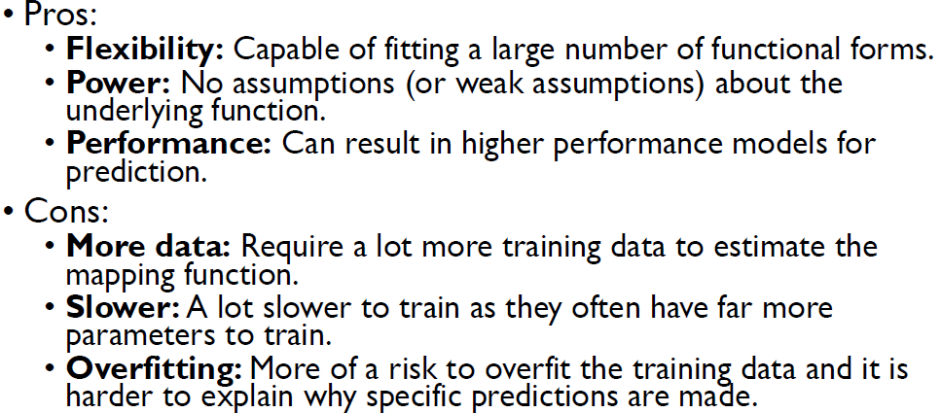
Parametric vs Non-parametric Models
Non-Parametric Model:
TCS Internal
12

Slide 13
Machine Learning – Class Imbalance
Class Imbalance:
The assumption that data sets are balanced: i.e., there are as many positive examples of the concept as there are negative ones is not always true in real-world
Standard learners are often biased towards the majority class
As a result, examples from the overwhelming class are well-classified whereas examples from the minority class tend to be misclassified
Some ML algorithms like Decision Trees are sensitive to class imbalance while others like NB are less prone to class imbalance
TCS Internal
13

Slide 14
Machine Learning – Class Imbalance
Handling Class Imbalance:
At the data Level: Re-Sampling
  Oversampling (Random or Directed)
  Undersampling (Random or Directed)
  Active Sampling
At the Algorithmic Level
  Adjusting the Costs
  Adjusting the decision threshold
Undersampling (random and directed) is not effective and can even hurt performance
Random oversampling helps quite dramatically at all complexity
TCS Internal
14

Slide 15
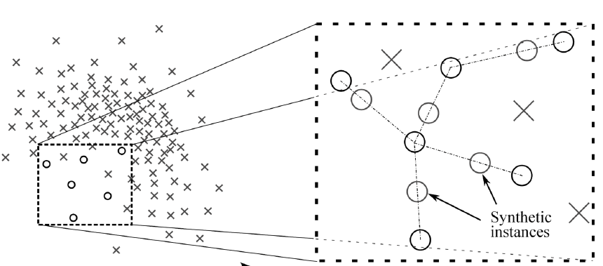
Machine Learning – Class Imbalance
Handling Class Imbalance: Oversampling
Synthetic Minority Oversampling Technique(SMOTE)
TCS Internal
15

Slide 16
Thank You
December 30, 2019
TCS Internal

