Slide 1
Machine Learning – Classifiers Evaluation
December 24, 2019
TCS Internal

Slide 2
Agenda
Machine Learning – Under-fitting and over-fitting
Machine Learning – Training, Validation, Test Sets
Machine Learning – Data sampling
Machine Learning – Cross Validation
Machine Learning – Confusion Matrix
Machine Learning – ROC
Machine Learning – P-R Curve
Machine Learning – ROC and P-R Curves
TCS Internal
2

Slide 3
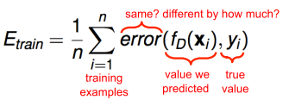
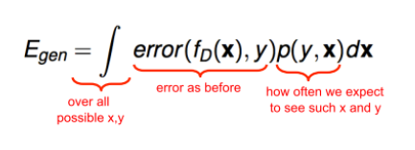
Machine Learning – Underfitting and overfitting
Training and Generalization Error
Training Error is Error between Actual and predicted values of training data
Generalization Error is an error which tells how well model do on future data
TCS Internal
3

Slide 4
Machine Learning – Underfitting and overfitting
Under-fitting:
A machine learning model is said to be under-fitting when it cannot capture the underlying trend of the data.
Model is too simple
Perform badly with both train and test data
Over-fitting:
A machine learning model is said to be over-fitting, when the model also consider the noise and inaccurate data entries of train data set
Model is biased towards train data
Perform badly with test data
TCS Internal
4

Slide 5
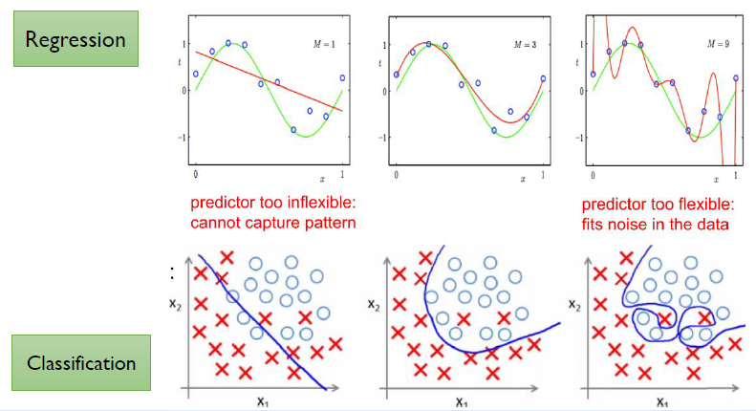
Machine Learning – Underfitting and overfitting
TCS Internal
5

Slide 6
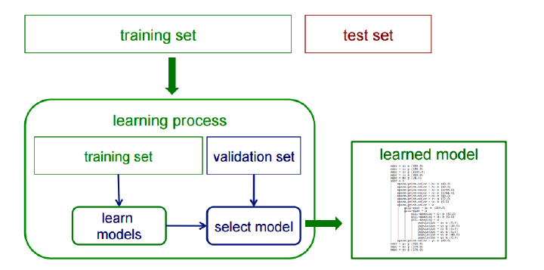
Machine Learning – Training, Validation, Test Sets
Training, Validation, Test Sets:
What is the approach build a proper model?
TCS Internal
6

Slide 7
Machine Learning – Data sampling
Data sampling:
Dataset needs to be split into Train,Validation and Test sets
Records in each set should be random order
Common types of sampling
  Random sampling
  Random resampling
  Stratified Sampling
TCS Internal
7

Slide 8
Machine Learning – Data sampling
  Random sampling:
We have only one dataset(labeled)
Dataset should be split into three portions
  Train: To train the model
  Test: To Test the model
  Validation: To choose best model i.e best possible ML algorithm with best hyper-parameters for the data
Split data in to above sets, randomly select records for each set.
TCS Internal
8

Slide 9
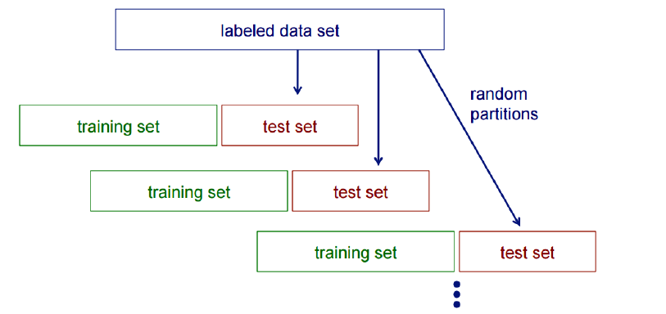
Machine Learning – Data sampling
Random Resampling:
Random Resampling same as random sampling
We can artificially increase training set size using random resampling
TCS Internal
9

Slide 10
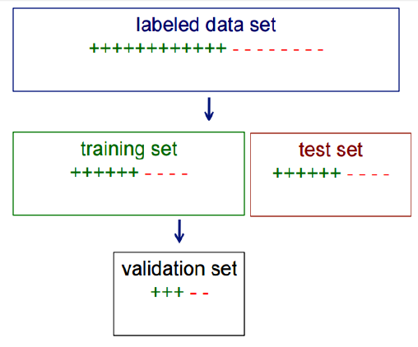
Machine Learning – Data sampling
Stratified Sampling:
In some cases, when randomly selecting training, validation or test sets, we may want to ensure that class proportions are maintained in each selected set
Then first stratify instances by class, then randomly select instances from each class proportionally.
This is called stratified sampling
TCS Internal
10

Slide 11
Machine Learning – Cross Validation
Cross Validation :
Cross-validation is a resampling technique used to evaluate machine learning models on a limited data sample
We train our model using the subset of the data-set and then evaluate using the complementary subset of the data-set which is called cross validation set / CV set.
Commonly used CV techniques are
    K-fold cross-validation
    N-fold cross-validation(Leave-one-out )
TCS Internal
11

Slide 12
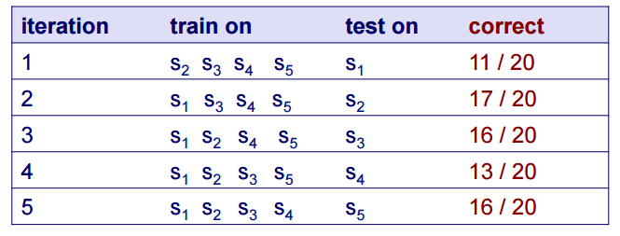
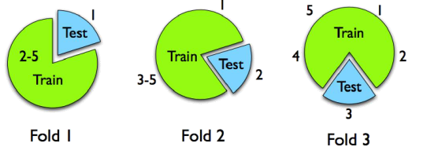
Machine Learning – Cross Validation
Cross Validation : Example
Suppose we have 100 instances, and we want to estimate accuracy with cross validation
Accuracy = 73/100 = 73%
TCS Internal
12

Slide 13
Machine Learning – Accuracy
Accuracy:
Accuracy is a primary evaluation measure for classification
Accuracy may not be useful in cases like
  large class skew
  Different misclassification costs etc
There are other efficient measures available
  Precision
  Recall
  Confusion Matrix
  ROC AUC
  P-R curve
TCS Internal
13

Slide 14
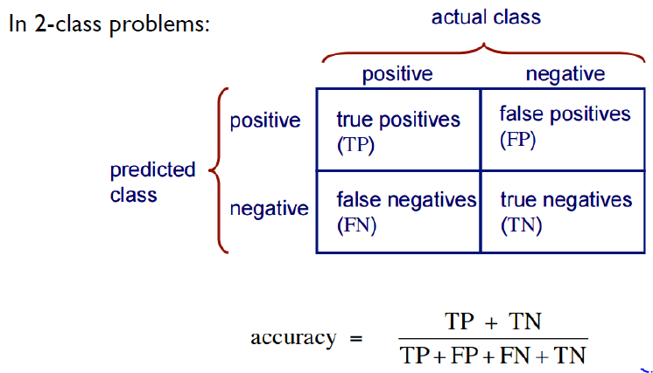
Machine Learning – Confusion Matrix
Confusion Matrix:
TCS Internal
14

Slide 15
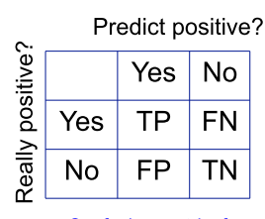
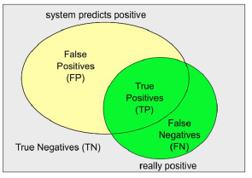
Machine Learning – Confusion Matrix
Confusion Matrix:
TCS Internal
15

Slide 16
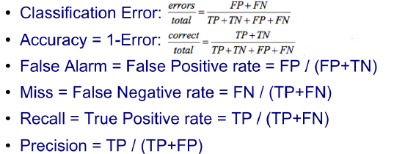
Machine Learning – Confusion Matrix
Confusion Matrix:
TCS Internal
16

Slide 17
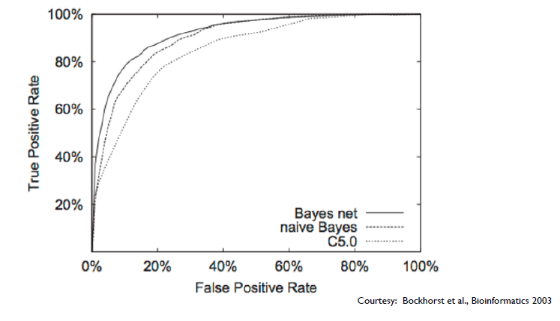
Machine Learning – ROC
ROC:
A Receiver Operating Characteristic (ROC) curve plots the TP-rate vs. the FP-rate as a threshold on the confidence of an instance being positive is varied
Area under ROC curve is called ROC-AUC
TCS Internal
17

Slide 18
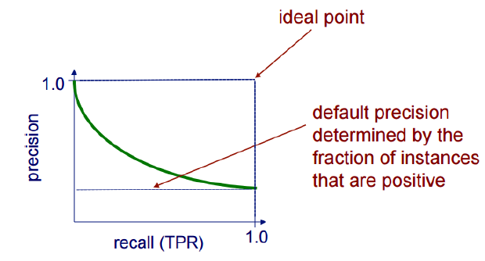
Machine Learning – P-R Curve
P-R Curve:
A precision/recall curve plots the precision vs. recall (TP-rate) as a threshold on the confidence of an instance being positive is varied.
TCS Internal
18

Slide 19
Machine Learning – ROC and P-R Curves
Advantages of ROC and P-R curves:
ROC is Insensitive to changes in class distribution
ROC Can identify optimal classification thresholds for tasks with differential misclassification costs
P-R shows the fraction of predictions that are false positives
P-R well-suited for tasks with lots of negative instances
Both allow predictive performance to be assessed at various levels of confidence
TCS Internal
19

Slide 20
Thank You
December 30, 2019
TCS Internal

