Slide 1
Machine Learning – Classifiers – Ensemble Methods
December 24, 2019
TCS Internal

Slide 2
Agenda
Machine Learning – Ensemble Methods
Machine Learning – Bagging
Machine Learning – Random Forrest
Machine Learning – Boosting
Machine Learning – AdaBoost
TCS Internal
2

Slide 3
Machine Learning – Ensemble Methods
Ensemble Learning
Ensemble learning is a machine learning paradigm where multiple models trained to solve the problem more accurately than single complex model.
The hypothesis behind ensemble learning is that a group of weak learners together form a strong learner.
They may combine outputs to get better accuracy.
TCS Internal
3

Slide 4
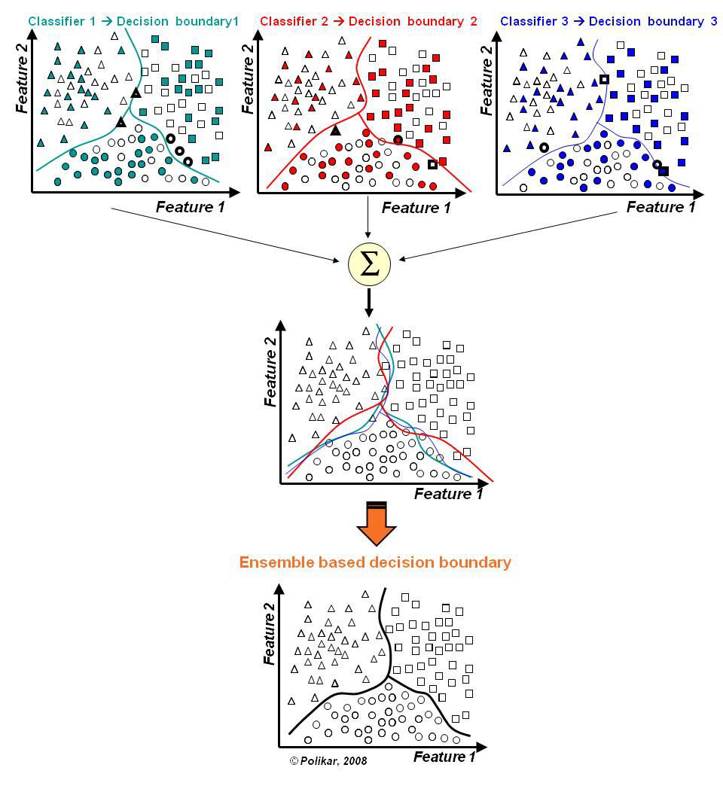
Machine Learning – Ensemble Methods
Ensemble Learning
TCS Internal
4

Slide 5
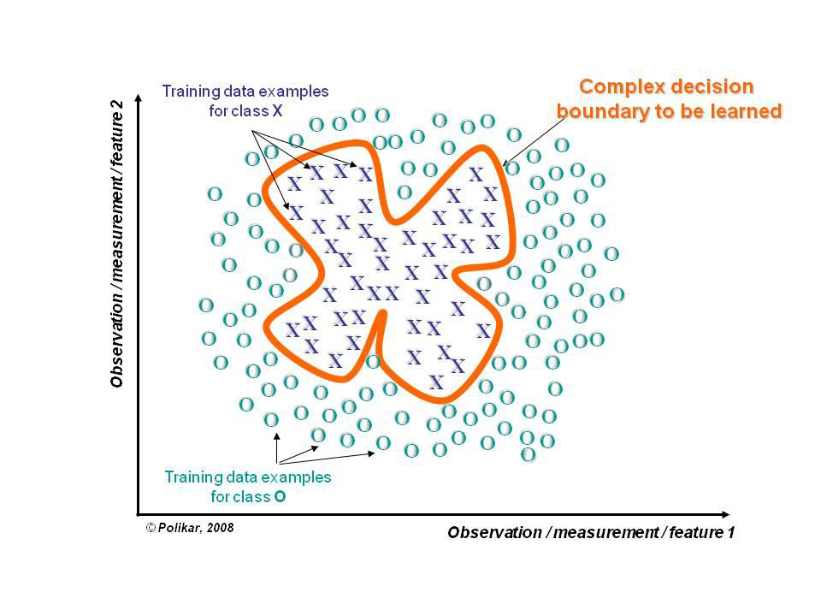
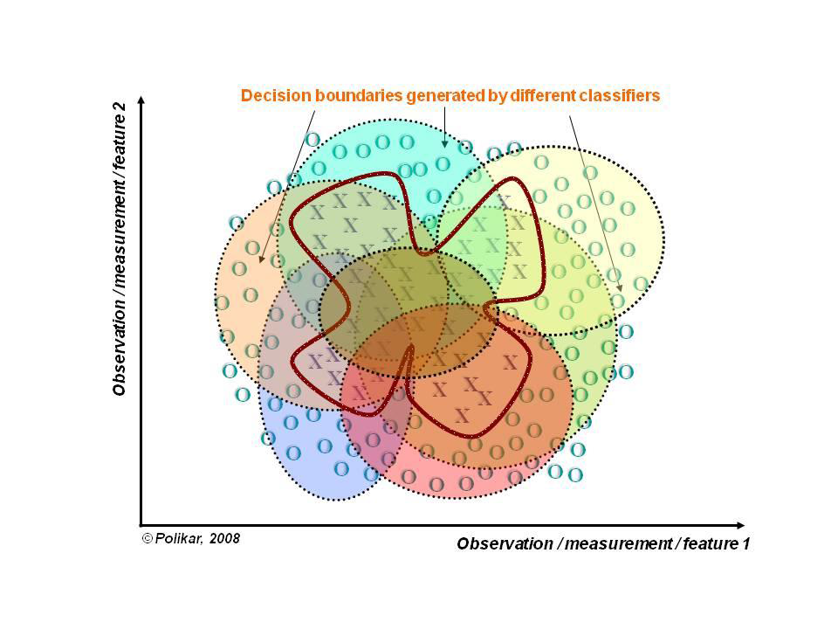
Machine Learning – Ensemble Methods
Ensemble Learning
Ensemble learning follows Divide and Conquer
TCS Internal
5

Slide 6
Machine Learning – Ensemble Methods
Ensemble Methods
An Ensemble method can have homogeneous weak learners i.e a single base learning algorithm that are trained with different subset of data/features. This is called homogeneous ensembles model
Similarly an Ensemble method can have heterogeneous weak learners i.e different type of base learning algorithm that are trained with different subset of data/features. This is called heterogeneous ensembles model
TCS Internal
6

Slide 7
Machine Learning – Ensemble Methods
Ensemble Methods - Types of Ensemble Classifiers
Bagging (bootstrap aggregating):
  Train several models using bootstrapped datasets
  The majority classification is selected
Boosting
  Use several weak classifiers to create a strong classifier
  Resample previously misclassified points
Stacking (stacked generalization)
  Train multiple tiers of classifiers
  Higher tiers can correct lower tiers
TCS Internal
7

Slide 8
Machine Learning – Bagging
Ensemble Methods - Bagging
Bagging(bootstrap aggregating): Bagging creates several subsets of data from training sample chosen randomly with replacement.
Each collection of subset data is used to train model, we get an ensemble of different models.
Average of all the predictions from different models are used which is more robust than a single decision tree classifier.
Bagging works as it reduces variance by voting/averaging
Some candidates for Bagging(week learners): Decision tree, decision stump, regression tree, linear regression, SVMs
TCS Internal
8

Slide 9
Machine Learning – Bagging
Ensemble Methods - Bagging Steps
Suppose there are N observations and M features in training data set.
A sample from training data set is taken randomly with replacement.
A subset of M features are selected randomly, and whichever feature gives the best split is used to split the node iteratively.
The tree is grown to the largest.
Repeat steps 1 to 3 n times and prediction is given based on the aggregation of predictions from n number of trees.
TCS Internal
9

Slide 10
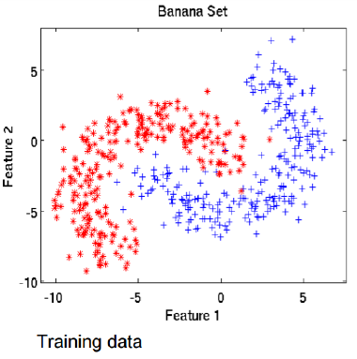
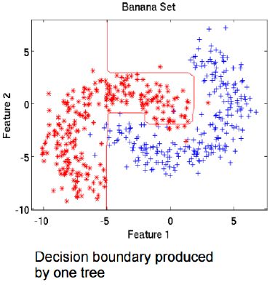
Machine Learning – Bagging
Ensemble Methods - Bagging Illustration
TCS Internal
10

Slide 11
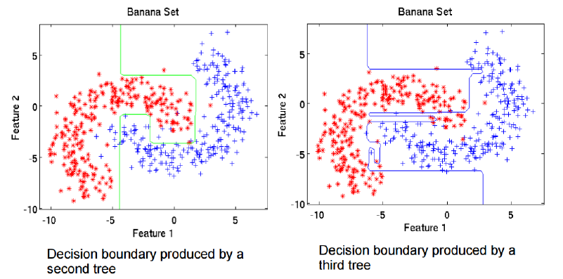
Machine Learning – Bagging
Ensemble Methods - Bagging Illustration
TCS Internal
11

Slide 12
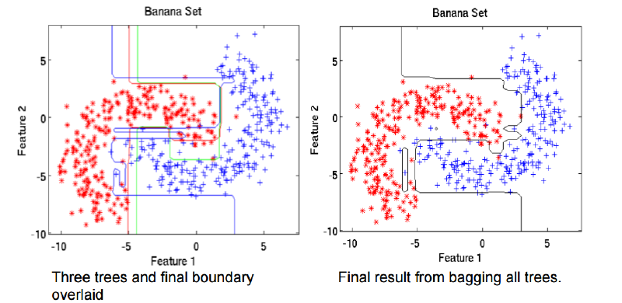
Machine Learning – Bagging
Ensemble Methods - Bagging Illustration
TCS Internal
12

Slide 13
Machine Learning – Bagging
Ensemble Methods - Bagging – Pros & Cons
Pros:
Reduces over-fitting of the model.
Handles higher dimensionality data very well.
Maintains accuracy for missing data.
Can help a lot if data is noisy
Cons:
As the final prediction is based on the mean predictions from subset trees, Predictions may not be precise.
TCS Internal
13

Slide 14
Machine Learning – Bagging
Ensemble Methods - Bagging – Example
Census Income dataset
from sklearn.ensemble import BaggingClassifier
from sklearn.tree import DecisionTreeClassifier
base_cls = DecisionTreeClassifier()
num_trees = 500
seed=8
model = BaggingClassifier(base_estimator = base_cls,
n_estimators = num_trees,
random_state = seed)
model.fit(X_train, y_train)
print("Accuracy of Bagging algorithm = ", model.score(X_test, y_test))
Accuracy of Bagging algorithm = 0.852469886175268
TCS Internal
14

Slide 15
Machine Learning – Random Forrest
Ensemble Methods - Random Forrest
The random forest is a bagging method which uses decision Trees/decision stumps as base learners i.e Random forests are a combination of tree predictors
Each tree depends on the values of a random vector sampled independently
The generalization error depends on the strength of the individual trees and the correlation between them
Using a random selection of features yields results robust w.r.t. noise
TCS Internal
15

Slide 16
Machine Learning – Random Forrest
Random Forrest - Algorithm
Given a training set S
For i = 1 to k do:
  Build subset Si by sampling with replacement from S
  Learn tree Ti from Si
  At each node:
  Choose best split from random subset of F features
  Each tree grows to the largest extend, and no pruning
Make predictions according to majority vote of the set of k trees.
TCS Internal
16

Slide 17
Machine Learning – Random Forrest
Random Forrest - Advantages
One of the best machine learning algorithm and most preferred in data science challenges.
It runs efficiently on large data bases can handle thousands of input variables without variable deletion
Does not overfit by design
The generalization error of a forest of tree classifiers depends on the strength of the individual trees in the forest and the correlation between them
TCS Internal
17

Slide 18
Machine Learning – Random Forrest
Ensemble Methods - Random Forrest – Example
Census Income dataset
from sklearn.ensemble import RandomForestClassifier
RF=RandomForestClassifier(n_estimators=100)
RF.fit(X_train, y_train)
RandomForestClassifier(bootstrap=True, class_weight=None, criterion='gini', max_depth=None, max_features='auto', max_leaf_nodes=None, min_impurity_decrease=0.0, min_impurity_split=None, min_samples_leaf=1, min_samples_split=2, min_weight_fraction_leaf=0.0, n_estimators=100, n_jobs=None, oob_score=False, random_state=None, verbose=0, warm_start=False)
print("Accuracy of Random Forrest algorithm = ", RF.score(X_test, y_test))
Accuracy of Random Forrest algorithm = 0.8511437727925738
TCS Internal
18

Slide 19
Machine Learning – Boosting
Ensemble Methods - Boosting
Boosting is a collection of predictors. In this technique, learners are learned sequentially with early learners fitting simple models to the data and then analyzing data for errors. Consecutive learners are fit and at every step, the goal is to improve the accuracy from the prior learner
The misclassified input weight is increased so that next hypothesis is more likely to classify it correctly. This process converts weak learners into better performing model.
TCS Internal
19

Slide 20
Machine Learning – Boosting
Ensemble Methods - Boosting - Steps
Draw a random subset of training samples s1 without replacement from the training set S to train a weak learner P1
Draw second random training subset s2 without replacement from the training set and add 50 percent of the samples that were previously falsely classified/misclassified to train a weak learner P2
Find the training samples s3 in the training set D on which P1 and P2 disagree to train a third weak learner P3
Combine all the weak learners via majority voting.
TCS Internal
20

Slide 21
Machine Learning – Boosting
Ensemble Methods - Boosting – Pros & Cons
Pros:
Supports different loss function
Works well with interactions.
Cons:
Prone to over-fitting
Requires careful tuning of different hyper-parameters.
TCS Internal
21

Slide 22

Machine Learning – AdaBoost
Ensemble Methods - AdaBoost
AdaBoost is an algorithm for constructing a “strong” classifier as linear combination of “simple” “weak” classifier
Final classification based on weighted vote of weak classifiers
TCS Internal
22

Slide 23
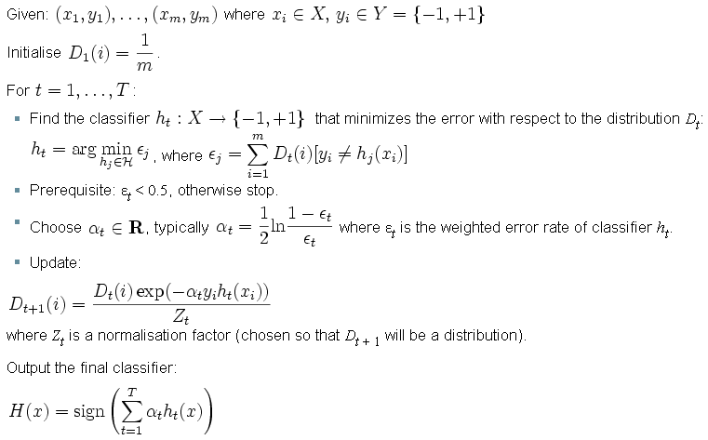
Ensemble Methods - AdaBoost
Machine Learning – AdaBoost
TCS Internal
23

Slide 24
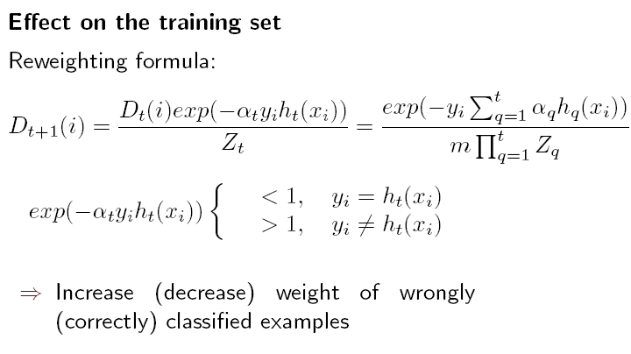
Ensemble Methods - AdaBoost
Machine Learning – AdaBoost
TCS Internal
24

Slide 25
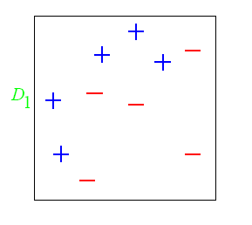
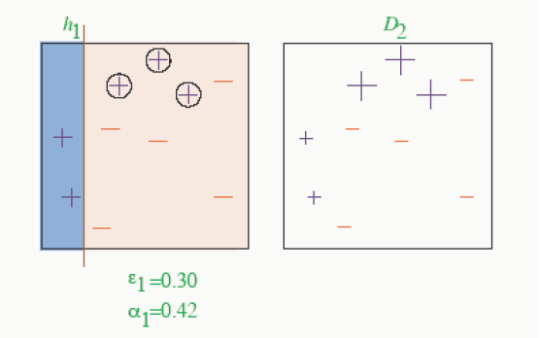
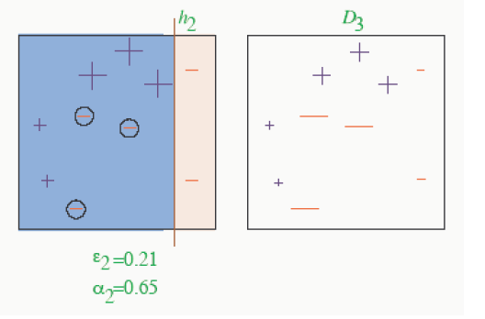
Ensemble Methods - AdaBoost - Example
Machine Learning – AdaBoost
TCS Internal
25

Slide 26
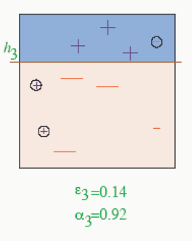
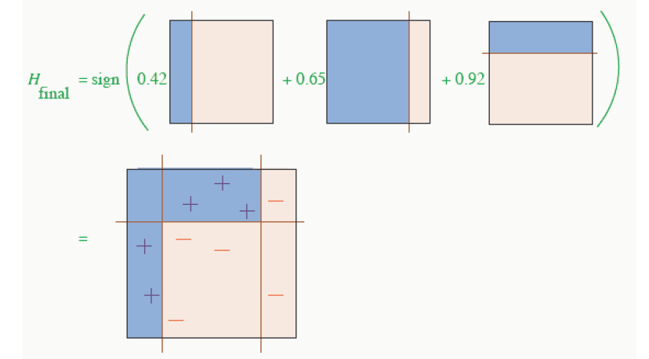
Ensemble Methods - AdaBoost - Example
Machine Learning – AdaBoost
TCS Internal
26

Slide 27
Machine Learning – AdaBoost
Ensemble Methods - AdaBoost – Example
Census Income dataset
from sklearn.ensemble import AdaBoostClassifier
Adboost = AdaBoostClassifier(n_estimators=100, random_state=0)
Adboost.fit(X_train, y_train)
AdaBoostClassifier(algorithm='SAMME.R', base_estimator=None, learning_rate=1.0, n_estimators=100, random_state=0)
print("Accuracy of AdaBoost algorithm = ", Adboost.score(X_test, y_test))
Accuracy of AdaBoost algorithm = 0.8635208310310531
TCS Internal
27

Slide 28
Thank You
December 30, 2019
TCS Internal

