Slide 1
Machine Learning – Classifiers
– Logistic Regression
December 24, 2019
TCS Internal

Slide 2
Agenda
Logistic Regression
Logistic Regression – Classifier
Decision boundary
Cost function
Multiclass classification
TCS Internal
2

Slide 3
Logistic Regression
Logistic Regression:
Logistic Regression is a statistical machine learning model to classify the data
Logistic Regression uses predictive analysis based on the concept of probability.
Logistic regression model finds the linear relationship between target and one or more predictors based on existing data.
Examples:
1. Whether the applicants are eligible for loan(Yes/No) or not based on
Age
Income
Credit history
Current EMI
TCS Internal
3

Slide 4
Logistic Regression
Logistic Regression:
The Target/dependent variable in Logistic regression is a Decision i.e YES/NO (or) TRUE/FALSE (or) 0/1
The incoming mail is Spam(Yes/No)? Based on..
Subject
Sender mail-id
Body of mail
Mail server
TCS Internal
4

Slide 5
Logistic Regression
Age | Salary | Loan Repaid
75 | 75000 | 1
66 | 91000 | 1
73 | 80000 | 1
27 | 80000 | 0
59 | 67000 | 1
90 | 48000 | 1
72 | 73000 | 1
45 | 73000 | 0
50 | 55000 | 0
58 | 57000 | 0
100 | 87000 | 1
TCS Internal
5

Slide 6
Logistic Regression
Logistic Regression:
We want binary classifier(mathematical function) which generates Y=0(will not repay) or Y=1(will repay) by taking age and salary of the person as input
Independent variables : Age and Salary
Dependent variable : zero or one
Age
Repay
f(age, salary)
Salary
Will not Repay
TCS Internal
6

Slide 7


Logistic Regression - Classifier
Logistic Regression:
The classifier instead of giving binary values Y=0 or Y=1, it will predict the probability of belonging to class 1
In general, for k independent variables
Where a0+a1*x1+a2*x2+…+ak*xk is called logit
TCS Internal
7

Slide 8
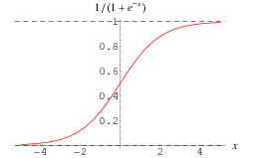
Logistic Regression - Classifier
Logistic Regression:
The Logistic classifier forms a sigmoid function w.r.t X variables i.e if the value of logit move towards +infinity, probability moves close to 1, and if logit move towards -infinity, probability comes down to zero.
TCS Internal
8

Slide 9
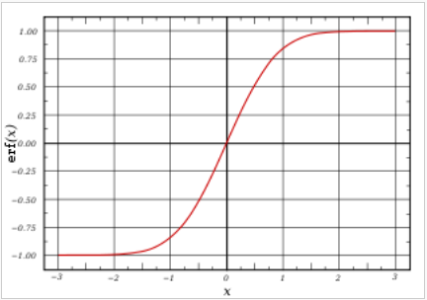
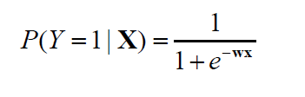
Logistic Regression - Classifier
Logistic Regression:
Let X be the data instance, and Y be the class label: Learn P(Y|X) directly
Let W = (W1, W2, … Wn), X=(X1, X2, …, Xn), WX is the dot product
Sigmoid function:
TCS Internal
9

Slide 10
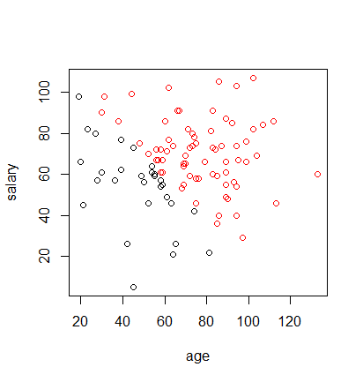
Logistic Regression – Decision boundary
Decision Boundary
Logistic Regression:
Data points above line falls into Y=1 class
a0+a1*age+a2*salary >= 0 i.e p > 0.5
Data points below line falls into Y=0 class
a0+a1*age+a2*salary < = 0 i.e p < 0.5
TCS Internal
10

Slide 11
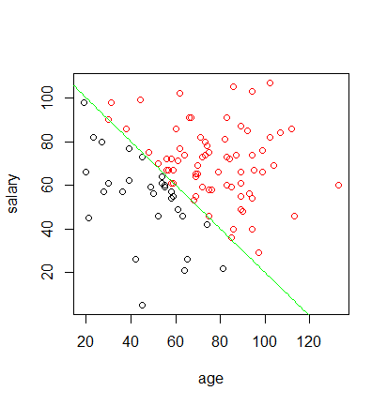
Logistic Regression – Decision boundary
Logistic Regression:
How to decide on decision boundary / cut-off value?
Cut-off = 0.5t
Cut-off > 0.5t
Cut-off < 0.5t
TCS Internal
11

Slide 12


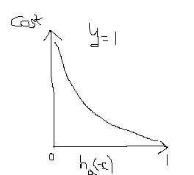
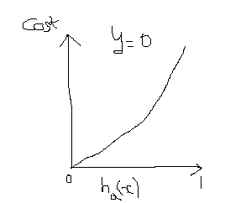
Logistic Regression – Cost function
Logistic Regression:
Let the classifier function is
Then cost function
TCS Internal
12

Slide 13
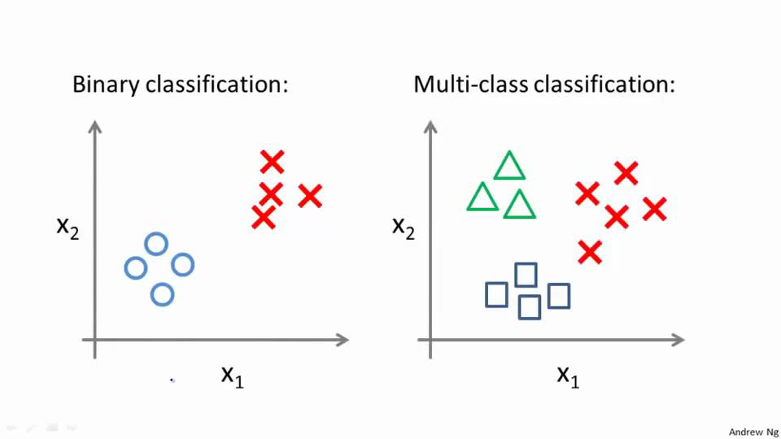
Logistic Regression – Multiclass classification
Logistic Regression:
News classification: politics, movies, entertainment, sports
Weather: Sunny, Cloudy, Rain, Snow
TCS Internal
13

Slide 14
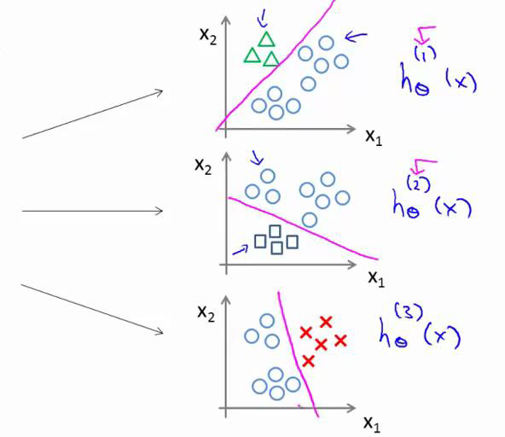
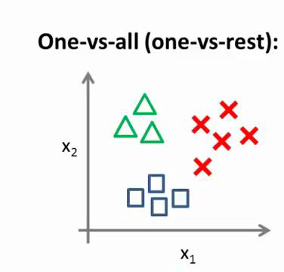
Logistic Regression – Multiclass classification
Logistic Regression:
How to perform Multiclass classification
TCS Internal
14

Slide 15
Logistic Regression – Multiclass classification
Logistic Regression: Example
Census Income dataset
from sklearn.linear_model import LogisticRegression
log_reg = LogisticRegression(random_state=0).fit(X_train, y_train)
print(log_reg.predict(X_test))
[' <=50K' ' <=50K' ' <=50K' ... ' <=50K' ' <=50K' ' <=50K']
print("Accuracy of Logistic Regression = ", log_reg.score(X_test, y_test))
Accuracy of Logistic Regression = 0.7863852359376726
TCS Internal
15

Slide 16
Thank You
December 30, 2019
TCS Internal

