Slide 1
Machine Learning – Classifiers – Naive Bayes
December 24, 2019
TCS Internal

Slide 2
Agenda
Machine Learning – Naive Bayes
TCS Internal
2

Slide 3

Machine Learning – Naive Bayes
Naive Bayes classifier:
Naive Bayes is a simple but powerful algorithm which uses probability i.e Bayes Theorm.
it has two parts "Naive" and "Bayes”
The Naive Bayes classifier assumes that the presence of a feature in a class is unrelated to any other feature. it is known as Naïve
Bayes therom for conditional probability
TCS Internal
3

Slide 4
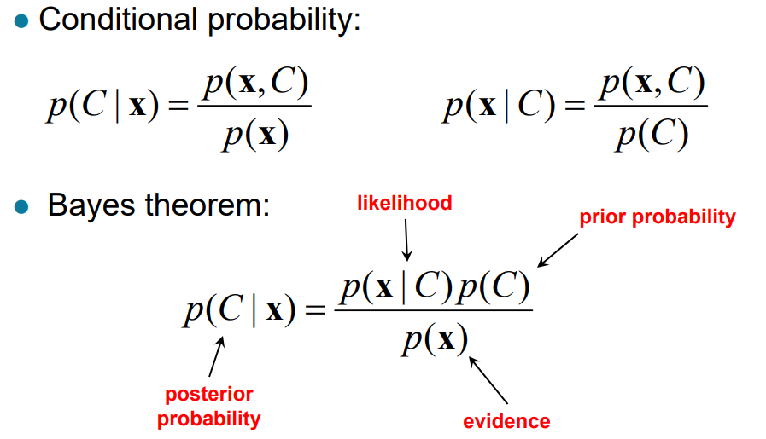
Machine Learning – Naive Bayes
Naive Bayes classifier: Bayesian classification
TCS Internal
4

Slide 5
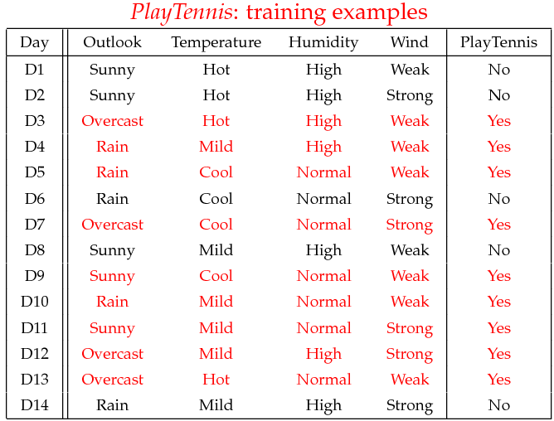
Machine Learning – Naive Bayes
Naive Bayes classifier:
Example:
TCS Internal
5

Slide 6
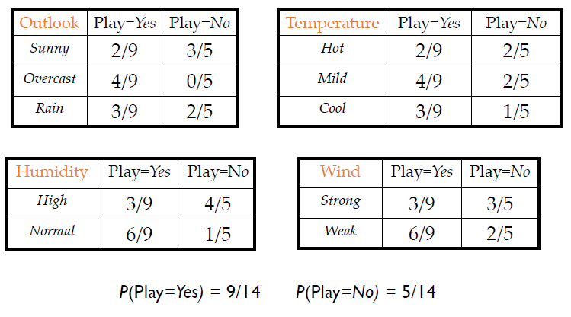
Machine Learning – Naive Bayes
Naive Bayes classifier: Training phase
TCS Internal
6

Slide 7
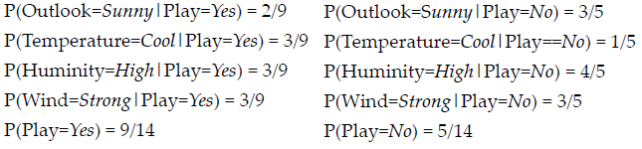
Machine Learning – Naive Bayes
Naive Bayes classifier: Test / Prediction phase
Given a new data point for prediction
x’=(Outlook=Sunny, Temperature=Cool, Humidity=High, Wind=Strong)
NB algorithm refers the Look up tables
TCS Internal
7

Slide 8
Machine Learning – Naive Bayes
Naive Bayes classifier: Test / Prediction phase
MAP rule
P(Yes|x’) :
[P(Sunny|Yes)P(Cool|Yes)P(High|Yes)P(Strong|Yes)]P(Play=Yes) = 0.0053
P(No|x’):
[P(Sunny|No) P(Cool|No)P(High|No)P(Strong|No)]P(Play=No) = 0.0206
As P(Yes|x’) < P(No|x’), x’ label will be predicted as “No”.
TCS Internal
8

Slide 9
Machine Learning – Naive Bayes
Naive Bayes classifier: Test / Prediction phase
MAP rule
P(Yes|x’) :
[P(Sunny|Yes)P(Cool|Yes)P(High|Yes)P(Strong|Yes)]P(Play=Yes) = 0.0053
P(No|x’):
[P(Sunny|No) P(Cool|No)P(High|No)P(Strong|No)]P(Play=No) = 0.0206
As P(Yes|x’) < P(No|x’), x’ label will be predicted as “No”.
TCS Internal
9

Slide 10
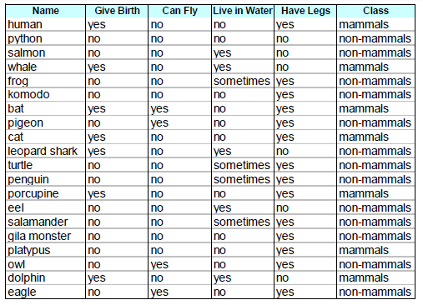
Machine Learning – Naive Bayes
Naive Bayes classifier:
Another example:
TCS Internal
10

Slide 11

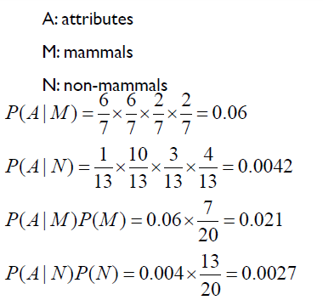
Machine Learning – Naive Bayes
Naive Bayes classifier:
Predict class for below instance
As P(A|M)P(M) > P(A|N)P(N) it is predicted as Mammals
TCS Internal
11

Slide 12
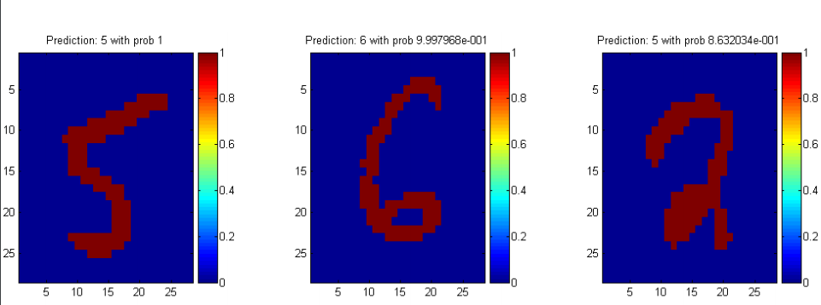
Machine Learning – Naive Bayes
Naive Bayes classifier: Applications
Digits classification
Spam Filtering
Weather Prediction
Stock market prediction
TCS Internal
12

Slide 13

Machine Learning – Naive Bayes
Naive Bayes classifier: Gaussian Naive Bayes classifier
In Gaussian Naive Bayes, continuous values associated with each feature are assumed to be distributed according to a Gaussian distribution
The likelihood of the features is assumed to be Gaussian, hence, conditional probability is given by:
TCS Internal
13

Slide 14
Machine Learning – Naive Bayes
Naive Bayes classifier : Example
Census Income Dataset
from sklearn.naive_bayes import GaussianNB
NB = GaussianNB()
NB.fit(X_train, y_train)
GaussianNB(priors=None, var_smoothing=1e-09)
print(NB.predict(X_test))
[' <=50K' ' <=50K' ' >50K' ... ' <=50K' ' <=50K' ' >50K']
print("Naive Bayes Accuracy = ", NB.score(X_test, y_test))
Naive Bayes Accuracy = 0.7850591225549785
TCS Internal
14

Slide 15
Machine Learning – Naive Bayes
Naive Bayes classifier : Pros & Cons
Pros:
NB is fast and accurate method for prediction
Naive Bayes has very low computation cost
It can efficiently work on both small and large dataset
Robust to noise points, outliers
Cons:
NB assumes features are independent of each other. In practice, it is almost impossible.
If there is no training tuple of a particular class, this causes zero posterior probability. In this case, the model is unable to make predictions. This problem is known as Zero Probability/Frequency Problem.
TCS Internal
15

Slide 16
Thank You
December 30, 2019
TCS Internal

