Slide 1
Machine Learning – Classifiers – Support Vector Machines(SVMs)
December 24, 2019
TCS Internal

Slide 2
Agenda
Machine Learning – Support Vector Machines(SVMs)
TCS Internal
2

Slide 3
Machine Learning – Support Vector Machines(SVMs)
Support Vector Machines(SVMs):
Support Vector Machines(SVMs) is a popular supervised learning model
SVM was first introduced in 1992
SVM is inspired from statistical learning theory
SVM gained popularity because of its success in handwritten digit recognition
TCS Internal
3

Slide 4
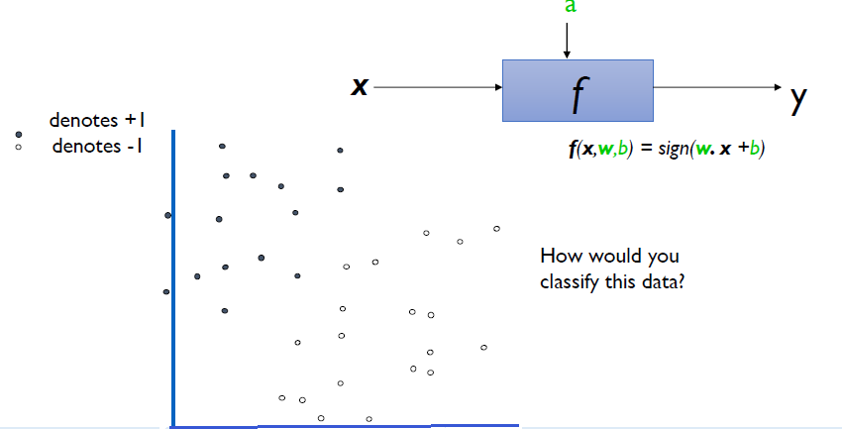
Machine Learning – Support Vector Machines(SVMs)
Support Vector Machines(SVMs):
TCS Internal
4

Slide 5
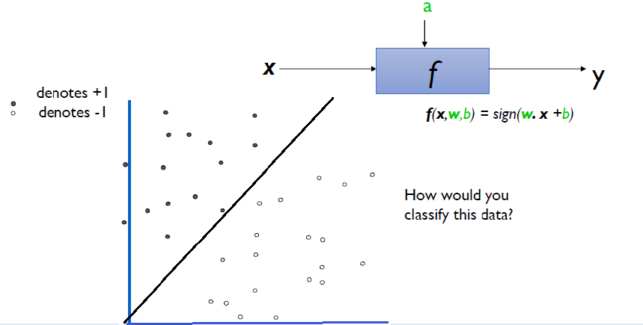
Machine Learning – Support Vector Machines(SVMs)
Support Vector Machines(SVMs):
TCS Internal
5

Slide 6
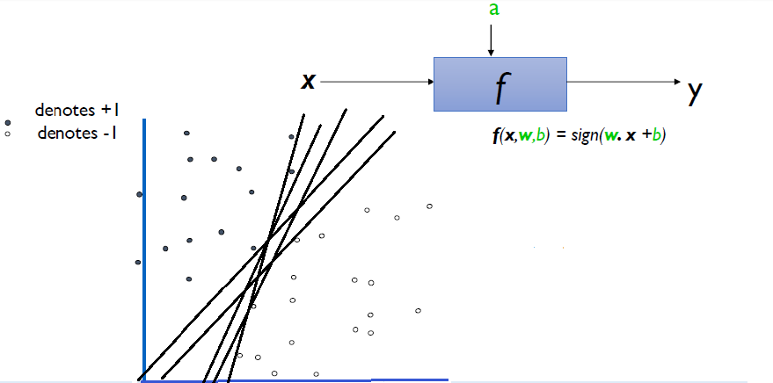
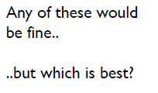
Machine Learning – Support Vector Machines(SVMs)
Support Vector Machines(SVMs):
TCS Internal
6

Slide 7
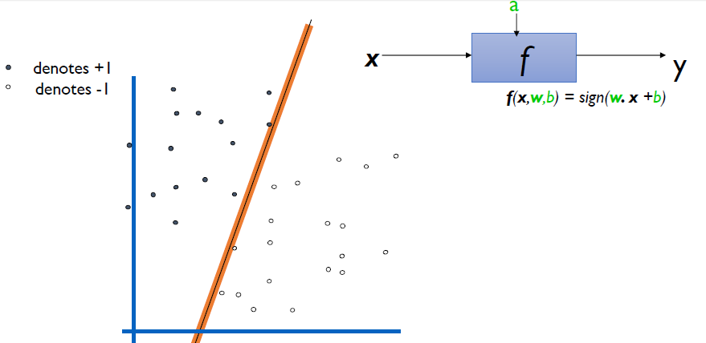
Machine Learning – Support Vector Machines(SVMs)
Support Vector Machines(SVMs):
Define the margin of a linear classifier as the width that the boundary could be increased by before hitting a data point.
TCS Internal
7

Slide 8
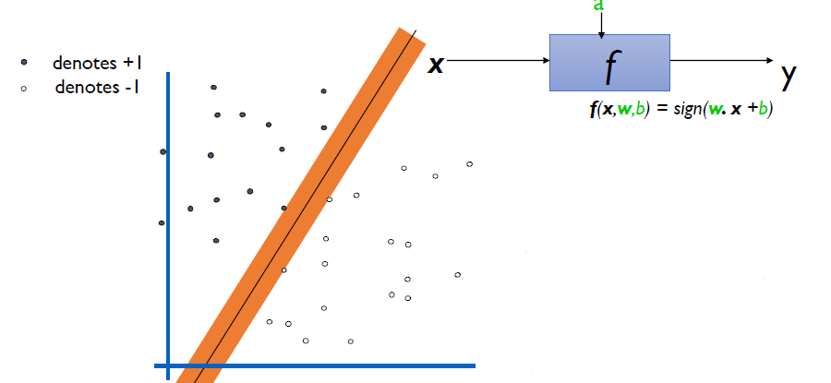
Machine Learning – Support Vector Machines(SVMs)
Support Vector Machines(SVMs):
The maximum margin linear classifier is the linear classifier with the maximum margin the simplest kind of SVM (Called an Linear SVM)
TCS Internal
8

Slide 9
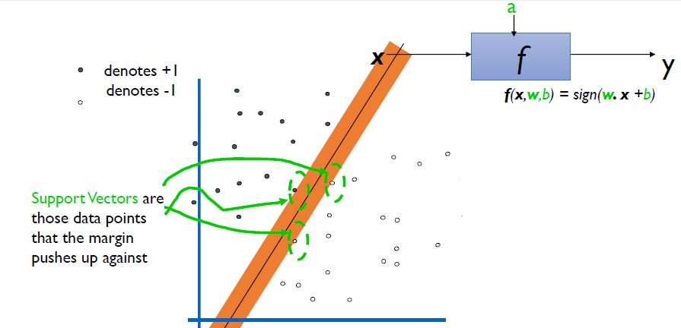
Machine Learning – Support Vector Machines(SVMs)
Support Vector Machines(SVMs):
TCS Internal
9

Slide 10
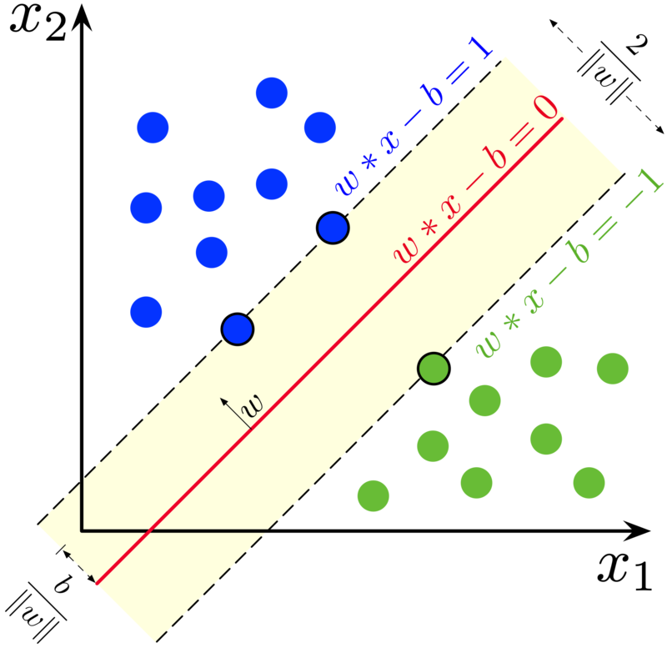
Machine Learning – Support Vector Machines(SVMs)
Support Vector Machines(SVMs):
TCS Internal
10

Slide 11
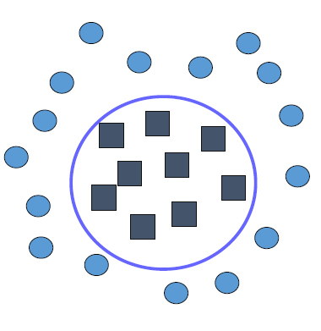
Machine Learning – Support Vector Machines(SVMs)
Support Vector Machines(SVMs): Non Linear data
TCS Internal
11

Slide 12
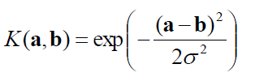
Machine Learning – Support Vector Machines(SVMs)
Support Vector Machines(SVMs): Kernel Functions
The kernel defines the similarity or a distance measure between new data and the support vectors. The dot product is the similarity measure used for linear SVM or a linear kernel because the distance is a linear combination of the inputs.
K(a,b)=(a . b +1)^d is an example of an SVM Kernel Function
Beyond polynomials there are other very high dimensional basis functions that can be made practical by finding the right Kernel Function This is called the Kernel Trick.
  Radial-Basis-style Kernel Function:
  Sigmoidal function
TCS Internal
12

Slide 13
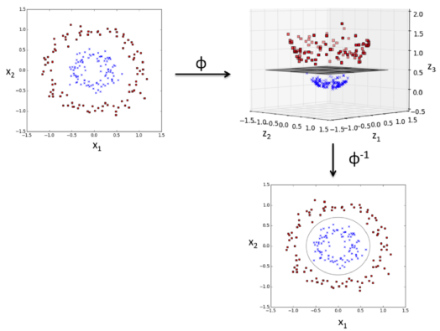
Machine Learning – Support Vector Machines(SVMs)
Support Vector Machines(SVMs): Kernel trick
TCS Internal
13

Slide 14
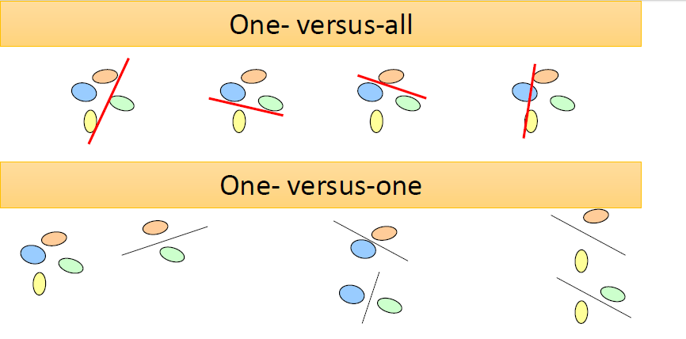
Machine Learning – Support Vector Machines(SVMs)
Support Vector Machines(SVMs): Multiclass classification
TCS Internal
14

Slide 15
Machine Learning – Naive Bayes
Naive Bayes classifier : Example
Census Income Dataset
from sklearn.naive_bayes import GaussianNB
NB = GaussianNB()
NB.fit(X_train, y_train)
GaussianNB(priors=None, var_smoothing=1e-09)
print(NB.predict(X_test))
[' <=50K' ' <=50K' ' >50K' ... ' <=50K' ' <=50K' ' >50K']
print("Naive Bayes Accuracy = ", NB.score(X_test, y_test))
Naive Bayes Accuracy = 0.7850591225549785
TCS Internal
15

Slide 16
Machine Learning – Support Vector Machines(SVMs)
Support Vector Machines(SVMs): Example
from sklearn.svm import SVC
svm = SVC(kernel='linear')
svm.fit(X_train, y_train)
SVC(C=1.0, cache_size=200, class_weight=None, coef0=0.0, decision_function_shape='ovr', degree=3, gamma='auto_deprecated', kernel='linear', max_iter=-1, probability=False, random_state=None, shrinking=True, tol=0.001, verbose=False)
print(svm.predict(X_test))
[' <=50K' ' <=50K' ' <=50K' ... ' >50K' ' <=50K' ' <=50K']
print("Accuracy of Linear SVM = ", svm.score(X_test, y_test))
Accuracy of Linear SVM = 0.7866062548347884
svm_pol = SVC(kernel='poly', degree=4)
svm_pol.fit(X_train, y_train)
print("Accuracy of Polynomial SVM = ", svm_pol.score(X_test, y_test))
Accuracy of Polynomial SVM = 0.5832688694883412
TCS Internal
16

Slide 17
Thank You
December 30, 2019
TCS Internal

