Slide 1
Machine Learning – Dimension Reduction
December 24, 2019
TCS Internal
Notes:
Page No. 1
‹#›

Slide 2
Agenda
Machine Learning – Curse of dimensionality
Machine Learning – principal component analysis
Machine Learning – Independent Component Analysis
Machine Learning – PCA Applications
Machine Learning – ICA Applications
TCS Internal
‹#›
Notes:
Page No. 1
‹#›

Slide 3
Machine Learning – Curse of dimensionality
Curse of dimensionality:
The curse of dimensionality refers to the phenomena that occur when working on high dimensional data that does not occur in low dimensional spaces, specifically the issue of data sparsity and “closeness” of data.
Sparsity of data occurs when moving to higher dimensions. the volume of the space represented grows so quickly that the data cannot keep up and thus becomes sparse. The sparsity issue is a major one for anyone whose goal has some statistical significance.
TCS Internal
‹#›
Notes:
Page No. 1
‹#›

Slide 4
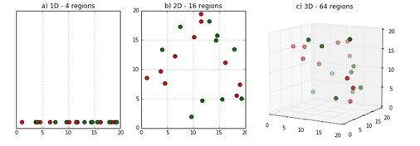
Machine Learning – Curse of dimensionality
Curse of dimensionality:
As the data space seen above moves from one dimension to two dimensions and finally to three dimensions, the given data fills less and less of the data space
TCS Internal
‹#›
Notes:
Page No. 1
‹#›

Slide 5
Machine Learning – principal component analysis (PCA)
Principal Component Analysis (PCA):
Principal Component Analysis (PCA) is the most basic yet important feature transform in feature extraction and dimensionality reduction researches
PCA is to reduce the dimensionality of a data set consisting of many variables correlated with each other, either heavily or lightly, while retaining the variation present in the dataset, up to the maximum extent.
The dataset on which PCA technique is to be used must be scaled
TCS Internal
‹#›
Notes:
Page No. 1
‹#›

Slide 6
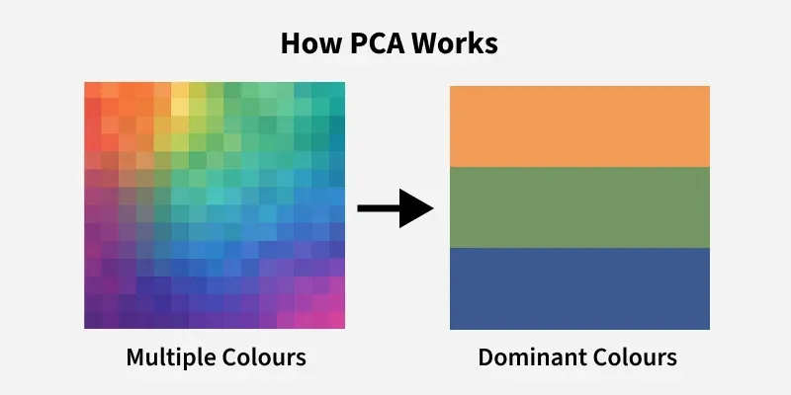
It helps us to remove redundancy, improve computational efficiency and make data easier to visualize and analyze.

Slide 7
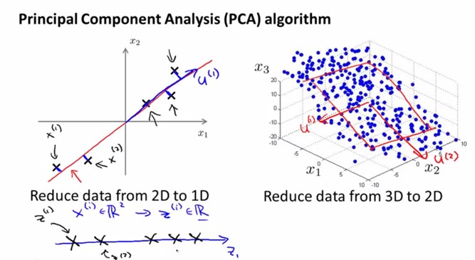
Machine Learning – principal component analysis (PCA)
Principal Component Analysis (PCA):
TCS Internal
‹#›
Notes:
Page No. 1
‹#›

Slide 8
How Principal Component Analysis Works
PCA uses linear algebra to transform data into new features called principal components. It finds these by calculating eigenvectors (directions) and eigenvalues (importance) from the covariance matrix. PCA selects the top components with the highest eigenvalues and projects the data onto them simplify the dataset.

Slide 9
Machine Learning – principal component analysis (PCA)
Principal Component Analysis (PCA):
Dimensionality: The number of random variables or the number of features in a dataset
Correlation: It shows how strongly two variable are related to each other. The value of the same ranges for -1 to +1.
Orthogonal: Uncorrelated to each other, i.e., correlation between any pair of variables is 0.
Covariance Matrix: This matrix consists of the covariances between the pairs of variables
TCS Internal
‹#›
Notes:
Page No. 1
‹#›

Slide 10
Machine Learning – Independent Component Analysis (ICA)
Independent Component Analysis (ICA):
Independent Component Analysis (ICA) is a machine learning technique to separate independent sources from a mixed signal.
principal component analysis(PCA) focuses on maximizing the variance of the data points where as the independent component analysis(ICA) focuses on independence, i.e. independent components.
ICA also performs whitening
TCS Internal
‹#›
Notes:
Page No. 1
‹#›

Slide 11
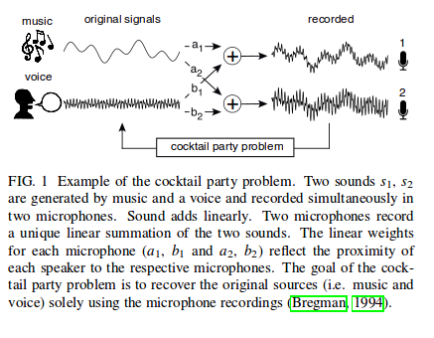
Machine Learning – Independent Component Analysis (ICA)
Independent Component Analysis (ICA):
TCS Internal
‹#›
Notes:
Page No. 1
‹#›

Slide 12
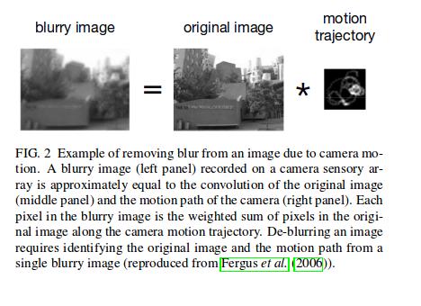
Machine Learning – Independent Component Analysis (ICA)
Independent Component Analysis (ICA):
TCS Internal
‹#›
Notes:
Page No. 1
‹#›

Slide 13
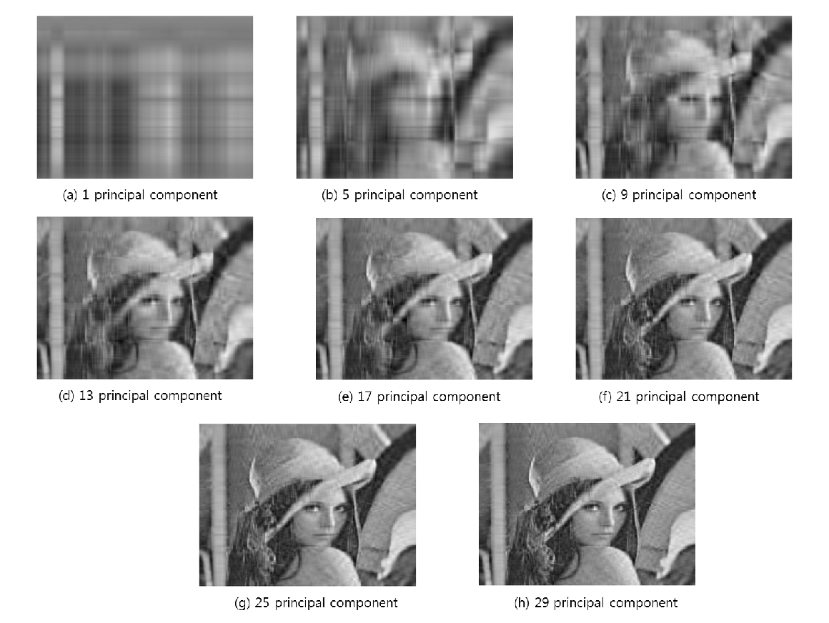
Machine Learning – PCA Applications
PCA Applications: Image compression
TCS Internal
‹#›
Notes:
Page No. 1
‹#›

Slide 14
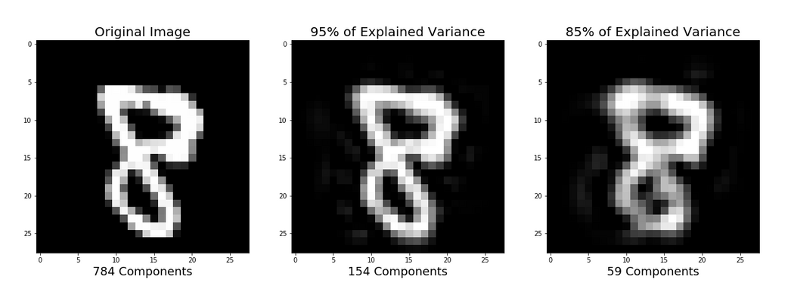
Machine Learning – PCA Applications
PCA Applications: Digits classification
TCS Internal
‹#›
Notes:
Page No. 1
‹#›

Slide 15
Machine Learning – ICA Applications
ICA Applications:
Optical Imaging of neurons
Face recognition
Predicting stock market prices
Mobile phone communications
Removing artifacts, such as eye blinks, from EEG data
Studies of the resting state network of the brain
TCS Internal
‹#›
Notes:
Page No. 1
‹#›

Slide 16
Thank You
December 30, 2019
TCS Internal
Notes:
Page No. 1
‹#›

