Slide 1
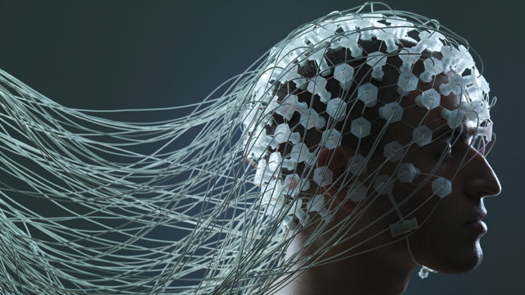
NEUROPROSTHECTICS
BY: SHIVANGI
B.YECH (CS) 5TH SEM- BATCH B
R.NO: 48 (9181) , BTBTC15092

Slide 2
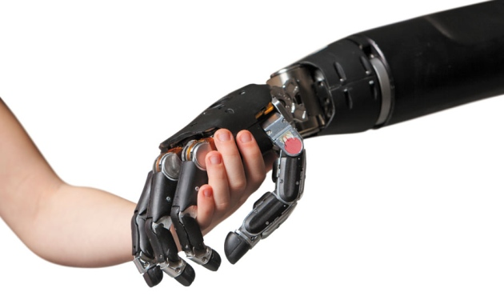
TECHNOLOGY WILL SAVE OUR MINDS AND BODIES

Slide 3
WHAT IS NEUROPROSTHETICS?
Neuroprosthetics (also called neural prosthetics) is a discipline related to neuroscience and biomedical engineering concerned with developing neural prostheses.
In its simplest form, a neuroprosthetic is a device that supplants or supplements the input and/or output of the nervous system.
Neural prostheses are a series of devices that can substitute a motor, sensory or cognitive modality that might have been damaged as a result of an injury or a disease.

Slide 4
WHAT IS NEUROPROSTHETICS?
The neuroprosthetic can act as a bridge between functioning elements of the nervous system and nerves over which control has been lost.
Implantable Devices
Can replace or improve the function of a central nervous system
Examples: Cochlear implant to restore hearing, retinal cortex prostheses for restoring vision, extra sensory inputs

Slide 5
TYPES OF NEUROPROSTHETICS
Sensory Prosthetics:
Pass information into the body’s sensory areas such as sight or hearing.
Motor Prosthetics:
Assist in regulation or stimulation of motor functions with issues, such as using arm and hand to pick up an object.
Cognitive Prosthetics:
If the brain has problem areas, the idea is that cognitive prosthetics will help improve these problems.

Slide 6
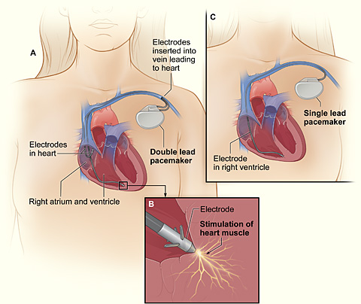
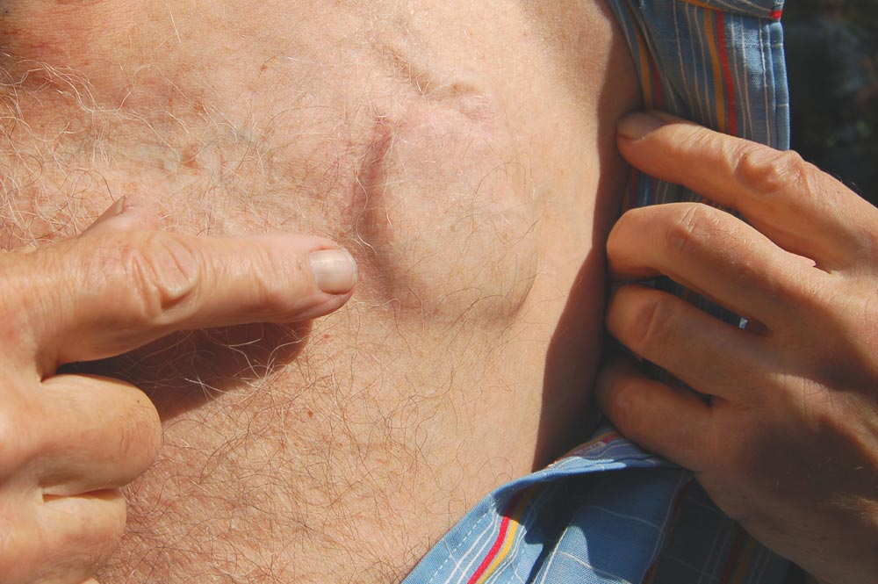
First pacemakers were introduced in the early 1960s.
3 million people use them worldwide.

Slide 7
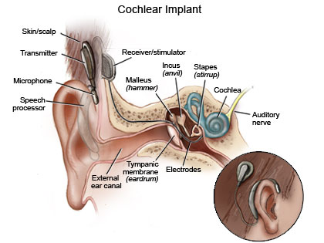
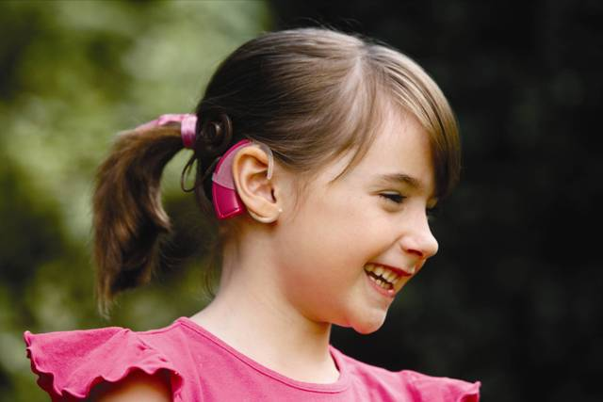
COCHLEAR IMPLANTS:
The neuroprosthetic currently undergoing the most widespread use is the cochlear implant, with over 300,000 in use worldwide as of 2015.
Every year, over 8 Lakh children are born with hearing disabilities, out of which, 1 Lakh are born in India.

Slide 8
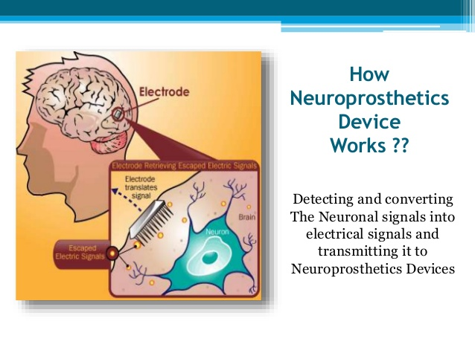

Slide 9
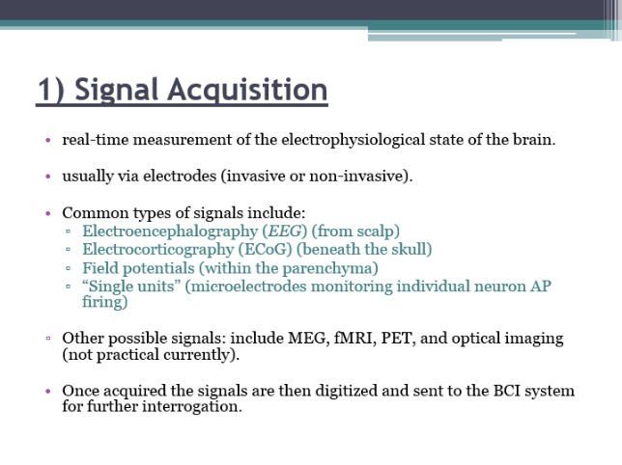
How does a neuroprosthetic work?

Slide 10
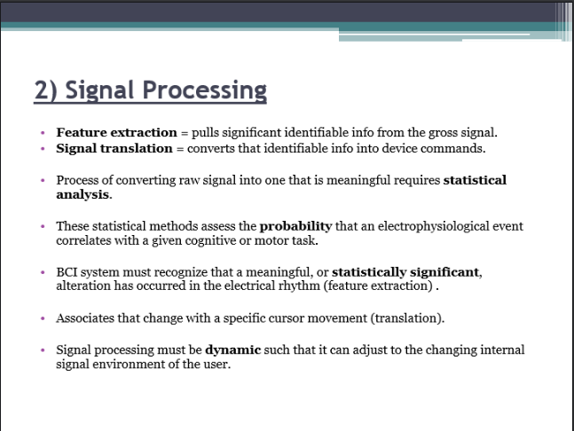
How does a neuroprosthetic work?

Slide 11
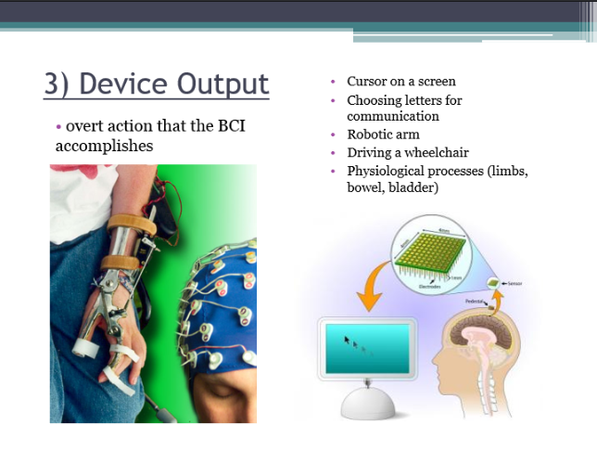
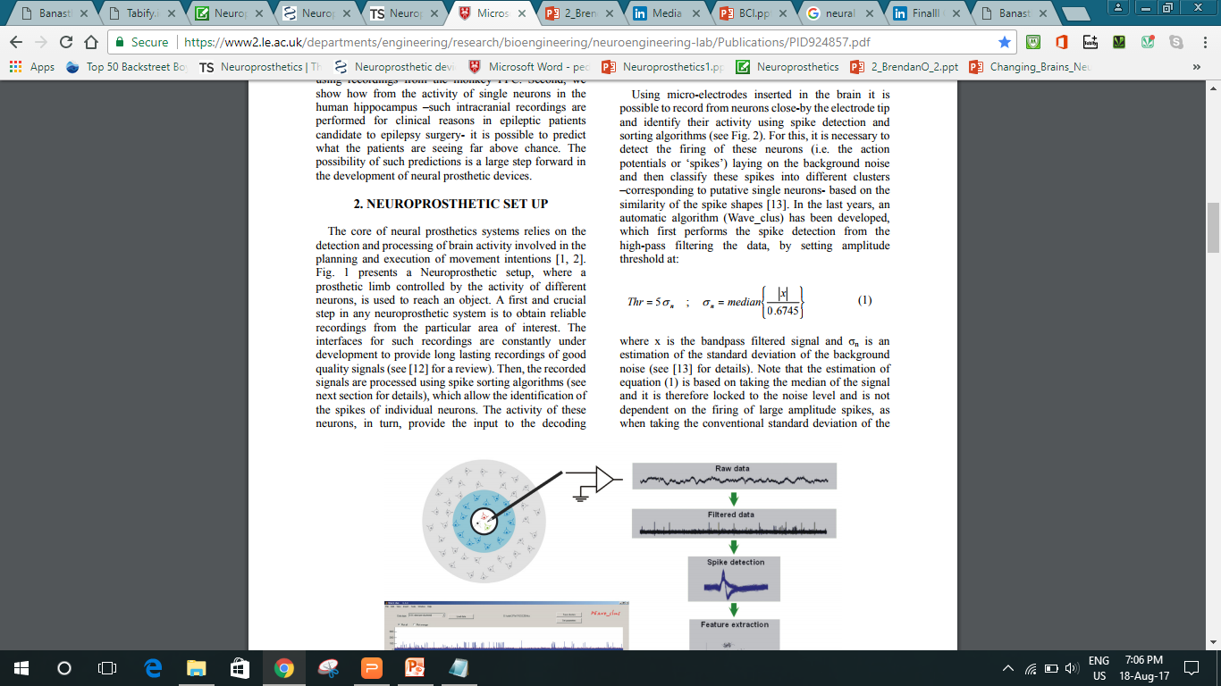
How does a neuroprosthetic work?

Slide 12
GROWTH IN BRAIN-CONTROLLED PROSTHETICS
Researchers began testing brain-controlled prosthetics on animals.
Over past fifteen years, researchers have demonstrated that:
-A robotic arm can be controlled by a rat to push a lever.
-A monkey is able to play a video game.
-The most miraculous achievement in brain-controlled prosthetics to date-a quadriplegic person can sip from a bottle using a straw.

Slide 13
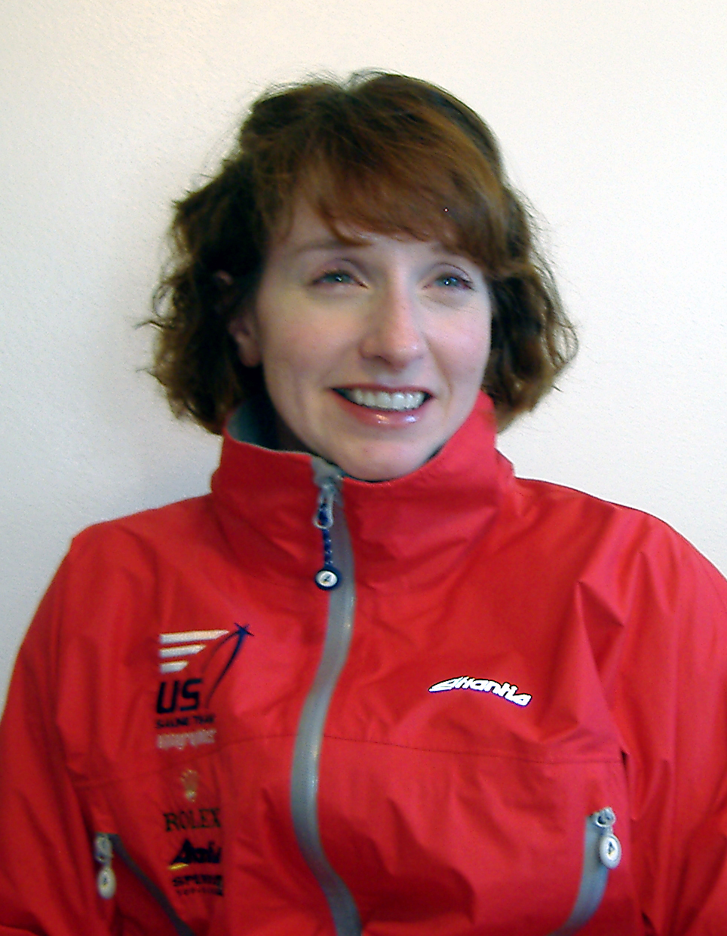

Jennifer French
US Sailing Paralympic Silver Medalist
While snowboarding in 1998, French suffered a severe spinal cord injury that left her a quadriplegic.
The following year she received implants that allowed her to stand and, ultimately, walk down the aisle at her wedding.
She is the first woman to receive an implanted neural prosthetic device allowing her to use paralysed lower limbs.

Slide 14
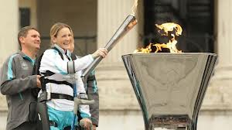
The ReWalk exoskeleton suit uses motorized legs that power knee and hip movement and is controlled by on-board computers and motion sensors, restoring self-initiated walking without needing tethers or switches to begin stepping. ReWalk controls movement using subtle changes in centre of gravity, mimics natural gait and provides functional walking speed. A forward tilt of the upper body is sensed by the system, which triggers the first step. Repeated body shifting generates a sequence of steps, which allows natural and efficient walking. The ReWalk also sits, stands, allows turning and has the ability to climb and descend stairs. Using crutches for support, the user can walk and speak eye-to-eye with others on city streets and also navigate slopes and uneven terrain.

Slide 15
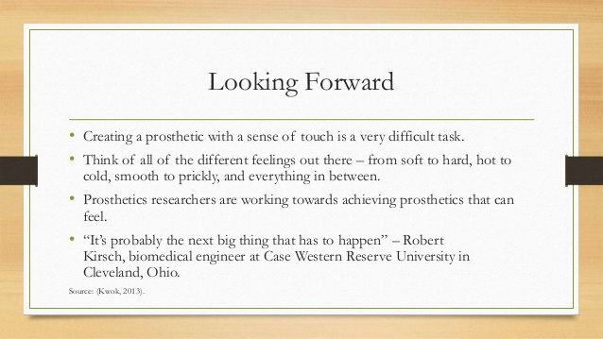

Slide 16
Limitations:
SIZE
POWER CONSUMPTION
DATA TRANSMISSION
ACCURACY
COST

Slide 17
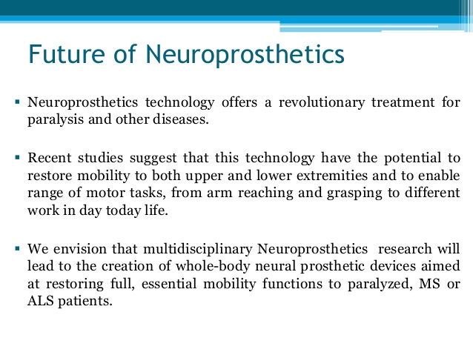

Slide 18
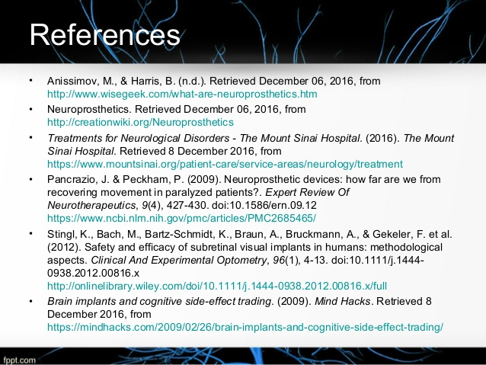

Slide 19
