Slide 1
Denoise brain responses for repeated stories dataset

Slide 2
Motivation
Subject is not attentive towards the story at some instant t
Response is not ideal response – need to detect this
Voxel 1
Voxel 1
Voxel 1
Voxel 2
Voxel 3
repetitions
time
attention

Slide 3
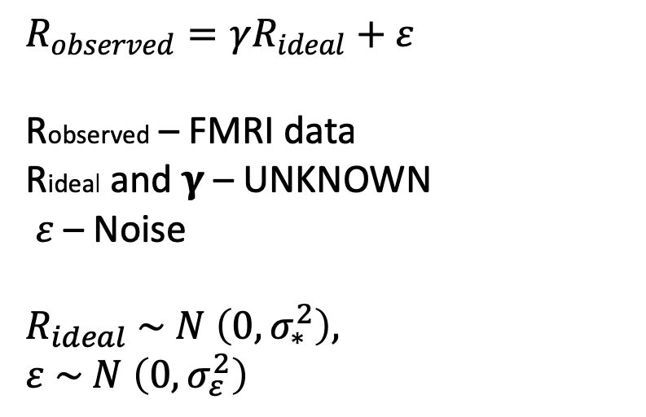
Idea
Assume that brain response with full attention as Rideal
Multiplicative noise 𝛄 – dampens the ideal response at instants when subject is not attentive
$$R_{observed}=γR_{ideal}+ε$$
Robserved – FMRI data
Rideal and 𝛄 – UNKNOWN
$ε$ – Noise
$$R_{ideal} \sim N \left(0,σ_{∗}^{2}\right),$$
$ε \sim N \left(0,σ_{ε}^{2}\right)$
Rideal
Robserved
1
1
1
0.2
1
1
1
𝛄 – noise vector over time
– take values between 0 and 1
– same for all voxels at a given time t
𝛄

Slide 4
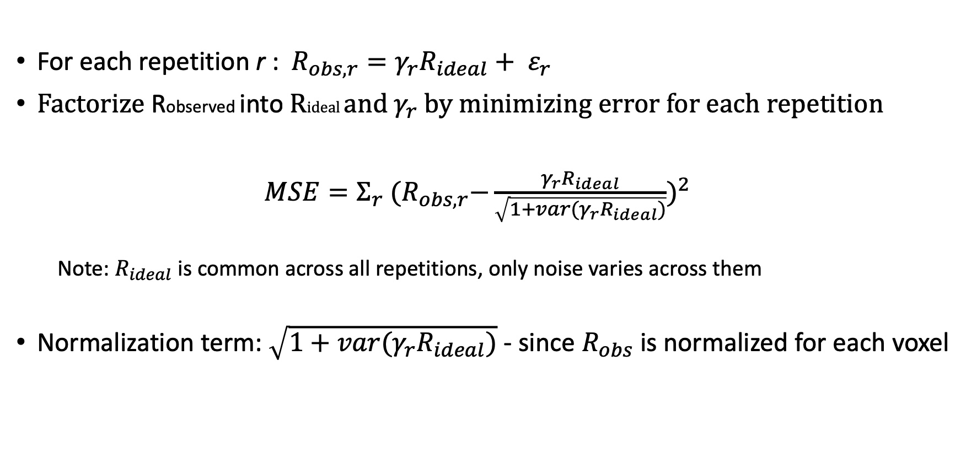
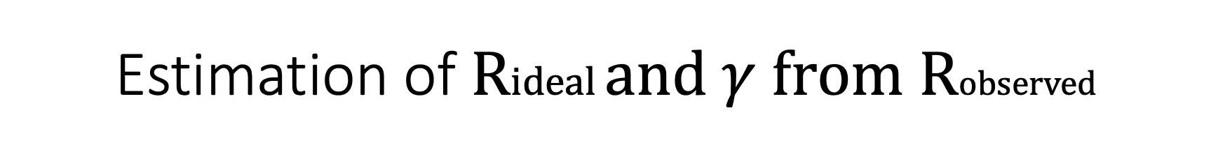
Estimation of Rideal and $γ$ from Robserved
For each repetition r : $R_{obs,r}=γ_{r}R_{ideal}+ ε_{r}$
Factorize Robserved into Rideal and${ γ}_{r}$ by minimizing error for each repetition
$MSE=Σ_{r}$ ${{(R}_{obs,r}−\frac{γ_{r}R_{ideal}}{\sqrt{1+var(γ_{r}R_{ideal})}})}^{2}$
Note: $R_{ideal}$ is common across all repetitions, only noise varies across them
Normalization term: $\sqrt{1+var(γ_{r}R_{ideal})}$ - since $R_{obs}$ is normalized for each voxel

Slide 5
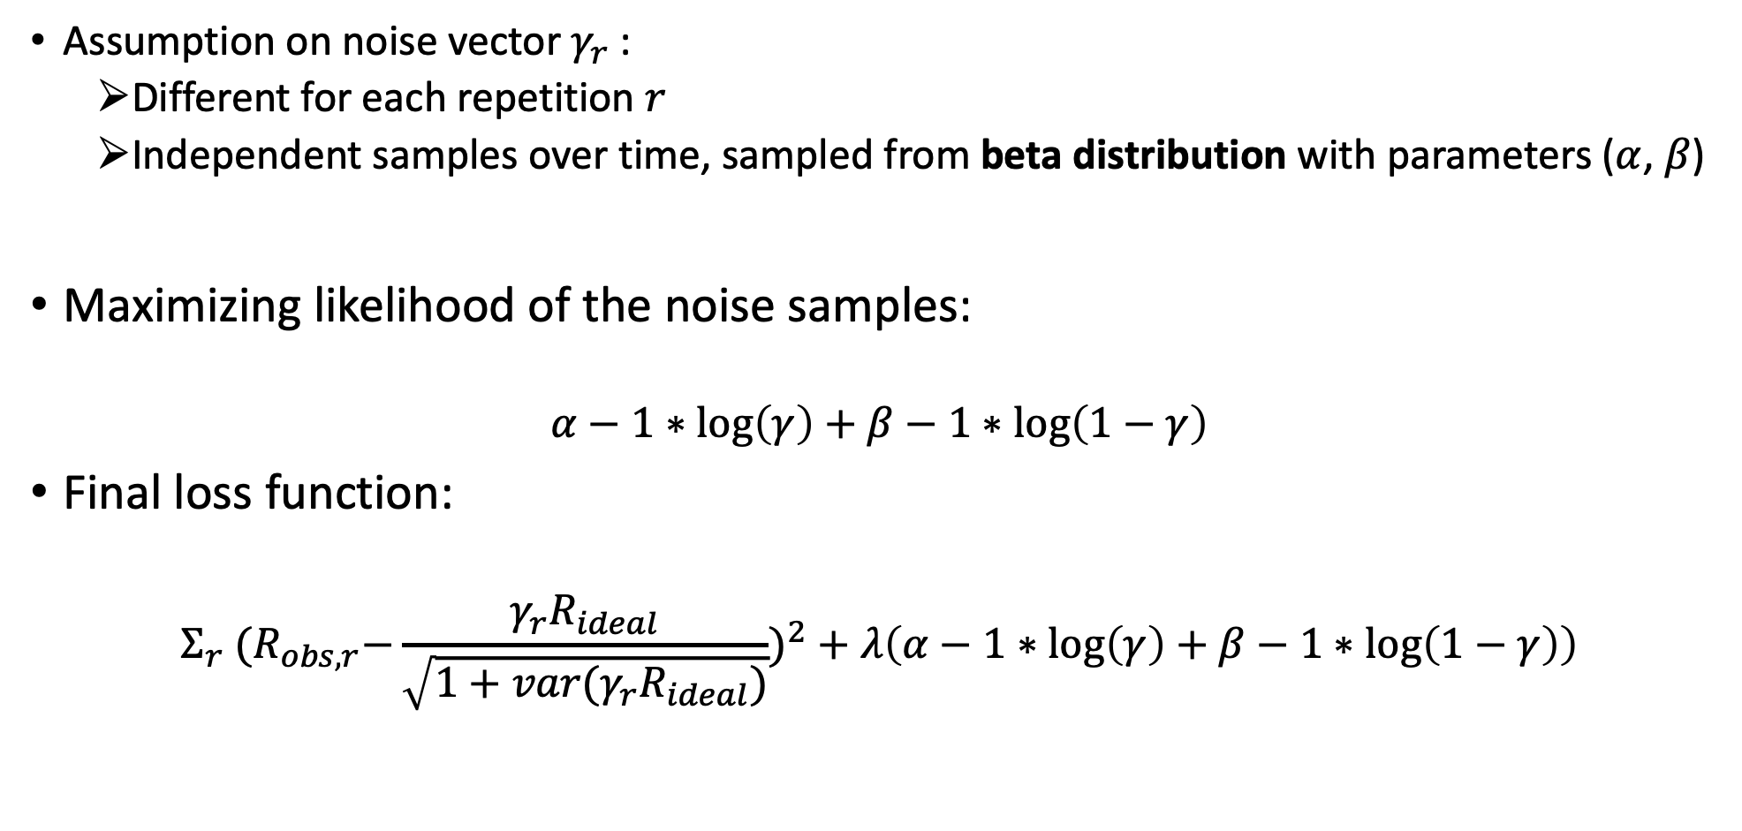
Assumption on noise vector $γ_{r}$:
Different for each repetition $r$
Independent samples over time, sampled from beta distribution with parameters ($α$, $β$)
Maximizing likelihood of the noise samples:
$$α−1∗\log\left(γ\right)+β−1∗\log\left(1−γ\right)$$
Final loss function:
$$Σ_{r} {{(R}_{obs,r}−\frac{γ_{r}R_{ideal}}{\sqrt{1+var(γ_{r}R_{ideal})}})}^{2}+λ\left(α−1∗\log\left(γ\right)+β−1∗\log\left(1−γ\right)\right)$$

Slide 6
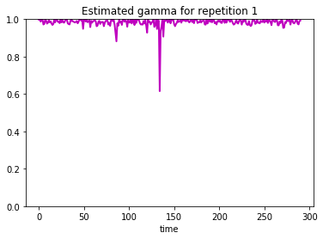
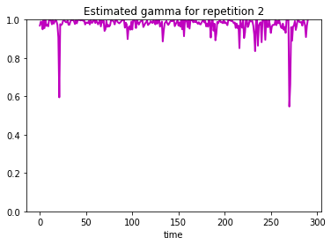
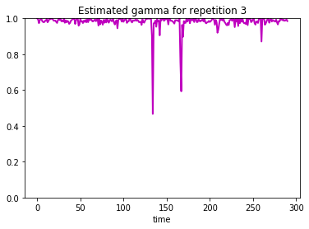


Experiments
Dataset: 10-times repeated ‘wheretheresmoke’ and subject - AA, AHfs, SJ
Divide into two parts: training set (data for any 9 repetitions ), test set (left 1 repetition)
Estimated Rideal and $γ$by minimizing loss function over training set
For AA dataset: 10 repetitions x 291 time x 95556 voxels
$$λ=1e−4, α=8, β=1$$

Slide 7
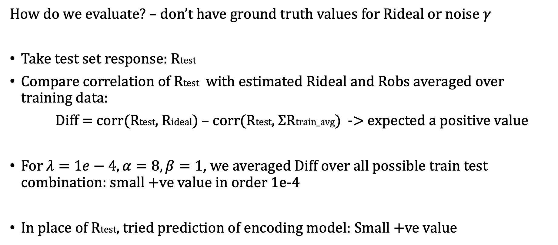
Evaluation
How do we evaluate? – don’t have ground truth values for Rideal or noise $γ$
Take test set response: Rtest
Compare correlation of Rtest with estimated Rideal and Robs averaged over training data:
Diff = corr(Rtest, Rideal) – corr(Rtest, $Σ$Rtrain_avg) -> expected a positive value
For $λ=1e−4, α=8, β=1$, we averaged Diff over all possible train test combination: small +ve value in order 1e-4
In place of Rtest, tried prediction of encoding model: Small +ve value

Slide 8
Next…
How responses varying over repetitions
– analyzing correlation functions in time
Training LM over test repetitions -

