Slide 1
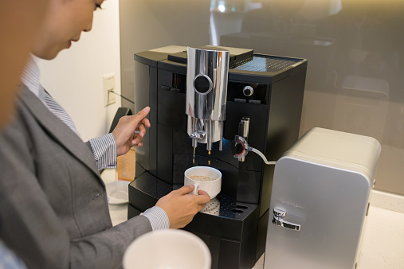
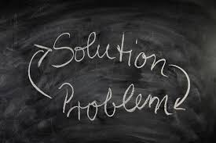
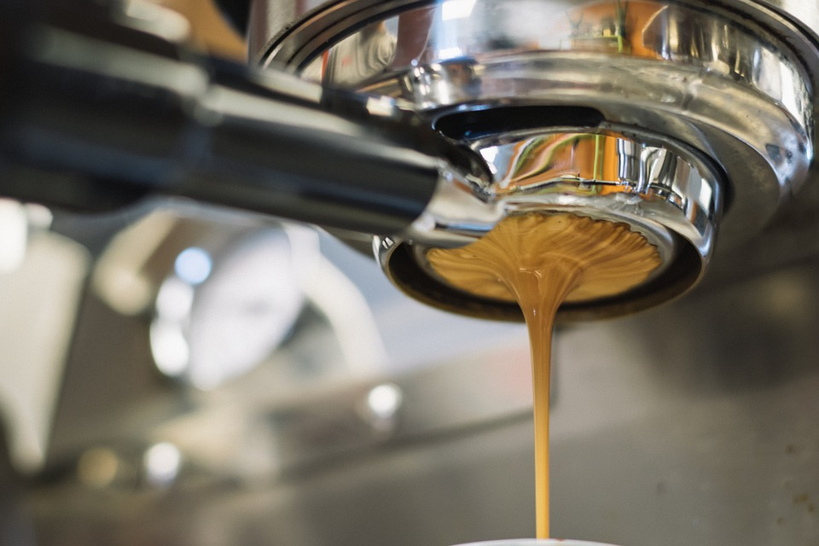
Coffee Maker
Saloni Nayi
Project Description Problem Statement Coffee lipid build-up, if not closely supervised and managed, may become a concern. In exposed areas, the lipids create a black, sticky and bitter-smelling build-up, and if this is not eliminated, the flavor of your coffee will begin to affect it. At the end of each day, automated machines with milk cannisters must be thoroughly cleaned. Also, Slow flow of water into the coffee maker, Resultant brewed coffee does not remain very warm, A leaking coffee maker, Unusual sounds made by the coffee maker. Conclusion In order to easily spread heat produced by the heating coils that are also located in the frame, vents were attached to the base of the maker as a feature. In order to improve the "freshness" aspect of the beverage, a coffee bean grinder may also be installed into the strainer. In order to enforce this properly, more analysis will need to be performed. | Objective/Approach Objective Coffee makers are kind of self-service machines. Usability and user experience as a quality of life will become even more important as the computerization of our everyday life increases. Approach -> Review literature on Coffee Makers, Virtual Coffee makers , etc.. -> Analyze requirements for Automated Coffee Machines templates, Design Overview. ->Define requirements specification and architecture of Caffeine. -> Implement and deploy CM -> Verify and Validate CM
Resources/Schedule | Requirements Benefits (Functional) -> The choice of cup size and brew strength -> delivers a cup of brewed coffee rapidly -> Time Consuming -> Very convenient Constraints (Non-functional) -> The constraints can be size of the coffee maker and the quantity of coffee and water available -> Machine can be stuck -> No correct information if you’re product will be late
Literature Review Report | Janaury 25, 2021
Requirements for UML Diagram | Janaury 25, 2021
Methodology - Use Cases and Architecture | Janaury 25, 2021
Proposal Presentation | Janaury 25, 2021
Thesis Defense | January 26, 2021

