Slide 1
Frontier Airlines
Frontier Airlines
Customer reviews

Slide 2
Customer Review Analysis
- Most reviews are neutral (789), with 216 negative and only 107 positive.
- Common complaints focus on poor customer service, flight experience,
and dissatisfaction.
- Topic Modeling identified three key themes:
1. Customer service issues: "customer," "service," "airlines."
2. Flight experience and recommendations: 'fly', 'frontier', 'airline', 'airlines'
3. Negative experiences: "worst," "horrible," "experience."

Slide 3
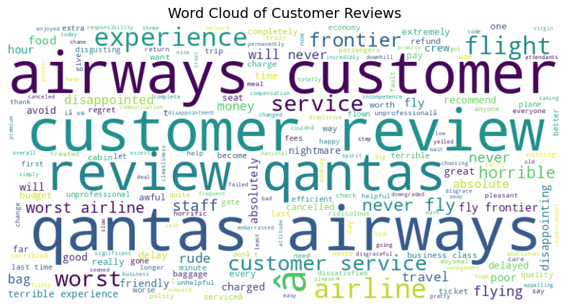
Word cloud visualization shows the most frequently mentioned terms.

Slide 4
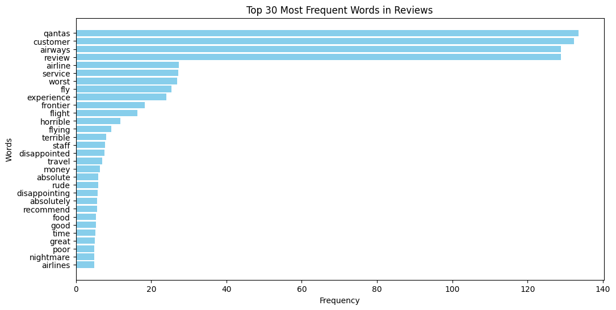
Bar Chart for the most frequent words in reviews

