Slide 1
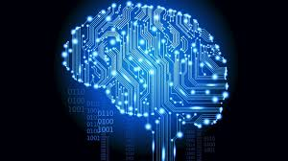


FACIAL RECOGNITION USING DEEP LEARNING
Presented by:
Shivangi Dixit
B.Tech (CS)
Under the supervision of :
External Guide Internal Guide
Dr. Pinaki Roy Chowdhury Mrs. Monika
Scientist - F Assistant Professor
DTRL Lab, DRDO, Delhi Banasthali University

Slide 2
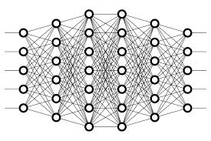
CONTENTS
INTRODUCTION
METHODOLOGY
2.1. DATASETS
2.2. DATA PREPROCESSING AND AUGMENTATION
2.3. DEEP LEARNING
2.3.1. CONVOLUTIONAL NEURAL NETWORKS
2.4. TOOLS
2.5. IMPLEMENTATION
RESULTS
CONCLUSION
5. REFERENCES

Slide 3
INTRODUCTION
Facial Recognition is one of the most researched areas in Computer Vision.
It is a challenging problem because of following factors:
Variation in poses
Presence or absence of components
Illumination
Occlusion
Different expressions
Our goal is to create a Facial Recognition system using Deep Learning which will help to recognise people in more efficient way.

Slide 4
METHODOLOGY
DATASETS
1. ORL Face database
2. JAFFE database
3. Extended Yale Face Database
4. Georgia Tech Face Database
5. Georgia Tech Face Database (Cropped)
6. UMIST Face database (Cropped)
7. UMIST Face database
8. MIT-CBCL Face database
9. Caltech Face Database
10. Caltech Face Database (Cropped)

Slide 5
DATA PREPROCESSING & DATA AUGMENTATION
Rescale - Scale with 1/255 factor
Shear range - For shape transformations
Zoom range - For randomly zooming images
Horizontal flip – For randomly flipping images

Slide 6
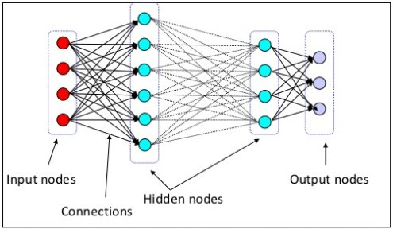
DEEP LEARNING
It is a subfield of machine learning that is concerned with algorithms inspired by the structure and function of the brain called ANNs.
Figure 1: Layers of neural network. Source [4]

Slide 7
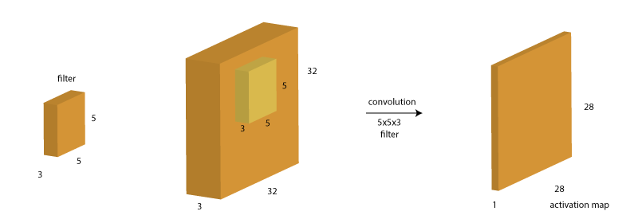
CONVOLUTIONAL NEURAL NETWORKS (CNN)
There are four main operations in the CNNs :
1. Convolution
Figure 2: The Convolution operation. Source [3]

Slide 8
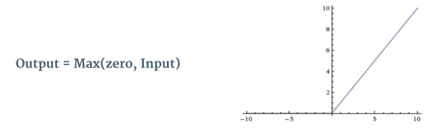
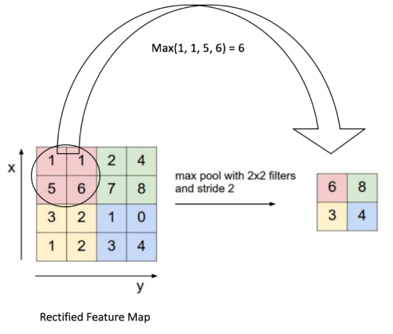
2. ReLU Layer
Figure 3: The ReLU operation. Source [5]
3. Pooling or Sub Sampling
Figure 4: Max Pooling. Source [6]

Slide 9
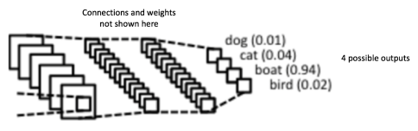
4. Classification (Fully Connected Layer)
Figure 5: Fully Connected Layer. Source [5]

Slide 10
TOOLS
Anaconda (Python Distribution)
- Open source
- Used for data processing, predictive analytics
Spyder
- IDE for Python
Keras (with Theano Background)
- Neural Network API
- Used as a Deep Learning library

Slide 11
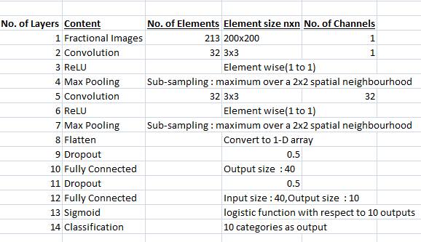
IMPLEMENTATION
We have used following CNN architectures for our 10 datasets:
1. Jaffe Face Database
batch size : 5
epochs : 100
Table 1: CNN architecture for Jaffe face database

Slide 12
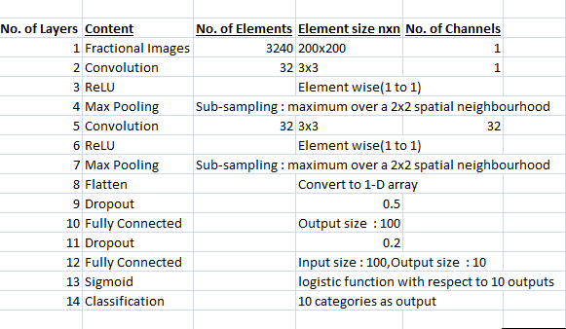
2. MIT-CBCL Face Database
batch size : 15
epochs : 100
Table 2: CNN architecture for MIT-CBCL face database

Slide 13
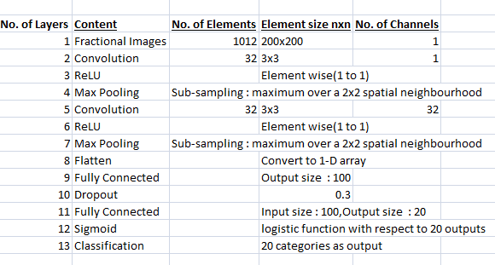
3. UMIST Face Database
batch size : 5
epochs : 100
Table 3: CNN architecture for UMIST face database

Slide 14
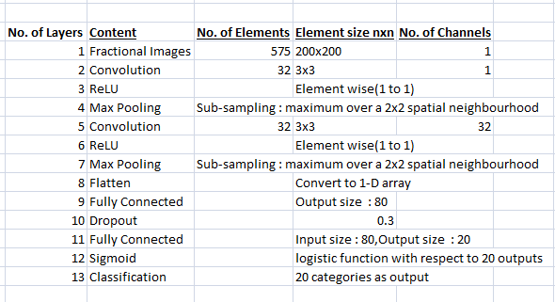
4. UMIST-Cropped Face Database
batch size : 5
epochs : 100
Table 4: CNN architecture for UMIST-Cropped face database

Slide 15
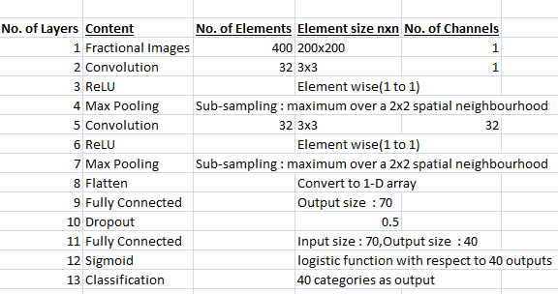
5. ORL Face Database
batch size : 2
epochs : 100
Table 5: CNN architecture for ORL face database

Slide 16
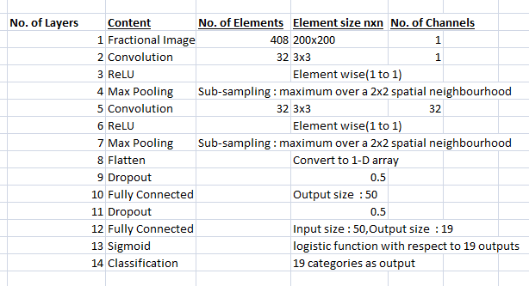
6. Caltech Face Database
batch size : 10
epochs : 100
Table 6: CNN architecture for Caltech face database

Slide 17
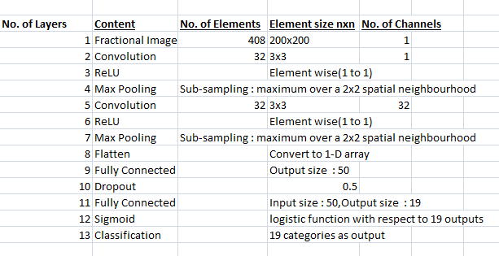
7. Caltech Cropped Face Database
batch size : 10
epochs : 100
Table 7: CNN architecture for Caltech Cropped face database

Slide 18
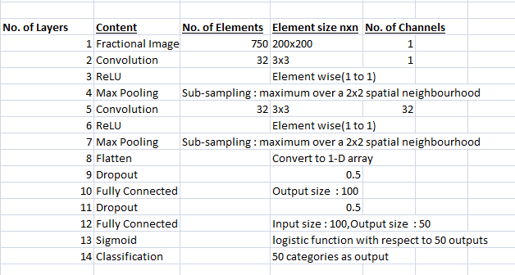
8. Georgia Tech Face Database
batch size : 5
epochs : 100
Table 8: CNN architecture for Georgia Tech face database

Slide 19
9. Georgia Tech (Cropped) Face Database
batch size : 5
epochs : 100
Table 9: CNN architecture for Georgia Tech(Cropped) face database

Slide 20
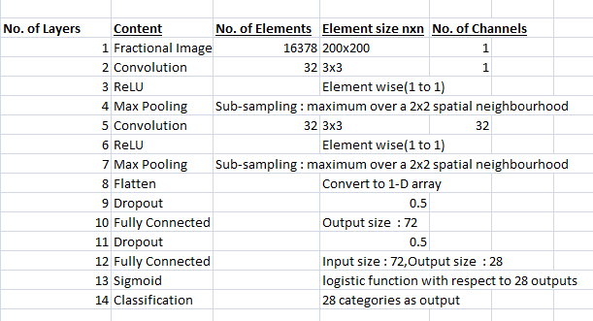
10. Extended Yale Face Database
batch size : 64
epochs : 50
Table 10: CNN architecture for Extended Yale B face database

Slide 21
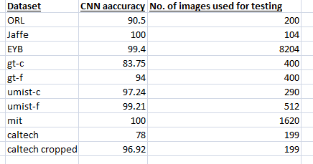
RESULTS
1. Accuracy comparison of different face datasets :

Slide 22
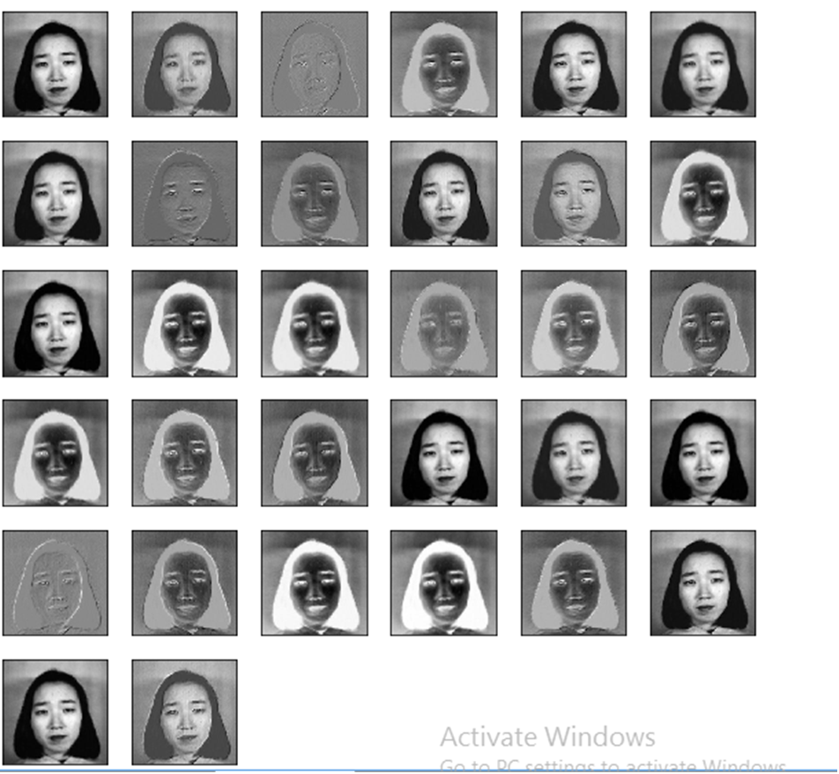
2. Visualization of CNN layers
i) Output after 1st Convolutional Layer

Slide 23
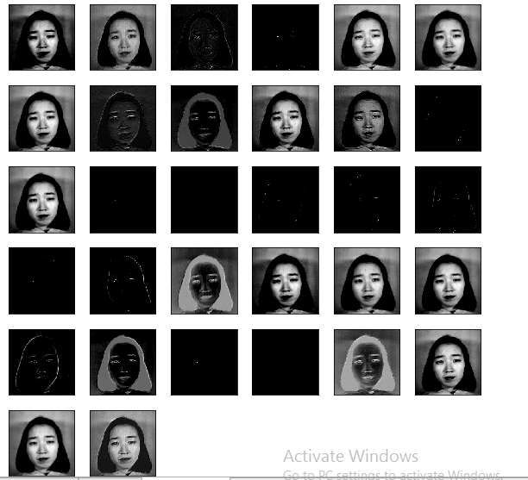
ii) Output after 1st ReLU Layer

Slide 24

iii) Output after 1st Pooling Layer

Slide 25
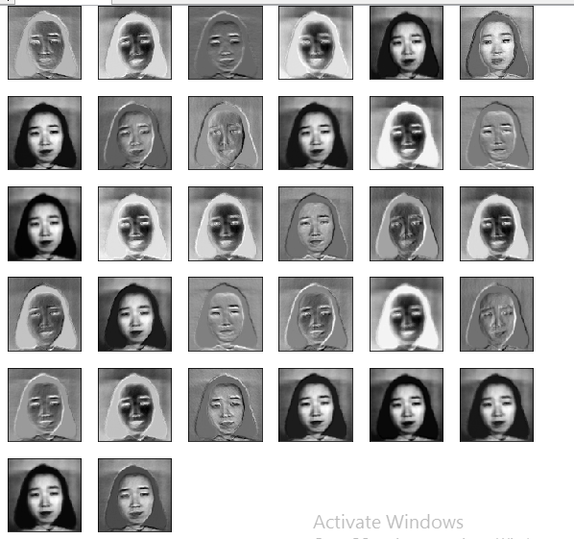
iv) Output after 2nd Convolutional Layer

Slide 26
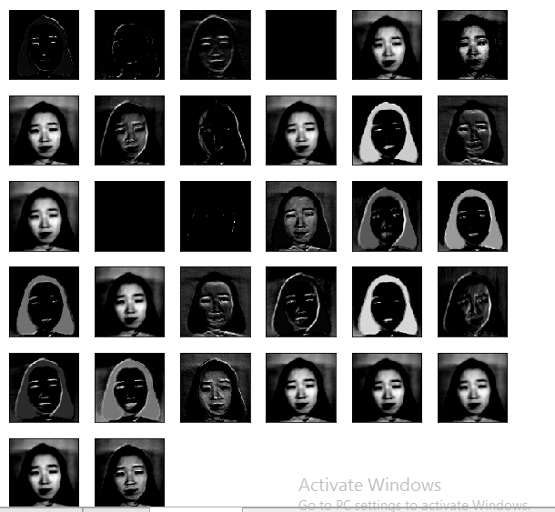
v) Output after 2nd ReLU Layer

Slide 27
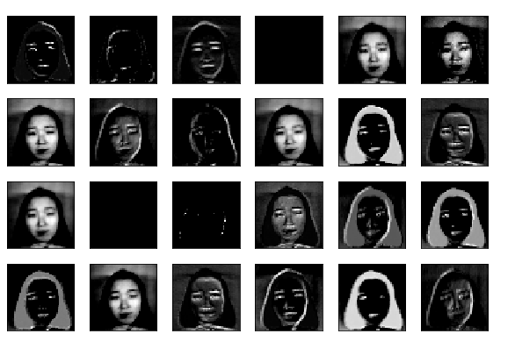
vi) Output after 2nd Pooling Layer

Slide 28
CONCLUSION
We evaluated the impact of different architectures of CNNs on different face databases.
Results demonstrated that deep CNNs are capable of learning facial characteristics very well as compared to other existing methods.
We have obtained 90% of accuracy for most of the datasets and 100% accuracy for 2 datasets.
Because of great results that CNNs give, now-a-days they are used in solving real life problems.

Slide 29
REFERENCES
1. D.R.Hush, B.G.Horne (1993). Progress in Supervised Neural Networks. IEEE Signal Processing Magazine ( Volume: 10, Issue:1, Jan. 1993 ). https://doi.org/10.1109/79.180705.
2. Omkar M. Parkhi, Andrea Vedaldi, Andrew Zisserman(Jan, 2015). Deep Face Recognition. Published in Conference: British Machine Vision Conference 2015. https://doi.org/10.5244/C.29.41.
3. https://www.analyticsvidhya.com/blog/2016/04/deep-learning-computer-vision-introduction-convolution-neural-networks/
4. https://www.kdnuggets.com/2016/01/seven-steps-deep-learning.html
5. https://ujjwalkarn.me/2016/08/11/intuitive-explanation-convnets/
6. http://cs231n.github.io/convolutional-networks/

Slide 30

The End...

