Slide 1
Project Title: Fraud Detection in Financial Transactions
Group Members:
Bista, Hirendra (M.S. Geography)
Borad, Shivangi Vipulbhai
Keesari, Suma Reddy
Podduturu, Pooja ( M.S. Health Data Analytics)
Ramineni, Madhumitha Chowdary

Slide 2
Goal: To build a machine learning model to predict fraudulent financial transactions.
Project Objectives
Fraud Detection using machine learning
Handle class imbalance responsibly
Compare and contrast models for classification
Tune the probability thresholds for maximum recall
Identify and select important driving features of fraud
Give recommendations for potential business changes that can be made.

Slide 3
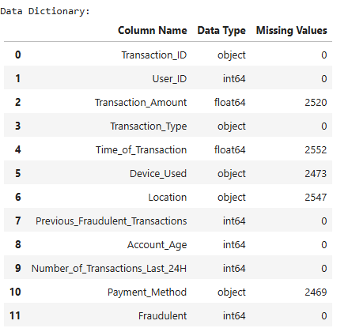
Dataset Overview
Total Features: 12
Target Variable: Fraudulent (0 = Not Fraud, 1 = Fraud)
Data Understanding & Initial Observations
There​‍​‌‍​‍‌​‍​‌‍​‍‌ are missing values mostly in the categorical fields.
Fraud rate is low → high class imbalance
Important behavioral variables:
Hours since last transaction Number of transactions in last 24 hours
Device used

Slide 4
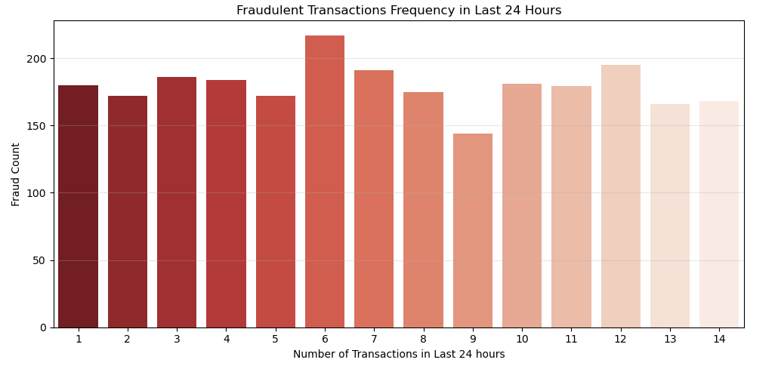
Fraud Frequency Based on Last 24-Hour Transaction Count
Trend Overview
The​‍​‌‍​‍‌​‍​‌‍​‍‌ chart illustrates the variation in fraud counts by the number of transactions a user made in the last 24 hours.
Fraud counts are mainly consistent around most transaction frequencies.
Key Insight
Fraud count at 6 transactions sharply rises to over 200, which is quite a lot higher than other points. It means that users with moderately high activity might be those who are in a higher fraud risk.
Velocity Feature Importance
The variable Number_of_Transactions_Last_24H is considered a velocity feature.
Velocity features indicate the speed or frequency of user transactions and are typically used in fraud detection.
Business Interpretation
Users with increased transaction activity may exhibit more fraudulent behavior.
Could indicate:
  Bot-like or automated activity
  Card testing attempts
  Rapid-fire transactions making it hard to ​‍​‌‍​‍‌​‍​‌‍​‍‌track

Slide 5
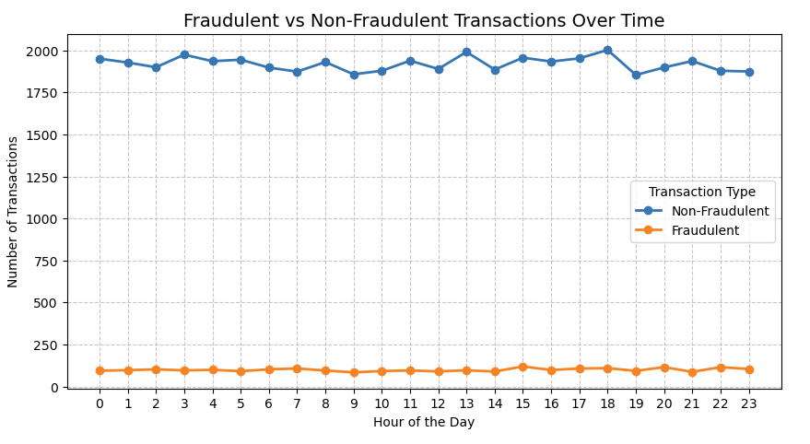
Key EDA Findings
Fraudulent vs Non-Fraudulent Transactions Over Time
The​‍​‌‍​‍‌​‍​‌‍​‍‌ line diagram illustrates the hourly changes in the number of transactions that were made throughout a day (0–23 hours)
Non-fraudulent transactions are always significantly more than fraudulent ones, fluctuating around 1850–2000 per hour.
Fraudulent transactions are kept at a minimal level but are consistent, with an average of 80–120 per hour for most hours.
The rise of fraudulent transactions around the 15–17 hours is only slight and implies that these could be the periods of high-risk.
As a result of the analysis of the two types of transactions, it has been established that they both have the same hourly patterns, which shows that fraud is usually committed during the hours when there is a high volume of transactions.
Business Insight: Fraudsters tend to blend in with normal traffic—just watching for volume spikes is not enough. We need behavior-based detection models.
Model's implication: The time-of-day feature is useful, but not very strong when taken alone. Prediction accuracy will be better if it is combined with user-level and transaction-level ​‍​‌‍​‍‌​‍​‌‍​‍‌variables.

Slide 6
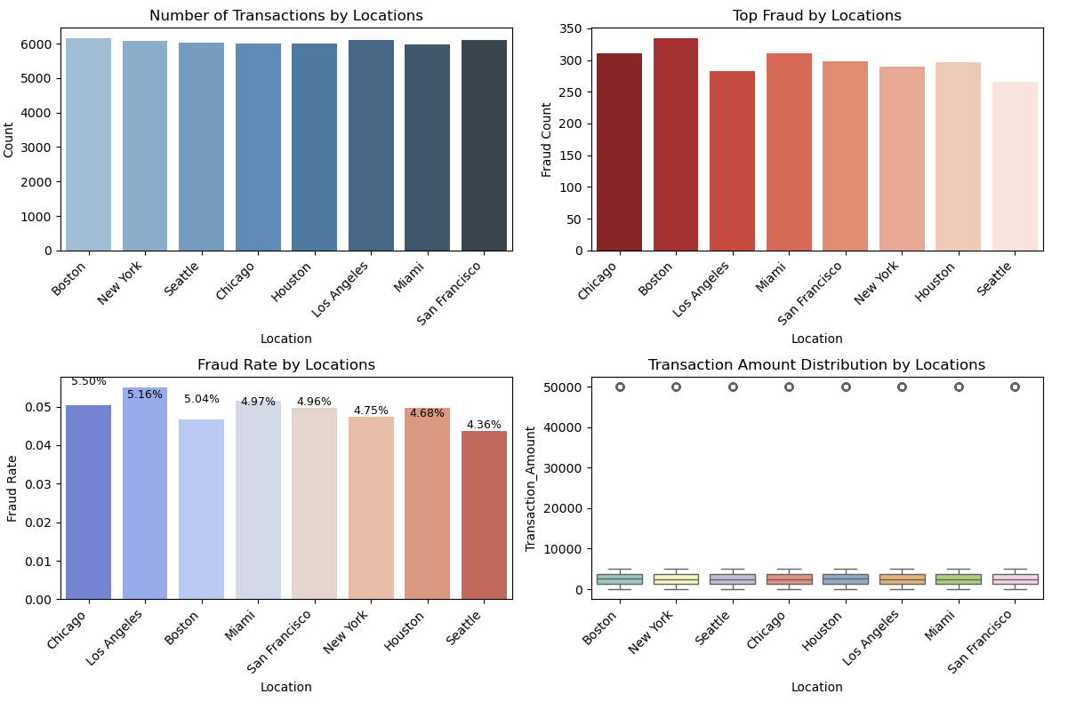
Fraud Patterns Across Different Locations
All​‍​‌‍​‍‌​‍​‌‍​‍‌ cities are displaying a high and comparable number of transactions (each around 5800–6200).
The text states that the overall customer activity is very close to being a perfect distribution of locations.
Top Fraud Counts by Location
Los Angeles, Boston, and Miami are three cities that show the most significant number of fraudulent transactions.
The number of fraud cases is not that of total transactions, which tightly follow, thus suggesting that there are location-specific risk factors that cause fraud.
Fraud Rate (%) by Location
Chicago leads the pack with the highest fraud rate (5.5%) while Los Angeles (5.16%) follows the city closely.
Even those cities that have fewer total transactions (e.g., Seattle) are not free of fraud cases, which means fraud risk is a matter of transaction volume only.
Is a clear indication of the possible existence of different types of patterns - fraud ones that are behavioral, demographic, or regional.
Transaction Amount Distribution (Box Plot)
The amount of transactions are quite close for all the cities.
There is no specific city that has either extremely high or low transaction amounts.
This brings us to the conclusion that fraud is not a result of the differences in transaction value across various locations.

Slide 7
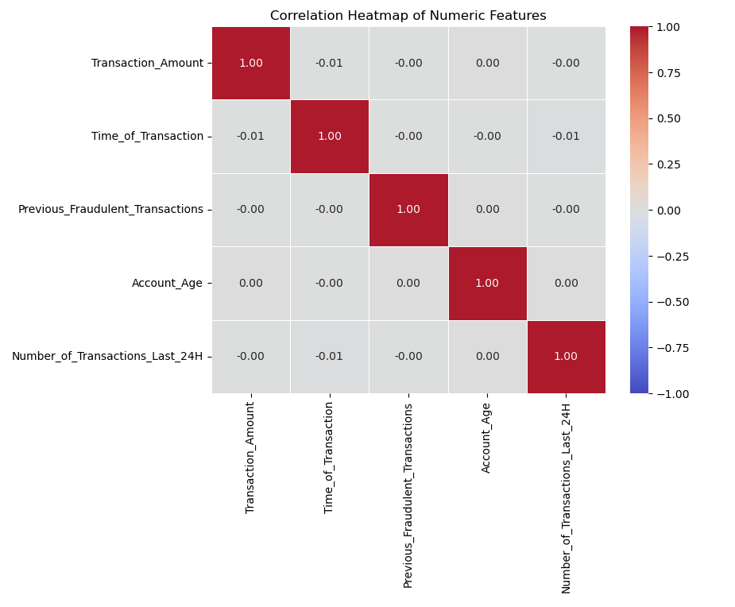
Correlation Analysis of Numeric Features
The​‍​‌‍​‍‌​‍​‌‍​‍‌ heatmap displays the correlation of the key numeric variables that were used in the fraud detection dataset.
Each feature has very low or close to zero correlation with the other features.
No pair of features show strong linear dependency — this implies that the dataset has low multicollinearity. Each variable can be considered as a potential source of unique, non-overlapping information for the model.
Some of the useful features like:
  Transaction_Amount
  Time_of_Transaction
  Previous_Fraudulent_Transactions
  Account_Age
  Transactions_Last_24H
  are all independently informative.
Business / Modeling Insight
As the features are not strongly interrelated, the model is able to detect different fraud patterns from each variable. This feature of the model helps to prevent redundancy and, thus, increases the model's stability and its ​‍​‌‍​‍‌​‍​‌‍​‍‌interpretability.

Slide 8

Data Cleaning & Preprocessing(Part 1)
Cleaning Steps:
1. Checked missing values
2. Verified datatypes for each feature
3. Removed inconsistent entries
4. Standardized formats for categorical fields
Data Cleaning & Preprocessing (Part 2)
Preprocessing Steps:
One-hot encoding for:
  Transaction Type
  Device Used
  Payment Method
Engineered new feature:
  Hours_Since_Last_Transaction
  Train–test split applied
  Threshold tuning instead of oversampling

Slide 9
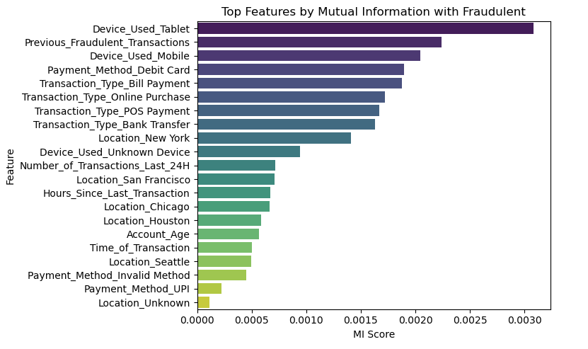
Mutual Information Ranking of Important Features
Mutual​‍​‌‍​‍‌​‍​‌‍​‍‌ Information was the method that was employed to assess the extent of association between each feature and fraudulent behavior.
The device-related variables (Tablet, Mobile, Unknown Device) have been demonstrated to possess a high predictive power for the detection of fraud.
In addition, the transaction type categories, e.g., Bill Payment, POS Payment, Online Purchase, and Bank Transfer, also have a significant contribution.
Furthermore, the behavioral indicators like Number_of_Transactions_Last_24H and Hours_Since_Last_Transaction are two examples of fraud-detection methods that can be used to acquire additional value.
These non-zero MI features were chosen for modeling because they are able to capture significant patterns of fraud in the ​‍​‌‍​‍‌​‍​‌‍​‍‌transactions.

Slide 10

Model Training and Prediction
Model Training Process
Four supervised learning models were trained: Logistic Regression, Decision Tree, Random Forest, XGBoost
Data used was preprocessed with categorical variables encoded and behavioral features created
Training and validation sets were made to keep the class distribution
Fraud detection recall was improved by probability threshold tuning (from 0.50 → 0.20)
Prediction Workflow
Probability scores for fraud likelihood were produced by each model
Predictions were evaluated with key metrics: Accuracy, Precision, Recall, F1-Score, ROC–AUC
By using a lower threshold (0.20) the models were able to identify more fraud case
The final predictions demonstrated that XGBoost was the best performing method in the case of fraudulent transaction ​‍​‌‍​‍‌​‍​‌‍​‍‌identification.

Slide 11
Model Evaluation
Evaluation Metrics Used
Accuracy – overall correctness
Precision – correctness of fraud predictions
Recall – ability to catch actual fraud cases (most important metric)
F1-Score – balance between precision and recall
ROC–AUC – discrimination ability between fraud & non-fraud
Confusion Matrix – prediction breakdown per model
Model Performance Comparison
Key Findings
XGBoost achieved the highest F1 Score (0.3673)
  Best balance between precision + recall
  Very important for imbalanced data like fraud detection
XGBoost shows strong Recall (0.8310)
  Catches most fraudulent transactions
  Critical because missing fraud is costlier than false alarms
Highest ROC-AUC (0.8509) for XGBoost
  Best separation between fraud and non-fraud
  Indicates strong ranking ability under class imbalance
Other Models Have Weaknesses:
  Logistic Regression: very high recall but poor precision → too many false alarms
  Random Forest: almost classifies everything as fraud → unusable precision
  Decision Tree: unstable and low precision

Slide 12
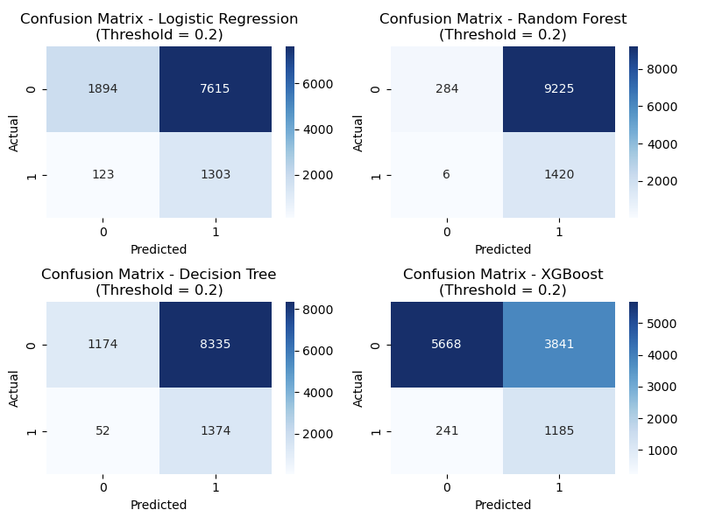
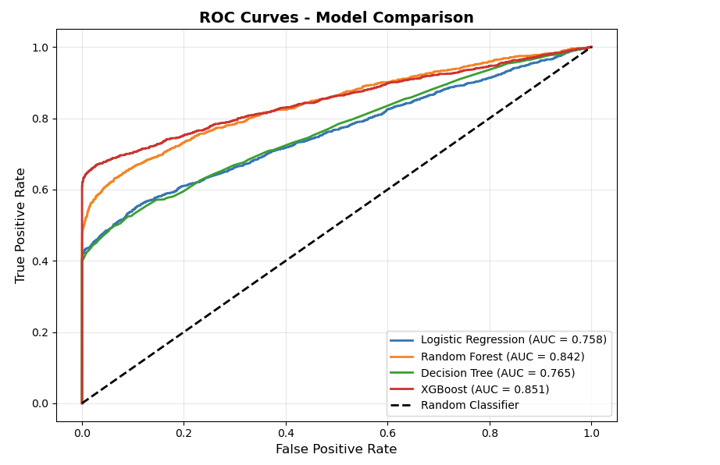
Confusion​‍​‌‍​‍‌​‍​‌‍​‍‌ Matrix Insights
Interpretation
By far, XGBoost delivers the most balanced prediction results
Unlike Random Forest & Logistic Regression, it does not label all transactions as fraud
Identifies fraud cases even as it keeps a large number of true normal transactions intact
Displays appropriate treatment of the issue of severe class imbalance
ROC Curve Comparison
Interpretation
XGBoost is a model whose curve is always on top of the other models'
It signals an excellent tradeoff between true positives and false positives
At the same time, it has the strongest capability of detecting fraud over the different ​‍​‌‍​‍‌​‍​‌‍​‍‌thresholds

Slide 13
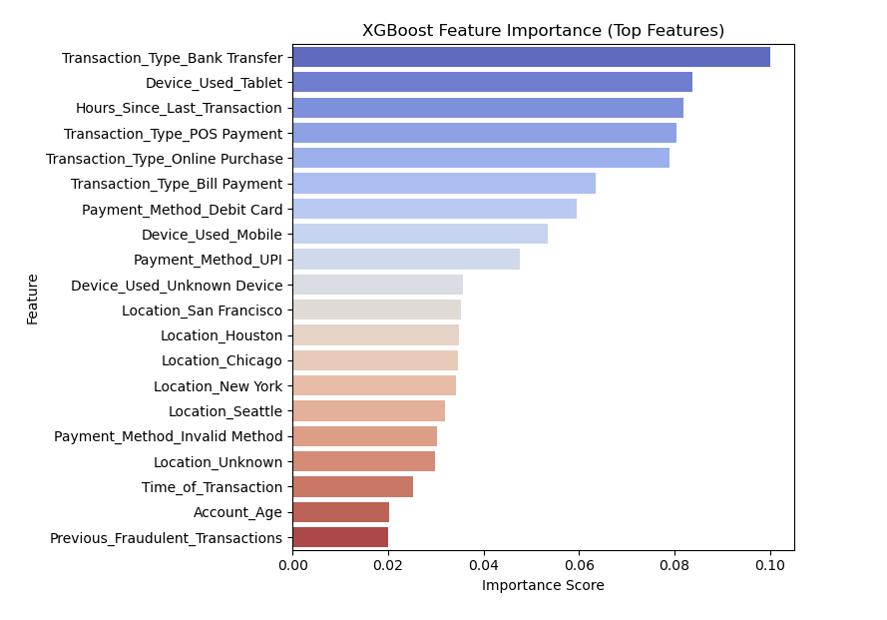
Feature Importance & Explainability
Why​‍​‌‍​‍‌​‍​‌‍​‍‌ Feature Importance Matters
Feature importance helps to determine which features have the greatest impact on fraud prediction. It also provides insight into the workings of the model by showing the rationale behind the model's decisions. The knowledge of feature importance thus allows business teams to come up with the most efficient anti-fraud measures that are focused on a specific area.
Key Findings from XGBoost Feature Importance
Top Predictors of Fraud
Transaction_Type_Bank Transfer – strongest fraud indicator
Device_Used_Tablet
Hours_Since_Last_Transaction
Transaction_Type_POS Payment
Transaction_Type_Online Purchase
Payment_Method_Debit Card / UPI
Device_Used_Mobile / Unknown Device
Interpretation
Transactional​‍​‌‍​‍‌​‍​‌‍​‍‌ behavior and device usage are the primary factors that have led to fraud.
Most of the time, fraud-related behavior is dictated by the interplay of timing e.g., Hours_Since_Last_Transaction has the major role.
Fraudsters use risky transaction types to a greater extent and also, they use less secure devices.
Location-based factors (San Francisco, Houston, Chicago, etc.) have a moderate impact on the situation.
On the other hand, traditional data (Account Age, Previous Fraud Cases) are less ​‍​‌‍​‍‌​‍​‌‍​‍‌indicative.

Slide 14

Key Insights from Fraud Analysis
Behavioral Patterns
Fraud is strongly linked to transaction timing, especially short intervals between consecutive payments
→ Higher fraud likelihood when customers perform 6+ transactions within 24 hours
→ Fraudulent transactions often occur through Bank Transfers, POS Payments, and Online Purchases
Device-Related Patterns
→ Fraudsters frequently use Tablets, Mobiles, or Unknown Devices
→ Device type ranks among the top predictors of fraud in XGBoost
Transaction Amount Patterns
→ Fraud clusters around mid-range amounts ($1,000–$5,000)
→ High-value transactions (> $10,000) show a higher fraud rate (6.3%), though less frequent
Business Recommendations
Strengthen Behavioral Monitoring
Implement velocity rules (e.g., flag >6 transactions within 24 hours)
Use timing-based alerts for rapid back-to-back transactions
Enhance Transaction Type & Device Risk Scoring
Assign higher risk scores to:
Bank Transfers, POS, Online Purchases, Tablet/Mobile devices
Require additional authentication (OTP, biometric check) for risky combinations
Refine Thresholds to Reduce False Negatives
Continue using lower classification thresholds to catch more fraud
Apply dynamic thresholds based on risk level rather than a fixed cutoff
Expected Business Impact
Higher fraud detection rates through behavioral and device-focused monitoring
Reduced financial loss by catching fraudulent events earlier
Lower operational burden through smarter, more targeted alerts
Improved customer trust, as false positives are minimized using refined thresholding and risk scoring

Slide 15

Conclusion
1. Behavioral​‍​‌‍​‍‌​‍​‌‍​‍‌ and transactional patterns have largely been the cause of fraud in this dataset. Some of these behaviors include rapid transaction velocity, risky transaction types, and device usage.
2. XGBoost turned out to be the most effective model that best-balanced recall, F1-score, and ROC-AUC.
3. A substantial fraud detection improvement was brought about by a reduction in false negatives when the probability threshold was lowered to ​‍​‌‍​‍‌​‍​‌‍​‍‌0.2
Key Takeaways
Fraud​‍​‌‍​‍‌​‍​‌‍​‍‌ detection yields better results if it emphasizes the manner, time, and device of a transaction rather than just looking at user profile attributes.
Behavioral and device-based features together offer the greatest predictive capability of identifying fraud at the earliest stage.
Overall Impact
Implementing these insights and models can substantially reduce financial losses,
Enhance real-time fraud monitoring,
And improve customer trust by reducing both missed fraud and unnecessary alerts.

Slide 16

Thank you

