Slide 1

AGE AND GENDER PREDICTION USING DEEP LEARNING
Mentor : Dr Dipanwita Thakur
Presented By :
Shivangi-1812864
Department of Computer Science
Banasthali Vidyapith

Slide 2

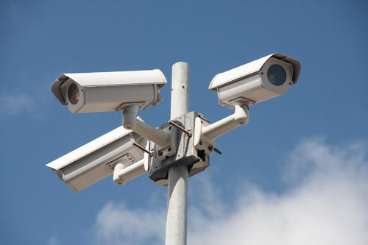
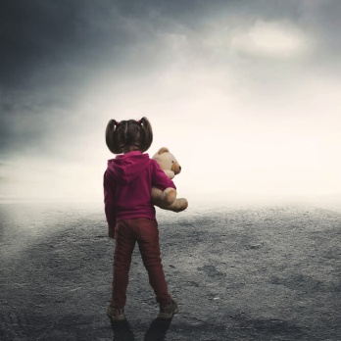
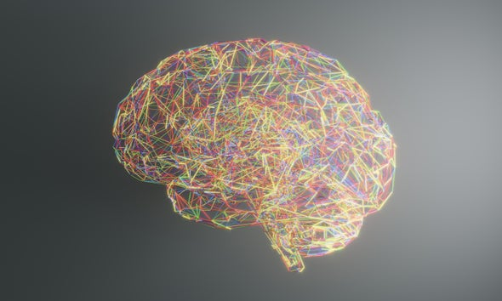
INTRODUCTION
To replicate the human capability at recognizing faces and complex patterns.
Application which predicts an age bracket as well as a gender between a male and female from a single image received as input.
Created with a simple convolutional neural net CAFFE architecture for gender classification and age estimation that can be used on ‘real-world’ images.
The product can be helpful in various ways:
Criminal records
Surveillance
Finding lost kids
Science

Slide 3
PRODUCT FEATURES
Age classification: Extracting age related attributes from facial images has received increasing attention in recent years. The focus here will be on age group classification rather than precise age estimation (i.e., age regression).
Gender Classification: The problem of predicting gender from images regards to foundational difference between the facial attributes of the two different genders
CNN for age and gender estimation: Data-sets for age and gender estimation from real-world social images are the relatively limited in size and presently no match in size with the much larger image classification data-sets (e.g. the Imagenet dataset). Overfitting is common problem when machine learning based methods are used on such small image collections. To avoid those Caffe model has been used.

Slide 4
HARDWARE SOFTWARE
Hardware Requirements :
Optionally, Internet access is helpful
Android Platform/Internet Browser
Well functioning mobile/computer camera
Software Requirements
Operating system: Android, Windows , Linux , Mac OS
Storage: Between 850 MB and 1.2 GB, depending on the language version
Memory required - 16 gb RAM
Python3.0+

Slide 5
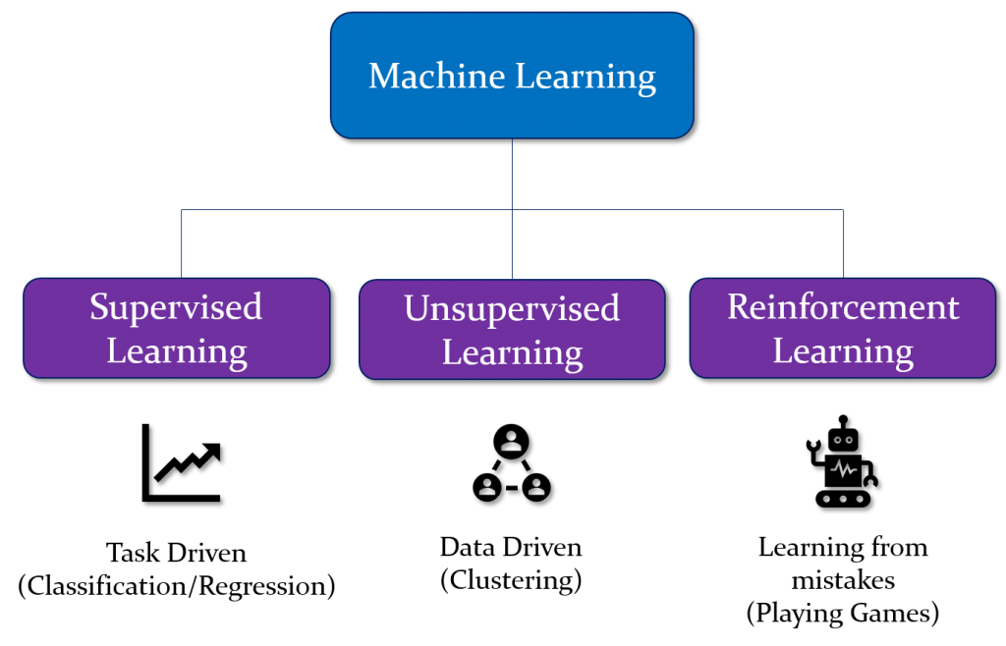
MACHINE LEARNING
Machine learning is also associated with a few other artificial intelligence subfields:-
Natural Language Processing
Neural Network
Deep Learning

Slide 6
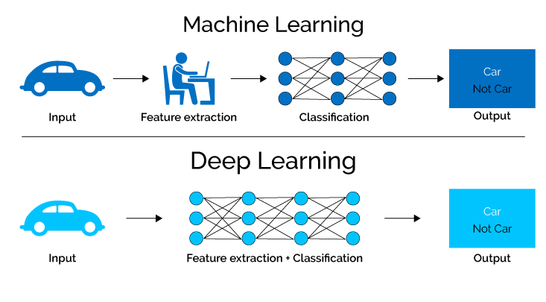
DEEP LEARNING
The foremost differentiate between conventional machine learning and deep learning algorithms is inside the feature engineering. In conventional machine learning algorithms, we have to be hand-craft the features. By differentiate, in deep learning algorithms feature engineering is done automatically by the algorithm.

Slide 7
Caffe (Convolutional Architecture for Fast Feature Embedding)
Caffe created by the Berkeley Vision and Learning Center (BVLC) .Being especially motivated by large scale visual recognition, where a particular sort of deep architecture has accomplished a commanding lead on the state-of-the-art. These Convolutional Neural Networks, or CNNs, are arranged by means of back-propagation through layers of convolutional filters and other operations such as rectification and pooling.
Advantages of Caffe model over other models-
Modularity
Separation of representation and implementation
Python binding
Pre-trained reference models

Slide 8
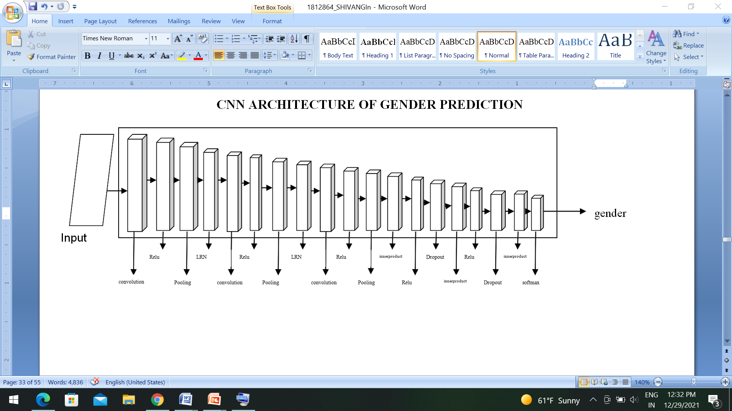
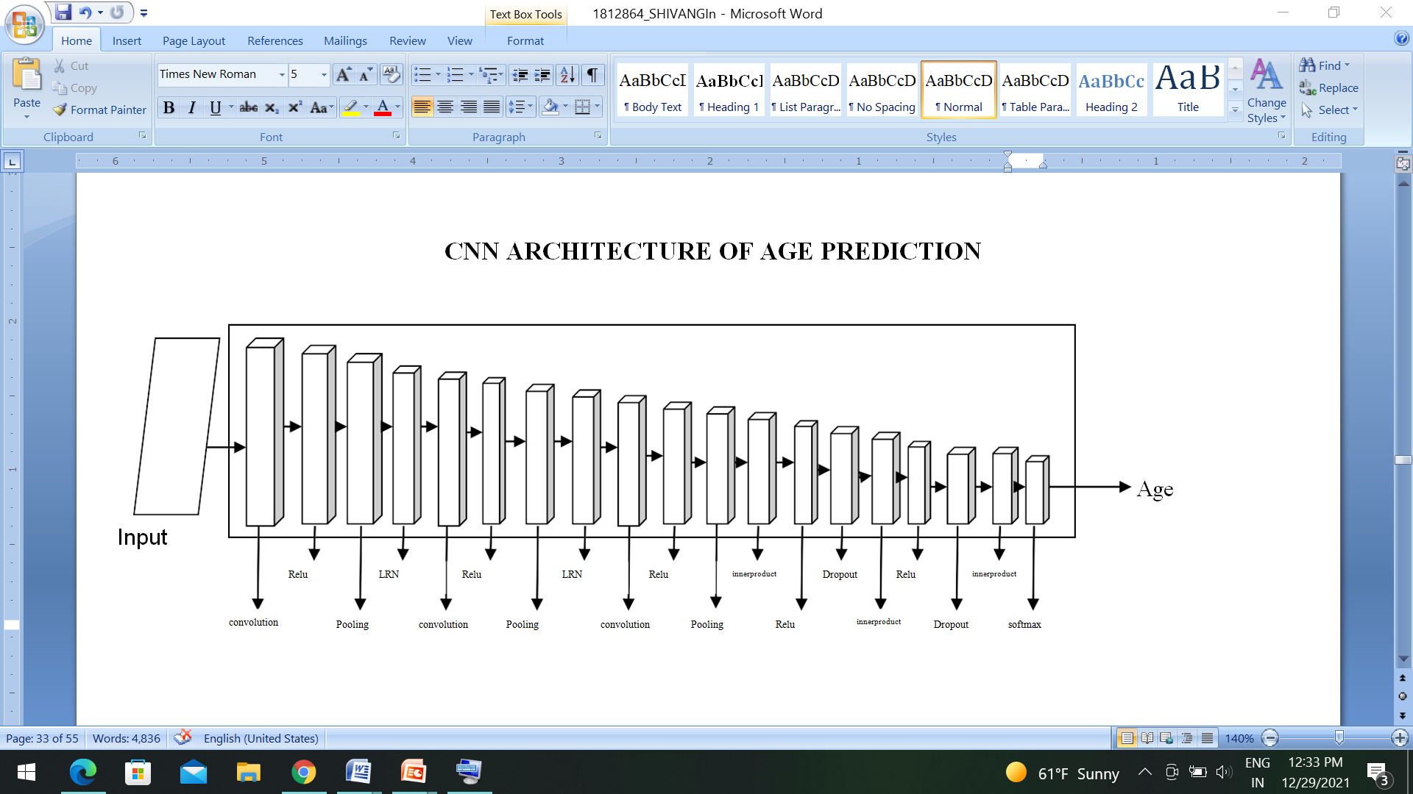
CNN ARCHITECUTRE
For gender model
For age model

Slide 9
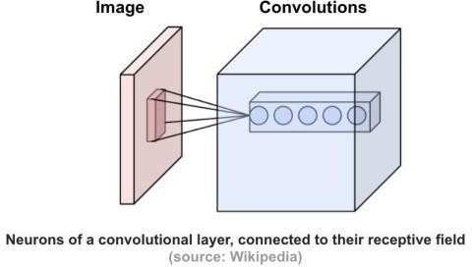
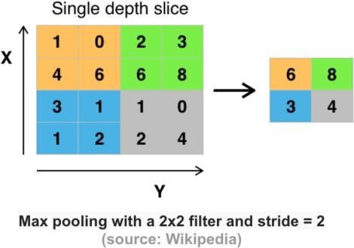
LAYERS FUNCTIONALITIES
Covolution layer
computing dot products between the entries of the filter and the input picture
Pooling layer
The objective of the pooling layer is to continuously decrease the spatial size of the representation to reduce the amount of parameters and computation within the network, and subsequently to also control overfitting.

Slide 10
3. ReLU / Rectified-Linear and Leaky-ReLU Layer
RelU work could be a piecewise linear function that yields the input straightforwardly in case is positive i.e. > 0, otherwise, it'll yield zero.
4.Local Response Normalization (LRN) Layer
"The local response normalization layer performs a kind of “lateral inhibition” by normalizing over local input regions.
5.Inner Product / Fully Connected Layer
The InnerProduct layer (also usually referred to as the fully connected layer) treats the input as a simple vector and produces an output in the form of a single vector (with the blob's height and width set to 1).
6. Dropout Layer
Dropout is a technique used to prevent a model from overfitting. Dropout works by randomly setting the outgoing edges of hidden units (neurons that make up hidden layers) to 0 at each update of the training phase
7. Softmax Layer
Softmax assigns decimal probabilities to each class in a multi-class problem. Those decimal probabilities must add up to 1.0. This additional constraint helps training converge more quickly than it otherwise would. Softmax is implemented through a neural network layer just before the output layer.

Slide 11
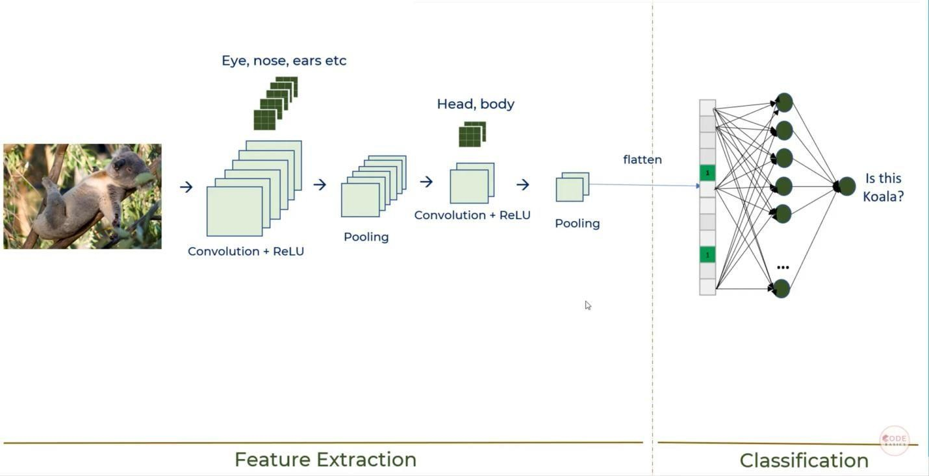
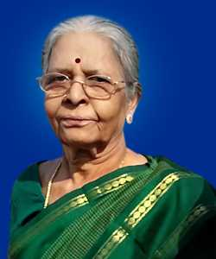

Slide 12
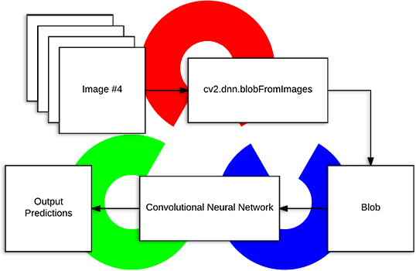
HOW CAFFE WORKS
Blob
A Blob is a wrapper over the genuine data being processed and passed along by Caffe.
The blob is the standard cluster of array and bound together memory interface for the framework.
The subtle elements of blob portray how data is put away and communicated in and over layers and nets.
Blobs give a unified memory interface holding data; e.g., bunches of pictures, model parameters, and derivatives for optimization.

Slide 13
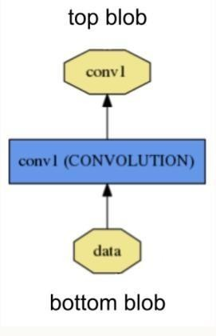
Layer
The layer comes taking after as the establishment of both model and computation.
A layer takes input through bottom connections and makes output through top connections.
Each layer type defines three critical computations: setup, forward, and backward.
Setup: initialize the layer and its connections once at model initialization.
Forward: given input from bottom compute the output and send to the top.
Backward: given the gradient w.r.t. the top output compute the gradient w.r.t. to the input and send to the bottom. A layer with parameters computes the gradient w.r.t. to its parameters and stores it internally.

Slide 14
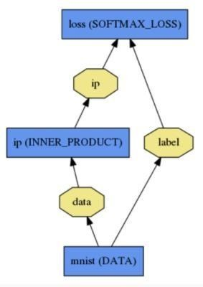
Net
The net takes after as the collection and connection of layers.
The net mutually characterizes a function and its gradient by composition and auto- differentiation. The composition of each layer’s output computes the function to do a given task, and the composition of each layer’s backward computes the gradient from the loss
to memorize the task. Caffe models are end-to-end machine learning engines.
The net is characterized as a set of layers and their affiliations in a plaintext modeling

Slide 15
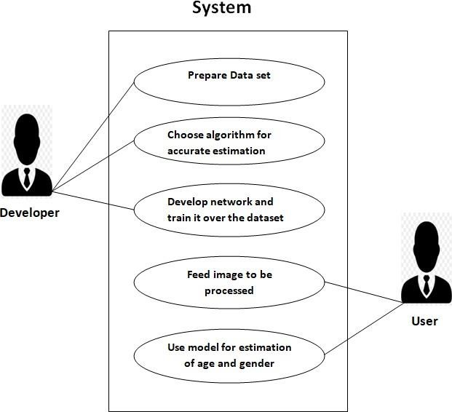
USE CASE DIAGRAM

Slide 16
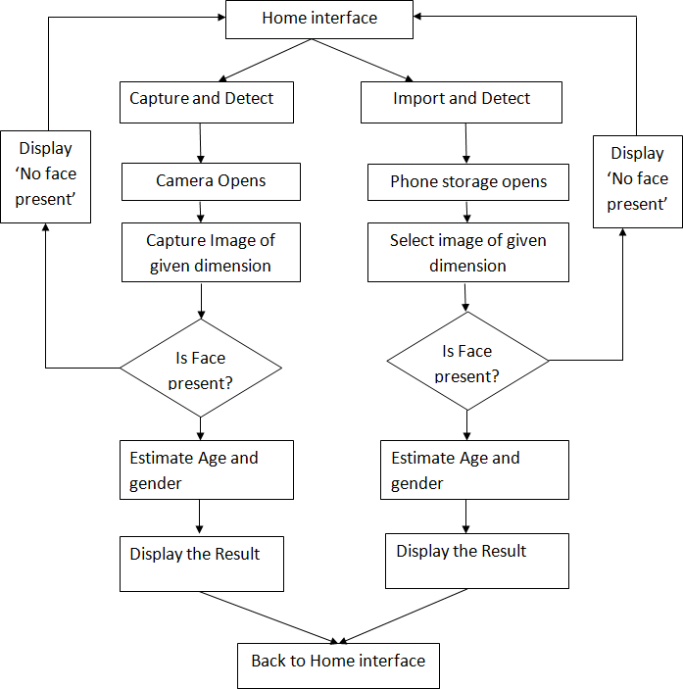
FLOW DIAGRAM

Slide 17
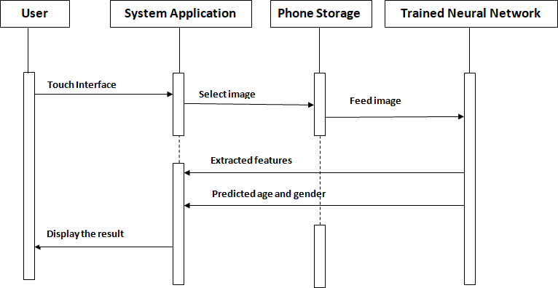
SEQUENCE DIAGRAM
IMPORT AND DETECT

Slide 18
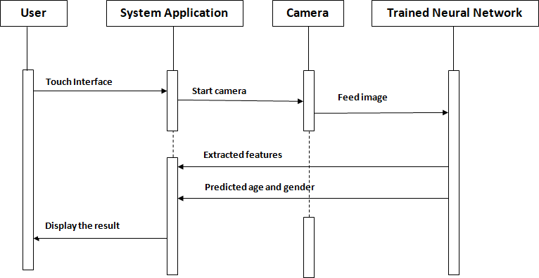
SEQUENCE DIAGRAM
CAPTURE AND DETECT

Slide 19
Test cases
CAPTURE AND DETECT
This feature enables user to open the camera of the user’s system and asks the user to take a picture which is then forwarded to processing and the results are provided.
Response sequence
Click the button " Capture and detect "
User will be redirected to camera screen.
User should now capture a perfect image.
Detect faces, if not present, display "No face detected".
If faces are present, the result containing the estimated age and gender of the persons will be displayed.
Functional Requirement
If image is not of given dimensions then, error message is generated. It asks the user to choose appropriate photo.
If photo is blurred, error message is generated-‘Picture is blurry’

Slide 20
IMPORT AND DETECT
This feature enables users to import picture from their pre existing images stored in phone memory and allows the app to process the picture and provide the result.
Response sequence
Click Button “Import and Detect”.
User is redirected to system storage.
User need to select image accordingly.
Detect faces, if not present display ‘no faces detected’.
If faces are present, estimate age and gender.
Display the result.
Functional Requirement
If image is not of given then, error message is generated. It asks the user to choose appropriate photo.
If photo is blurred, error message is generated-‘Picture is blurry’.

Slide 21
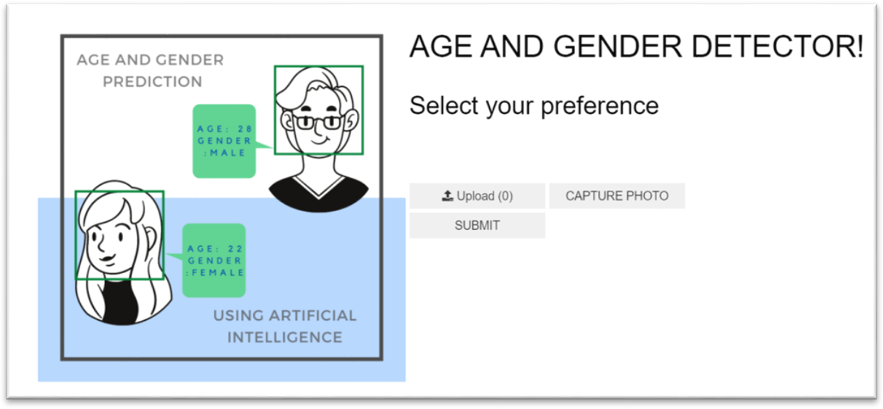
LAYOUT
HOME PAGE

Slide 22
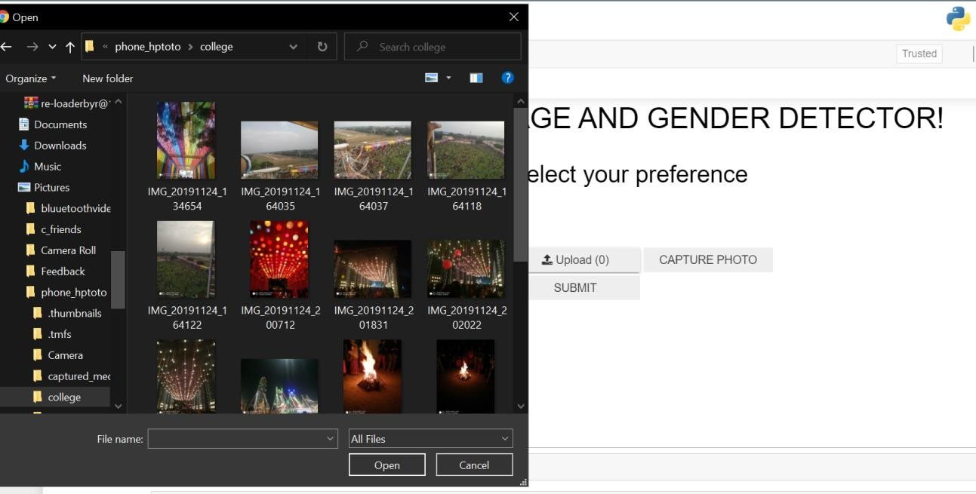
SELECT AND DETECT

Slide 23
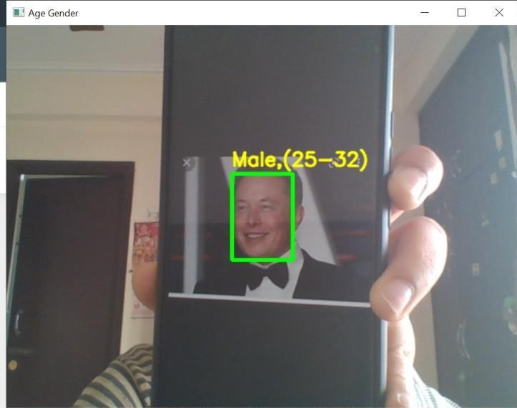
CAPTURE AND DETECT

Slide 24
REFERENCES
https://erandiganepola.medium.com/machine-learning-based-age- and-gender-predictions-in-image-processing-223031dea847
https://www.hindawi.com/journals/tswj/2020/1289408/
https://www.researchgate.net/publication/321479959_Facial_detecti on_using_deep_learning55
Yangqing Jia (2014) Caffe: Convolutional Architecturefor Fat Feature Embedding

Slide 25
THANK YOU

