Slide 1
Mobile Price Prediction Analysis
Data Exploration • EDA • Machine Learning • Business Insights
531 Smartphone Records
BY SHIVANGINI

Slide 2
Executive Summary & Project Objective
Objective: Build a data-driven mobile price prediction system using 531 smartphone listings with specifications (Model, RAM, Memory, Battery, Camera, Processor, AI Lens, etc.).
Approach: Data cleaning → Univariate & Bivariate EDA → Multivariate correlation → Feature engineering → Label encoding → Standardization → Ensemble ML models.
Final Model: Tuned XGBoost (Anti-Overfit) selected as winner — R² = 0.6167 on test data; 83.18% predictions within ±20% error margin.
Key Finding: Brand (36.36%) and Total Camera MP (31.50%) drive ~68% of predictive power; budget-to-mid-range segment (₹8,000–₹20,000) dominates the dataset.
Business Value: Enables pricing intelligence for retailers, competitive benchmarking, and data-backed launch pricing for budget/mid-range smartphones.
2

Slide 3
Step 1: Data Exploration & Cleaning
Dataset: 531 mobile entries | 187 unique models | 275 unique colours | 123 unique processors | 0 missing values.
Duplicates: 10 duplicate rows identified and removed during data cleaning.
Price: Mean ₹16,305.77 | Min ₹920 | Max ₹80,999 | Median ₹13,999 (50% phones below ₹13,999).
Hardware: Avg RAM 5.4 GB (max 8 GB) | Median storage 128 GB (max 256 GB) | Avg battery 4,873.87 mAh (max 7,000 mAh).
Camera: 50MP rear camera most popular (255 entries) | 16MP front camera leads (162 entries) | Top colour: Yellow (12 listings).
Data fixes: 'MP' stripped from camera columns | 17 unrealistic Mobile Height values (4.50–41.94 cm) replaced with median 16.76 cm.
3

Slide 4
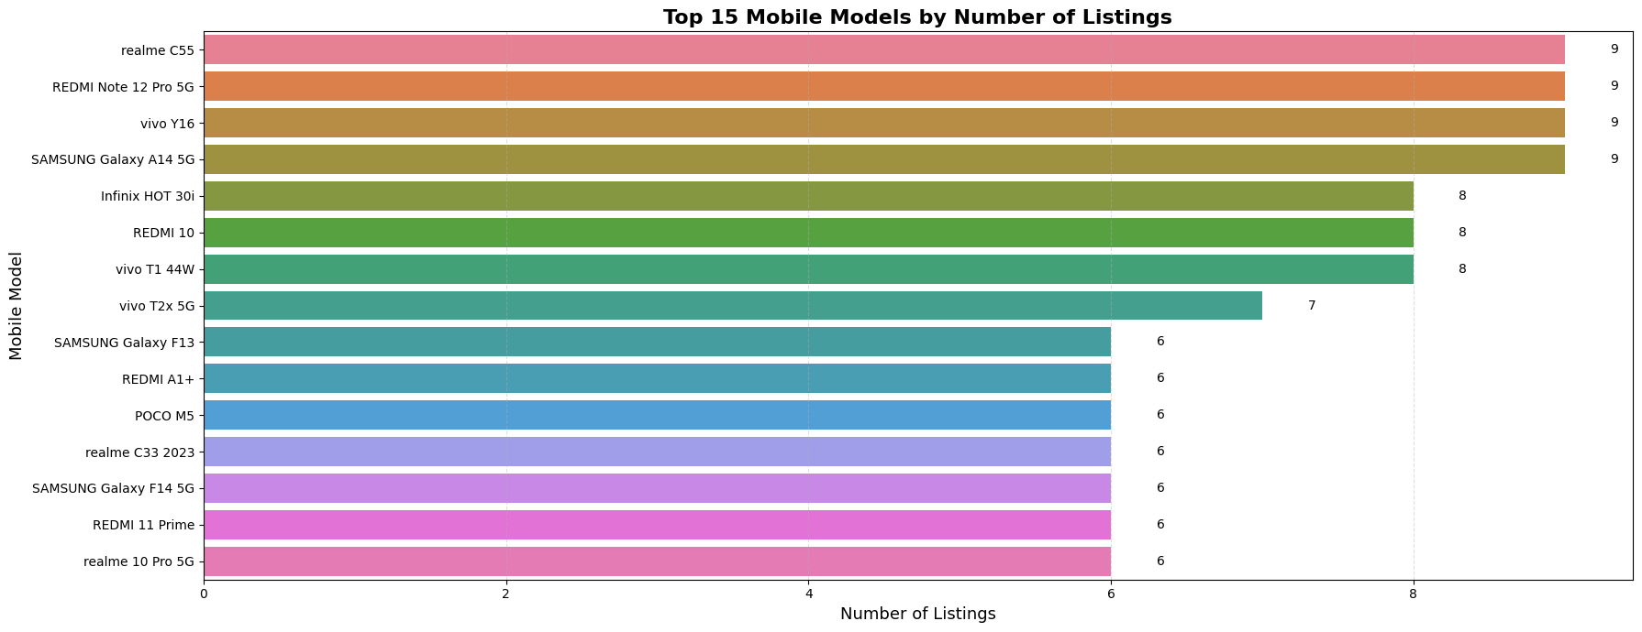
Univariate Analysis — Top 15 Mobile Models
Graph Reading: Horizontal bar chart showing listing frequency of top 15 models.
realme C55, REDMI Note 12 Pro 5G, vivo Y16, Samsung Galaxy A14 5G lead with 9 listings each; Infinix HOT 30i, REDMI 10, vivo T1 44W have 8 each.
Max frequency is only 9 out of 524 records — no single model overrepresented; reduces ML bias.
Business Insight: Dataset covers popular budget/mid-range models from Realme, Redmi, Vivo, Samsung, Infinix — suitable for generalized price prediction.
4

Slide 5
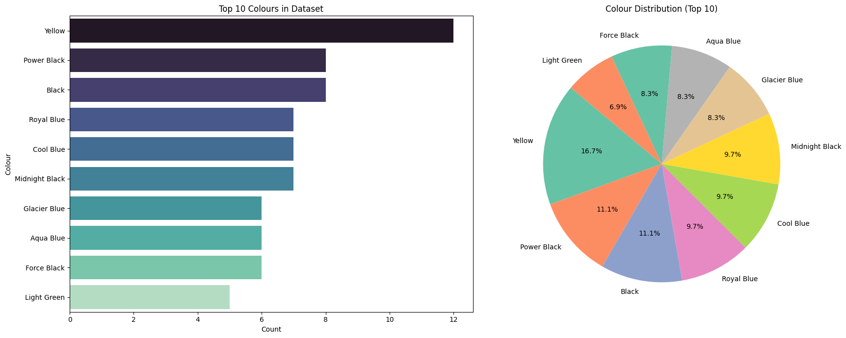
Univariate Analysis — Colour Distribution (Top 10)
Graph Reading: Bar chart (counts) + Pie chart (% share) for top 10 colours; 275 unique colour values total.
Yellow: 12 listings (16.7%) | Power Black & Black: 8 each (11.1%) | Royal Blue, Cool Blue, Midnight Black: 7 each (9.7%).
Distribution is balanced — no single colour dominates among top 10.
Business Insight: Dark colours (Black variants) remain consumer favourites; colour naming inconsistency (275 values) was later standardized via Colour_Category.
5

Slide 6
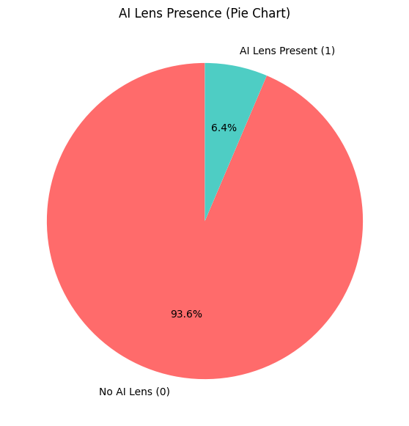
Univariate Analysis — AI Lens Presence
Graph Reading: Pie chart of AI Lens feature availability across 531 smartphones.
93.6% phones WITHOUT AI Lens | Only 6.4% WITH AI Lens — highly imbalanced feature.
Low variability reduces AI Lens importance in price prediction models.
Business Insight: AI Lens is not yet a standard market feature; manufacturers focus on core specs (RAM, Memory, Processor, Camera) over AI Lens technology.
6

Slide 7
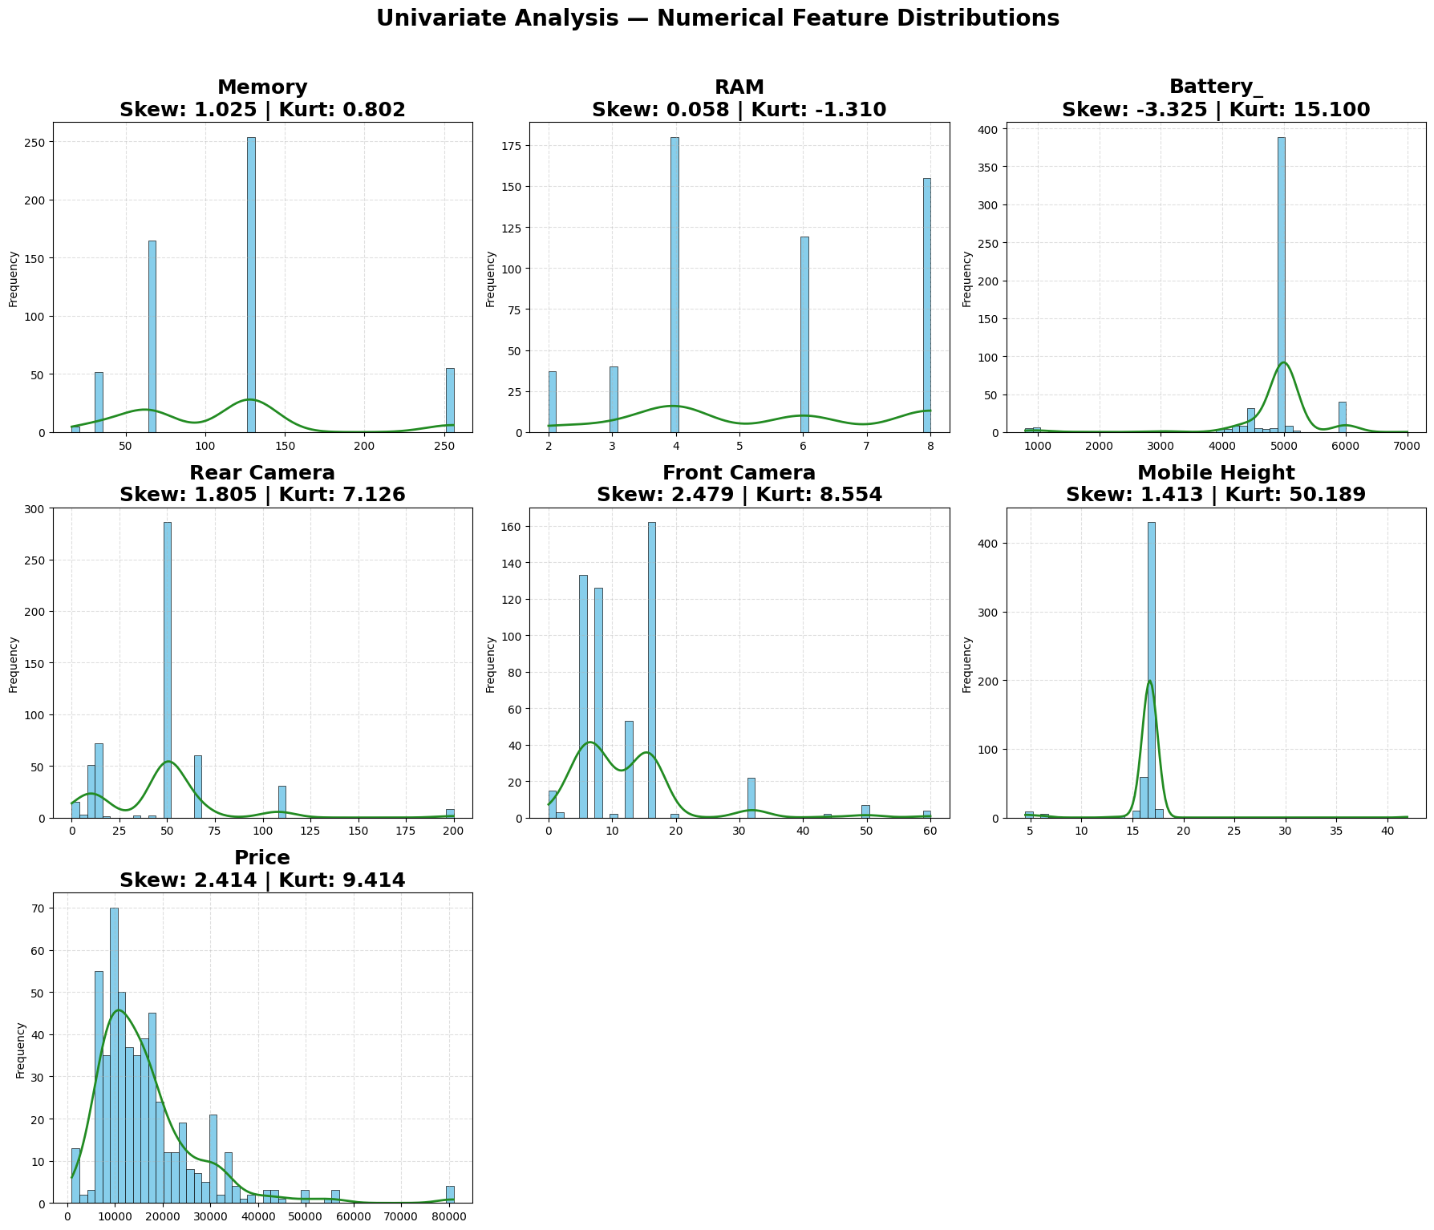
Univariate Analysis — Numerical Feature Distributions
Graph Reading: 3×3 histogram grid with KDE for Memory, RAM, Battery, Rear/Front Camera, Mobile Height, Price.
Memory: Skew 1.03 (64–128 GB dominant) | RAM: Skew 0.06 (symmetric, 4–8 GB) | Battery: Skew -3.33 (5000 mAh peak).
Rear Camera: Skew 1.81 (50 MP dominant) | Price: Skew 2.41 (budget/mid-range concentration).
Business Insight: Most market volume sits in affordable segments; premium outliers represent niche flagship segment.
7

Slide 8
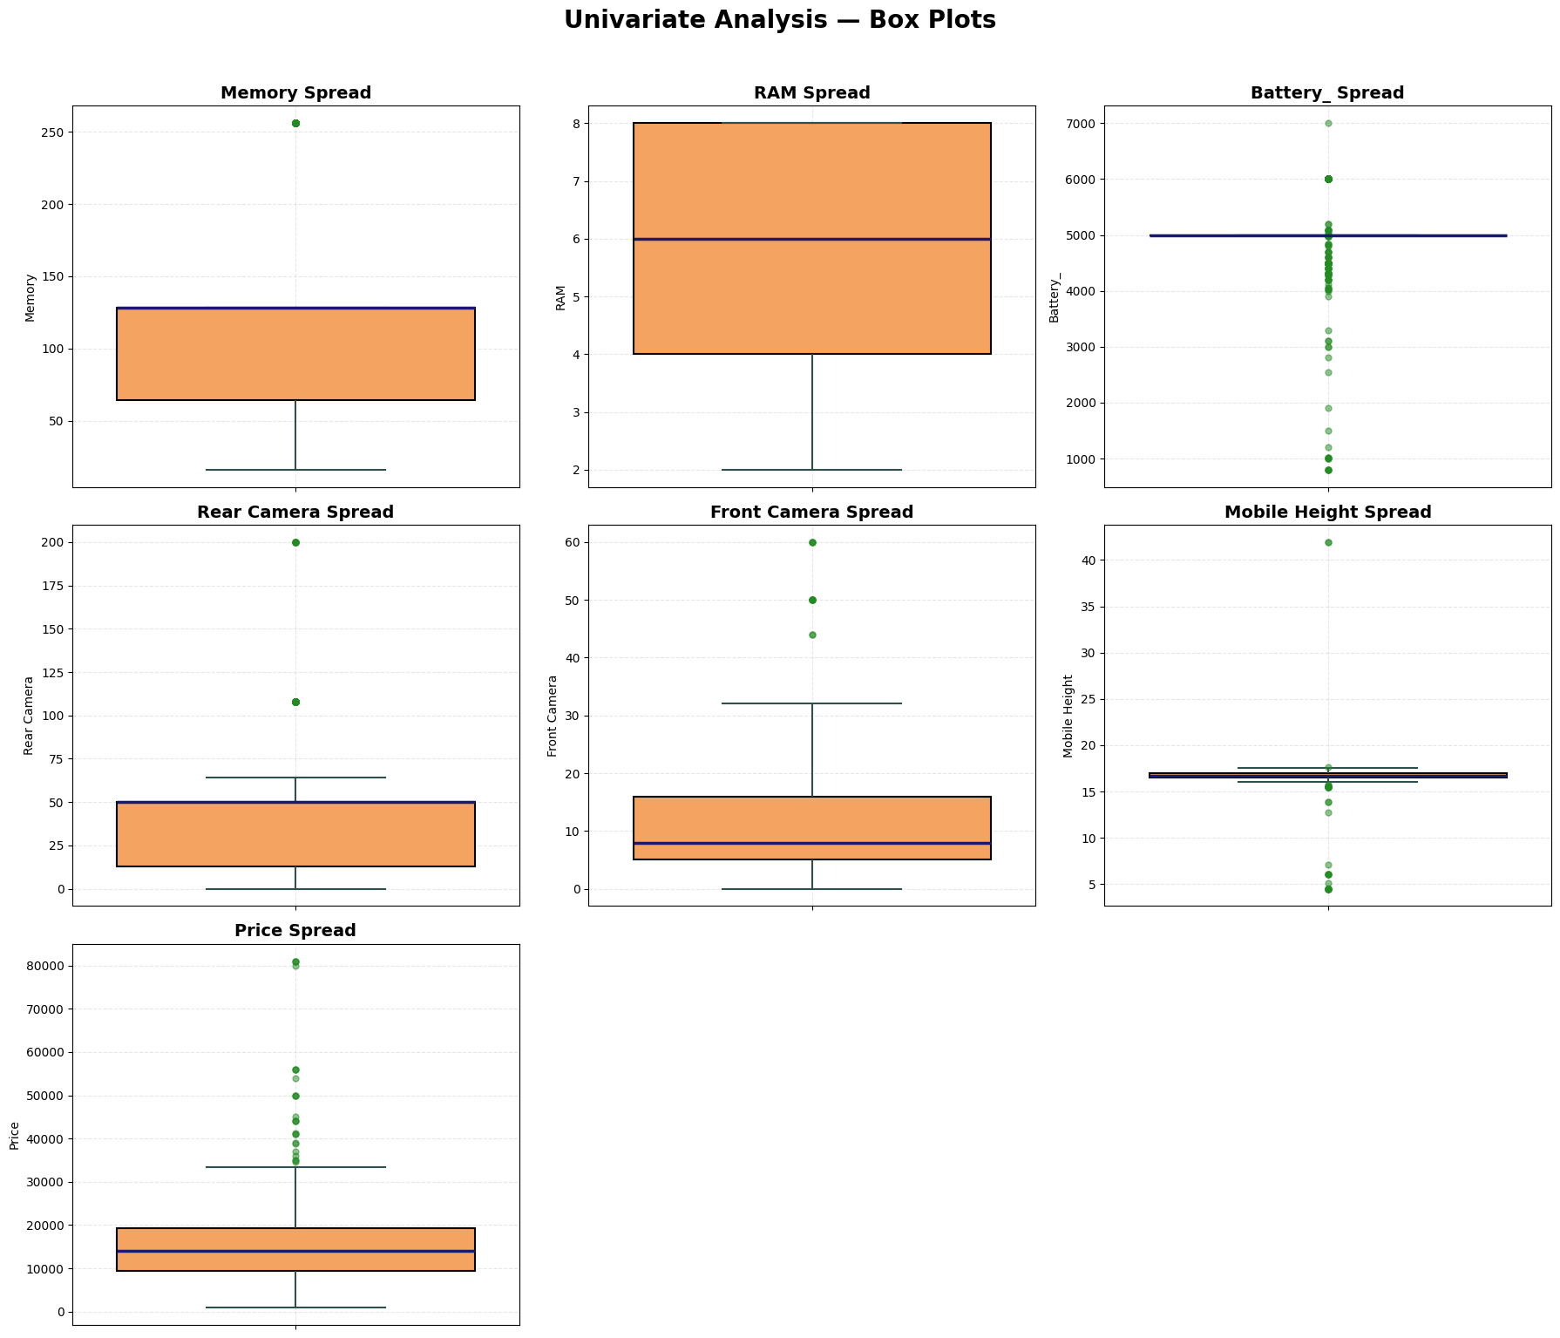
Univariate Analysis — Box Plots & Outlier Detection
Graph Reading: Box plots revealing spread and outliers for all numerical features.
IQR Outliers: Memory 55 | Battery 148 | Rear Camera 39 | Front Camera 13 | Mobile Height 32 | Price 25 | RAM 0.
Price: Majority in ₹9,000–₹20,000; flagships ₹35,000–₹80,999+ are genuine outliers (retained for training).
Business Insight: Premium devices create right-skewed pricing; tree-based models (Random Forest, XGBoost) handle these outliers robustly.
8

Slide 9
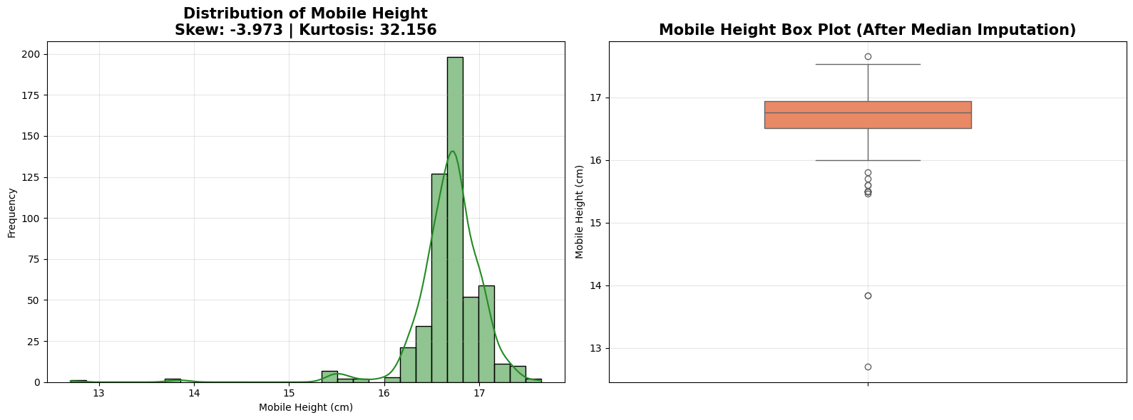
Data Quality Fix — Mobile Height After Median Imputation
Graph Reading: Histogram + box plot after correcting 17 impossible height values (4.50, 6.10, 41.94 cm, etc.).
Corrected Range: 12.70–17.65 cm | Mean 16.68 cm | Median 16.76 cm | Skewness -3.973 | Kurtosis 32.156.
Mean and median are very close — smartphones cluster around 16–17 cm height.
Business Insight: Data quality correction prevents model learning from erroneous physical dimensions; essential for reliable feature engineering.
9

Slide 10
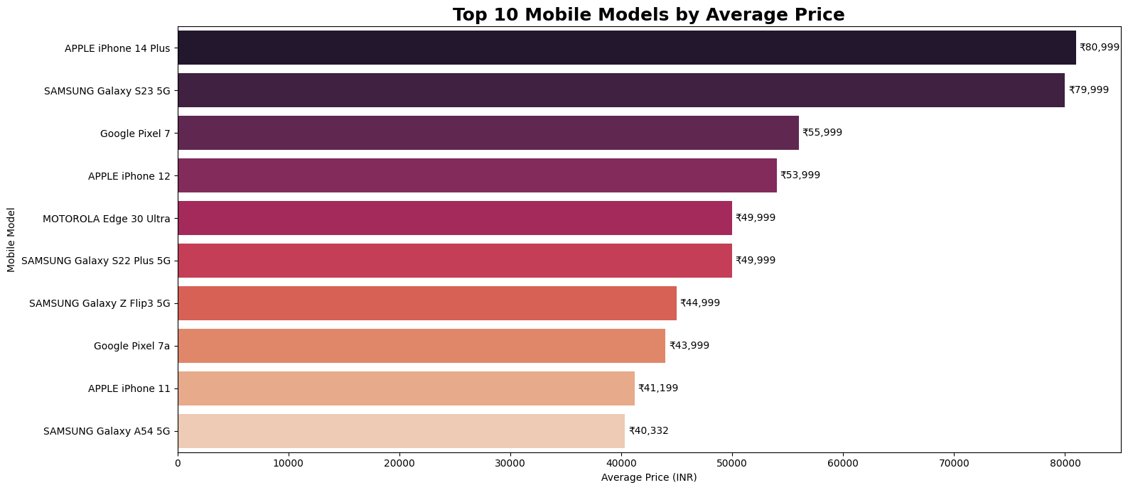
Bivariate Analysis — Top 10 Models by Average Price
Graph Reading: Bar chart of average price for top 10 most expensive models (187 unique models total).
APPLE iPhone 14 Plus: ₹80,999 (highest) | SAMSUNG Galaxy S23 5G: ₹79,999 | Top 10 range: ~₹40,000–₹81,000.
Apple, Samsung, Google, Motorola dominate premium segment.
Business Insight: Brand reputation and flagship positioning strongly drive premium pricing beyond raw specifications.
10

Slide 11
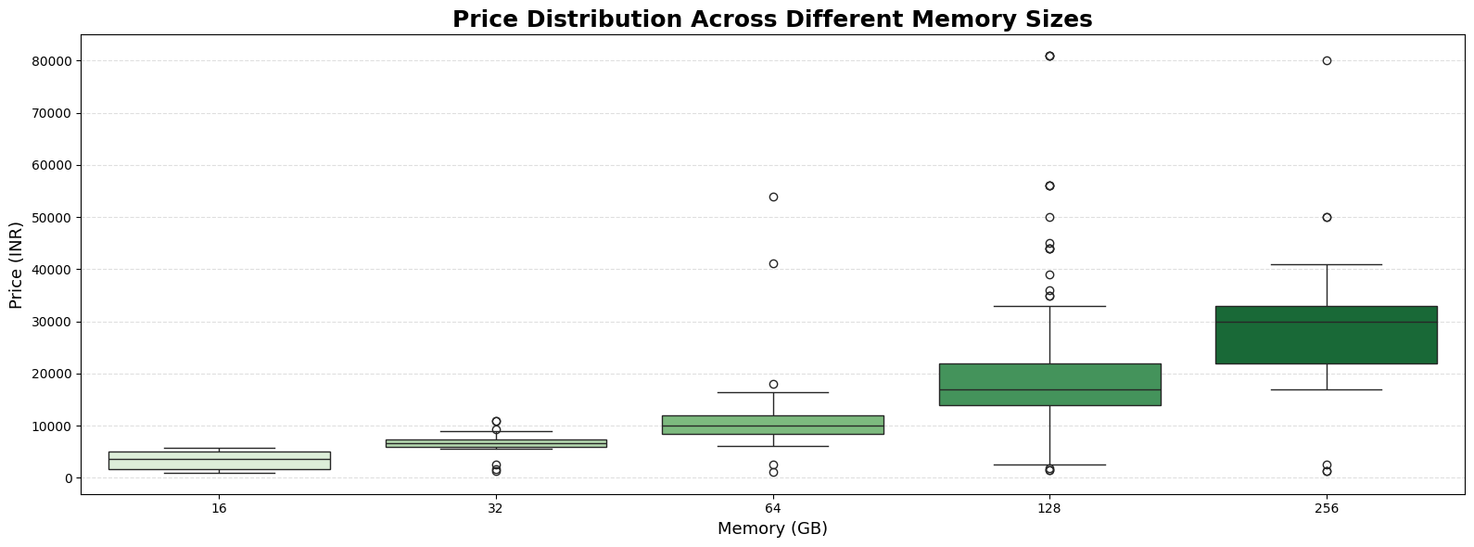
Bivariate Analysis — Price vs Memory (Storage)
Graph Reading: Box plot of price distribution across memory variants (16 GB – 256 GB, 5 unique variants).
Higher storage configurations generally associate with higher price spread and upper quartile values.
Memory correlation with Price: 0.56 (strongest predictor in EDA heatmap).
Business Insight: Storage tier is a key pricing lever — 128 GB and 256 GB variants command premium over 32/64 GB entry models.
11

Slide 12
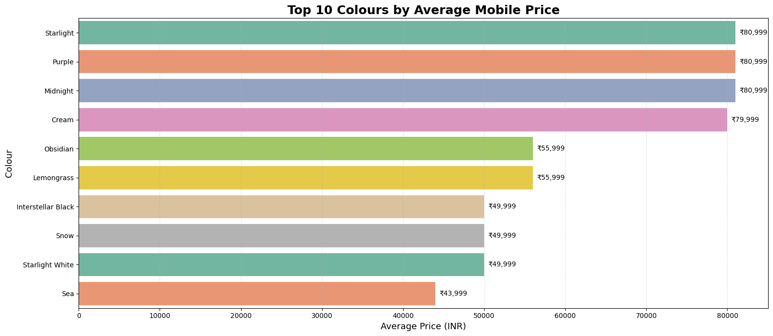
Bivariate Analysis — Top 10 Colours by Average Price
Graph Reading: Horizontal bar chart showing average price for top 10 highest-priced colour variants.
275 unique colours analysed; premium colour variants correlate with flagship model availability.
Colour_Category_Encoded later shows only 0.06 correlation with price — cosmetic factor has minimal pricing impact.
Business Insight: Colour choice affects SKU variety but not core pricing strategy; focus pricing on specs and brand instead.
12

Slide 13
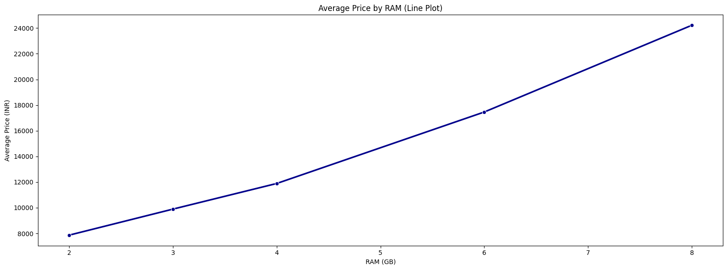
Bivariate Analysis — Average Price by RAM
Graph Reading: Line plot with markers showing average price increasing with RAM capacity.
8 GB RAM → highest average price | 2 GB RAM → lowest average price; consistent upward trend.
RAM correlation with Price: 0.53 — second strongest numeric predictor.
Business Insight: RAM is a visible performance indicator for consumers; upgrading RAM justifies mid-to-premium price positioning.
13

Slide 14
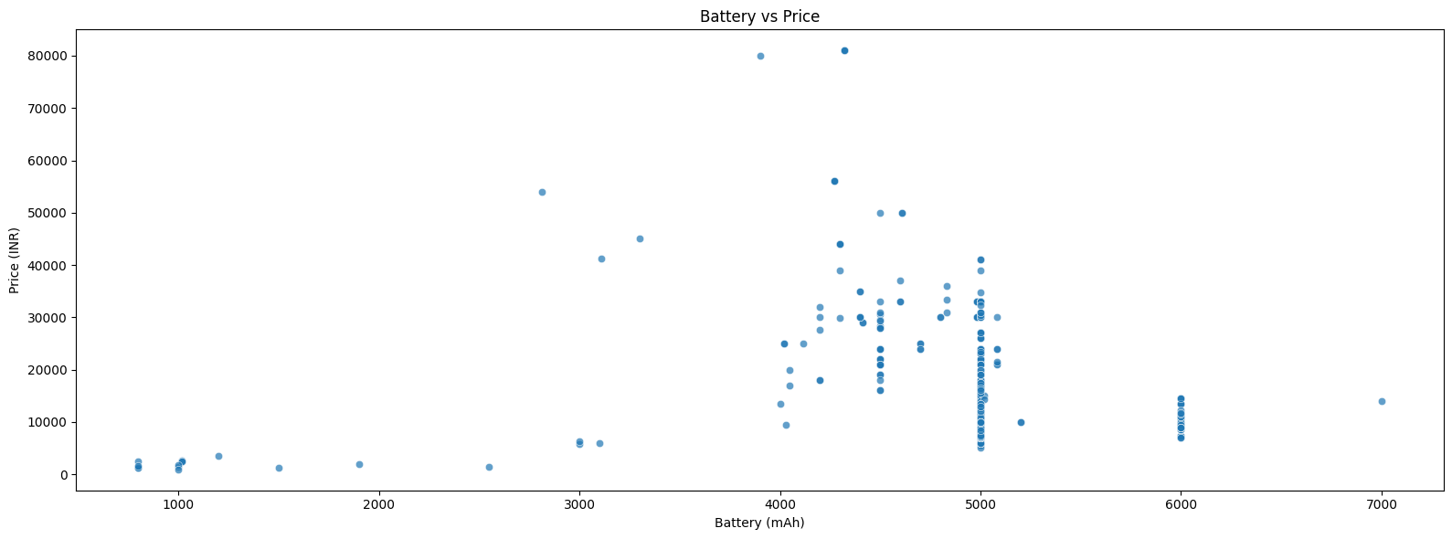
Bivariate Analysis — Battery vs Price
Graph Reading: Scatter plot of battery capacity (800–7,000 mAh) against price.
No strong linear relationship — 5000 mAh phones span entire price range from budget to premium.
Battery correlation with Price: -0.05 (negligible).
Business Insight: Large battery (5000 mAh) is now table-stakes in mid-range; battery alone cannot justify premium pricing.
14

Slide 15
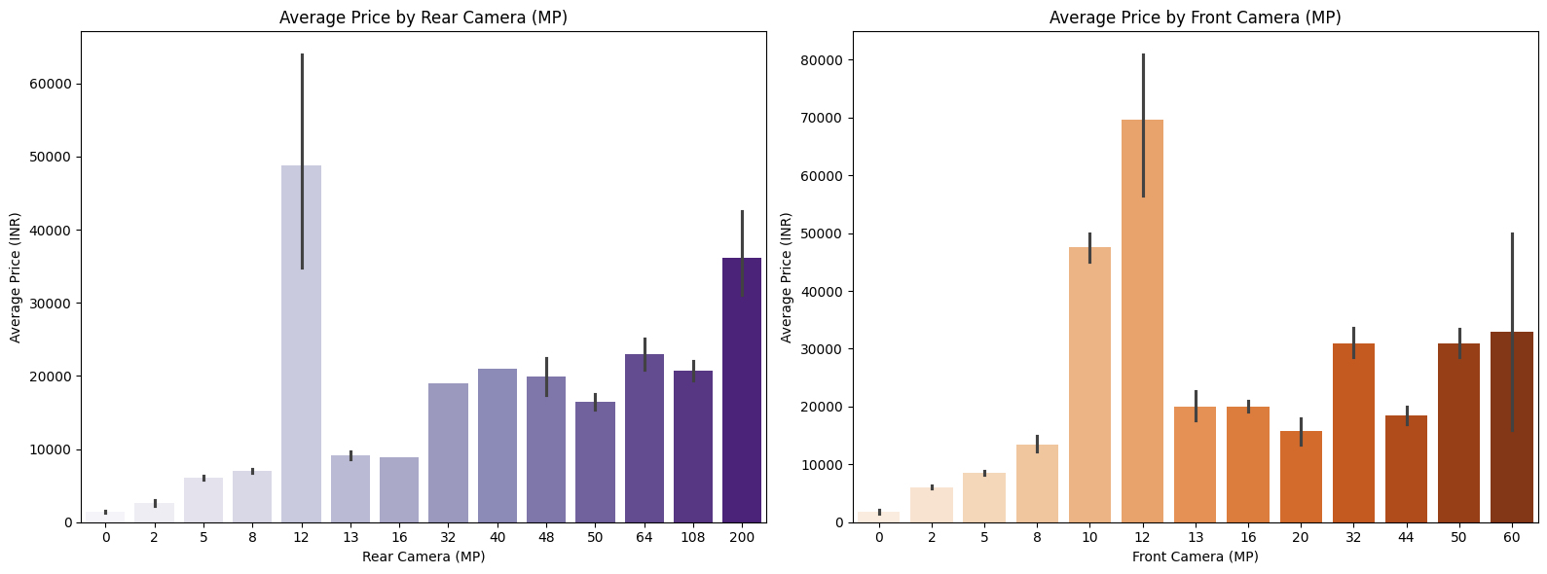
Bivariate Analysis — Camera vs Price
Graph Reading: Dual bar charts — average price by Rear Camera MP (left) and Front Camera MP (right).
Rear: 12 MP & 200 MP have highest avg prices; Front: 12 MP highest, then 60 MP & 50 MP flagship variants.
Rear Camera corr: 0.41 | Front Camera corr: 0.53 with Price.
Business Insight: Camera megapixels signal premium positioning; combined Total_Camera_MP became a key engineered feature (31.50% model importance).
15

Slide 16
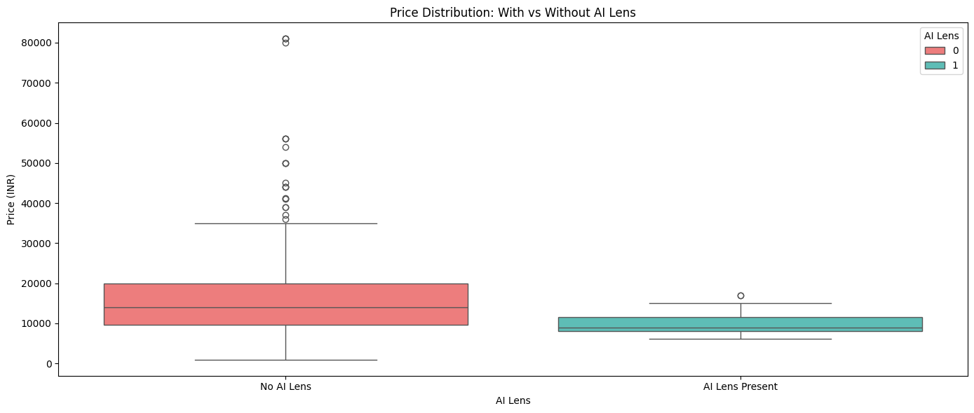
Bivariate Analysis — AI Lens vs Price
Graph Reading: Box plot comparing price distribution for phones with vs without AI Lens.
Without AI Lens: wider price range with high-priced outliers (premium flagships). With AI Lens: narrow, lower-to-mid segment.
AI Lens correlation with Price: -0.16 — does not increase price.
Business Insight: AI Lens is not a premium differentiator yet; invest in camera MP and brand equity for pricing power.
16

Slide 17
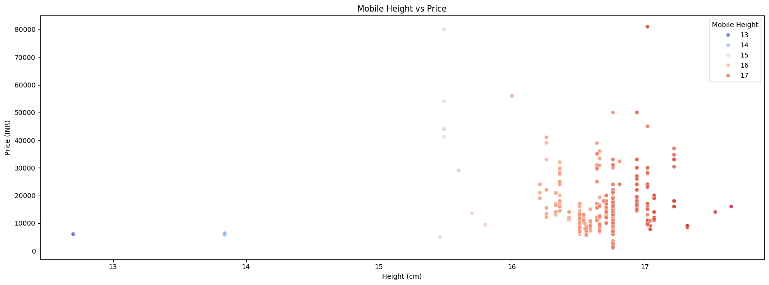
Bivariate Analysis — Mobile Height vs Price
Graph Reading: Scatter plot of phone height (cm) against price after data cleaning.
Mobile Height correlation with Price: 0.17 (very weak) — size has minimal pricing influence.
Most devices cluster at 16.5–17.0 cm regardless of price tier.
Business Insight: Physical dimensions are standardized; pricing strategy should not rely on phone size as a value driver.
17

Slide 18
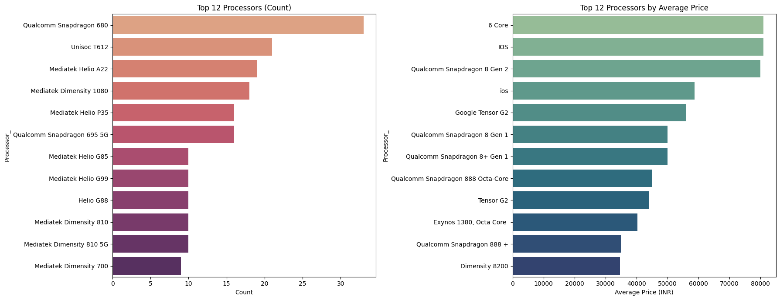
Bivariate Analysis — Processor Count & Average Price
Graph Reading: Dual panel — Top 12 processors by count (left) and by average price (right); 123 unique processors.
Most frequent: Qualcomm Snapdragon 680 (33 variants) | Premium: Snapdragon 8 Gen 2, Google Tensor G2, iOS chips.
Processor type significantly impacts price — flagship chipsets command substantially higher prices.
Business Insight: Chipset tier is critical for segment positioning; budget chips (Unisoc, Helio A22) anchor entry-level pricing.
18

Slide 19
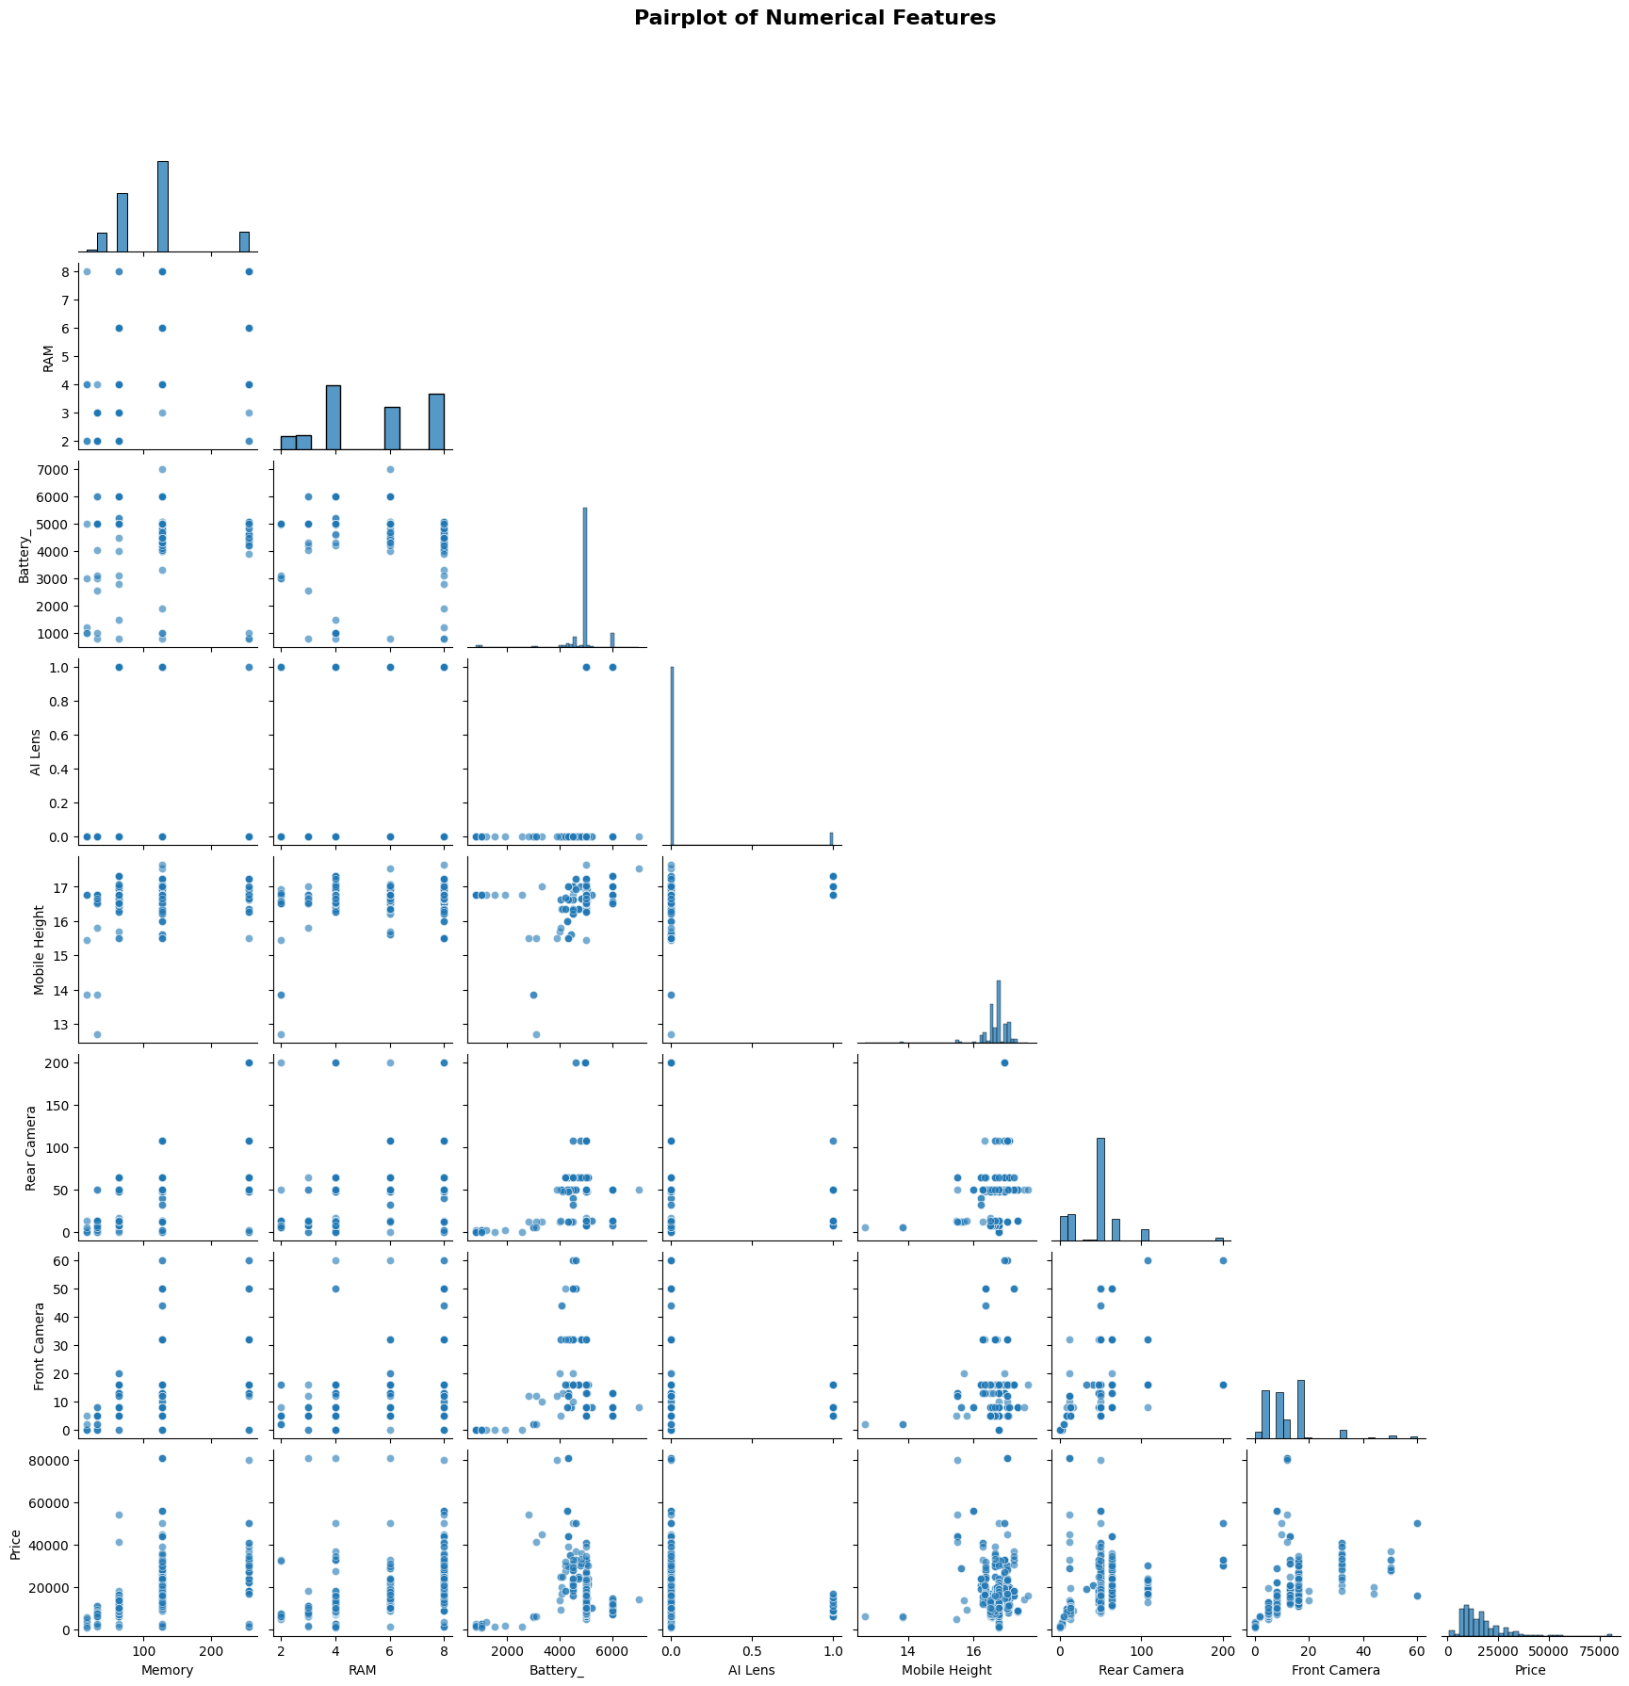
Multivariate Analysis — Pairplot of Numerical Features
Graph Reading: Corner pairplot showing pairwise relationships among Memory, RAM, Battery, Cameras, Height, Price.
Visible linear trends between Memory/RAM and Price; scatter clouds show non-linear premium segment behavior.
Memory–RAM positive co-movement visible; Battery–Height correlation observable.
Business Insight: Confirms multi-feature interactions require ensemble/tree models rather than simple linear regression.
19

Slide 20
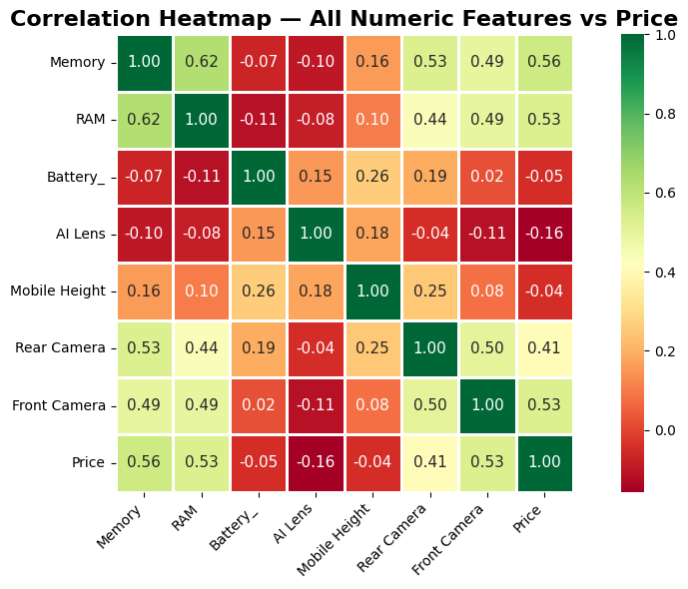
Multivariate Analysis — Correlation Heatmap (EDA)
Graph Reading: Heatmap of all numeric features with annotated correlation coefficients.
Price correlations: Memory 0.56 | RAM 0.53 | Front Camera 0.53 | Rear Camera 0.41 | AI Lens -0.16 | Battery -0.05.
Feature pairs: Memory–RAM 0.62 | Battery–Mobile Height 0.68.
Business Insight: Prioritize Memory, RAM, and Camera specs for pricing models; deprioritize Battery and AI Lens as standalone price drivers.
20

Slide 21
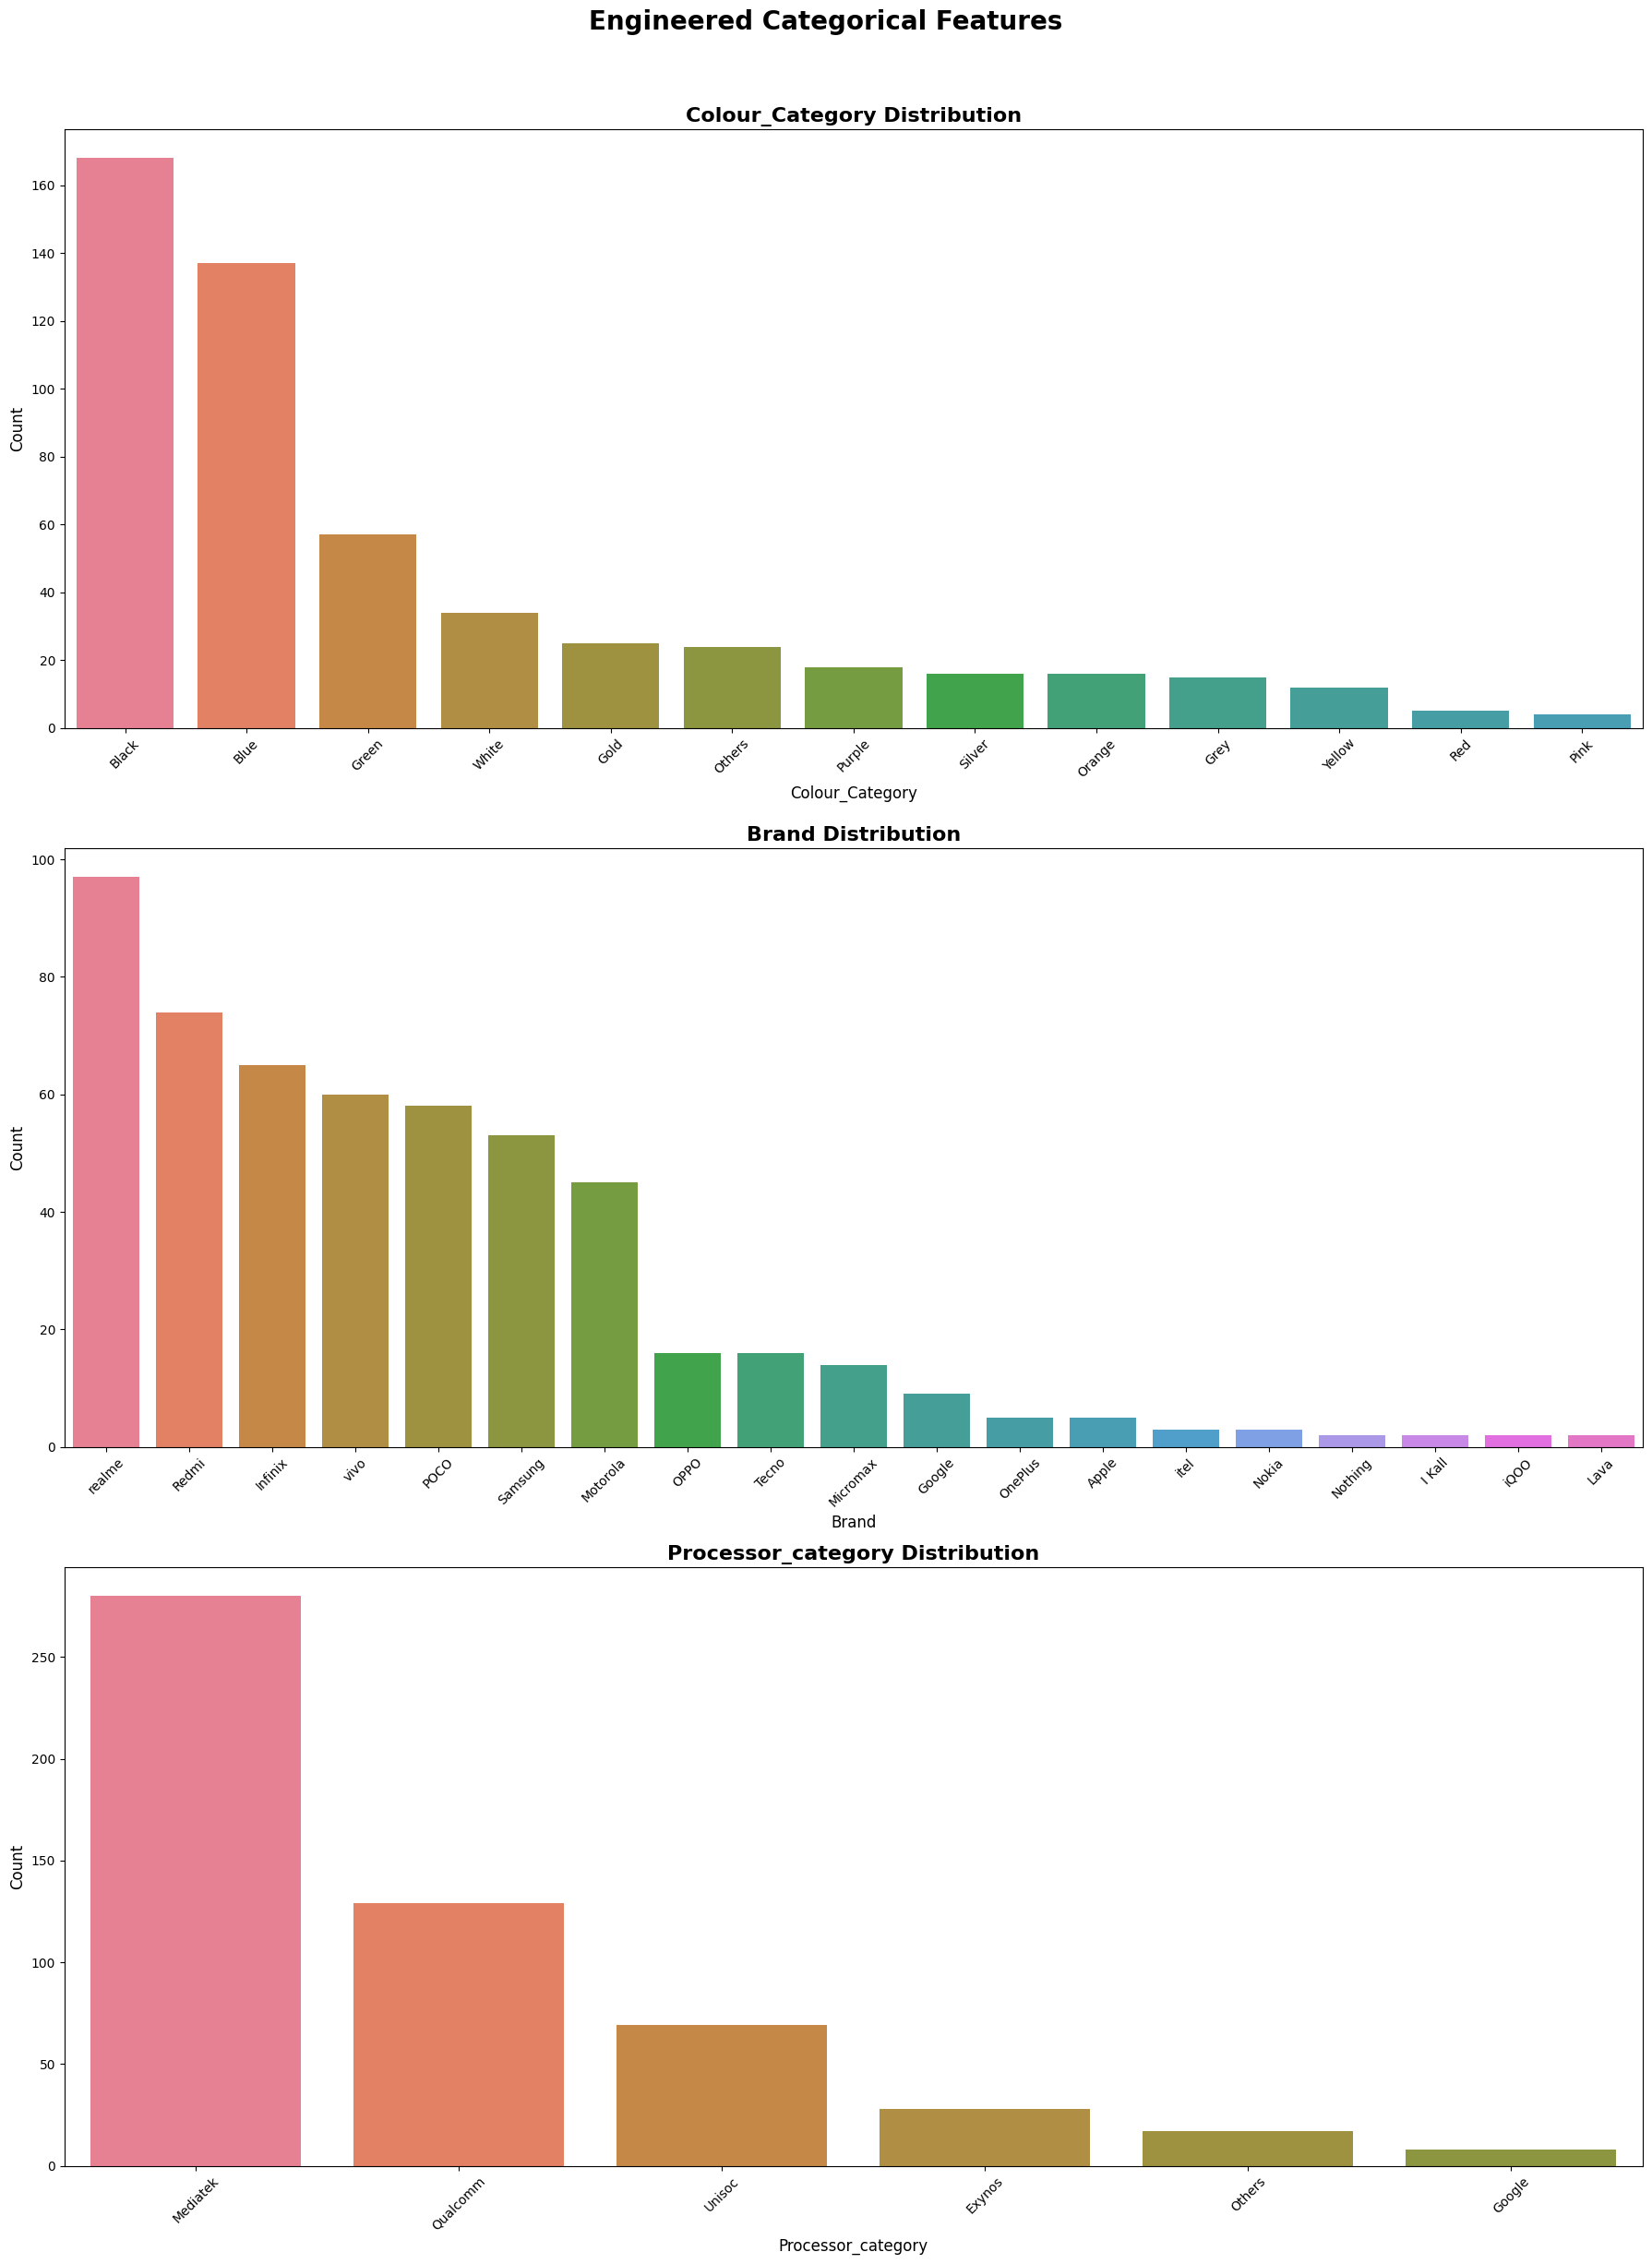
Step 3: Feature Engineering — Engineered Categories
Graph Reading: Count plots for Colour_Category, Brand, and Processor_category after feature engineering.
Brand counts: realme 97 | Redmi 74 | Infinix 65 | vivo 60 | POCO 58 | Samsung 53 | Motorola 45.
Processor_category: Mediatek 280 | Qualcomm 129 | Unisoc 69 | Exynos 28.
New features: Total_Camera_MP (Rear+Front), Brand, Colour_Category, Processor_category; dropped redundant raw columns.
21

Slide 22
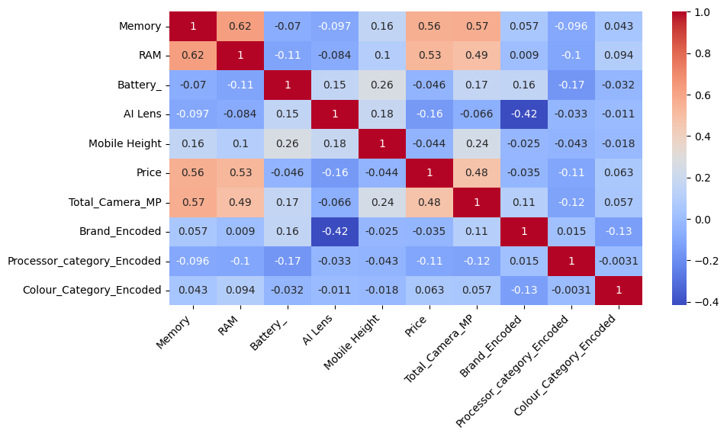
Step 4: Label Encoding — Correlation Heatmap (Final Features)
Graph Reading: Correlation heatmap after label encoding — 531 records, 10 features ready for modeling.
Total_Camera_MP corr with Price: 0.48 | Memory 0.56 | RAM 0.53 | Battery -0.05.
Weak price drivers: AI Lens (-0.16), Processor_Category (-0.11), Colour_Category (0.06).
Business Insight: Performance/storage specs outweigh aesthetics; engineered features capture pricing signals more efficiently.
22

Slide 23
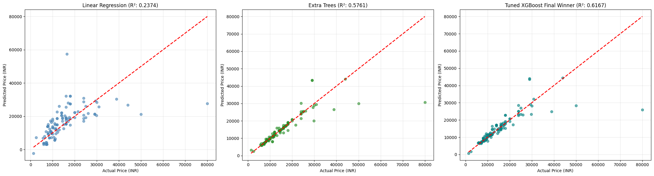
Step 9–12: Model Evaluation — Actual vs Predicted
Graph Reading: Scatter plots vs ideal diagonal — Linear Regression (R² 0.2374) | Extra Trees (R² 0.5761) | Tuned XGBoost (R² 0.6167).
Best accuracy in ₹5,000–₹25,000 range; all models underpredict flagships above ₹40,000.
Leaderboard: Extra Trees R² 0.6777 MAE ₹1,791.96 | Tuned XGBoost R² 0.6156 MAE ₹2,304.50 | Linear Regression R² 0.2374.
CV Best: XGBoost avg R² 0.6275; Hyperparameter tuning improved to 0.6812; Anti-overfit final test R² 0.6156.
23

Slide 24
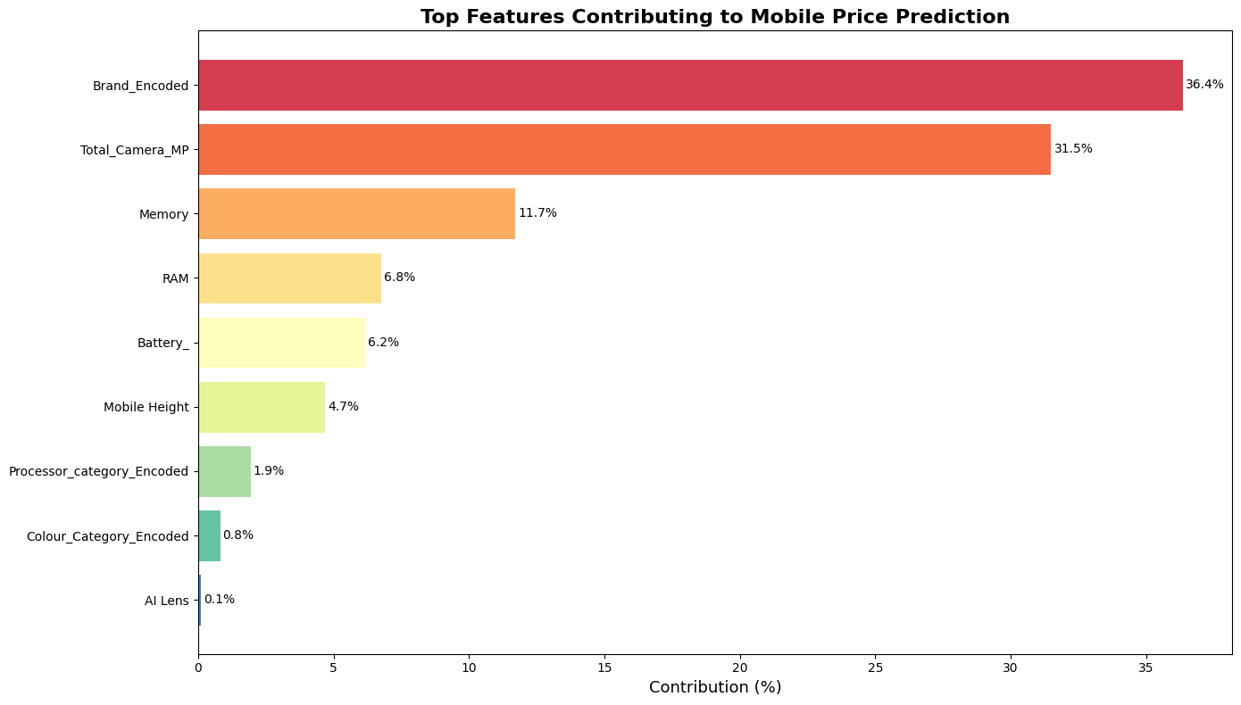
Step 13: Feature Importance Analysis
Graph Reading: Horizontal bar chart of feature contribution % to Random Forest price prediction model.
Brand_Encoded 36.36% | Total_Camera_MP 31.50% | Memory 11.71% | RAM 6.77% | Battery_ 6.15% | Mobile Height 4.68%.
Minimal: Processor_category 1.93% | Colour_Category 0.81% | AI Lens 0.11%.
Business Insight: Brand + Camera = ~68% of pricing power; premium pricing driven by reputation and hardware, not colour or AI Lens.
24

Slide 25
Business Recommendations & Final Conclusion
Deploy Tuned XGBoost for price estimation: 37.38% within ±5%, 61.68% within ±10%, 73.83% within ±15%, 83.18% within ±20% error.
Pricing Strategy: Anchor prices on Brand equity + Camera MP + Memory/RAM tiers; do not over-weight battery capacity or colour variants.
Segment Focus: Model excels in budget/mid-range (₹5,000–₹25,000); add brand prestige scores & benchmark data to improve flagship (₹40,000+) predictions.
Product Portfolio: Prioritize 128 GB / 6–8 GB RAM / 50 MP camera configurations — highest market correlation with consumer price expectations.
Data Governance: Standardize colour naming (275→categories), validate physical specs (height), and expand dataset with display quality & launch year.
Conclusion: Ensemble ML (Tuned XGBoost, R² 0.6167) effectively captures non-linear smartphone pricing; project delivers actionable pricing intelligence for the Indian mobile market.
25

