Slide 1
SUPPLY BRAIN · CAPSTONE MID-REVIEW
A Multi-Echelon Inventory Optimization System
Segmentation → MEIO → adaptive, self-tuning stocking policy
Sunnel Nelson · Swasti Baghel · Vishwajeet Undhal · Shivangini Aggarwal · Varshil Rambhia
Sponsor: Accenture Strategy | Mid-Review Panel: ISB | 12 September 2026, 2:10–2:30 PM
1

Slide 2
AGENDA
What this review covers
• The problem & what Supply Brain is — a MEIO system for buffer positioning across the DC network.
• Segmentation — why we cluster SKUs, and how clusters aid management review & decision-making.
• Model building — the MEIO engine, its current yearly stocking plan, and its evolution to a weekly decision cadence.
• The Multi-Armed Bandit layer — tuning MEIO's own hyperparameters via simulation to minimize total cost.
• Roadmap — remaining charter phases and timeline.
2

Slide 3
PROBLEM STATEMENT
A static, one-size-fits-all buffer policy in a business that isn't static
• CPG companies carry excess stock on the wrong SKUs while stocking out on the SKUs that matter — a structural planning failure, not a forecasting one.
  – Today: one safety-stock formula for thousands of SKUs; a blanket ~99% service target set once and rarely revisited; lead-time variability averaged away; no feedback loop from outcomes back to parameters.
• Supply Brain's objective: segment SKUs → set differentiated service policies → decide how much buffer to hold and where to position it across the network → keep re-tuning that decision as outcomes come in.
Working capital
Free capital trapped in redundant safety stock by right-sizing it to each segment's real demand risk.
Service level
Protect high-margin, critical SKUs via differentiated targets & multi-echelon positioning.
Write-offs
Reduce waste on high-variety, demand-uncertain SKUs via segment-aware planning.
Strategic IP
A deployable, self-tuning MEIO framework Accenture can take to CPG clients.
3

Slide 4
WHAT WE'RE BUILDING
Supply Brain: a MEIO system for buffer positioning across the DC network
• MEIO = Multi-Echelon Inventory Optimization — decide, for every SKU at every stocking node, how much safety stock to hold and where in the network to hold it, instead of one blanket policy everywhere.
• Scope: 500 SKUs across 5 categories, replenished through a 4-echelon network — Plant → Plant DC → Regional DC → Customer DC.
• 23 nodes actually carry demand/inventory in this dataset: 8 Regional DCs + 15 Customer DCs, fed by Plant DCs. Regional DCs pool their own direct demand with every Customer DC they primary-source (echelon / installation-stock positioning).
• The system is meant to be closed-loop and self-recalibrating — segment SKUs, set the policy, position the buffer, then keep re-learning from outcomes rather than freezing the policy after one setup.
4

Slide 5
THE NETWORK
Where buffer can be positioned
PLANT
production only
no inventory held
PLANT DC
first stocking
echelon
REGIONAL DC
8 nodes
pools direct + downstream CDC demand
CUSTOMER DC
15 nodes
last echelon before the customer
Plant DC is fixed per SKU by which plant is actually qualified to make it (not every plant can make every product); Regional DC → Customer DC is single-sourced via the fastest available lane.
MEIO decides the buffer at each of the 23 stocking nodes — this positioning choice is exactly what a one-size-fits-all safety-stock formula cannot do.
5

Slide 6
APPROACH
Charter work-plan — six phases
# | Phase | What it delivers
1 | Data Preparation & Sampling | Representative 500-SKU CPG dataset + documentation
2 | Exploration & Segmentation | Cluster SKUs; validate with statistics & mentor feedback
3 | Model Development & Optimization | MEIO buffer positioning; weekly-cadence model; bandit tuning engine
4 | Simulation & Digital Twin Testing | Test build-ahead, positioning trade-offs at scale
5 | Agentic Interface & LLM Integration | Natural-language planner interface
6 | Assessment & Refinement | Refine on outcomes; finalize prototype for handover
6

Slide 7
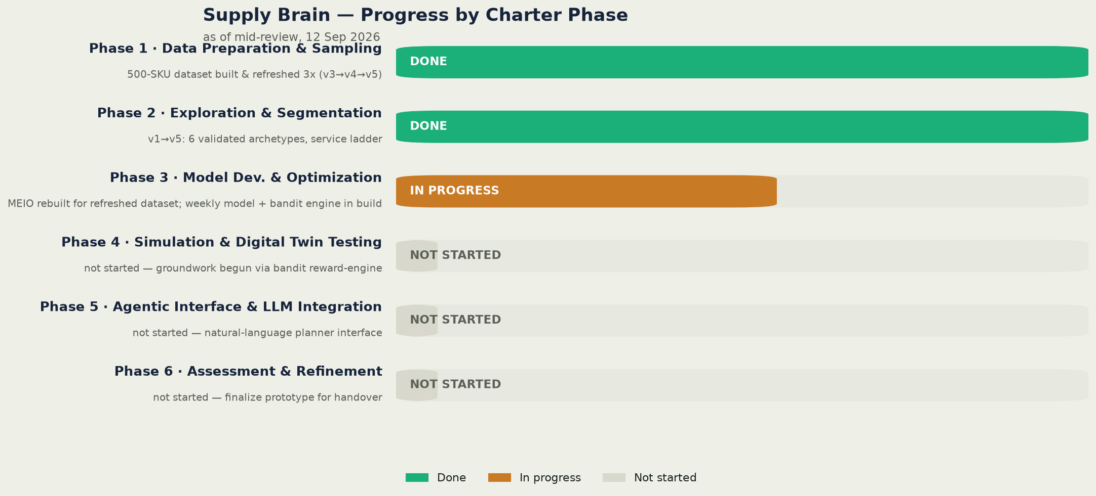
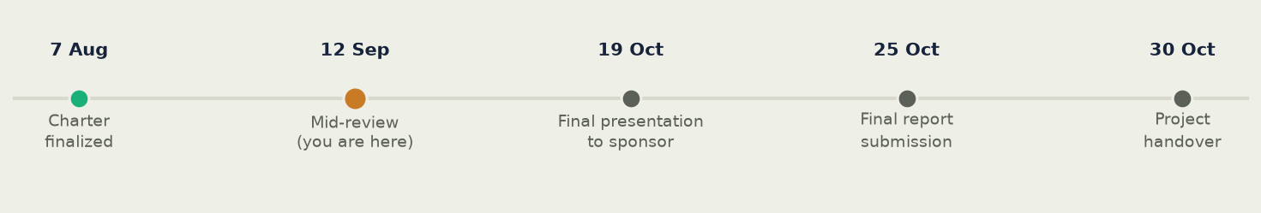
WHERE WE ARE
Progress against the charter phases
7

Slide 8
PHASE 2 · SEGMENTATION
Why we cluster before we optimize
• 500 SKUs cannot each get a bespoke policy by hand, and a single blanket policy ignores real differences in margin, demand volatility, forecastability and supply risk.
• Clustering compresses that complexity into a small number of archetypes management can actually review and sign off on — a segment is a decision unit, not just a modeling convenience.
• Each cluster gets its own recommended service-level target and, downstream, feeds MEIO's per-segment safety-stock policy — segmentation is the bridge between raw SKU data and a policy stakeholders can reason about.
• Built to be statistically defensible, not just visually plausible: every feature that survives into the clustering is tested for significance, and the number of clusters is chosen by reproducibility, not just by eye.
8

Slide 9
PHASE 2 · SEGMENTATION METHOD
v1 → v5 — feature design, validation, k-selection
Step | What we do
Feature blocks | 9 features in 4 balanced blocks: Value, Variability, Forecastability, Supply-Risk — each block scaled to carry an equal share of the distance metric
Exclude by design | Shelf life & write-off rate excluded before clustering even runs — perishability answers a different question (obsolescence risk) than the one this segmentation exists to answer (fill-rate policy)
Statistical validation | One-way ANOVA per feature vs. cluster assignment — 8 of 9 features significant at p<0.05 (otd_pct sits right at the boundary, p=0.051, and is flagged as a likely data-generator artifact)
Choose k | Test k=4–8; pick the split with the highest bootstrap reproducibility (stability), tie-broken on silhouette — k=6 wins outright (0.824)
Business profile | Attach revenue, margin, concentration and a recommended service level to every resulting cluster
9

Slide 10
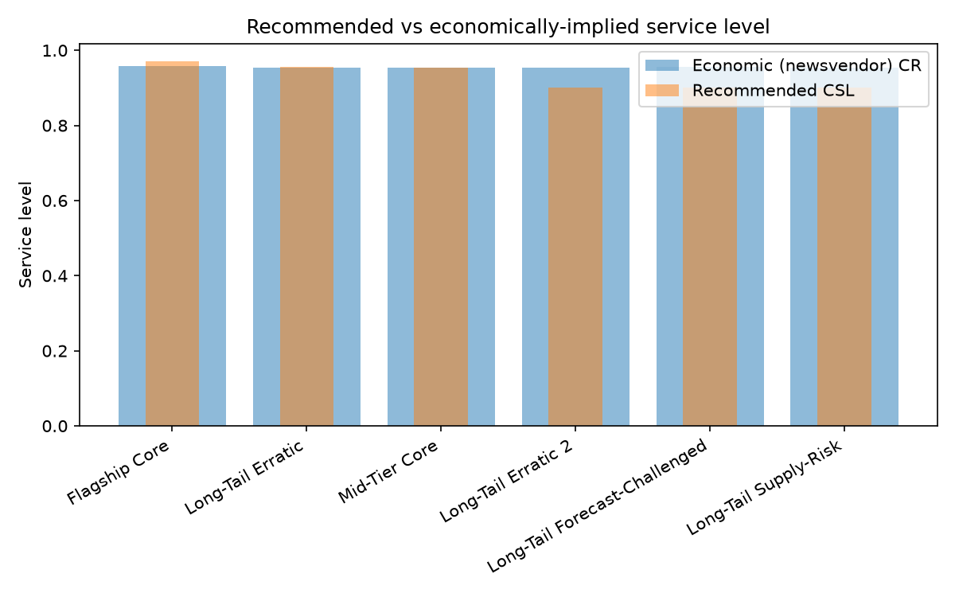
PHASE 2 · SEGMENTATION RESULTS
Six archetypes, ready for management review
500 SKUs · 9 candidate features (2 excluded by design) · 8 of 9 significant, p<0.05
k=6 — most reproducible split (bootstrap stability 0.82) across k=4–8
Flagship Core — 80 SKUs (16% of catalog) = 52% of revenue, 61% of margin → target CSL 97%.
Mid-Tier Core — 100 SKUs (20%) = 28% of revenue, 20% of margin → CSL 95%.
Four long-tail segments — 320 SKUs (64% of catalog) return just 20% of revenue → CSL 90%.
One 16-SKU cluster shows a promo-forecast collapse (22×–169× normal error) — the same SKUs flagged in every prior version of this analysis.
10

Slide 11
FROM SEGMENTS TO A STOCKING PLAN
Model building — MEIO turns policy into numbers
• Segmentation tells us what target to aim for per segment (e.g. 98% for Flagship Core, 88% for the long tail).
• MEIO turns that target into an actual number for every SKU at every one of the 23 stocking nodes: how much safety stock, what reorder point, what order-up-to level.
• This is where the network structure (Plant DC → Regional DC → Customer DC) and each SKU's real demand and lead-time variability enter the calculation — not just its segment label.
11

Slide 12
PHASE 3 · HOW THE MEIO MODEL IS BUILT
Newsvendor safety stock, positioned across the network
Step | What it does
1 · Primary lane | Plant DC is fixed per SKU by its qualified primary plant; Regional DC → Customer DC still picks the fastest available lane
2 · Cumulative lead time | Walk Plant → Plant DC → Regional DC (→ Customer DC) per SKU to get mean & variance of lead time to every node
3 · Demand estimate | Forward (2026) demand mean from the forecast; forward variability scaled by each SKU's own historical coefficient of variation
4 · Echelon pooling | A Regional DC's demand = its own direct demand + every Customer DC it primary-sources — it must buffer for its downstream nodes too
5 · Holding cost | Location- and density-aware: storage cost per unit (DC × subcategory) + unit cost × capital/shrink rate — not one flat category rate
6 · Target service level | Newsvendor critical ratio: CR = stockout cost ÷ (stockout cost + holding cost) → service-level target per SKU
7 · Safety stock | SS = z · √(lead-time weeks × demand variance + demand² × lead-time variance) — under demand AND lead-time uncertainty
8 · Compare to baseline | Reorder point & order-up-to vs. the current (2026-W01) policy, to quantify the working-capital gap
12

Slide 13
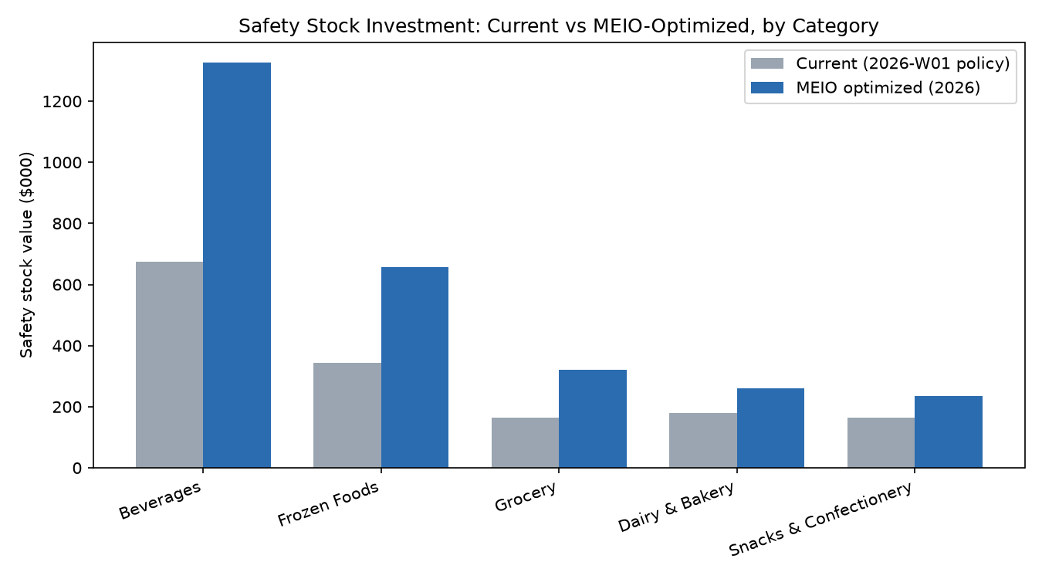
PHASE 3 · CURRENT OUTPUT — THE YEARLY STOCKING PLAN
Rerun on the refreshed dataset — a gap, not a surplus
Rerun this week on the refreshed dataset, with SKU-specific plant sourcing (not every plant can make every SKU) and a location-aware holding-cost model — both new in this data drop.
Current (2026-W01) safety stock: $1.53M
MEIO-optimized: $2.80M
Gap: +$1.27M (+83%)
Reason: routing SKUs only through the plant qualified to make them is slower than the old "ship from whichever DC is closest" assumption — lead times to Regional DCs are longer for 74% of SKU-lanes, by ~3.7 days on average.
Biggest gaps: Beverages +97%, Grocery +94%, Frozen Foods +92%.
13

Slide 14
PHASE 3 · NEXT — FROM A YEARLY PLAN TO A WEEKLY DECISION
Making the model responsive, not a once-a-year snapshot
TODAY — yearly model
One run per year, against the full 2026 forecast
Output: a single SS / ROP / order-up-to figure per SKU-DC for the whole horizon
Doesn't react to a demand spike, a late shipment, or a forecast revision mid-year — e.g. this week's +83% gap finding sits frozen until the next annual run
NEXT — weekly model
Re-run on a rolling weekly cadence against the latest forecast + last week's actuals
Output: a stocking decision for the upcoming week — how much to order, updated reorder point — not just an annual number
Directly implements the charter's closed-loop, self-recalibrating requirement, and is what the bandit layer (next) needs to have a fresh reward signal every round
14

Slide 15
PHASE 3 · ALSO BEING BUILT — A MULTI-ARMED BANDIT TUNER
Why a learning loop, not a one-shot optimization
• MEIO has hyperparameters — the safety factor, review cadence, positioning template, service-level tier per segment — that a one-shot optimization fixes once from historical data and never revisits.
• A multi-armed bandit (MAB) instead runs repeated simulation rounds across different hyperparameter settings (“arms”), observing a reward each round, and balances two things every round:
  – Exploitation — favor the setting that has worked best so far.
  – Exploration — keep testing other settings, in case conditions have shifted.
• Recommended algorithm: Thompson Sampling — it keeps a belief distribution per arm rather than a single average, which doubles as an easy-to-explain “confidence” for stakeholders, and naturally keeps re-checking settings instead of locking in early.
15

Slide 16
PHASE 3–4 · APPLYING THE BANDIT TO MEIO
Simulating across hyperparameters to minimize total cost
Ingredient | In this project
Arms | Discrete MEIO configuration templates — e.g. positioning (hold at Regional DC / push to Customer DC / split), service-level tier per segment, safety-factor setting
Reward | Simulated total cost for that setting: holding cost + stockout cost + capital cost, over a simulated period
Rounds | Each simulated week is a round; beliefs per arm update as new simulated outcomes come in
Why not one-shot | A regression/LP solve gives one fixed answer from historical data; the bandit keeps updating as conditions (demand, lead time) drift — the literal mechanism behind “continuously re-learns from outcomes” in the charter
Why this partly pre-builds Phase 4 (Simulation & Digital Twin Testing): a bandit needs a safe, repeatable reward generator to test arms against — that generator is the same simulation/digital-twin mechanism Phase 4 scopes. Building the bandit engine now pulls a meaningful slice of that phase forward.
16

Slide 17
PHASE 5 · AGENTIC INTERFACE
What the agent is planned to do
Capability | What it does
Review proposed tuning changes | Before a bandit-recommended MEIO parameter change goes live, the agent explains it in plain language to the planner and holds for explicit confirmation — human-in-the-loop, not autonomous
Run planner-directed simulations | The planner poses a what-if (e.g. "what if lead time from a plant rises 5 days?"); the agent runs it through the simulation engine and returns the optimal solution found for that scenario
Suggest segment service levels | The agent proposes optimal service-level targets for each identified segment, as a direct input to supply-planning decisions and SLA negotiations with customers and suppliers
Same principle throughout: the agent explains and proposes; a person confirms before anything real changes — a tuning setting, a simulation scope, a service-level number going into an SLA conversation.
Built on top of the bandit engine and segmentation output from Phase 3 — this layer has no independent decision logic of its own; it's a conversational front-end over decisions those models already make or can simulate.
17

Slide 18
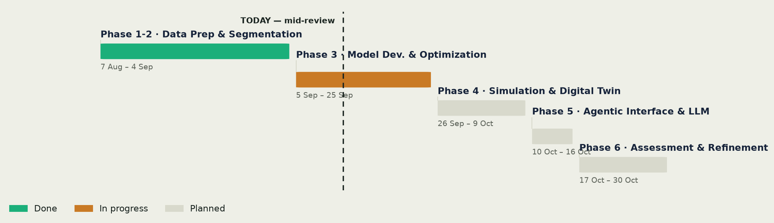
ROADMAP
Phase 3 close-out → Phase 4–6
• Phase 3 (through 25 Sep): finish the weekly-cadence MEIO model; stand up the generic bandit engine against mocked simulation output.
• Phase 4 (26 Sep–9 Oct): wire the bandit engine to the real digital twin; run the full 52-week horizon per segment — largely de-risked by the head start from Phase 3.
• Phase 5 (10–16 Oct): natural-language planner interface over segmentation / MEIO / bandit outputs, with human confirmation gating any real write.
• Phase 6 (17–30 Oct): compare the bandit-converged policy against the static baseline on the charter's own KPIs; finalize prototype for sponsor handover.
18

Slide 19
Thank you
Questions & discussion

