Slide 1
Approaching Text Summarization using ML and DNN
Name: Shivangi Sachan
Roll Number: MCS21025

Slide 2
Things to cover:
● Introduction to Text Summarization.
● Various approaches.
● Propose possible solutions.
● Create a basic solution.
● Code Walkthrough.

Slide 3
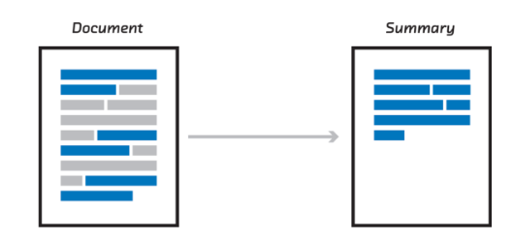
Introduction
Text summarization is the process of shortening a set of data computationally, to create a subset (a summary) that represents the most important or relevant information within the original content.
Text summarization is the technique for generating a concise and precise summary of voluminous texts while focusing on the sections that convey useful information, and without losing the overall meaning.

Slide 4
Various approaches for text summarization?
Extractive Summarization
Abstractive Summarization

Slide 5
Extractive Summarization
Extractive summarization means identifying important sections
(paragraphs or sentences or even words) of the text and selecting (copy paste) them and producing a subset of the text from the original text.

Slide 6
Extraction-based summarization

Slide 7
Abstractive Summarization
Abstractive summarization is the technique of generating a summary of a text from its main ideas, not by copying verbatim most salient sentences from text.
Abstractive Text Summarization is the task of generating a short and concise summary that captures the salient ideas of the source text. The generated summaries potentially contain new phrases and sentences that may not appear in the source text.

Slide 8
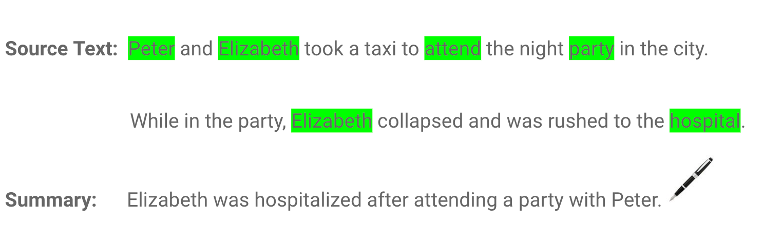
Abstraction-based summarization

Slide 9
Approaching Extractive Summarization?
One approach could be to create a semantic representation of sentences.
Following can be used to create a semantic representation for texts:
Count-based techniques like Count Vectorizer, Tf-Idf Vectorizer
Pretrained word embeddings based techniques like Word2Vec

Slide 10
Approaching Extractive Summarization?
● What is TF-IDF Vectorizer:
TF-IDF is an abbreviation for Term Frequency Inverse Document Frequency It can be defined as the calculation of how relevant a word in a series or corpus is to a text. The meaning increases proportionally to the number of times in the text a word appears but is compensated by the word frequency in the corpus (data-set).

Slide 11
Term Frequency:
In document d, the frequency represents the number of instances of a given word t. Therefore, we can see that it becomes more relevant when a word appears in the text, which is rational. Since the ordering of terms is not significant, we can use a vector to describe the text in the bag of term models.
tf(t,d) = count of t in d / number of words in d
Document Frequency:
This tests the meaning of the text, which is very similar to TF, in the whole corpus collection. The only difference is that in document d, TF is the frequency counter for a term t, while df is the number of occurrences in the document set N of the term t. In other words, the number of papers in which the word is present is DF.
df(t) = occurrence of t in documents

Slide 12
Inverse Document Frequency:
Mainly, it tests how relevant the word is. The key aim of the search is to locate the appropriate records that fit the demand. Since tf considers all terms equally significant, it is therefore not only possible to use the term frequencies to measure the weight of the term in the paper. First, find the document frequency of a term t by counting the number of documents containing the term:
df(t) = N(t)
where
df(t) = Document frequency of a term t
N(t) = Number of documents containing the term t
idf(t) = log(N/ df(t))

Slide 13

Approaching Extractive Summarization?
Word2Vec embedding:
Embedding is something like key-value pair.
For each word in our vocabulary, there will be a learned numerical representation for it.
To handle unknown words, we will treat each of them as OOV (Out of vocabulary) words and will use the learned OOV representation.
Word2vec can utilize either of two model architectures to produce a distributed
representation of words: continuous bag-of-words (CBOW) or continuous skip-gram

Slide 14
Approaching Extractive Summarization?
What is BERT:
BERT stands for Bi-directional Encoder Representation from Transformers.
It is designed to pre-train deep bidirectional representations from unlabeled text by jointly conditioning on both left and right context.
BERT is pre-trained on two NLP tasks:
Masked Language Modeling
Next Sentence Prediction

Slide 15
Approaching Extractive Summarization Summary
One approach could be to create a semantic representation of sentences.
Following can be used to create a semantic representation for texts:
Count-based techniques like Count Vectorizer, Tf-Idf Vectorizer.
Pretrained word embeddings based techniques like Word2Vec.
Pretrained SOTA transformers like BERT (or its variants) to better capture context as well.
3. Train your own
4. Now comparison can be done between each sentences as they are no
more a sequence of characters and words but a numerical vector now.
5. Use the comparisons to score each sentences and pick the top scored ones as your summary.
6. Scoring technique needs to be intelligent enough to properly evaluate what are the information content of a sentence and thus score it accordingly.

Slide 16
References
https://medium.com/analytics-vidhya/deep-reinforcement-learning-deeprl-for-abstractive-text-summarization-made-easy-tutorial-9-c6914999c76c
https://blog.floydhub.com/gentle-introduction-to-text-summarization-in-machine-learning/
https://www.sciencedirect.com/science/article/pii/S0885230821000796
https://data-flair.training/blogs/machine-learning-text-summarization/

Slide 17
Appendix (Optional)
Codelink: https://colab.research.google.com/drive/1gkDBD_qpTgQW_0BYKQdjyAJQoNF8x1S7#scrollTo=1eJRxnthHPcD

