Slide 1
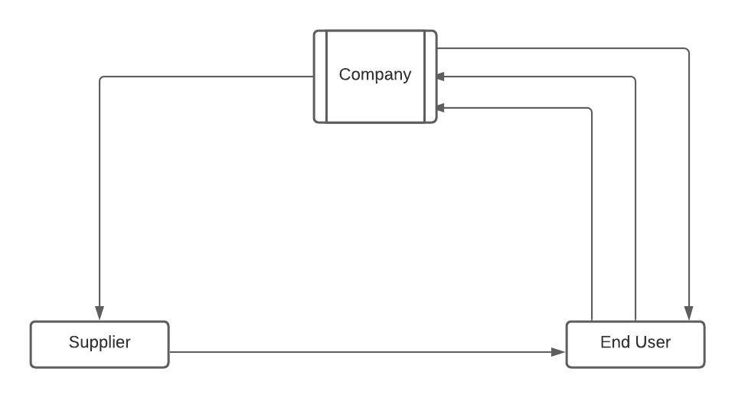
A salesperson from a company needs to introduce the company to the customer and gather the query. The sales process follows as per the following diagram:-
(Product dealing done: After negotiation the price )
(Company raises own PO)
PO
Invoice
Quotation
(Finalize the deal)
Payment
Supply the products

Slide 2






ABC COMPANY
Company
Sends to
Supplier
generates
Customer
Supplies
Salesman
Product dealing : After negotiating the price of the products
Pays
Bill Payment
Quotation
PO

