Slide 1
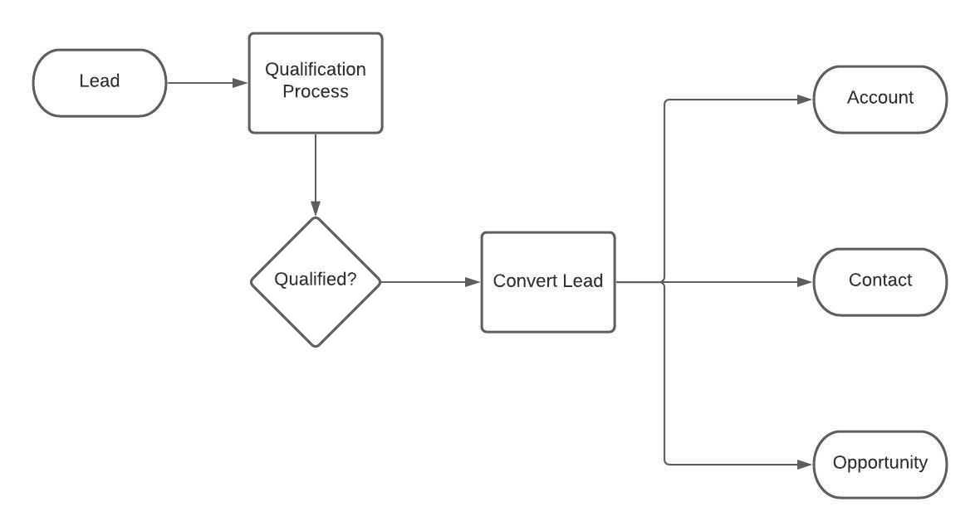
What Sales Process includes??

Slide 2









XYZ Company
ABC Company
Want product like hardware, Server.
But where I go to buy all these in company’s budget?
Refers to and asked for their services
Introduce the company and gathers the query
Newspaper Reference
Opportunity
Lead/
Contact
Finalize the product price and accepts the quotation and give PO
Social Media Reference
Prospect
Salesman
Customer
Person to Person Reference
XYZ Company
Sends the invoice to
Supplies
Supplies
Deal
Supplier
Customer
Account

