Slide 1
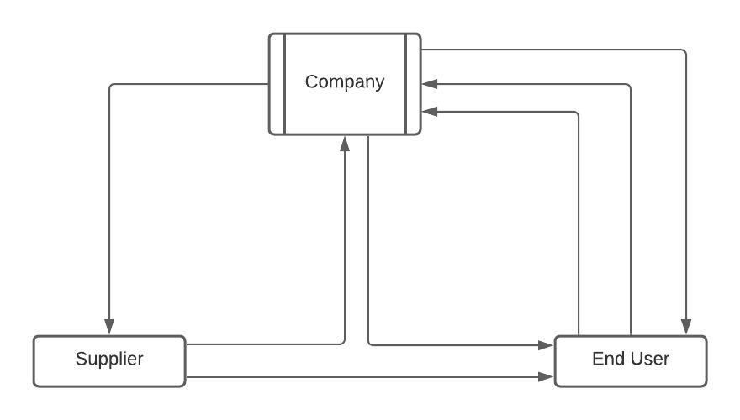
A salesperson from a company needs to introduce the company to the customer and gather the query. The sales process follows as per the following diagram:-
(Product dealing done: After negotiation the price )
(Company raises own PO)
PO
Invoice
(Finalize the deal)
Supply the products
Payment
Quotation
Supply the products
Supply the products

Slide 2






ABC COMPANY
Company
Sends to
Supplier
generates
Customer
Supplies
Salesman
Product dealing : After negotiating the price of the products
Pays
Bill Payment
Quotation
PO

