Slide 1
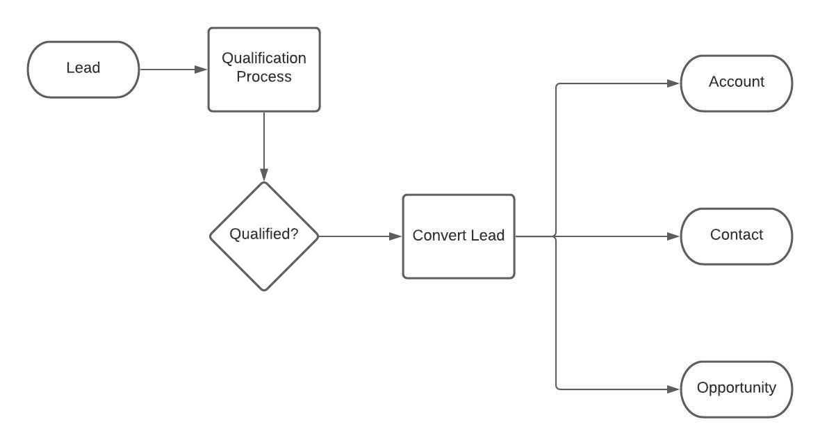

Slide 2





ABC Company
XYZ Company
Account
Introduce the company and gathers the query
Opportunity
Lead
Finalize the product price and accepts the quotation and give PO
Customer
Salesman
Introduce the company and gathers the query
Deal
query
Contact
Refers(XYZ Company)

