Slide 1

Cost Burden and Effects of Socioeconomic factors on Population Health
ALY6160 - Healthcare Business Intelligence Professor: Dr. Cartik Saravanamuthu
Team: Shivangi Vashi, Catherine Richard

Slide 2
Table of Contents
Background
Exploratory Data Analysis
Models
Conclusion

Slide 3
Background
Medicare and Medicaid
Medicare is the federal health insurance program for:
People who are 65 or older
Certain younger people with disabilities
People with End-Stage Renal Disease (permanent kidney failure requiring dialysis or a transplant, sometimes called ESRD)
Administered by Centers for Medicare & Medicaid Services (CMS)
MCBS = Ongoing Survey of Medicare and Medicaid Beneficiaries

Slide 4
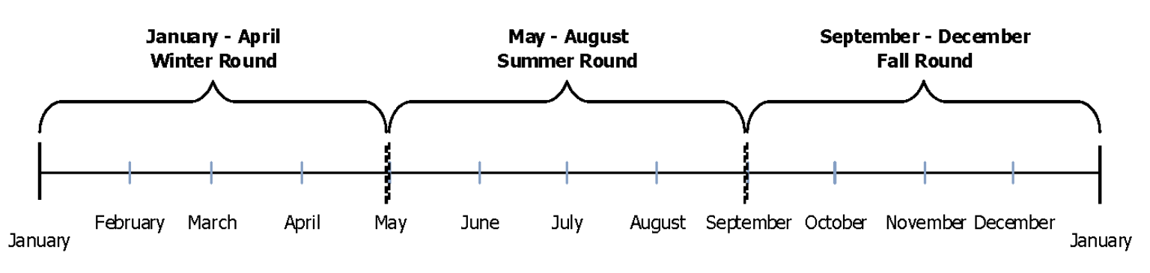
Focus on Fall Round
Notes:
Typical MCBS Data Collection Year
3 Rounds: Winter, Summer, Fall
Total 2018 Respondents: 5,803

Slide 5
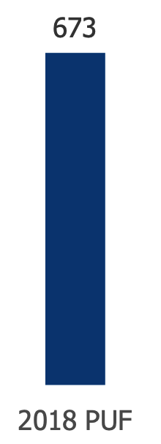
Target Variables:
Total #
ACC_HCDELAY: Last year ever delay in care due to cost
ACC_PAYPROB: Problem paying medical bills
Notes:
MCBS PUF (public use file) variables :
Total 673 - Although not all available for Fall, Winter and Summer = 239 variables
Randomly generated IDs to protect identity of patients - but also prevent multi-year time series analyses
No Geographic identifiers
Populations Weights

Slide 6
Data Cleaning & Pre-processing
Simplified variables
Cleaning non-response
Notes:
MCBS PUF (public use file) variables :
Total 673 - Although not all available for Fall, Winter and Summer = 239 variables
Randomly generated IDs to protect identity of patients - but also prevent multi-year time series analyses
No Geographic identifiers
Populations Weights

Slide 7
Feature Engineering
Notes:
MCBS PUF (public use file) variables :
Total 673 - Although not all available for Fall, Winter and Summer = 239 variables
Randomly generated IDs to protect identity of patients - but also prevent multi-year time series analyses
No Geographic identifiers
Populations Weights

Slide 8
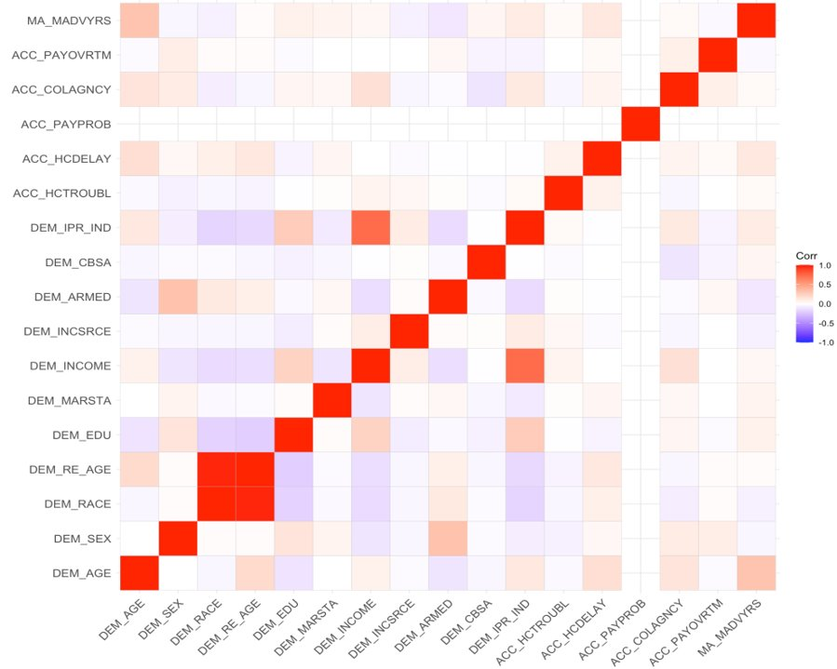
Correlation Between Demographics and Problems with Access to Care

Slide 9
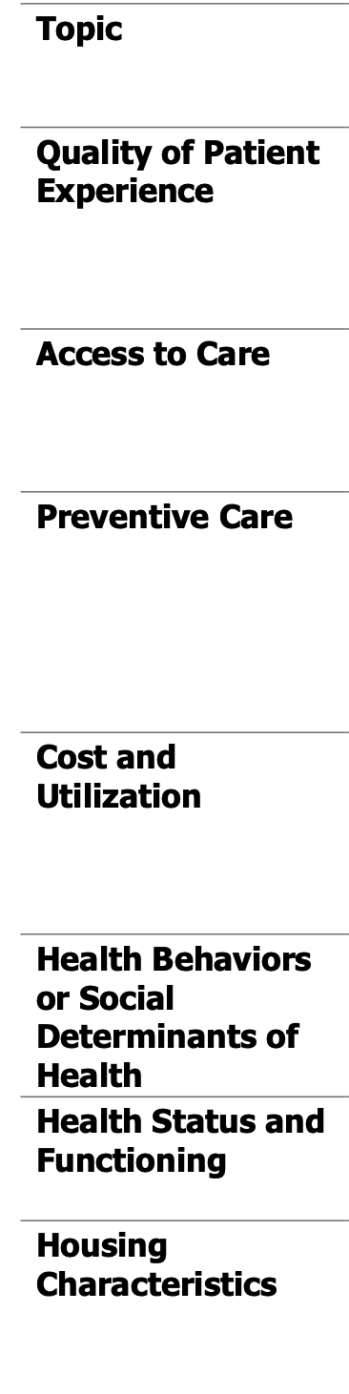
Area of focus / Objective
Socioeconomic Factors impacting Health Status and Functioning
Cost-Burden
Chronic Conditions and Severity
Notes:
Specifically: Medicaid and health insurance coverage
Years enrolled in Medicaid
Chronic Conditions -> Severity
Cost burden - impact of socio-economic situation on Health Status and Functioning

Slide 10
Clustering
Notes:
Unsupervised learning

Slide 11
Model
Correlation analysis

Slide 12
Model 2
Dimension Reduction
Feature Selection, Exclusion,
Feature Extraction and Engineering
Correlation Analysis
Data Analysis and Predictive Modelling
Model Validation and Testing, improvements

Slide 13
XGBoost Model

Slide 14
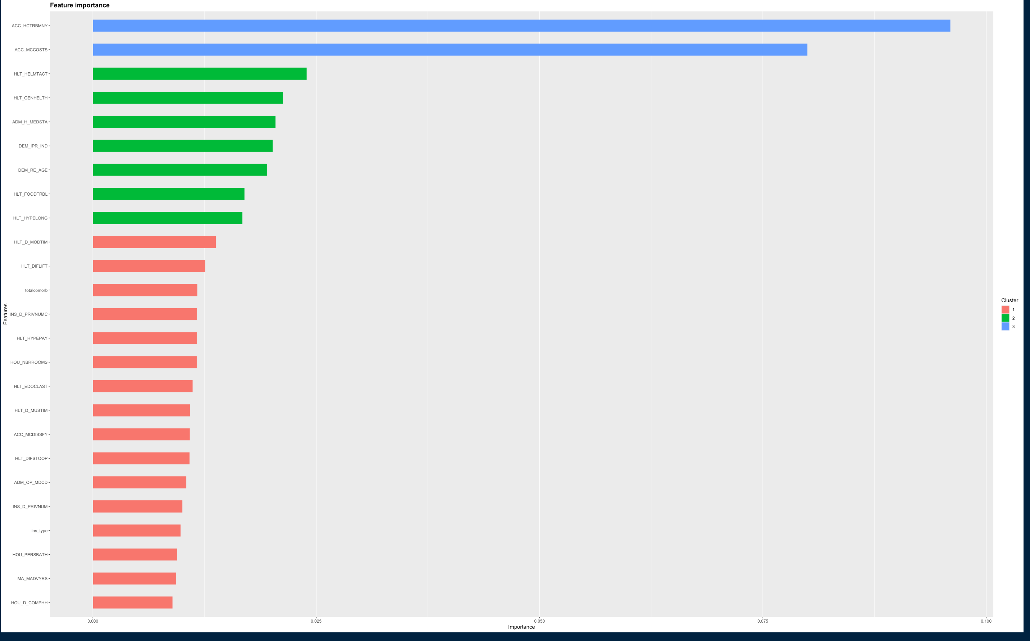
Feature Importance

Slide 15
Classification
Logistic regression or svm

Slide 16
Model Evaluation
Notes:
Specifically: Medicaid and health insurance coverage
Years enrolled in Medicaid
Chronic Conditions -> Severity
Cost burden - impact of socio-economic situation on Health Status and Functioning

Slide 17
Model Evaluation
Model Validation and Testing
Notes:
Specifically: Medicaid and health insurance coverage
Years enrolled in Medicaid
Chronic Conditions -> Severity
Cost burden - impact of socio-economic situation on Health Status and Functioning

Slide 18
Conclusions & Next Steps
High Dimensional Dataset
Missing Data (or removed to protect privacy)
High non-response
Variable Sample each Round: Smaller Summer Sample Size -> impact on Power
Weighted Sampling
Notes:
As noted earlier, to protect beneficiary privacy, variables, such as those related to geography and costs for example, were removed. Limiting our

Slide 19
Thank you !
Questions?
Notes:
References :

Slide 20
References:
Centers for Medicare & Medicaid Services (September 22, 2020). DATA USER’S GUIDE: PUBLIC USE FILE.
https://www.medicare.gov/what-medicare-covers/your-medicare-coverage-choices/whats-medicare

