Slide 1

Cost Burden and Effects of Socioeconomic factors on Population Health
ALY6160 - Healthcare Business Intelligence Professor: Dr. Cartik Saravanamuthu
Team: Shivangi Vashi, Catherine Richard

Slide 2
Table of Contents
Background
Exploratory Data Analysis
Models
Conclusion

Slide 3
Background
Medicare and Medicaid
Medicare is the federal health insurance program for:
People who are 65 or older
Certain younger people with disabilities
People with End-Stage Renal Disease (permanent kidney failure requiring dialysis or a transplant, sometimes called ESRD)
Administered by Centers for Medicare & Medicaid Services (CMS)
MCBS = Ongoing Survey of Medicare and Medicaid Beneficiaries

Slide 4
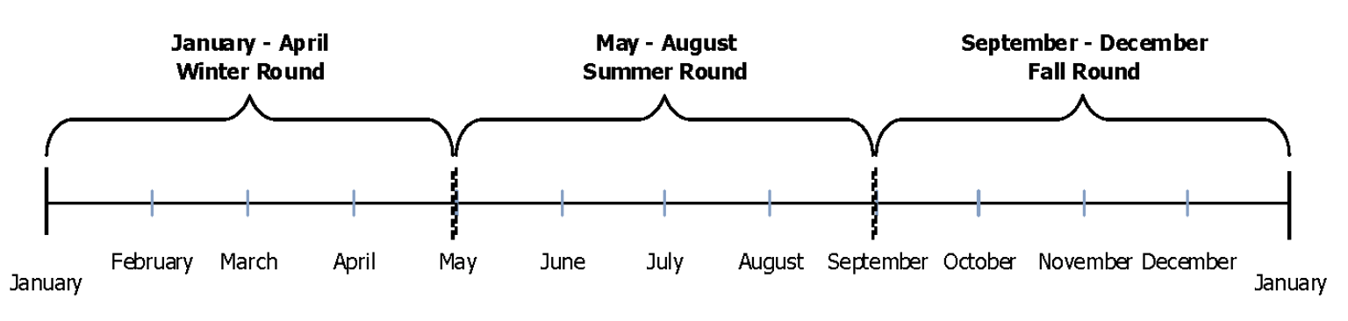
Focus on Fall Round
Notes:
Typical MCBS Data Collection Year
3 Rounds: Winter, Summer, Fall
Total 2018 Respondents: 5,803

Slide 5
Area of focus
Defined as:
Cost-Burden
Notes:
Specifically: Medicaid and health insurance coverage
Years enrolled in Medicaid
Chronic Conditions -> Severity
Cost burden - impact of socio-economic situation on Health Status and Functioning

Slide 6
Target Variables for
Cost Burden
Indicated by variables:
Composite variable :
Notes:
MCBS PUF (public use file) variables :
Total 673 - Although not all available for Fall, Winter and Summer = 239 variables
Randomly generated IDs to protect identity of patients - but also prevent multi-year time series analyses
No Geographic identifiers
Populations Weights

Slide 7
Data Cleaning & Pre-processing
Notes:
MCBS PUF (public use file) variables :
Total 673 - Although not all available for Fall, Winter and Summer = 239 variables
Randomly generated IDs to protect identity of patients - but also prevent multi-year time series analyses
No Geographic identifiers
Populations Weights

Slide 8
Feature Engineering

Slide 9
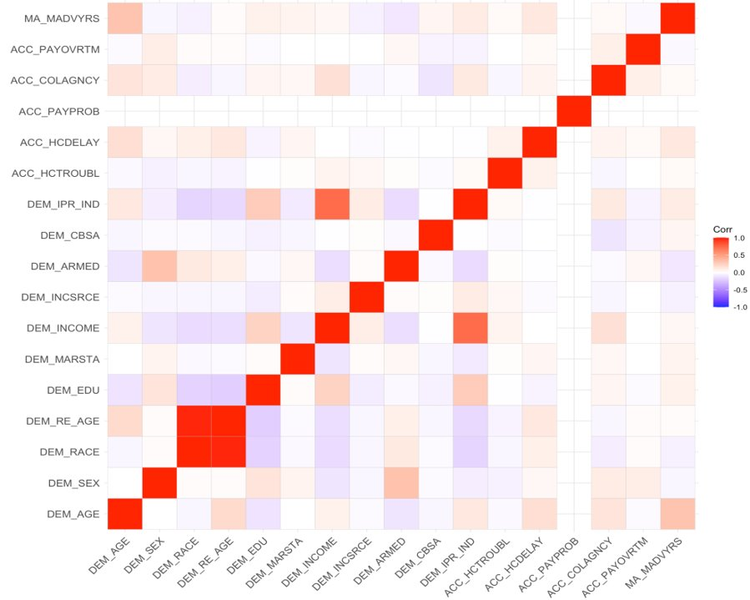
Correlation Between Demographics and Problems with Access to Care

Slide 10
Clustering kNN
Notes:
Unsupervised learning

Slide 11
Model
Correlation analysis

Slide 12
Model 2
Dimension Reduction
Feature Selection, Exclusion,
Feature Extraction and Engineering
Correlation Analysis
Data Analysis and Predictive Modelling
Model Validation and Testing, improvements

Slide 13
SVM Classification

Slide 14
Model Evaluation
Notes:
Specifically: Medicaid and health insurance coverage
Years enrolled in Medicaid
Chronic Conditions -> Severity
Cost burden - impact of socio-economic situation on Health Status and Functioning

Slide 15
Model Evaluation
Model Validation and Testing
Notes:
Specifically: Medicaid and health insurance coverage
Years enrolled in Medicaid
Chronic Conditions -> Severity
Cost burden - impact of socio-economic situation on Health Status and Functioning

Slide 16
Conclusions
Model accuracy comparison
Feature importance
Cost burden expanded definition
Notes:
As noted earlier, to protect beneficiary privacy, variables, such as those related to geography and costs for example, were removed. Limiting our

Slide 17
Conclusions & Next Steps
High Dimensional Dataset
Missing Data (or removed to protect privacy)
High non-response
Variable Sample each Round: Smaller Summer Sample Size -> impact on Power
Weighted Sampling
Notes:
As noted earlier, to protect beneficiary privacy, variables, such as those related to geography and costs for example, were removed. Limiting our

Slide 18
Thank you !
Questions?
Notes:
References :

Slide 19
References:
Centers for Medicare & Medicaid Services (September 22, 2020). DATA USER’S GUIDE: PUBLIC USE FILE.
https://www.medicare.gov/what-medicare-covers/your-medicare-coverage-choices/whats-medicare

