Slide 1

Cost Burden and Effects of Socioeconomic factors on Population Health
ALY6160 - Healthcare Business Intelligence Professor: Dr. Cartik Saravanamuthu
Team: Shivangi Vashi, Catherine Richard

Slide 2
Table of Contents
Background
Exploratory Data Analysis
Models: KNN, SVM, XgBoost, SVM
Results & Model Comparison

Slide 3
Background
Medicare and Medicaid
Medicare is the federal health insurance program for:
People who are 65 or older
Certain younger people with disabilities
People with End-Stage Renal Disease (permanent kidney failure requiring dialysis or a transplant, sometimes called ESRD)
Administered by Centers for Medicare & Medicaid Services (CMS)
MCBS = Ongoing Survey of Medicare and Medicaid Beneficiaries

Slide 4
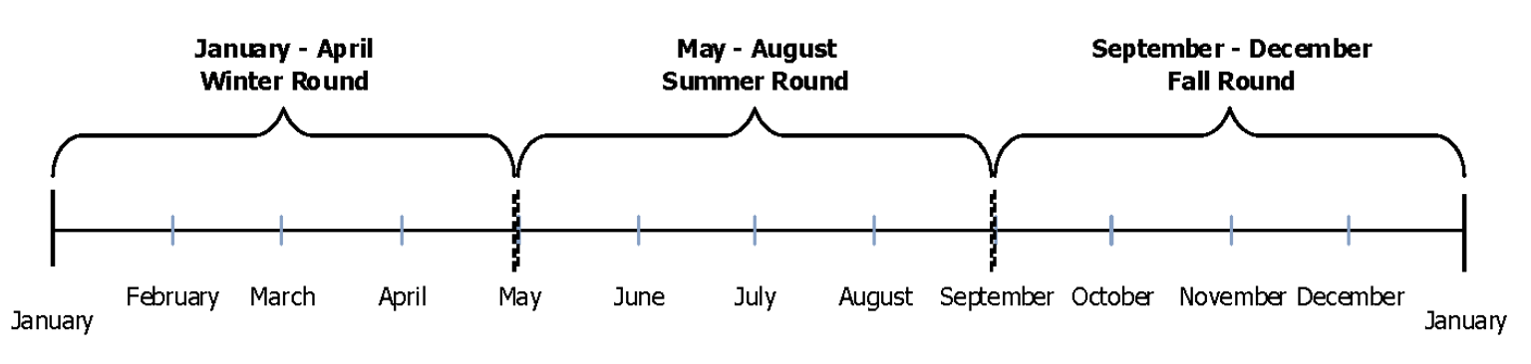
Focus on Fall Round
Notes:
Typical MCBS Data Collection Year
3 Rounds: Winter, Summer, Fall
Total 2018 Respondents: 5,803

Slide 5
Area of focus
Defined as:
Cost-Burden
nearly 1 in 3 Americans are financially burdened by their medical expenses [1, 2]. Beyond just financial consequences, high out-of-pocket medical costs have been associated with lower quality of life, delayed or forgone care, and increased risk of adverse health outcomes [2–7].
Notes:
Specifically: Medicaid and health insurance coverage
Years enrolled in Medicaid
Chronic Conditions -> Severity
Cost burden - impact of socio-economic situation on Health Status and Functioning

Slide 6
Target Variables for
Cost Burden
ACC_HCDELAY: Last year ever delay in care due to cost
ACC_PAYPROB: Problem paying medical bills
Indicated by variables:
Composite variable :
Notes:
MCBS PUF (public use file) variables :
Total 673 - Although not all available for Fall, Winter and Summer = 239 variables
Randomly generated IDs to protect identity of patients - but also prevent multi-year time series analyses
No Geographic identifiers
Populations Weights

Slide 7
Data Cleaning & Pre-processing
Simplified variables
Cleaning non-response
Notes:
MCBS PUF (public use file) variables :
Total 673 - Although not all available for Fall, Winter and Summer = 239 variables
Randomly generated IDs to protect identity of patients - but also prevent multi-year time series analyses
No Geographic identifiers
Populations Weights

Slide 8
Feature Engineering

Slide 9
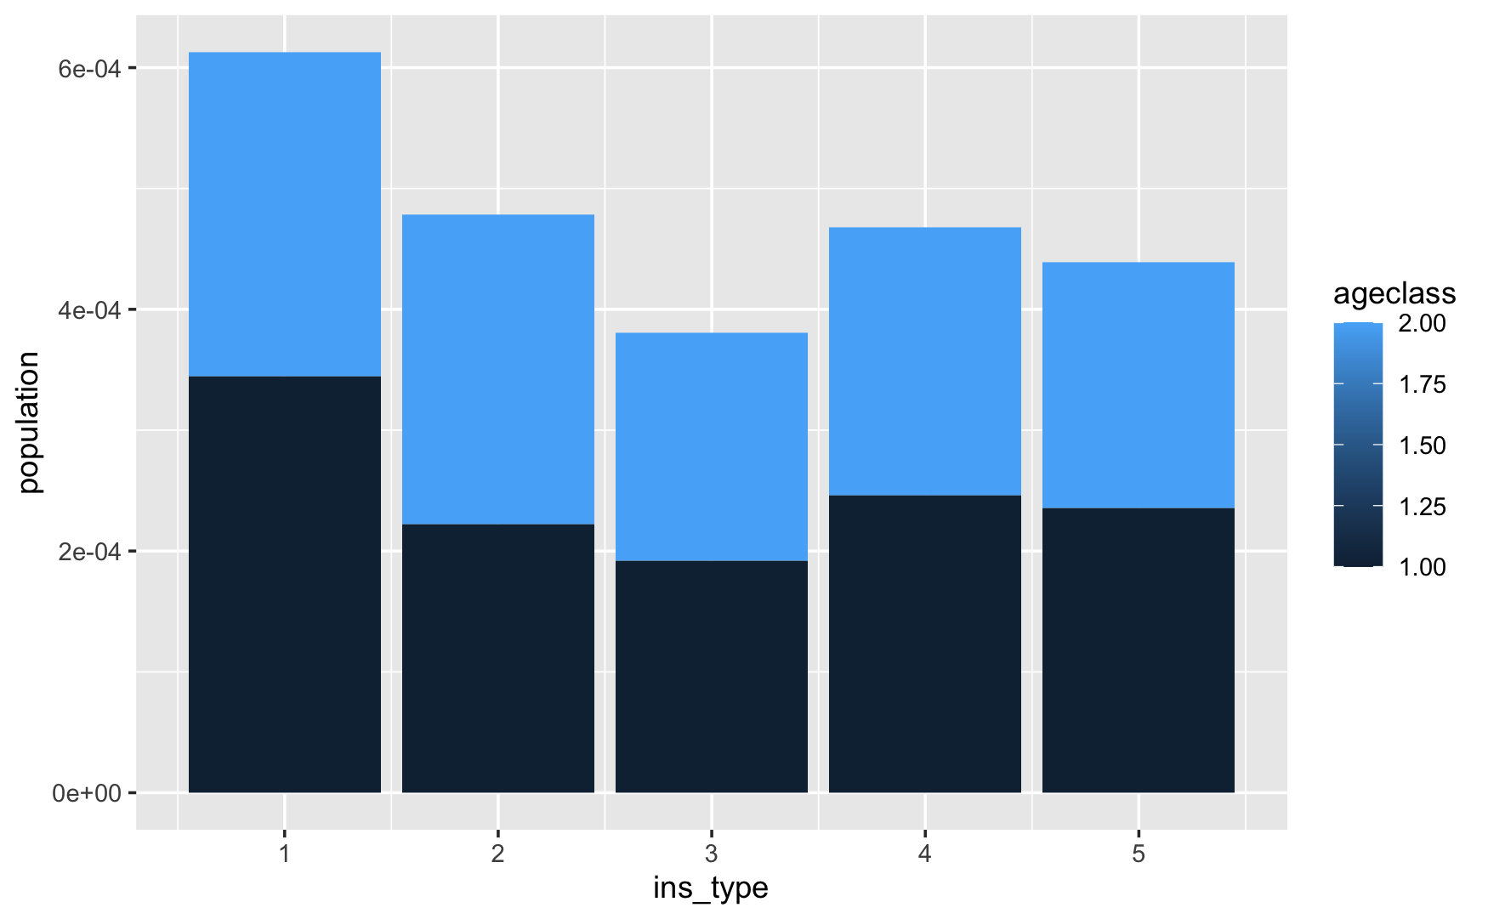
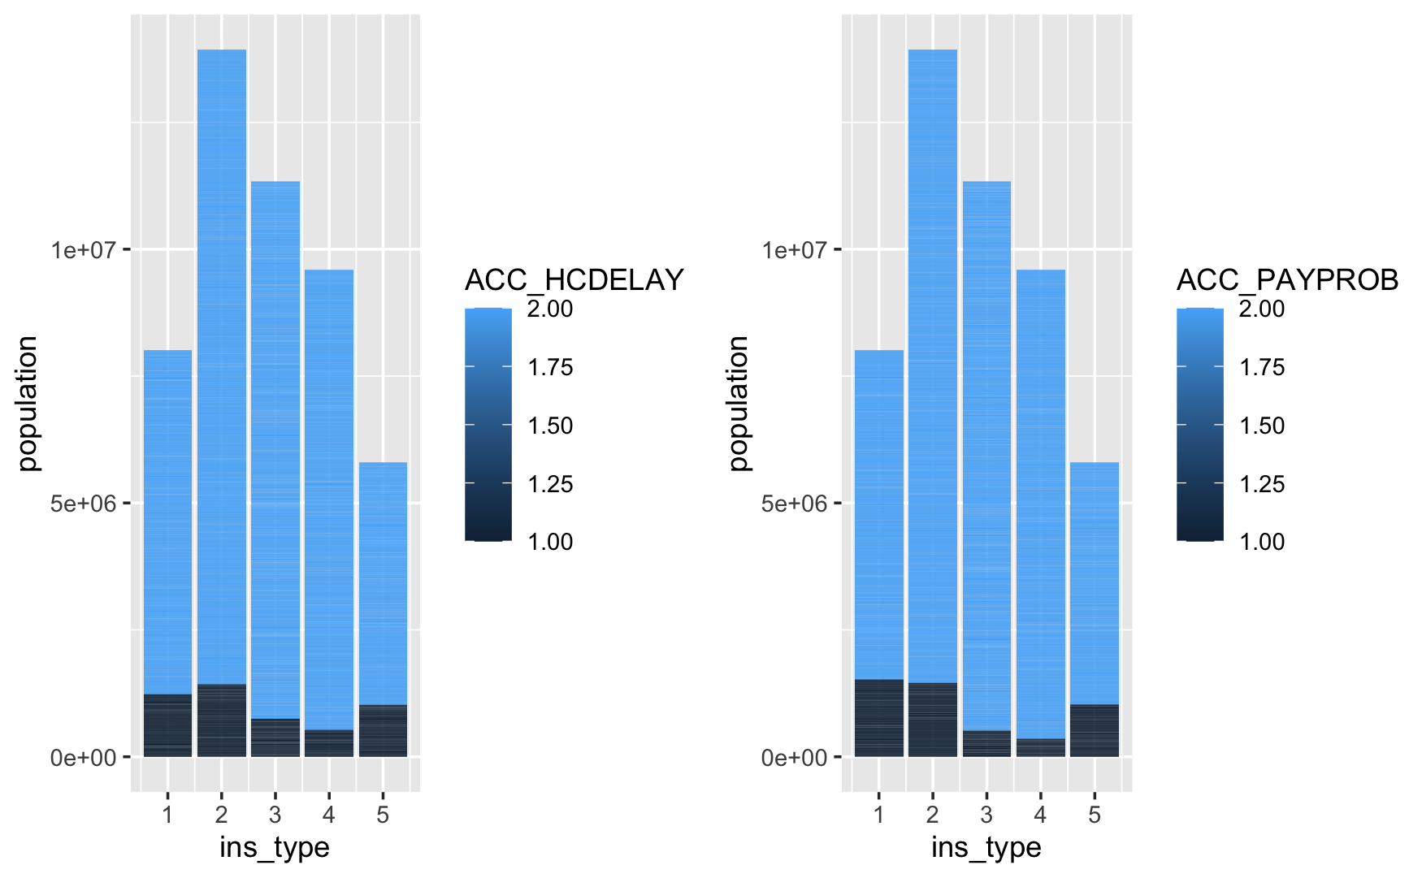
Demographics
Notes:
The first plot describes the distribution of disabled and elderly groups by their insurance type.
The second describes the breakdown of whether a beneficiary experiences delay in healthcare due to cost by the age class.

Slide 10
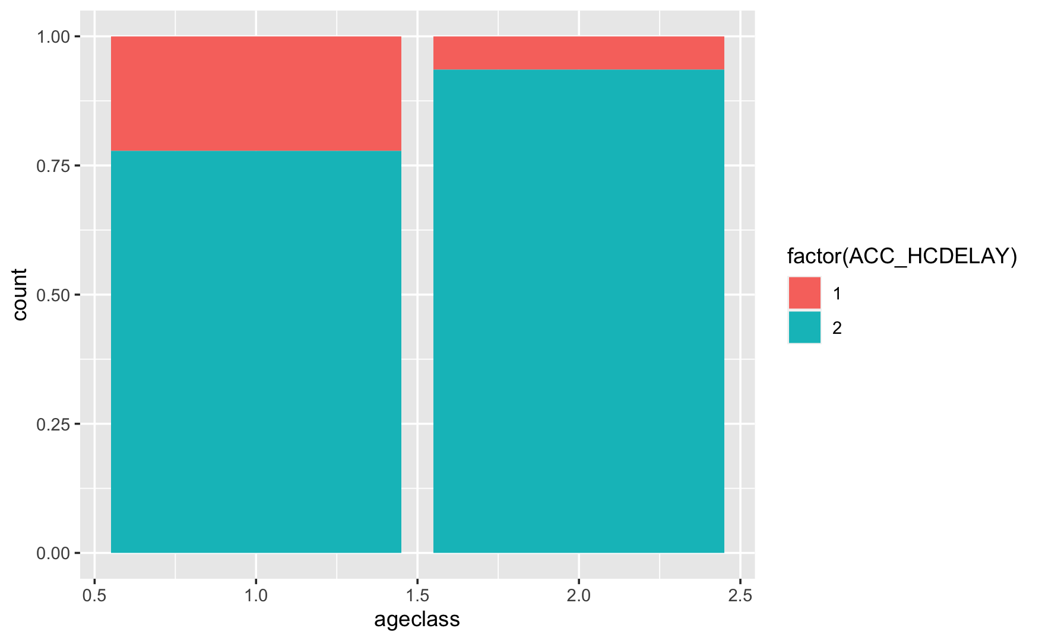
Age and variables of interest

Slide 11
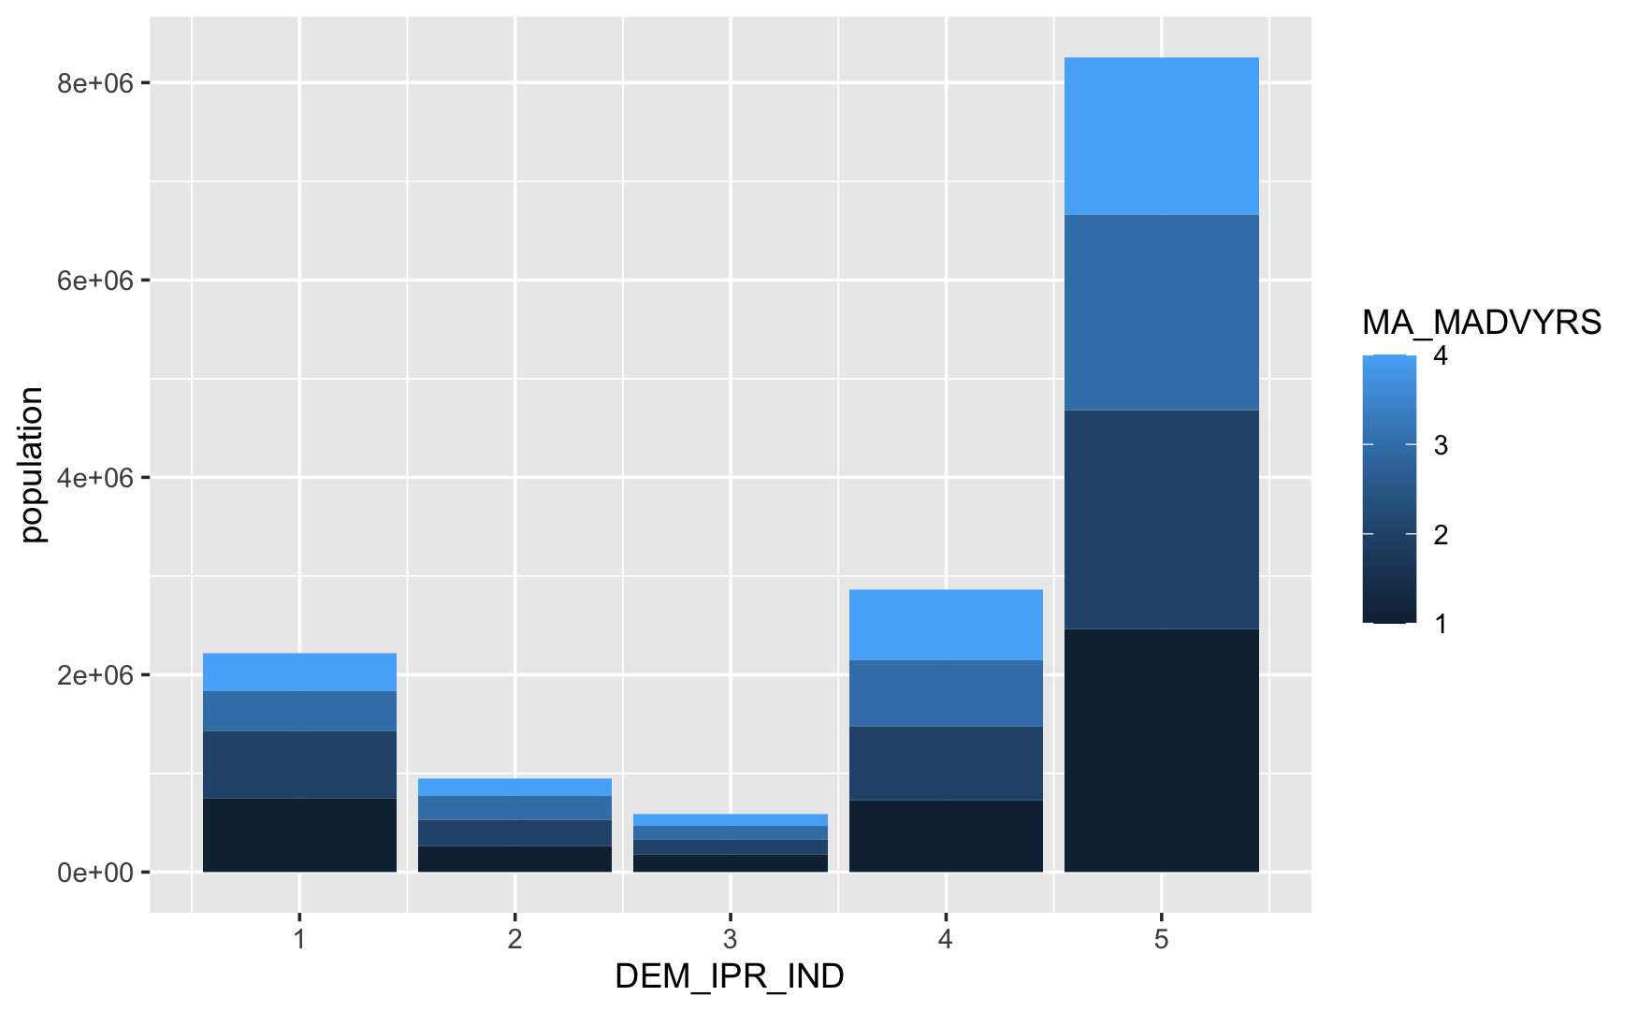
Notes:
#Income below Federal Poverty level by yeats in MedADV
#Income below Poverty Line by Insurance Type
#Income below Poverty Line by Insurance Type

Slide 12
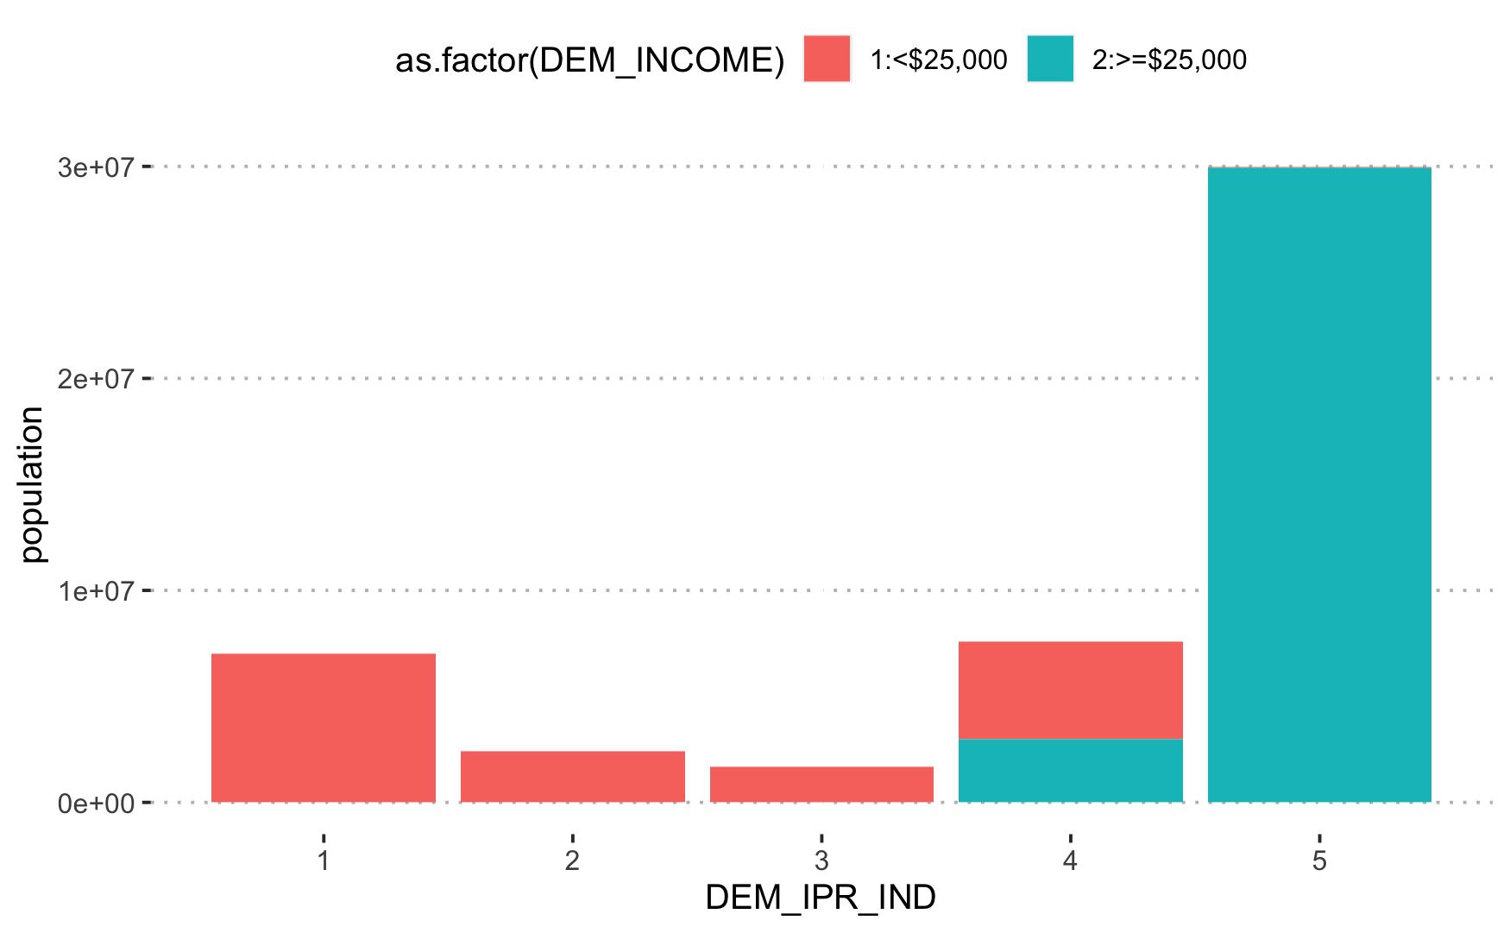
Notes:
#Income below Federal Poverty level by yeats in MedADV
#Income below Poverty Line by Insurance Type
#Income below Poverty Line by Insurance Type

Slide 13
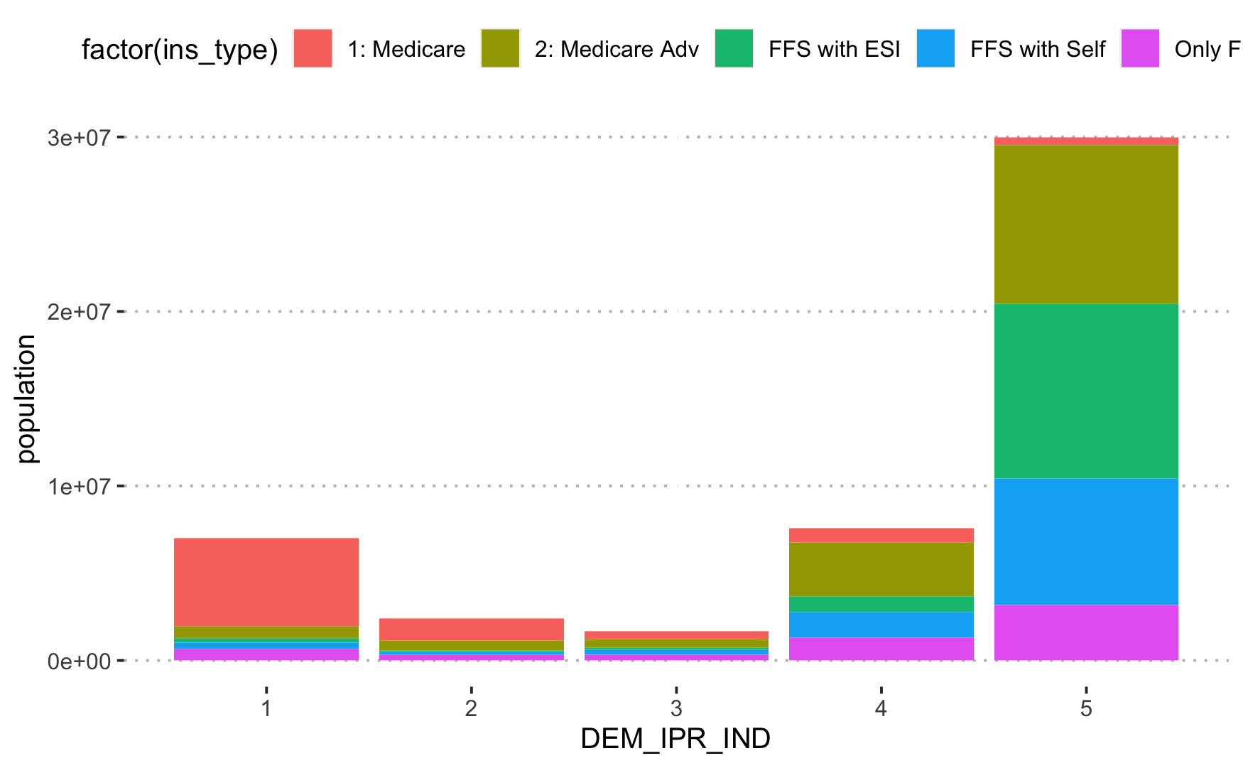
Notes:
#Income below Federal Poverty level by yeats in MedADV
#Income below Poverty Line by Insurance Type
#Income below Poverty Line by Insurance Type

Slide 14
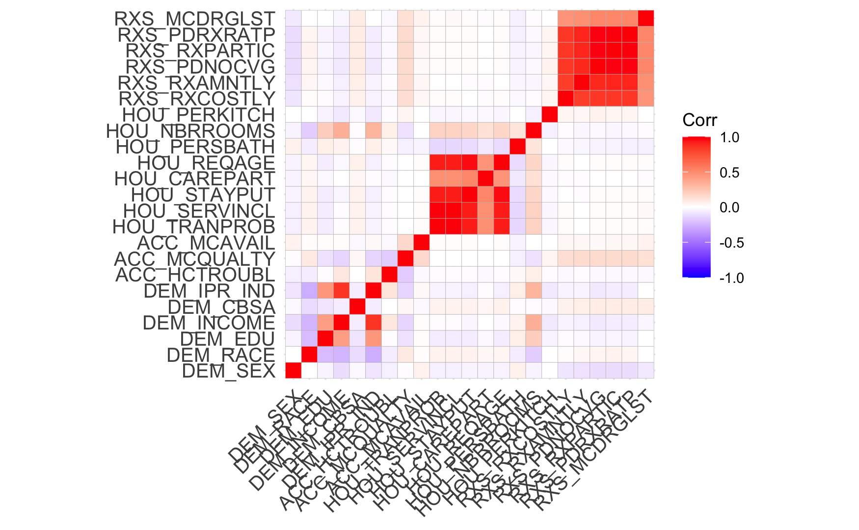
Correlation Between Demographics and Problems with Access to Care

Slide 15
kNN
Notes:
Unsupervised learning

Slide 16
Model Random Forest on ACC_HCDELAY
Correlation analysis

Slide 17
Model Random Forest on costburden
Correlation analysis

Slide 18
SVM (RBF)
Dimension Reduction
Feature Selection, Exclusion,
Feature Extraction and Engineering
Correlation Analysis
Data Analysis and Predictive Modelling
Model Validation and Testing, improvements

Slide 19
SVM Classification

Slide 20
XgBoost

Slide 21
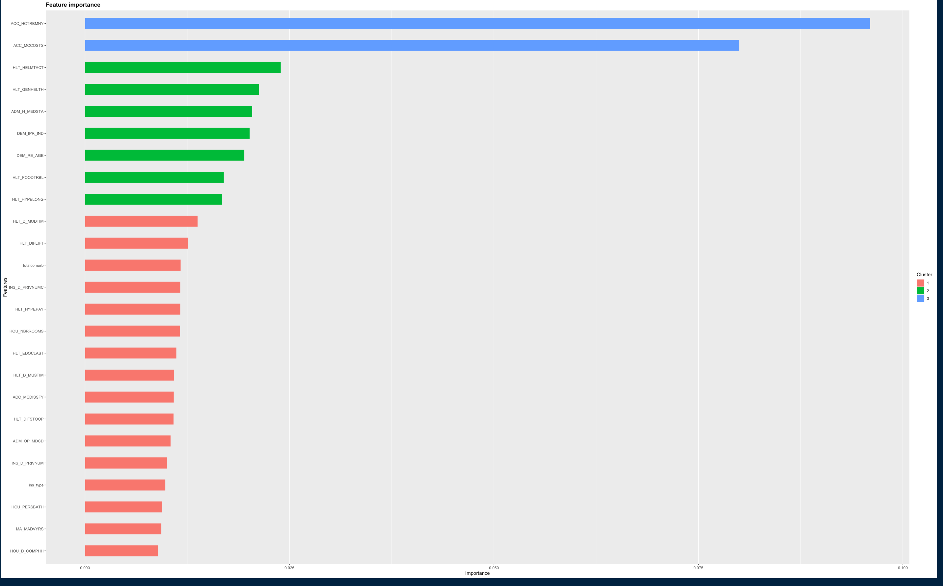
Feature Importance

Slide 22
Model Evaluation
Notes:
Specifically: Medicaid and health insurance coverage
Years enrolled in Medicaid
Chronic Conditions -> Severity
Cost burden - impact of socio-economic situation on Health Status and Functioning

Slide 23
Model Evaluation
Model Validation and Testing
Notes:
Specifically: Medicaid and health insurance coverage
Years enrolled in Medicaid
Chronic Conditions -> Severity
Cost burden - impact of socio-economic situation on Health Status and Functioning

Slide 24
Conclusions
Model accuracy comparison
Feature importance
Cost burden expanded definition
Notes:
As noted earlier, to protect beneficiary privacy, variables, such as those related to geography and costs for example, were removed. Limiting our

Slide 25
Conclusions & Next Steps
High Dimensional Dataset
Missing Data (or removed to protect privacy)
High non-response
Variable Sample each Round: Smaller Summer Sample Size -> impact on Power
Weighted Sampling
Notes:
As noted earlier, to protect beneficiary privacy, variables, such as those related to geography and costs for example, were removed. Limiting our

Slide 26
Thank you !
Questions?
Notes:
References :

Slide 27
References:
Centers for Medicare & Medicaid Services (2020, September 22). DATA USER’S GUIDE: PUBLIC USE FILE.
https://www.medicare.gov/what-medicare-covers/your-medicare-coverage-choices/whats-medicare
Ramsey, S. et al. (2020). Chapter 30 - Economic Burdens and Access to Care Barriers for the Older Cancer Patient. In Management of Cancer in the Older Patient. W.B. Saunders.
Hunter, W.G., Hesson, A., Davis, J.K. et al. (2016). Patient-physician discussions about costs: definitions and impact on cost conversation incidence estimates. BMC Health Serv Res 16, 108 https://doi.org/10.1186/s12913-016-1353-2

