Slide 1
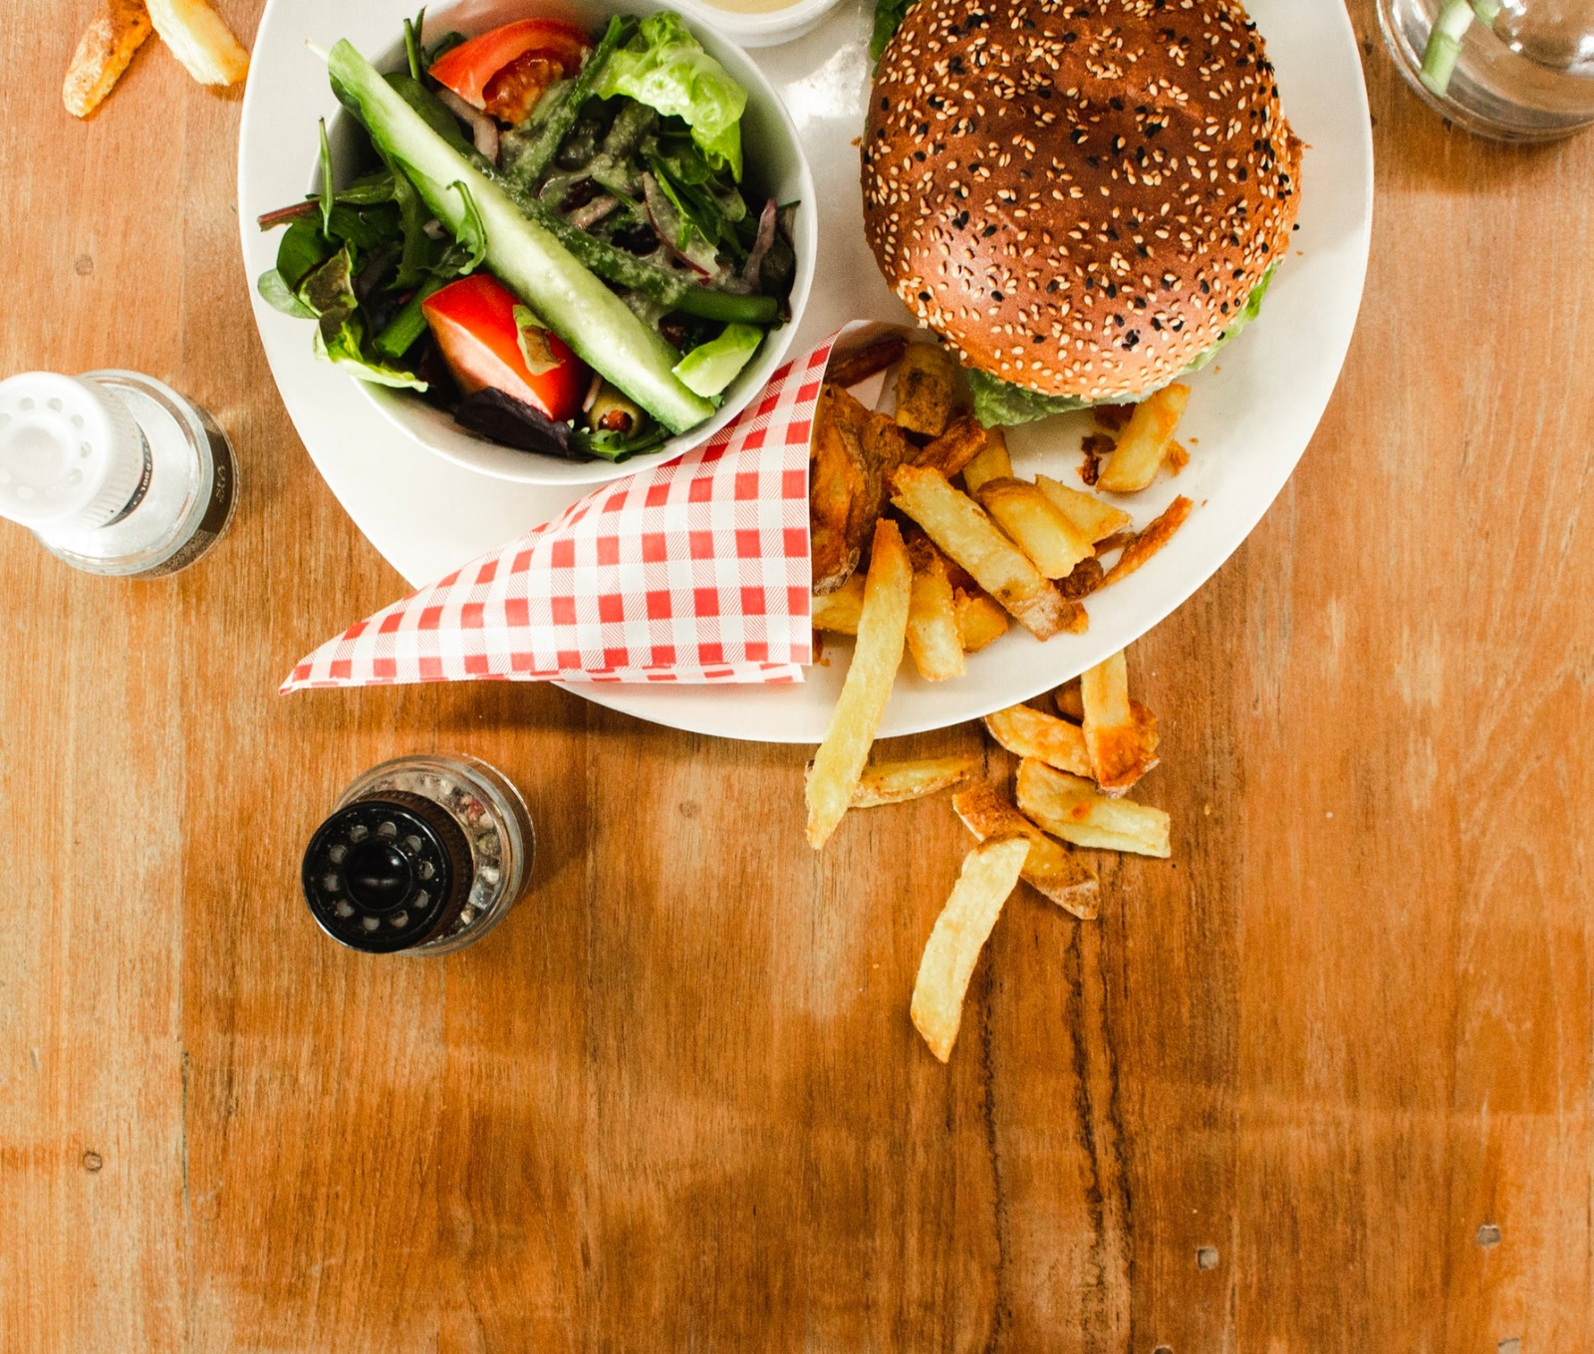
CRAVE
Customized Drive-Thru
TEAM 10:
Pooja Kataria
Saumil Shah
Shivang Mistry
Tejas Desai

Slide 2
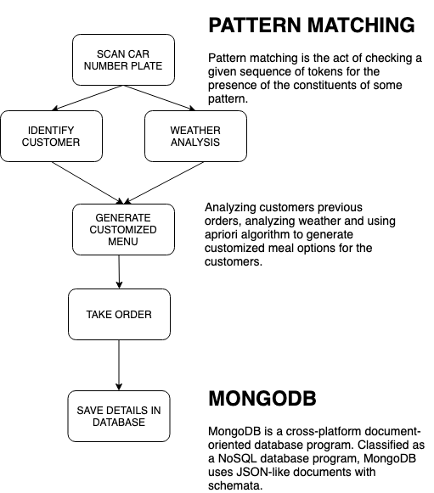
SYSTEM ARCHITECTURE FLOW

Slide 3
WHY?
Reduce time
Increase efficiency
Improve Customer Experience and Satisfaction

Slide 4
Who - John Doe, an executive manager at Burger King.
What - Aiming to improve efficiency by reducing waiting time, resulting in increase in sales.
Wow - Increase in sales and profit with easy and convenient user experience.

Slide 5
COMPONENTS
PATTERN MATCHING
WEATHER ANALYSIS
ASSOCIATION MINING

Slide 6
TECHNOLOGIES
PYTHON
NODE JS
REACT JS
MONGO DB

Slide 7
Future prospect
Multiple customers per vehicle
User Feedback

Slide 8
THANK YOU!

