Slide 1
Quora
Akshay Bajaj
Amit Kamboj
Dhruvil Bhaveshbhai Parikh
Pardis Tashakori
Pooja Kataria
Shivang Mistry

Slide 2
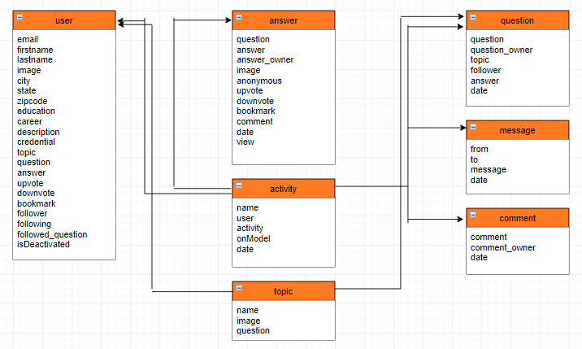
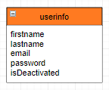
Database Schemas
MySQL
MongoDB

Slide 3
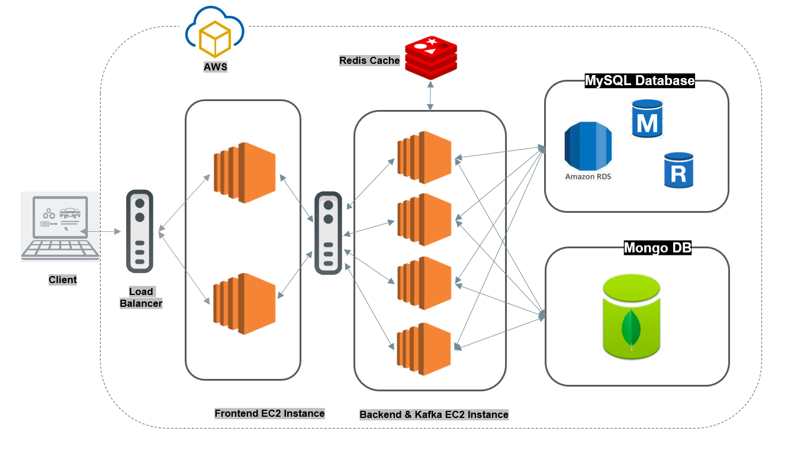
System Architecture

Slide 4
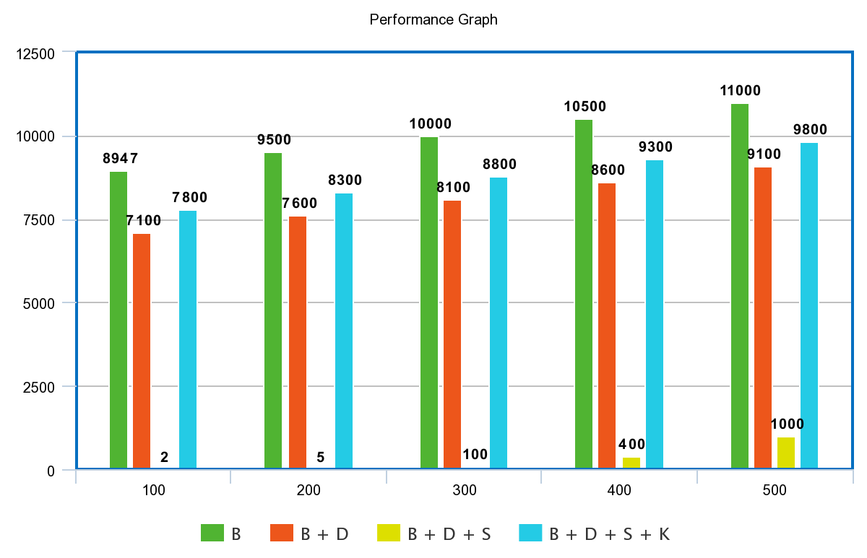
Performance Graph: Part 1

Slide 5
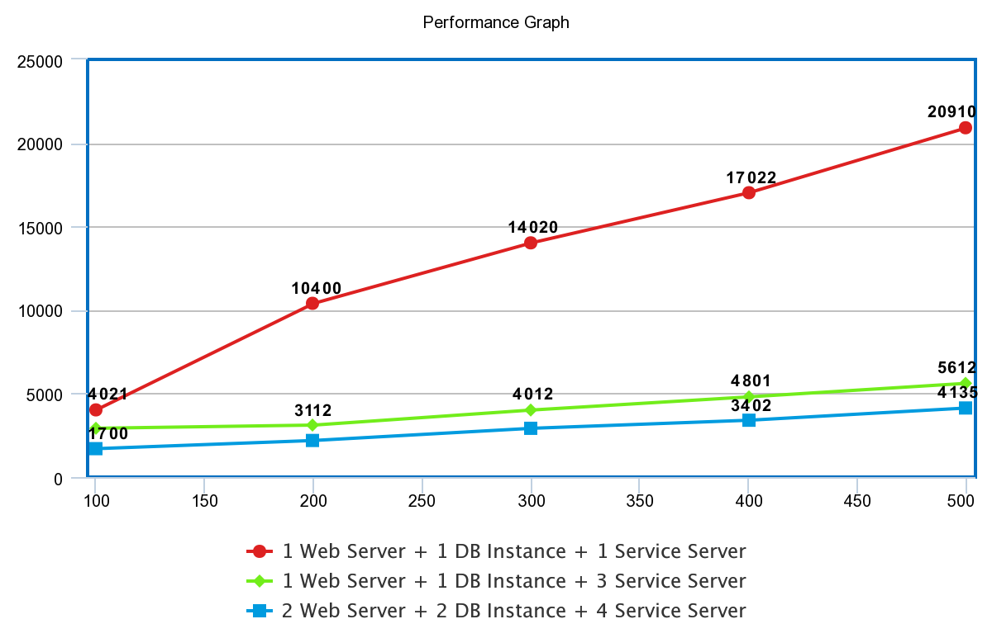
Performance Graph: Part 2
￼

