Slide 1


FACULTY GUIDE:
PROF. NAYAN MALI
Chaitanya Dave
Shivang Pandya
Yash Devmurari
150010116009
150010116054
150010116011

Slide 2

Current Scenario
Discuss with family to buy a new house
Visit a builder on an ongoing site
Builder shows 2-D Floor plans prepared by the architect
Choose and buy a house according to preference of size and affordability

Slide 3
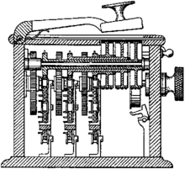

Problem with current system
The real estate industry largely depends on imagination and speculation, both by the user and customer. The builder and architects design the house according to their imaginations and designs which may or may not be liked by the user, however the user never got a chance to look at the design in the first place.
2. The modeling and designing in the real estate industry is generally done in a 2-D format, in a sheet of A-4 paper or brochures. The customer might not be able to visualize the exact dimensions of the house since it is impossible to be done in a 2-D Environment.
3. A user/customer buying the house cannot change the design and colors of the house after it is built. All he can do is regret not to have changed earlier.

Slide 4
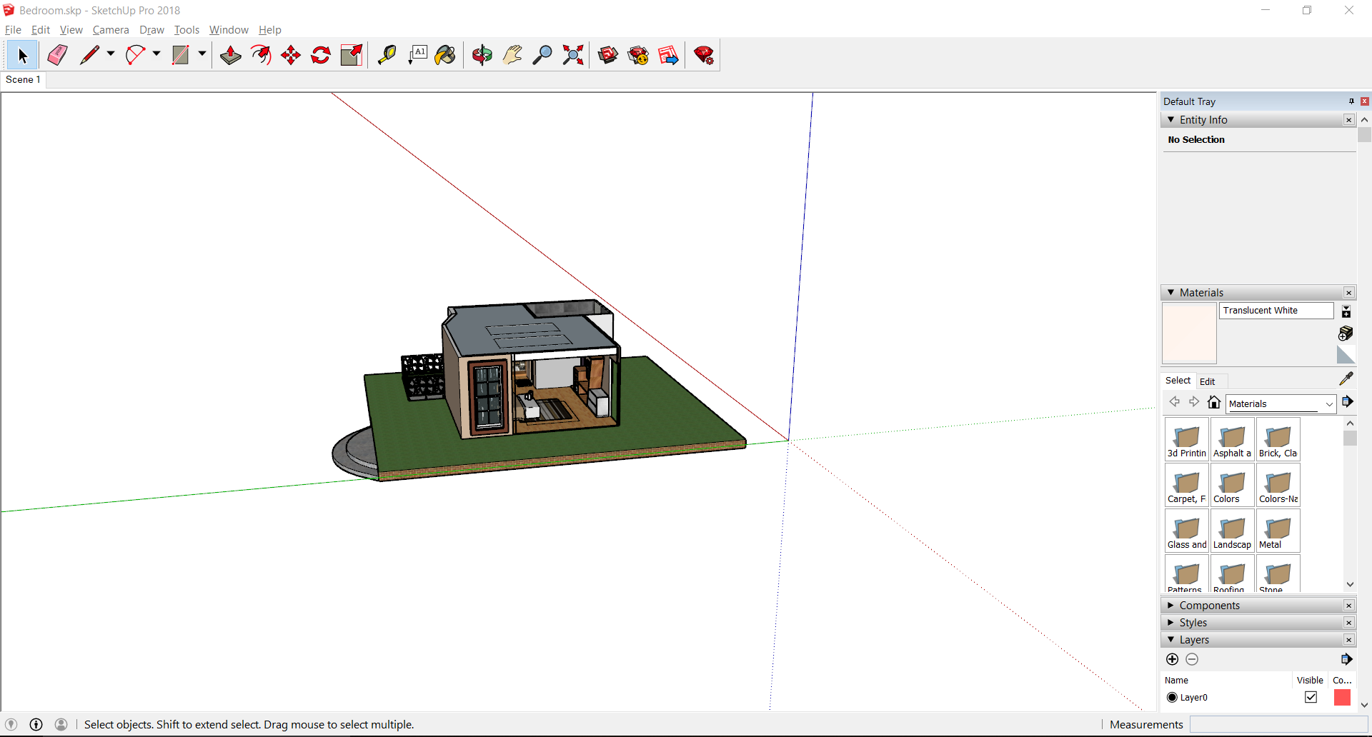
Homevibe system
PREPARING 3-D MODEL OF THE HOUSE

Slide 5
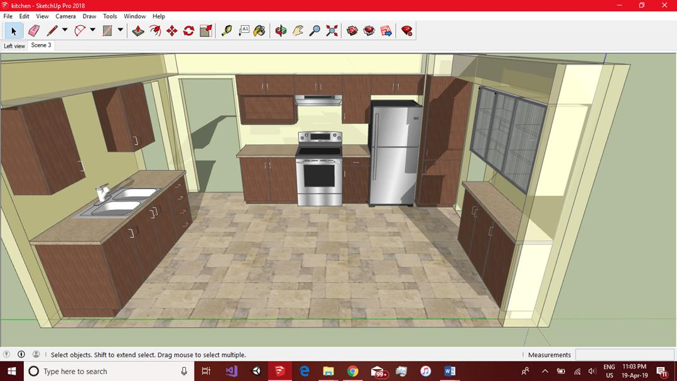
Homevibe system
DESIGN 3-D MODEL OF THE HOUSE

Slide 6
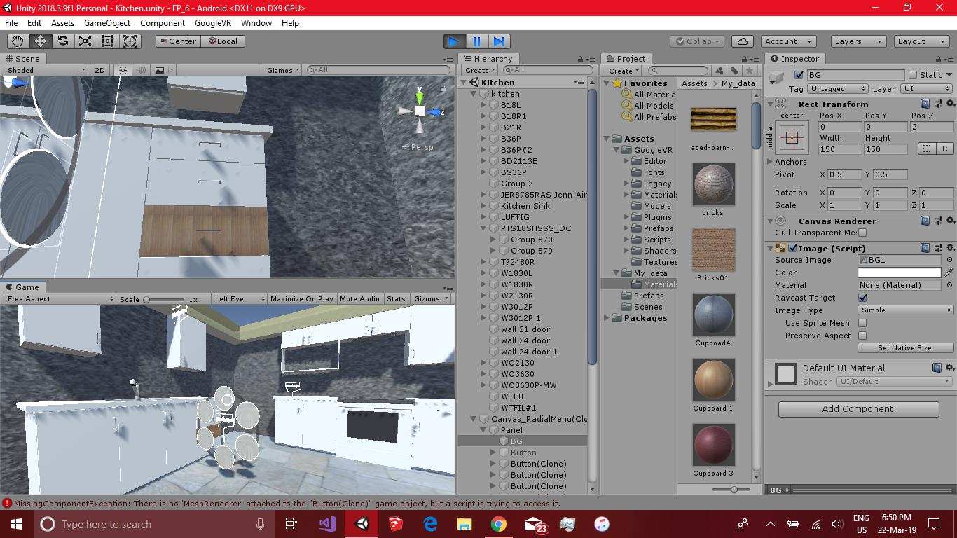
Homevibe system
HAVE INFINITE CUSTOMIZATION USING DESIGN PALET

Slide 7



Homevibe Features
Helps designers to eliminate any scope of calculation error from creeping in.Designers can let us walk through designs and interact in endless possible ways
Modify or hide walls, doors, furniture, change color of wall paint, add or remove layers
Infinite customization

Slide 8
Scope of Project
VR enabled illustrations are the exact replica of the design to the exact 1:1 scale.
With the assistance of virtual reality software; projects, designs and concepts can be brought to life prior to execution, so no need to start breaking ground or buying materials.
Giving designers the ability to finalize details through effective planning and visual conceptualizations means that project viability can be determined much earlier in the process
These detailed and explicit plans can then be accurately communicated to contractors and construction teams.

Slide 9

REFERENCES
https://unity3d.com/learn/tutorials
https://home.by.me/en/
https://www.turbosquid.com/Search/3D-Models/free
https://archive3d.net/
https://www.reddit.com/r/3dsmax/comments/306lk9/exporting_from_3ds_m ax_to_unity_while_preserving/
https://www.westpierstudio.com/
https://www.linkedin.com/pulse/importing-models-unity-3d-from-google- sketchup-muhammad-faizan-atiq

