Slide 1
GitHub FAQ Chatbot with Fallback Mechanism
By Shivang Shukla
12214963

Slide 2
Project Overview
Building a Telegram bot that answers GitHub-related questions, utilizing a trained FAQ model and integrating a fallback mechanism for real-time information retrieval from GitHub's public API.
It uses a MongoDB database for logging queries.

Slide 3
Key Components
Telegram Bot (bot.py)
MongoDB
Listen To User Queries
Sends them to the FastAPI backend.
Stores chat logs and user analytics.
FastAPI Backend (main.py)
Docker
Containerizes everything for easy deployment.
Uses AI models to find answers.
Logs queries to MongoDB.

Slide 4
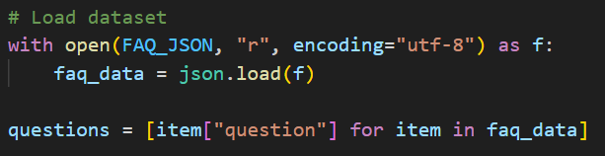
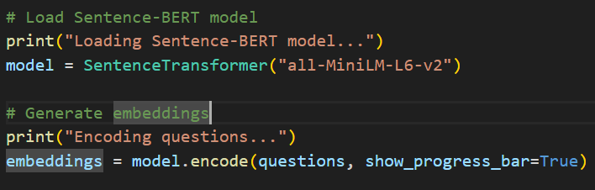
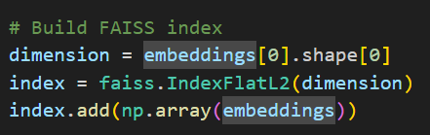
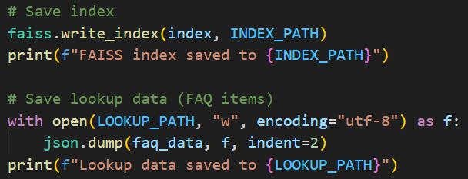
Chatbot Flow
Faq_index.py
Loaded FAQ questions from dataset
Generated embeddings using Sentence-BERT.
Built a FAISS index for fast similarity search.
Saved in index and lookup file

Slide 5
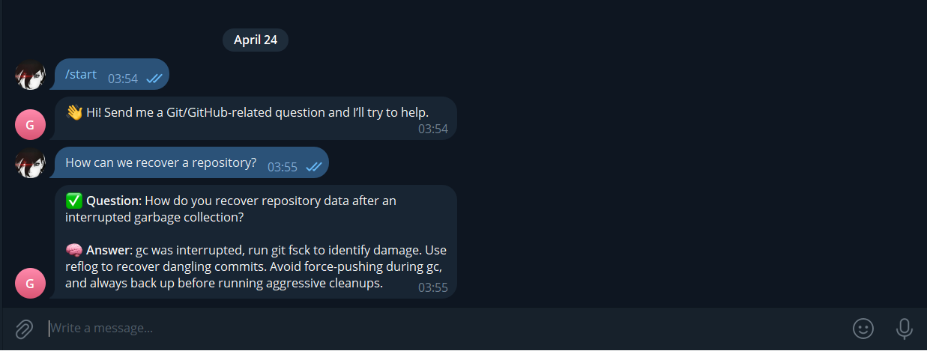
The user then sends a GitHub-related query (bot.py)

Slide 6
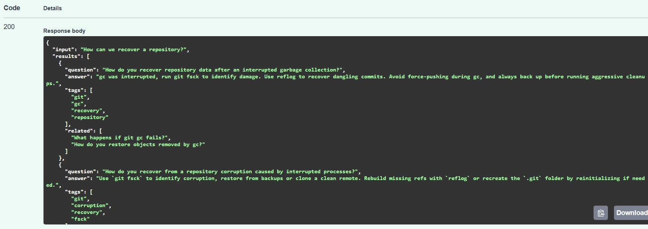
The system will check if a relevant answer exists in the trained model, then chooses the Best Match (done in main.py)

Slide 7
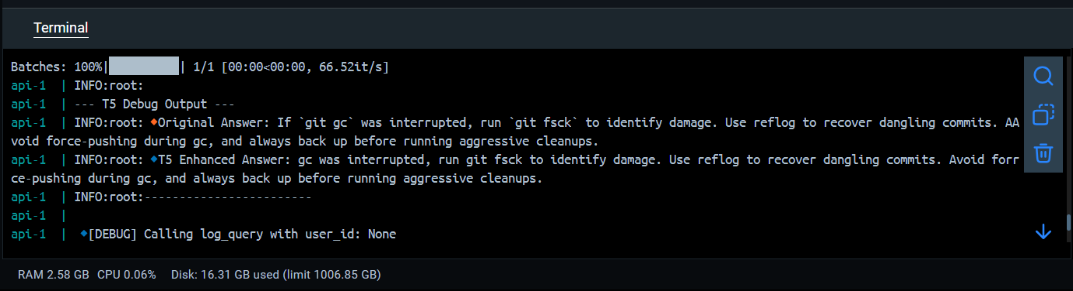
The Best Match will then be enhanced by T5 and will be given as output (main.py)
Although T5 almost won’t change the answer in most cases as the answer in dataset is in already good form

Slide 8
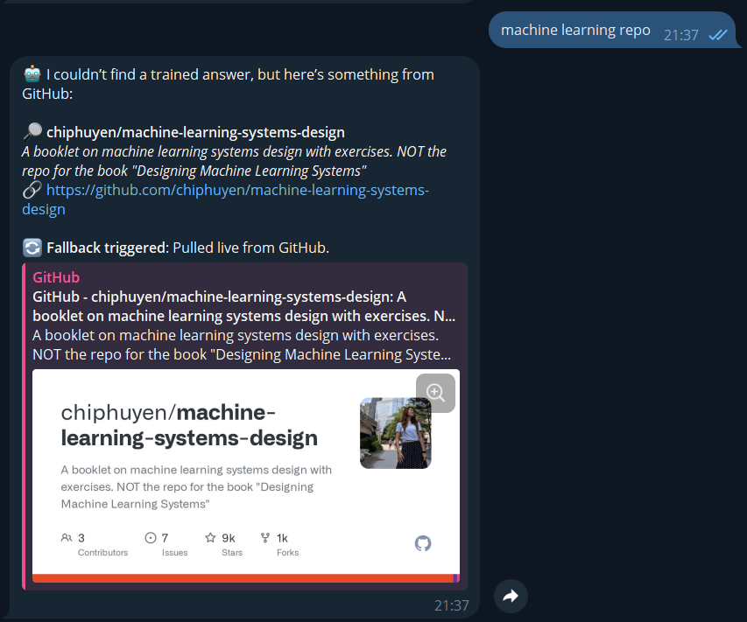
If no Similarity then Fallback Mechanism
The fallback system queries GitHub’s repositories.
Repository name, description, and URL are returned.
A fallback message is shown indicating that the response is live from GitHub.

Slide 9
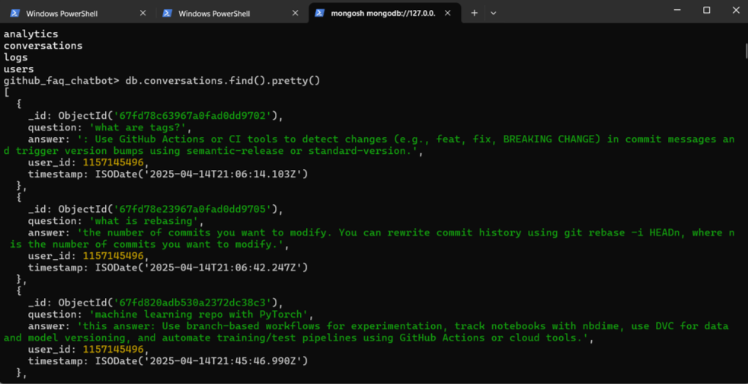
All interactions will be logged in MongoDB for analytics and improvement (logger.py)

Slide 10
Dockerization
The entire application is containerized using Docker for easy deployment and scaling.
Contains 4 Files
Dockerfile
Dockerignore file
Blueprint to build a container image.
Excludes unnecessary files from the Docker build.
Yaml file
Shell Script File
Orchestrating multiple containers as a single system.
Shares the same Python environment (saves disk space).
Lets you reuse the same Dockerfile (simpler maintenance)

Slide 11
Dockerfile
Builder Stage: "The Kitchen"
Runtime Stage: "The Final Dish"
Installs all the tools and ingredients needed to cook the app.
Creates a clean, ready-to-serve version of your app.ext processing
Uses a lightweight Python image 3.12-slim.
Installs system tools (to compile some Python packages).
Downloads PyTorch (for AI) and other Python libraries (requirement.txt).
Adds sentencepeice (helper for text processing)
Starts fresh with another lightweight Python image.
Copies only the installed libraries.
Adds your pre-downloaded AI models.
Copies your app code.
Sets up the startup command (entrypoint.sh).

Slide 12
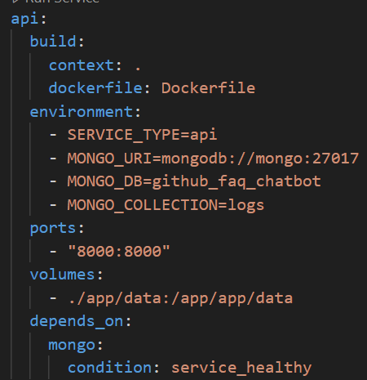
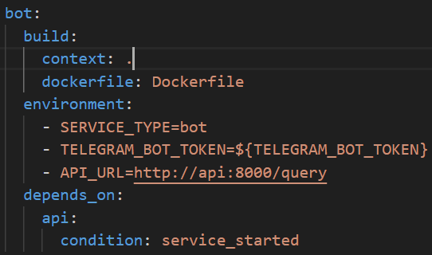
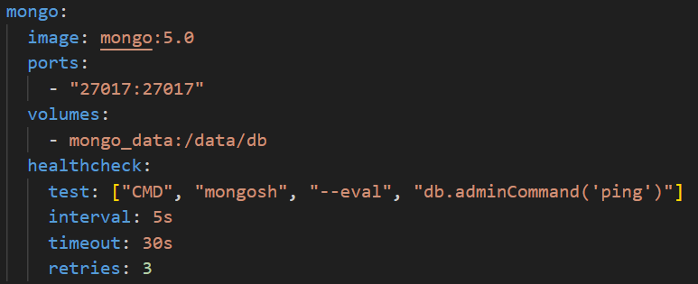

YAML File
CHEF
MANAGER
depends_on-> container running
healthchecks-> service running
FRIDGE
WAITER
Health-checks
Detects if MongoDB crashed or isn't responding.
Prevents api from starting too soon

Slide 13
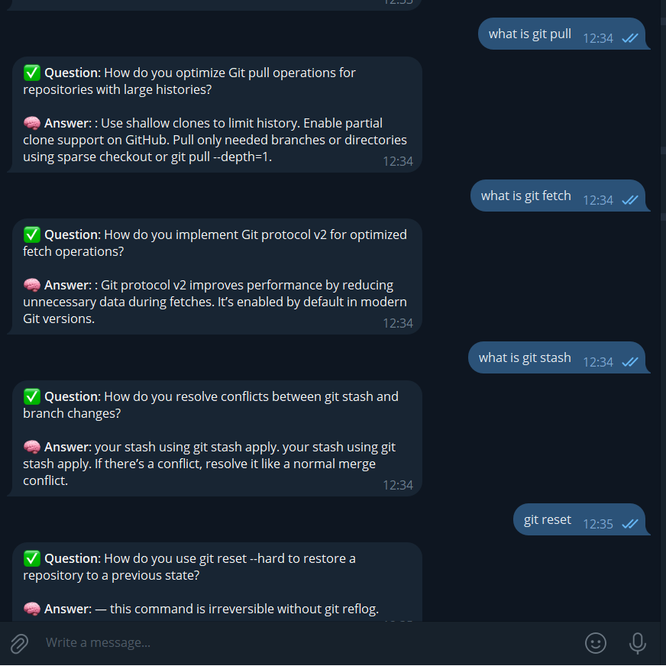
Problems For NOW
Not accurate answers. It will be relatable most of times.
Not able to answer follow-up questions.
Not able to answer Mixed Questions. Only answers the first one.

Slide 14
Future Improvements
Model Enhancement: Train the FAQ model on more specific GitHub-related questions to reduce fallback usage.
More APIs: Integrate additional external APIs (e.g., StackOverflow, GitLab) to broaden the fallback mechanism.
Personalization: Further personalize the chatbot based on user behavior, history, and preferences.

Slide 15
Conclusion
Summary: The GitHub FAQ chatbot with a fallback mechanism successfully answers GitHub-related queries and fetches real-time information when necessary.
Impact: Provides a seamless experience for developers and GitHub users, with the ability to handle both general and specific questions.
Future Vision: Continuous improvements based on user data, ensuring better accuracy and user engagement.

