Slide 1
Software for Pebble
Shivang Gangadia

Slide 2
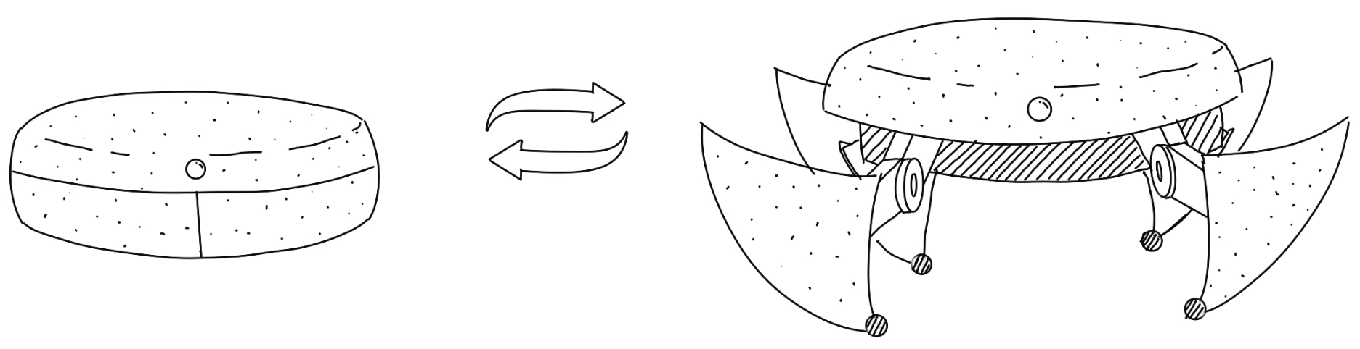
The Project
A robot that walks like a tortoise and can “hide” in its shell while monitoring environment remotely.

Slide 3


The team
Me
Software
Electronics
Teammate
Mechanical design

Slide 4
Goals
Low latency remote control
Real time video feed
Operable by human and AI
Low power consumption
Analog and smooth gait control

Slide 5
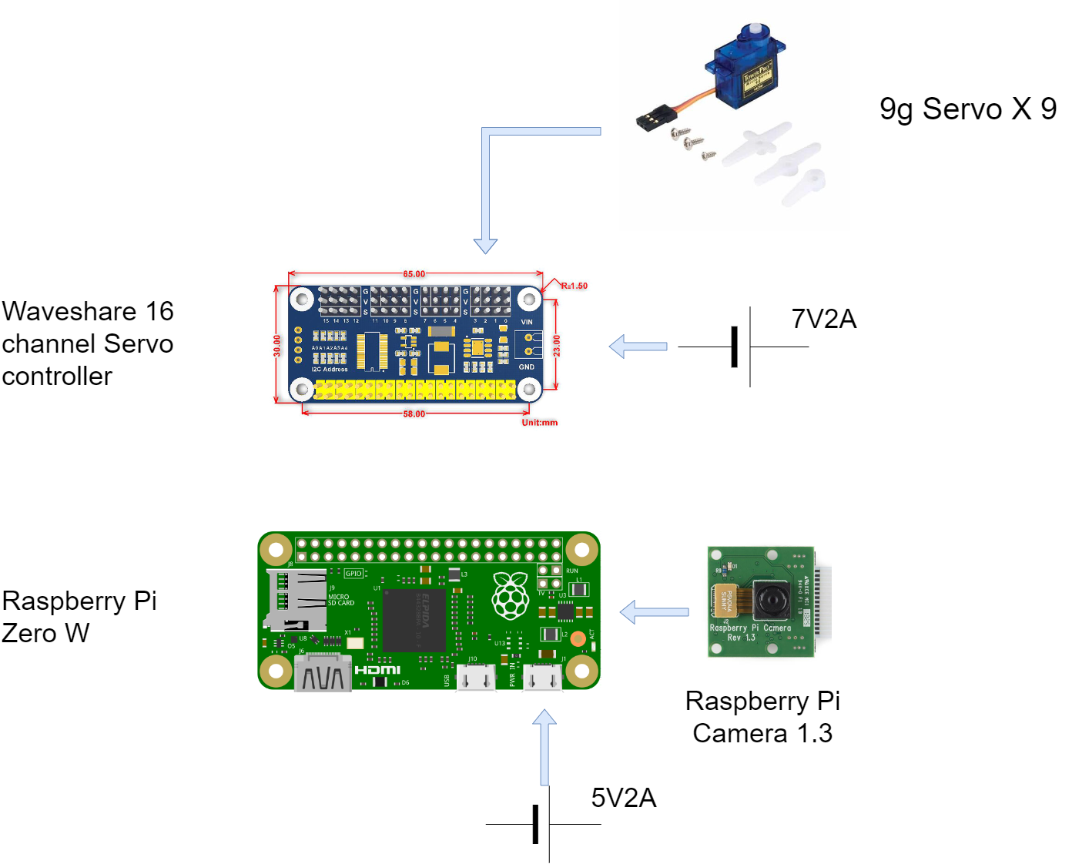
Electronics Stack
Notes:
Explain need for each component

Slide 6
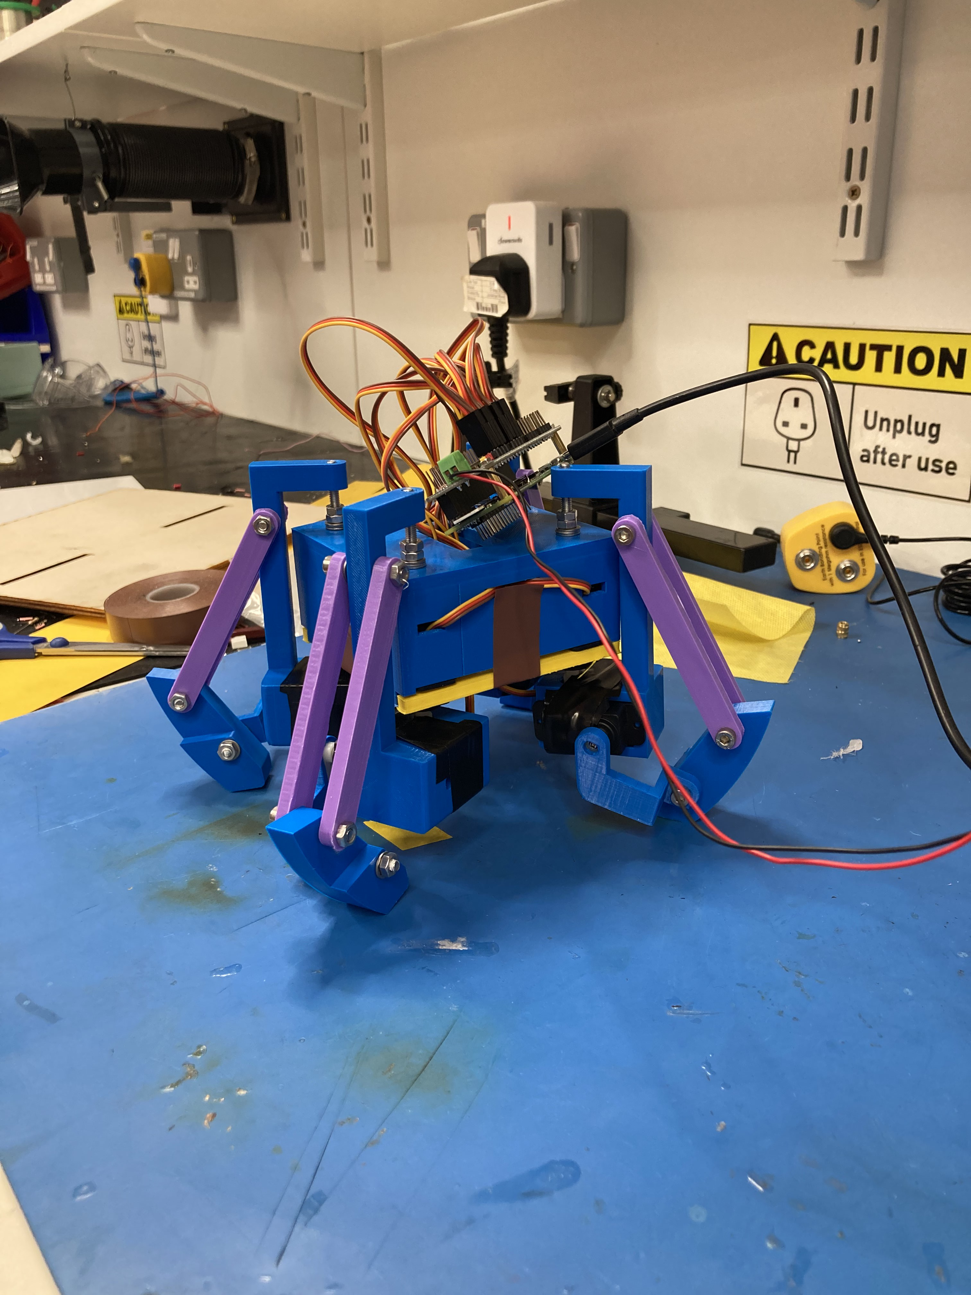
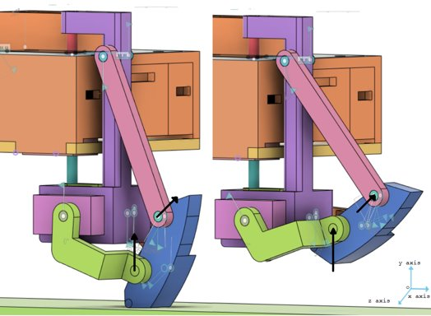
Mechanical Design
Feet controlled directly by servos without kinematic processing

Slide 7
Software
Initial choice – ROS – cannot be run on Raspberry Pi 0
Requirements
Displaying video feed in real time
Controlling remotely with low turnaround (atomic tasks)
API that can be accessed by human based and software (AI) based controllers
Wireless communication
Running videostream and command interpreter in parallel
Notes:
Since ROS was not viable, the software would need to do not only the mechatronics control but also the communication and process management tasks of ROS.

Slide 8
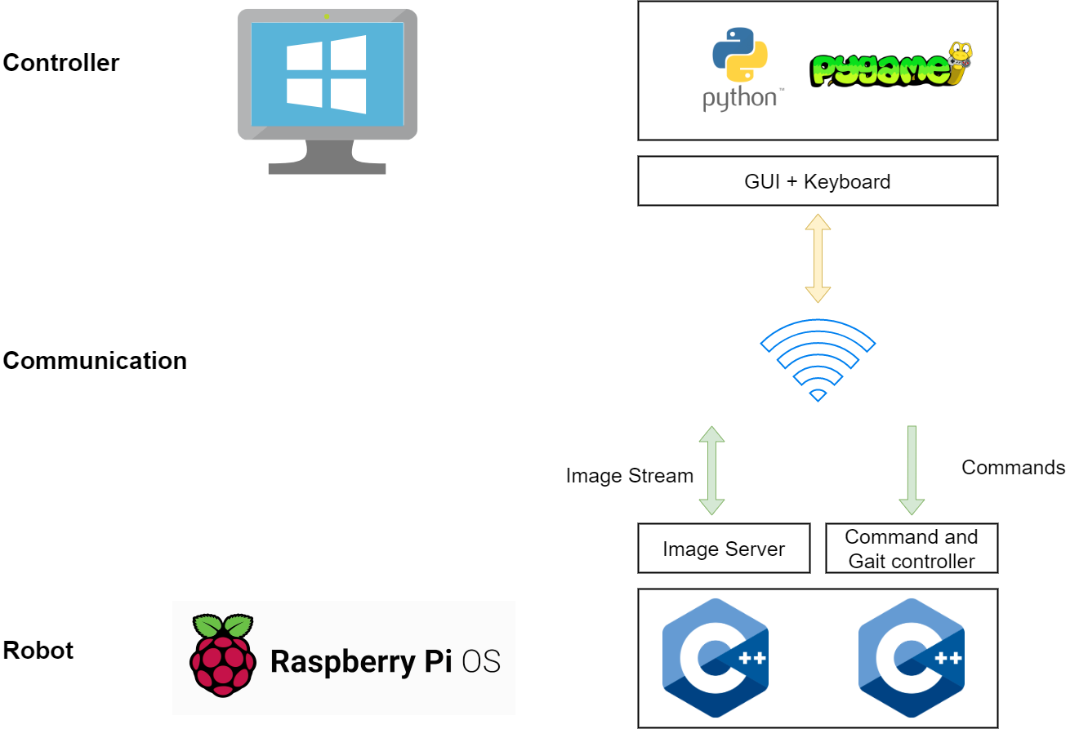
Solution

Slide 9
Robot side
Video stream
01
Serve frames on request
Command Engine
02
Receive and Execute commands
Control Gait
Talk to hardware
Talk to camera

Slide 10
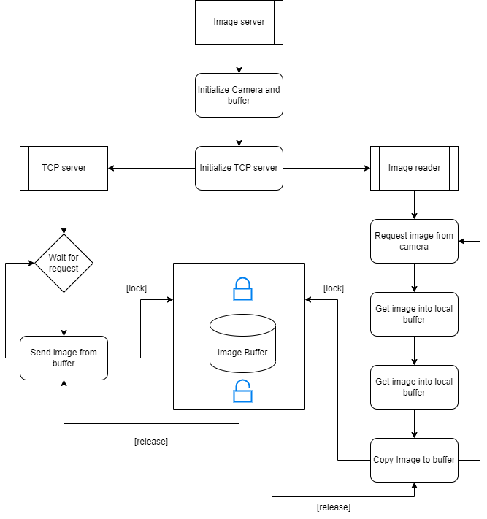
Image Server

Slide 11
Risks and Mitigation
Risk | Mitigation
Unsynchronized termination of threads | No permanent wait states (std::try_lock), SIGTERM handler, Mutex mediated exit flags
Camera driver takes too long to return image | Double buffer, copy only when ready

Slide 12
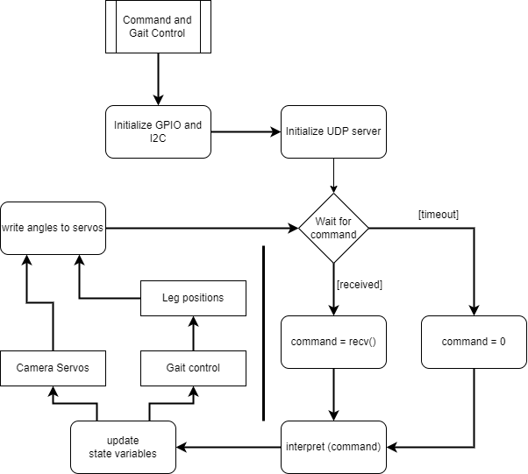
Command and Control

Slide 13
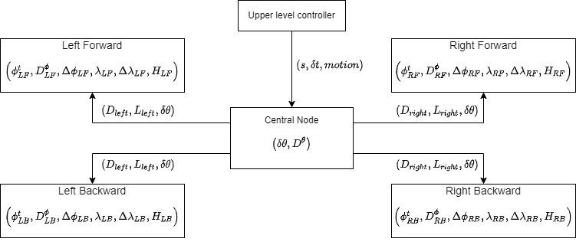
State variables
Notes:
The gait control led the design choices for the classes more than software engineering principles, which is why UML diagrams for classes have not been included.

Slide 14
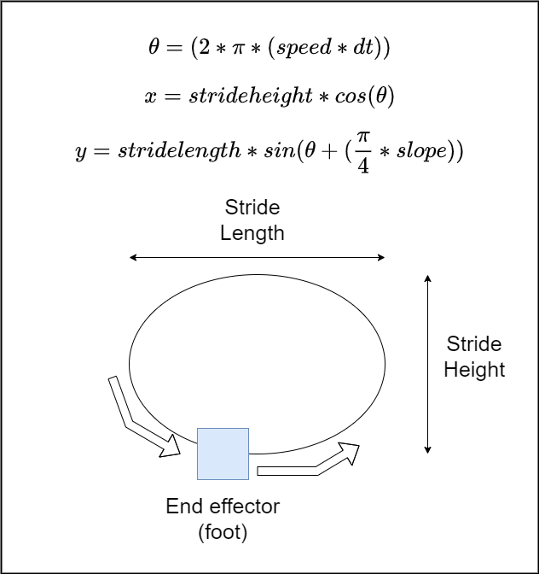
Gait calculations

Slide 15
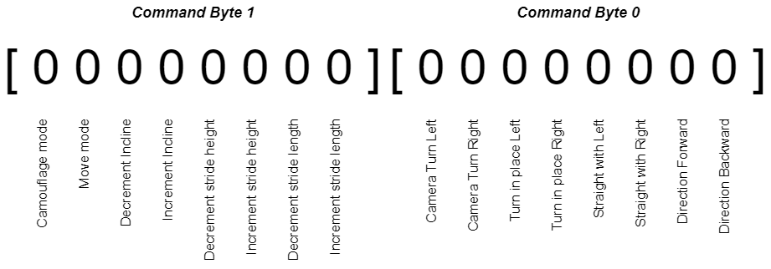
The API
Design Philosophy: Express what, not how
Notes:
Previous slides show how computation for gait happens and how the intent is expanded into gait step wise like a pyramid. The design philosophy for the API was developed keeping this abstraction in mind and thus follows the principle of “Express What, not How”, i.e. say what you want the system to do but don’t tell it how to do it. This way, an autonomous system could be plugged in instead of manual control by a human and it would easily be able to guide the robot based on feedback from the video feed.

Slide 16
Risks and Mitigation
Risk | Mitigation
Bad command | Default behavior : do nothing
No command for too long | Timeout so that maintenance can be done
Variable execution times | Gait control uses change in time instead of absolute time
Notes:
Maintenance here was bringing the robot back to a stable posture instead of leaving its leg hanging in space. Thus, this benefits from both the default behavior and timeout.

Slide 17
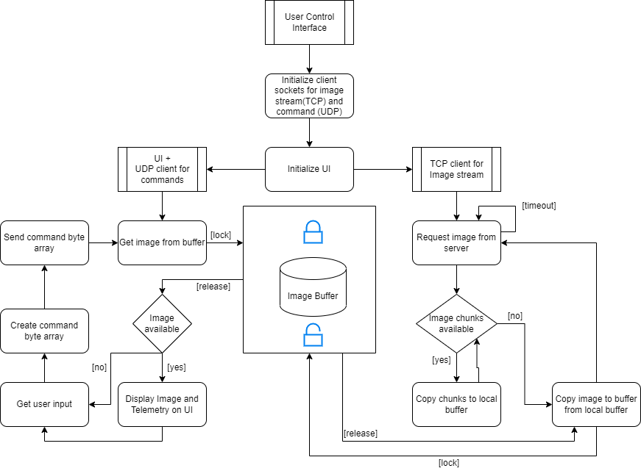
Remote side
Requirements
User Interface and Image stream viewer
User input and command generation

Slide 18
Risks and Mitigation
Risk | Mitigation
Image transfer takes time due to many chunks | Double buffer
Image server shutdown | Timeout and retry
Image transfer stops midway | Header with expected image size to qualify image
User input works faster than command execution on robot end | Limit framerate

Slide 19
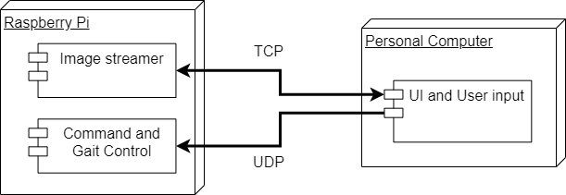
Deployment diagram

Slide 20
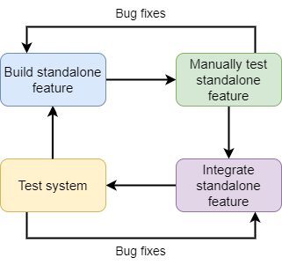
Development process – CI/CD
Feature | Test strategy
TCP communication | Sent = Received
UDP communication | Sent = Received
Image Reader | Read and store to local file at source
Image transceiver | Transmit and save at destination
Multi thread image stream | Transmit and display on UI
GPIO library instantiation | Blink
I2C communication | Test PWM with multimeter
Servo use with PWM from controller | Programmed sweep within range
Pattern Generator (each leg) | Interactively Plot algorithm output
Pattern Generator to servo PWM | Visually inspect each leg
Gait control with pattern generator | Test robot in air
UI and user input | Image stream and print input to console
Command interpreter | Test each command programmatically
Command interpreter with user input | Test for smooth state change and latency
Full system test | Test all commands with Image Stream

Slide 21
Future developments
Autonomous navigation and object detection
Desktop software to be rewritten in a language that supports true threading
IMU for posture stabilization

Slide 22

Thank You !

