Slide 1
Genetic Correlates of Morton’s Toe
Emma Weeding
April 21st, 2021

Slide 2
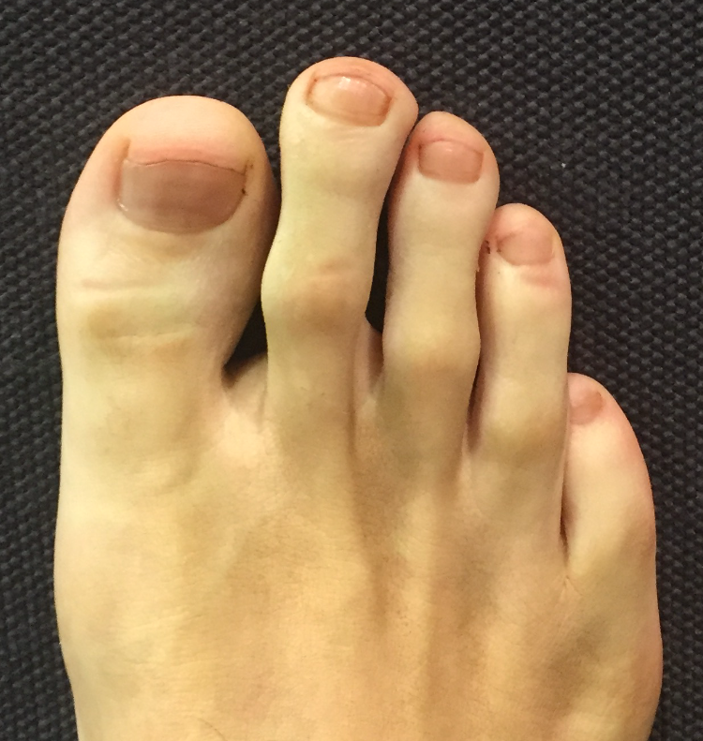
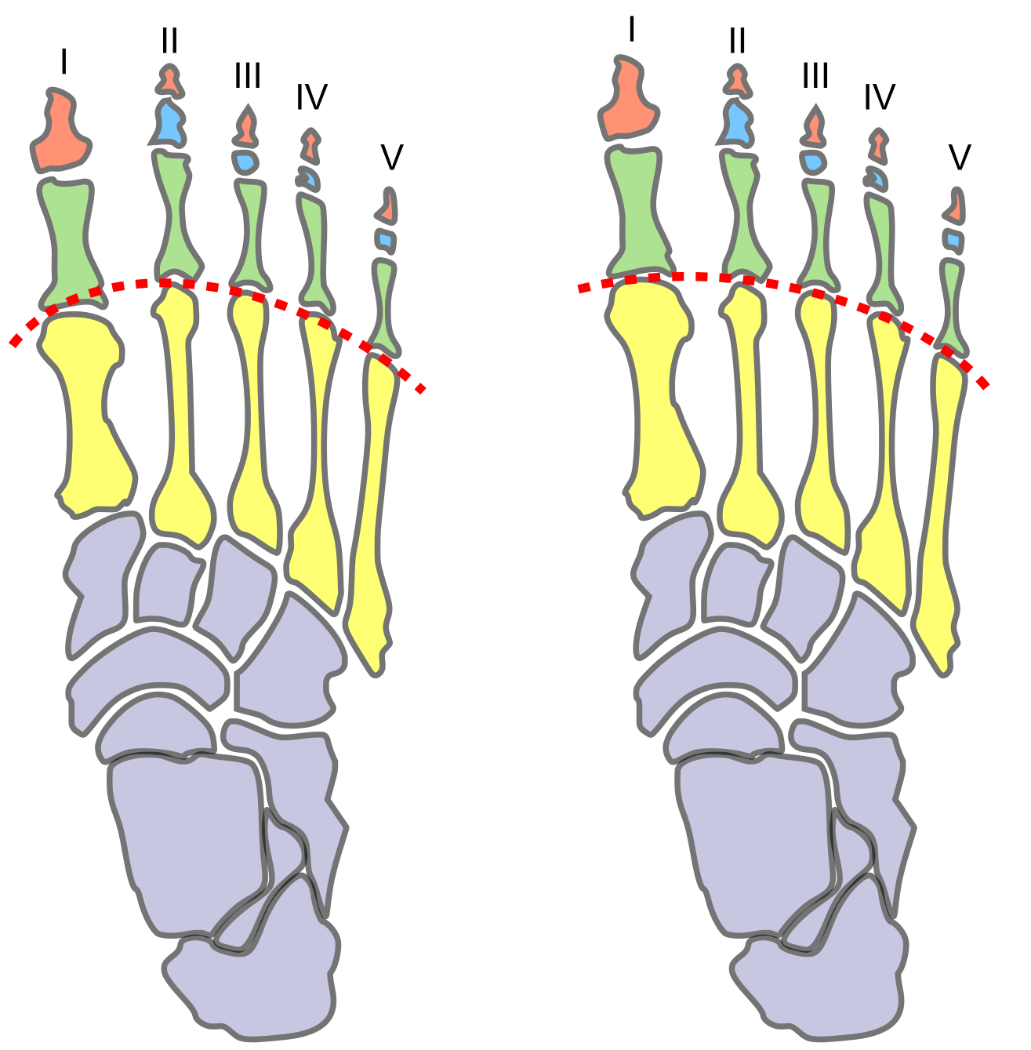
What is Morton’s Toe?
Morton’s toe is an anatomical variant where the first metatarsal is shortened compared to the second
This variant is present in roughly 10-30% of humans, but prevalence can vary significantly by ethnicity and region – ranging from 3% in Sweden to 90% in northern Japan
Morton’s Toe Normal
(Romanus 1949, Kaplan 1964, Vounotrypidis 2015)
Notes:
Generally no significant medical problems
Image sources:
https://en.wikipedia.org/wiki/Morton%27s_toe

Slide 3
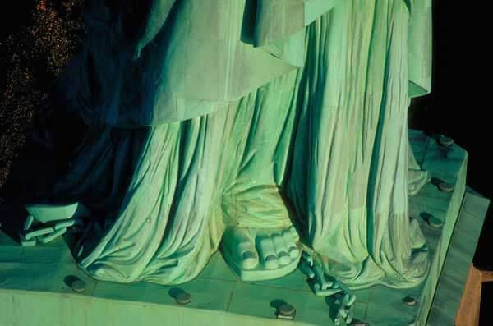
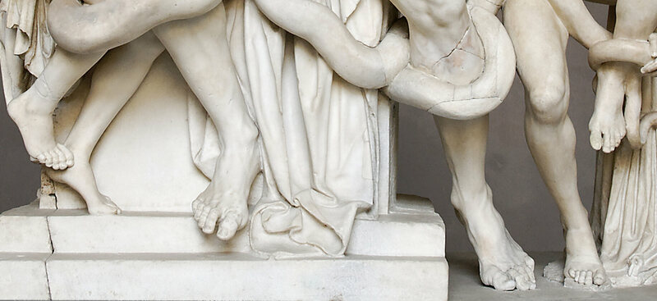
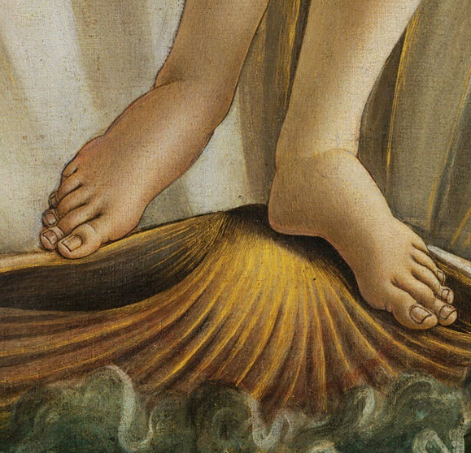
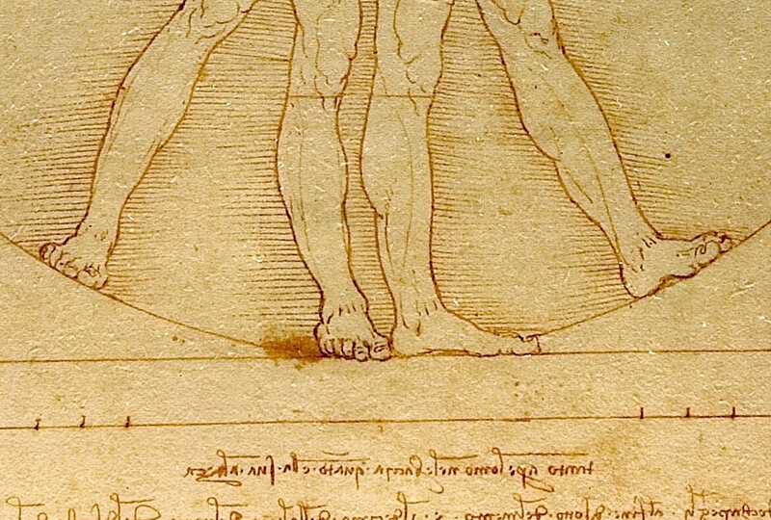
Cultural Significance
Part of the idealized form in many periods of Western art
AKA “Greek toe”
Long association with disputed cultural interpretations, e.g. intelligence, leadership ability
(Romanus 1949, Kaplan 1964, Vounotrypidis 2015)
Notes:
It was an idealized form in Greek sculpture, and persisted as a standard through the Roman and Renaissance periods
Image sources:
https://historydaily.org/mortons-toe-history-humanitys-weirdest-symbol-beauty
https://www.atlasobscura.com/articles/mortons-toe-greek-foot
Botticelli’s Venus, Vitruvian man

Slide 4

Genetics
“The Andersson Toe”
Morton’s toe is believed to be genetic and can be observed in families across several generations
Mode of inheritance has been a subject of debate – initially thought Mendelian, but likely polygenic
(Beers 1942, Romanus 1949, Morton 1952, Kaplan 1964, Vounotrypidis 2015, Aigbogun 2019)

Slide 5
Aims
Specific genetic correlates with Morton’s toe have never
been described in the literature
Identify SNPs which are associated with Morton’s toe
Develop a binary classification model to predict which individuals are likely to have Morton’s toe based on SNPs

Slide 6
Methods – Data
Data was obtained from OpenSNP users reporting a phenotype with respect to “Morton's Toe” and/or “Index Toe Longer than Big Toe” (n = 281)
Removed indeterminate and discordant responses (n = 24)
Filtered by most common reference genome, GRCh37 (n = 66 excluded)
Consolidated users with multiple data files uploaded (n = 10)
→ Final cohort with Morton’s toe and controls (n = 181)

Slide 7
Methods – Data
Final cohort with Morton’s toe and controls (n = 181)
No Morton’s Toe Morton’s Toe
Significant limitations =
Insufficient ethnicity and nationality data
All samples used for discovery
Notes:
88 with Morton’s toe (48.6%)

Slide 8

Methods – Challenges
Initial approach: Identify SNPs associated with Morton’s toe via Fisher’s exact test in OpenCRAVAT
No SNPs with p value considered significant after adjustment for multiple comparisons and/or < 5 x 10⁻⁸ (GWAS standard)
Suspicion: polygenic trait, genetics may vary by population, OpenSNP sample size is low
How can we select meaningful features?
Notes:
Image source:
https://www.nature.com/articles/d41586-019-00857-9

Slide 9
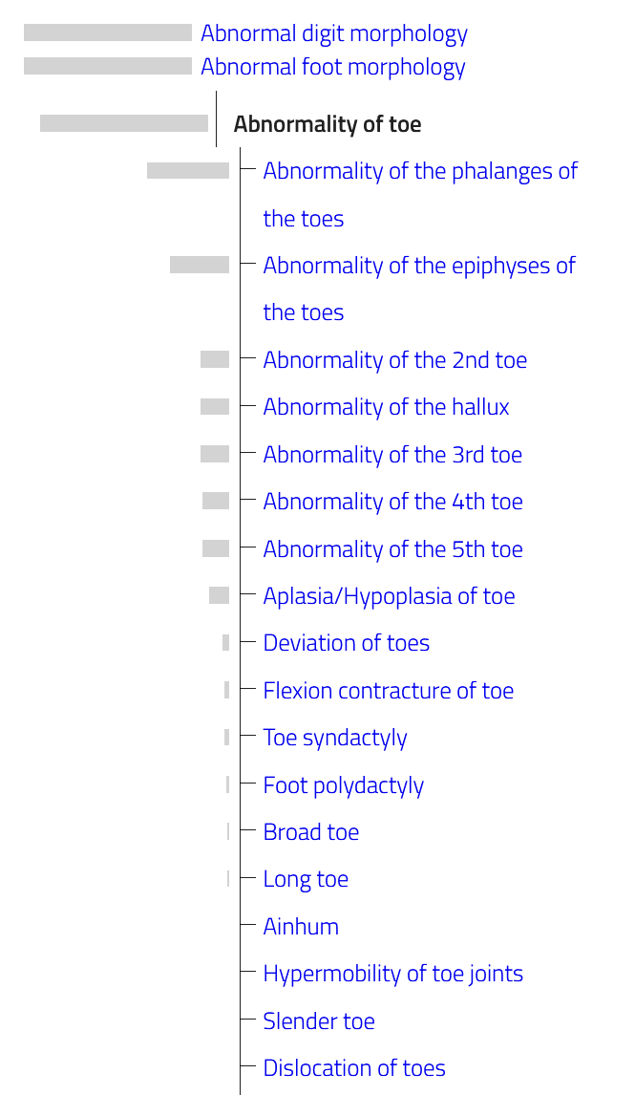
Methods – Challenges
Gene Set: HP_ABNORMALITY_OF_TOE
Human Phenotype Ontology via MSigDB
Total of 616 genes associated with various abnormalities of the toes
Reduces number of variants from 1,258,255 → 27,037
(not Morton’s toe)
Notes:
MSigDB Molecular Signatures Database
Image source:
https://hpo.jax.org/app/browse/term/HP:0001780

Slide 10
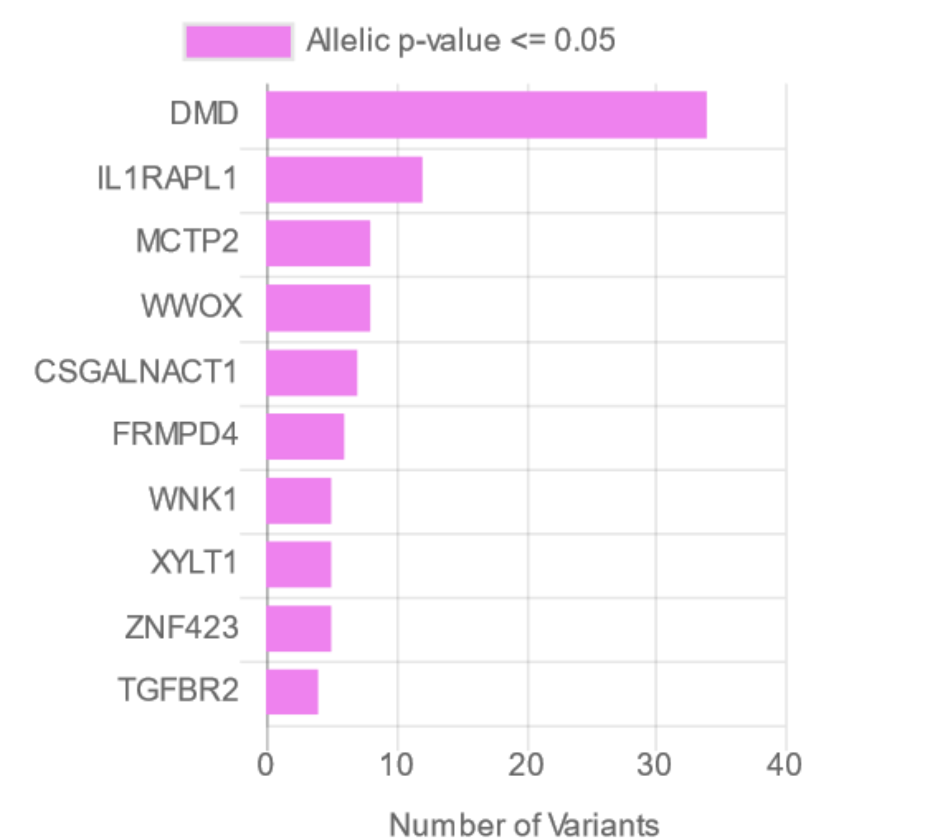
Methods – Challenges
Gene Set: HP_ABNORMALITY_OF_TOE
Human Phenotype Ontology via MSigDB
Total of 616 genes associated with various abnormalities of the toes
Reduces number of variants from 1,258,255 → 27,037
Notes:
DMD, the largest known human gene, provides instructions for making a protein called dystrophin. This protein is located primarily in muscles used for movement (skeletal muscles) and in heart (cardiac) muscle. Small amounts of dystrophin are present in nerve cells in the brain.
X-linked interleukin-1 receptor accessory protein-like 1, member of interleukin 1 receptor family

Slide 11
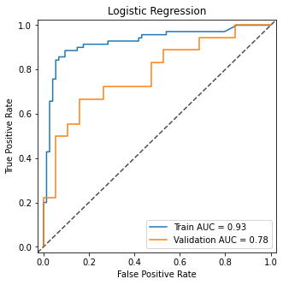
Exploratory Results
Fit elastic net logistic regression
Regressors = all SNPs with unadjusted allelic p value < 0.01 (n = 260)
For every user and SNP, assigned value of 0 for reference, 1 for heterozygous, or 2 for homozygous
Outcome = Morton’s toe versus no Morton’s toe
No hyperparameter tuning (yet)
Cohort split 80 / 20 for training and validation
NB: no true test set

Slide 12
Next Steps
More structured way to select SNPs to be used as regressors
Filter by effect size, but can’t be too strict
Build additional model(s) and tune hyperparameters
Add true k-fold cross-validation
Evaluate and interpret SNP importance in the above models

Slide 13
THANK YOU
Questions?

Slide 14
References
Aigbogun EO, et al. Morton's Toe: Prevalence and Inheritance Pattern among Nigerians. Int J Appl Basic Med Res. 2019 Apr-Jun;9(2):89-94.
Beers, CV and Clark, LA. Tumors and short-toe—a dihybrid pedigree: a family history showing the inheritance of hemangioma and metatarsus atavicus. J. Hered. 1942;33: 366-368.
Kaplan, AR. Genetics of Relative Toe Lengths. Acta Genet Med Gemellol (Roma). 1964 Jul;13:295-304.
Morton, DJ. Inheritance of a long second toe. J Hered. 1952;43:49-50.
Romanus, T. Heredity of a long second toe. Hereditas. 35: 651-652, 1949.
Vounotrypidis, P and Noutsou, P. The Greek Foot: Is it a Myth or Reality? An Epidemiological Study in Greece and Connections to Past and Modern Global History. Rheumatology. 2015 Apr;54:i182-i183.

