Slide 1
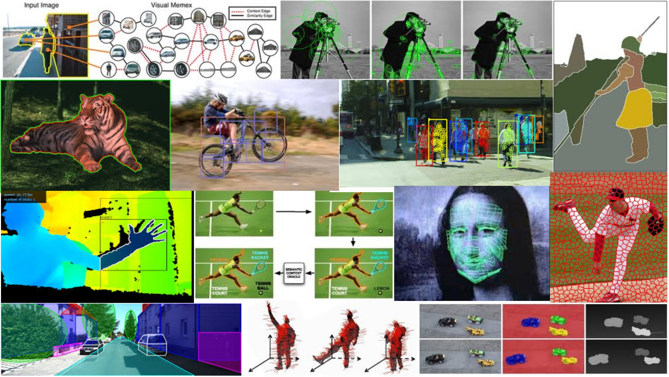
Deep neural networks II May 31st, 2018
Yong Jae Lee
UC Davis
Many slides from Rob Fergus, Svetlana Lazebnik, Jia-Bin Huang, Derek Hoiem, Adriana Kovashka, Andrej Karpathy

Slide 2
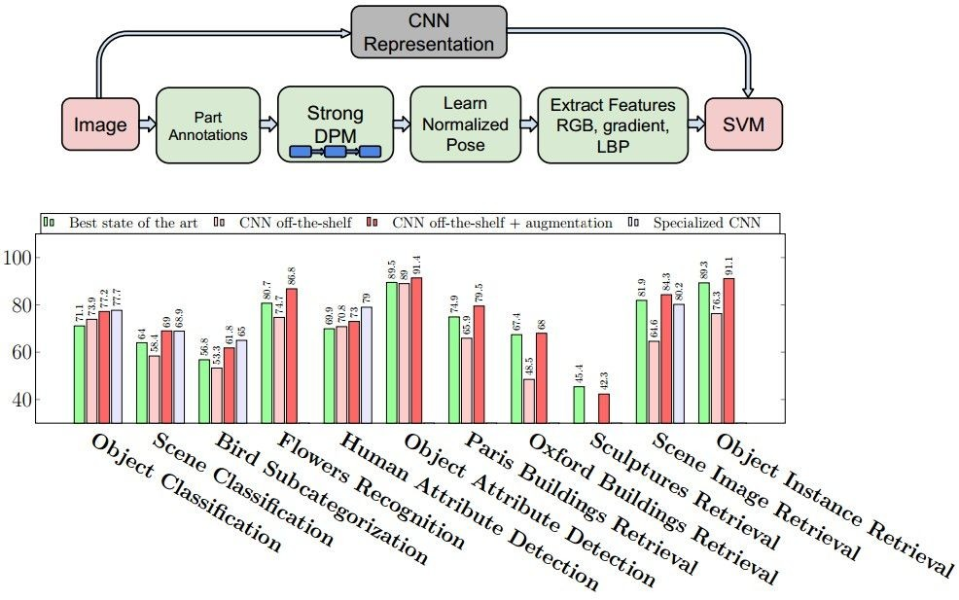
Why (convolutional) neural networks?
State of the art performance on many problems
Most (all?) papers in recent vision conferences use deep neural networks
Razavian et al., CVPR 2014 Workshops

Slide 3
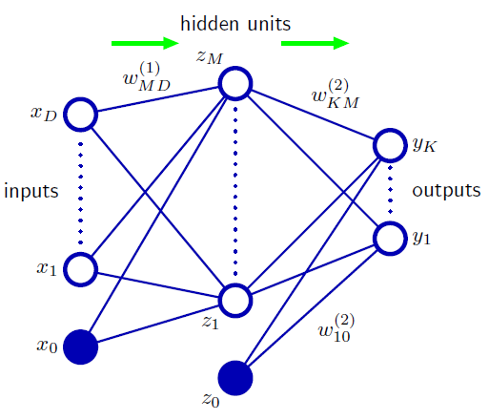
Neural network definition
Nonlinear classifier
Can approximate any continuous function to arbitrary accuracy given sufficiently many hidden units
Figure from Christopher Bishop
Notes:
Example two-layer network. The input, hidden, and output varialbes are represented by nodes, and the weights are represented by edges.

Slide 4
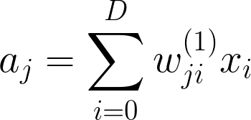

Neural network definition
Activations:
Nonlinear activation function h (e.g. sigmoid, RELU):
Figure from Christopher Bishop
Notes:
Example two-layer network. The input, hidden, and output varialbes are represented by nodes, and the weights are represented by edges.

Slide 5
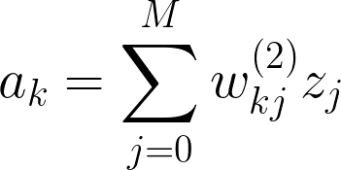

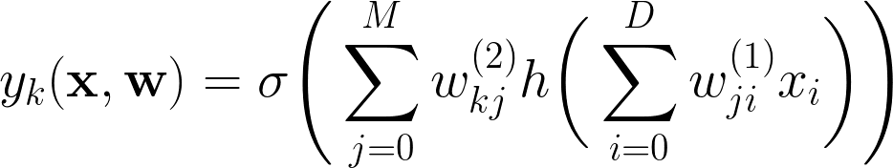
Neural network definition
Layer 2
Layer 3 (final)
Outputs (e.g. sigmoid/softmax)
Putting everything together:
(binary)
(multiclass)

Slide 6
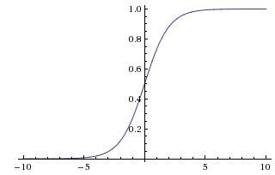
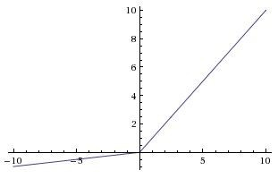

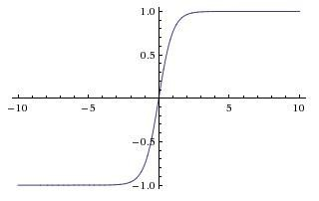

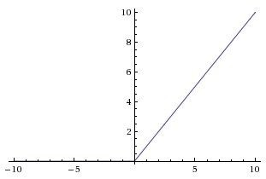

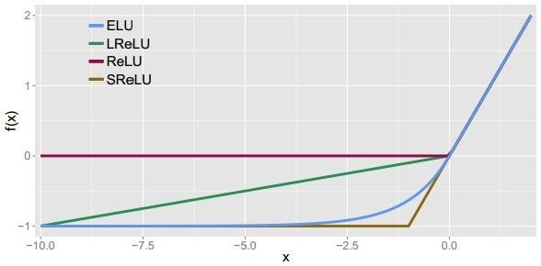
Leaky ReLU
max(0.1x, x)
Nonlinear activation functions
Sigmoid
tanh
tanh(x)
Maxout ELU
ReLU
max(0,x)
Andrej Karpathy

Slide 7
Multilayer networks
Cascade neurons together
Output from one layer is the input to the next
Each layer has its own sets of weights
HKUST

Slide 8
Feed-forward networks
Predictions are fed forward through the network to classify
HKUST

Slide 9
Feed-forward networks
Predictions are fed forward through the network to classify
HKUST

Slide 10
Feed-forward networks
Predictions are fed forward through the network to classify
HKUST

Slide 11
Feed-forward networks
Predictions are fed forward through the network to classify
HKUST

Slide 12
Feed-forward networks
Predictions are fed forward through the network to classify
HKUST

Slide 13
Feed-forward networks
Predictions are fed forward through the network to classify
HKUST

Slide 14
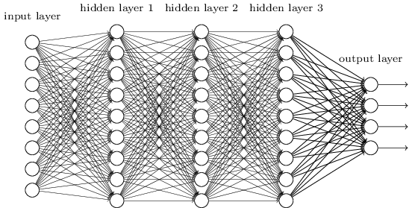
Deep neural networks
Lots of hidden layers
Depth = power (usually)
Weights to learn!
Weights to learn!
Weights to learn!
Weights to learn!
Figure from http://neuralnetworksanddeeplearning.com/chap5.html

Slide 15
How do we train them?
The goal is to iteratively find a set of weights that allow the activations/outputs to match the desired output
For this, we will minimize a loss function
The loss function quantifies the agreement between the predicted scores and GT labels
First, let’s simplify and assume we have a single layer of weights in the network
Notes:
a score function that maps the raw data to class scores, and a loss function that quantifies the agreement between the predicted scores and the ground truth labels. We cast this as an optimization problem in which we minimize the loss function with respect to the parameters of the score function

Slide 16
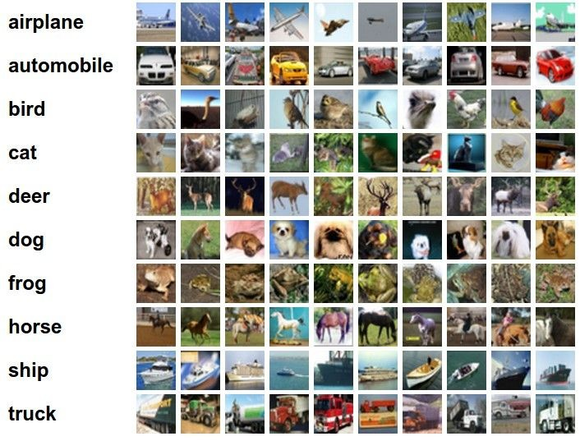
Classification goal
Example dataset: CIFAR-10 10 labels
50,000 training images each image is 32x32x3
10,000 test images.
Andrej Karpathy

Slide 17

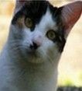
Classification scores
+ b
image
parameters
f(x,W)
10 numbers, indicating class scores
[32x32x3]
array of numbers 0...1 (3072 numbers total)
Andrej Karpathy

Slide 18
Linear classifier
3072x1
+b
10x1
10x1
10x3072
10 numbers, indicating class scores
[32x32x3]
array of numbers 0...1
parameters, or “weights”
Andrej Karpathy
Notes:
The parameters in W are often called the weights, and b is called the bias vector because it influences the output scores, but without interacting with the actual data x.
(In 2D: the biases b allow our classifiers to translate the lines. In particular, without the bias terms, all lines would be forced to cross the origin.)

Slide 19
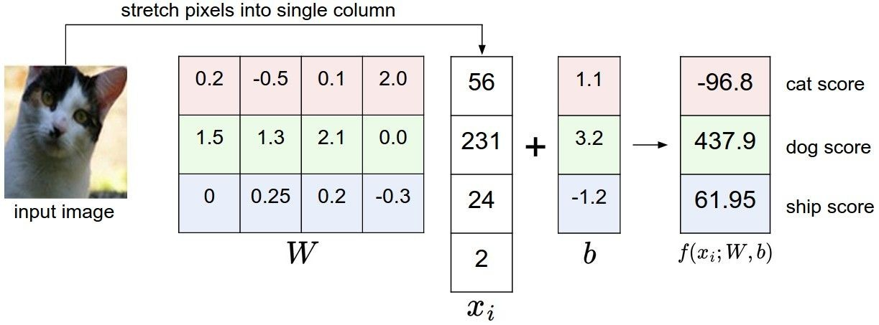
Linear classifier
Example with an image with 4 pixels, and 3 classes (cat/dog/ship)
Andrej Karpathy

Slide 20

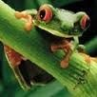
Linear classifier
TODO:
1. Define a loss function that quantifies our unhappiness with the scores across the training data.
-3.45
-8.87
0.09
2.9
4.48
8.02
3.78
1.06
-0.36
-0.72
-0.51
6.04
5.31
-4.22
-4.19
3.58
4.49
-4.37
-2.09
-2.93
3.42
4.64
2.65
5.1
2.64
5.55
-4.34
-1.5
-4.79
6.14
2. Come up with a way of efficiently finding the parameters that minimize the loss function. (optimization)
Andrej Karpathy

Slide 21
Linear classifier
Suppose: 3 training examples, 3 classes. With some W the scores
are:
cat car frog
3.2
5.1
-1.7
1.3
4.9
2.0
2.2
2.5
-3.1
Adapted from Andrej Karpathy

Slide 22





Linear classifier: Hinge loss
Suppose: 3 training examples, 3 classes. With some W the scores
Hinge loss:
Given an example
are:
where where
is the image and
is the (integer) label,
and using the shorthand for the scores vector:
cat car frog
the loss has the form:
3.2
5.1
-1.7
1.3
4.9
2.0
2.2
2.5
-3.1
Want: s_{yi} >= s_{j} + 1
i.e. s_{j} – s_{yi} + 1 <= 0
If true, loss is 0
If false, loss is magnitude of violation
Adapted from Andrej Karpathy

Slide 23
Linear classifier: Hinge loss
Suppose: 3 training examples, 3 classes. With some W the scores
Hinge loss:
Given an example
are:
where where
is the image and
is the (integer) label,
and using the shorthand for the scores vector:
the loss has the form:
cat car frog | 3.2 5.1 -1.7 | 1.3 2.2 4.9 2.5 2.0 -3.1
Loss: | 2.9
= max(0, 5.1 - 3.2 + 1)
+max(0, -1.7 - 3.2 + 1)
= max(0, 2.9) + max(0, -3.9)
= 2.9 + 0
= 2.9
Adapted from Andrej Karpathy

Slide 24
Linear classifier: Hinge loss
Suppose: 3 training examples, 3 classes. With some W the scores
Hinge loss:
Given an example
are:
where where
is the image and
is the (integer) label,
and using the shorthand for the scores vector:
the loss has the form:
cat 3.2 car 5.1 frog -1.7 | 1.3 4.9 2.0 | 2.2 2.5 -3.1
Loss: 2.9 | 0
= max(0, 1.3 - 4.9 + 1)
+max(0, 2.0 - 4.9 + 1)
= max(0, -2.6) + max(0, -1.9)
= 0 + 0
= 0
Adapted from Andrej Karpathy

Slide 25
Linear classifier: Hinge loss
Suppose: 3 training examples, 3 classes. With some W the scores
Hinge loss:
Given an example
are:
where where
is the image and
is the (integer) label,
and using the shorthand for the scores vector:
the loss has the form:
cat car frog | 3.2 5.1 -1.7 | 1.3 4.9 2.0 | 2.2 2.5 -3.1
Loss: | 2.9 | 0 | 12.9
= max(0, 2.2 - (-3.1) + 1)
+max(0, 2.5 - (-3.1) + 1)
= max(0, 5.3 + 1)
+ max(0, 5.6 + 1)
= 6.3 + 6.6
= 12.9
Adapted from Andrej Karpathy

Slide 26

Linear classifier: Hinge loss
Suppose: 3 training examples, 3 classes. With some W the scores
Hinge loss:
Given an example
are:
where where
is the image and
is the (integer) label,
and using the shorthand for the scores vector:
cat car frog
the loss has the form:
3.2
5.1
-1.7
1.3
4.9
2.0
2.2
2.5
-3.1
and the full training loss is the mean over all examples in the training data:
L = (2.9 + 0 + 12.9)/3
Loss:
2.9
0
12.9
= 15.8 / 3 = 5.3
Lecture 3 - 12
Adapted from Andrej Karpathy

Slide 27
Linear classifier: Hinge loss
Adapted from Andrej Karpathy

Slide 28


Linear classifier: Hinge loss
λ = regularization strength (hyperparameter)
Weight Regularization
In common use: L2 regularization L1 regularization
Dropout (will see later)
Adapted from Andrej Karpathy
Notes:
L2 penalty prefers smaller and more diffuse weight vectors, final classifier is encouraged to take into account all input dimensions to small amounts rather than a few input dimensions and very strongly.
The set of W is not necessarily unique: there might be many similar W that correctly classify the examples. One easy way to see this is that if some parameters W correctly classify all examples (so loss is zero for each example), then any multiple of these parameters λW where λ>1 will also give zero loss because this transformation uniformly stretches all score magnitudes and hence also their absolute differences.

Slide 29



Another loss: Softmax (cross-entropy)
scores = unnormalized log probabilities of the classes.
where
cat car frog
Want to maximize the log likelihood, or (for a loss function) to minimize the negative log likelihood of the correct class:
3.2
5.1
-1.7
Andrej Karpathy
Notes:
Generalization of binary Logistic Regression to multiple classes.
Cross-entropy objective wants the predicted distribution to have all of its mass on the correct answer.

Slide 30

Another loss: Softmax (cross-entropy)
unnormalized probabilities
cat car frog
3.2 5.1 -1.7 | exp
0.13
0.87
0.00
24.5
164.0
0.18
L_i = -log(0.13)
= 0.89
normalize
unnormalized log probabilities
probabilities
Adapted from Andrej Karpathy

Slide 31


How to minimize the loss function?
Andrej Karpathy
Notes:
Optimization is the process of finding the set of parameters W that minimize the loss function.
One analogy is to think of yourself as hiking on a hilly terrain with a blindfold on, and trying to reach the bottom. At every point on the hill we achieve a particular loss (the height of the terrain).
It turns out that there is no need to randomly search for a good direction: we can compute the best direction along which we should change our weight vector that is mathematically guaranteed to be the direction of the steepest descent. This direction will be related to the gradient of the loss function. In our hiking analogy, this approach roughly corresponds to feeling the slope of the hill below our feet and stepping down the direction that feels steepest.

Slide 32

How to minimize the loss function?
In 1-dimension, the derivative of a function:
In multiple dimensions, the gradient is the vector of (partial derivatives).
Andrej Karpathy

Slide 33
current W:
gradient dW:
[0.34,
-1.11,
0.78,
0.12,
0.55,
2.81,
-3.1,
-1.5,
0.33,…]
loss 1.25347
[?,
?,
?,
?,
?,
?,
?,
?,
?,…]
Andrej Karpathy
Notes:
Numerical gradient

Slide 34
current W:
W + h (first dim):
gradient dW:
[0.34,
-1.11,
0.78,
0.12,
0.55,
2.81,
-3.1,
-1.5,
0.33,…]
loss 1.25347
[0.34 + 0.0001,
-1.11,
0.78,
0.12,
0.55,
2.81,
-3.1,
-1.5,
0.33,…]
loss 1.25322
[?,
?,
?,
?,
?,
?,
?,
?,
?,…]
Andrej Karpathy

Slide 35
current W:
W + h (first dim):
gradient dW:
[0.34,
-1.11,
0.78,
0.12,
0.55,
2.81,
-3.1,
-1.5,
0.33,…]
loss 1.25347
[0.34 + 0.0001,
-1.11,
0.78,
0.12,
0.55,
2.81,
-3.1,
-1.5,
0.33,…]
loss 1.25322
[-2.5,
?,
?,
?,
?,
?,
?,
(1.25322 - 1.25347)/0.0001
= -2.5
?,
?,…]
Andrej Karpathy
Notes:
Partial derivative of loss with respect to first dimension

Slide 36
current W:
W + h (second dim):
gradient dW:
[0.34,
-1.11,
0.78,
0.12,
0.55,
2.81,
-3.1,
-1.5,
0.33,…]
loss 1.25347
[0.34,
-1.11 + 0.0001,
0.78,
0.12,
0.55,
2.81,
-3.1,
-1.5,
0.33,…]
loss 1.25353
[-2.5,
?,
?,
?,
?,
?,
?,
?,
?,…]
Andrej Karpathy

Slide 37
current W:
W + h (second dim):
gradient dW:
[0.34,
-1.11,
0.78,
0.12,
0.55,
2.81,
-3.1,
-1.5,
0.33,…]
loss 1.25347
[0.34,
-1.11 + 0.0001,
0.78,
0.12,
0.55,
2.81,
-3.1,
-1.5,
0.33,…]
loss 1.25353
[-2.5,
0.6,
?,
?,
?,
?,
?,
?,
(1.25353 - 1.25347)/0.0001
= 0.6
?,…]
Andrej Karpathy

Slide 38
current W:
W + h (third dim):
gradient dW:
[0.34,
-1.11,
0.78,
0.12,
0.55,
2.81,
-3.1,
-1.5,
0.33,…]
loss 1.25347
[0.34,
-1.11,
0.78 + 0.0001,
0.12,
0.55,
2.81,
-3.1,
-1.5,
0.33,…]
loss 1.25347
[-2.5,
0.6,
?,
?,
?,
?,
?,
?,
?,…]
Andrej Karpathy
Notes:
the numerical gradient has complexity linear in the number of parameters. This problem only gets worse, since modern Neural Networks can easily have tens of millions of parameters. Clearly, this strategy is not scalable and we need something better.

Slide 39



This is silly. The loss is just a function of W:
want
Andrej Karpathy
Notes:
We can differentiate the function with respect to the weights using calculus.

Slide 40
This is silly. The loss is just a function of W:
want
Use Calculus!
= ...
Andrej Karpathy

Slide 41
current W:
gradient dW:
[0.34,
-1.11,
0.78,
0.12,
0.55,
2.81,
-3.1,
-1.5,
0.33,…]
loss 1.25347
[-2.5,
0.6,
0,
0.2,
0.7,
-0.5,
1.1,
1.3,
-2.1,…]
dW = ...
(some function data and W)
Andrej Karpathy
Notes:
Compute gradient in one step (analytical gradient)

Slide 42
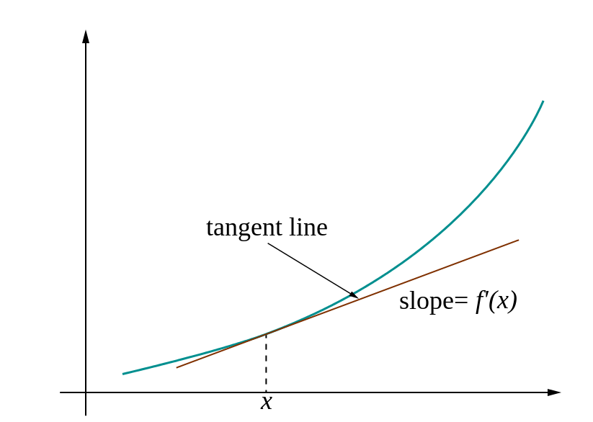
Loss gradients
Denoted as (diff notations):
i.e. how the loss changes as a function of the weights
We want to change the weights in such a way that makes the loss decrease as fast as possible
Notes:
the gradient is just a vector (partial) derivatives for each dimension in the input space
the derivative on each variable tells you the sensitivity of the whole expression on its value.

Slide 43
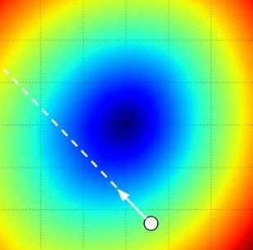
Gradient descent
We’ll update weights iteratively
Move in direction opposite to gradient:
L
Time
Learning rate
W_2
loss function landscape
original W
W_1
negative gradient direction
Figure from Andrej Karpathy
Notes:
we are making an update in the negative direction of the gradient since we wish our loss function to decrease, not increase.

Slide 44
Gradient descent
Iteratively subtract the gradient with respect to the model parameters (w)
i.e. we’re moving in a direction opposite to the gradient of the loss
i.e. we’re moving towards smaller loss
Notes:
the procedure of repeatedly evaluating the gradient and then performing a parameter update is called Gradient Descent

Slide 45
Mini-batch gradient descent
In classic gradient descent, we compute the gradient from the loss for all training examples (can be slow)
So, use only use some of the data for each gradient update
We cycle through all the training examples multiple times
Each time we’ve cycled through all of them once is called an ‘epoch’

Slide 46
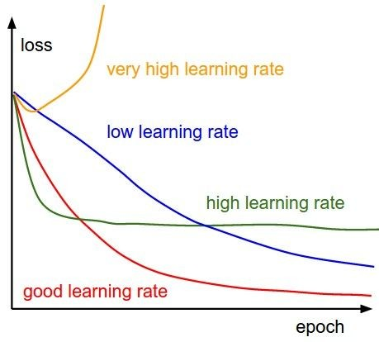
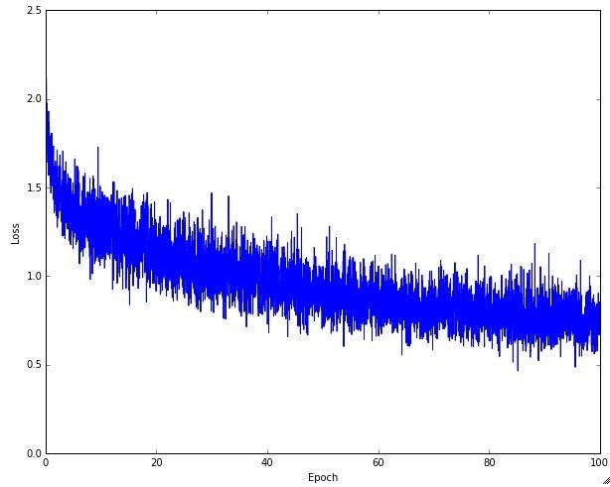
Learning rate selection
The effects of step size (or “learning rate”)
Andrej Karpathy
Notes:
With low learning rates the improvements will be linear. With high learning rates they will start to look more exponential. Higher learning rates will decay the loss faster, but they get stuck at worse values of loss (green line). This is because there is too much "energy" in the optimization and the parameters are bouncing around chaotically, unable to settle in a nice spot in the optimization landscape.

Slide 47
Gradient descent in multi-layer nets
We’ll update weights
Move in direction opposite to gradient:
How to update the weights at all layers?
Answer: backpropagation of loss from higher layers to lower layers

Slide 48
Backpropagation: Graphic example
First calculate error of output units and use this to change the top layer of weights.
output
k
j
i
Update weights into j
w⁽²⁾
hidden
w⁽¹⁾
input
Adapted from Ray Mooney
Notes:
Backpropagation is a way of computing gradients of expressions through recursive application of chain rule.
It can be thought of as gates communicating to each other (through the gradient signal) whether they want their outputs to increase or decrease (and how strongly), so as to make the final output value higher.

Slide 49
Backpropagation: Graphic example
Next calculate error for hidden units based on errors on the output units it feeds into.
output
k
j
i
hidden
input
Adapted from Ray Mooney

Slide 50
Backpropagation: Graphic example
Finally update bottom layer of weights based on errors calculated for hidden units.
output
k
j
i
Update weights into i
hidden
input
Adapted from Ray Mooney

Slide 51
Backpropagation
Easier if we use computational graphs, especially when we have complicated functions typical in deep neural networks
Figure from Karpathy

Slide 52
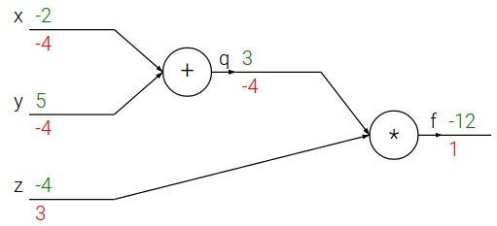

e.g. x = -2, y = 5, z = -4
Backpropagation: a simple example
Fei-Fei Li & Andrej Karpathy & Justin Johnson Lecture 4 - 13 Jan 2016
Lecture 4 - 10
Andrej Karpathy
Notes:
Green shows the intermediate and output values.

Slide 53





e.g. x = -2, y = 5, z = -4
Backpropagation: a simple example
Want:
Fei-Fei Li & Andrej Karpathy & Justin Johnson Lecture 4 - 13 Jan 2016
Lecture 4 - 11
Andrej Karpathy
Notes:
Want to compute the input gradients, will do it by computing intermediate gradients and using chain rule.

Slide 54

e.g. x = -2, y = 5, z = -4
Backpropagation: a simple example
Want:
Fei-Fei Li & Andrej Karpathy & Justin Johnson Lecture 4 - 13 Jan 2016
Lecture 4 - 12
Andrej Karpathy
Notes:
Base case, identify function. Its derivative is 1.

Slide 55
e.g. x = -2, y = 5, z = -4
Backpropagation: a simple example
Want:
Fei-Fei Li & Andrej Karpathy & Justin Johnson Lecture 4 - 13 Jan 2016
Lecture 4 - 13
Andrej Karpathy
Notes:
Red shows gradients

Slide 56

e.g. x = -2, y = 5, z = -4
Backpropagation: a simple example
Want:
Fei-Fei Li & Andrej Karpathy & Justin Johnson Lecture 4 - 13 Jan 2016
Lecture 4 - 14
Andrej Karpathy

Slide 57
e.g. x = -2, y = 5, z = -4
Backpropagation: a simple example
Want:
Fei-Fei Li & Andrej Karpathy & Justin Johnson Lecture 4 - 13 Jan 2016
Lecture 4 - 15
Andrej Karpathy
Notes:
This means that a small positive change h in z will result in a positive change of 3h of the output

Slide 58

e.g. x = -2, y = 5, z = -4
Backpropagation: a simple example
Want:
Fei-Fei Li & Andrej Karpathy & Justin Johnson Lecture 4 - 13 Jan 2016
Lecture 4 - 16
Andrej Karpathy

Slide 59
e.g. x = -2, y = 5, z = -4
Backpropagation: a simple example
Want:
Fei-Fei Li & Andrej Karpathy & Justin Johnson Lecture 4 - 13 Jan 2016
Lecture 4 - 17
Andrej Karpathy
Notes:
If q were to increase by h, f would decrease by 4h

Slide 60

e.g. x = -2, y = 5, z = -4
Backpropagation: a simple example
Want:
Fei-Fei Li & Andrej Karpathy & Justin Johnson Lecture 4 - 13 Jan 2016
Lecture 4 - 18
Andrej Karpathy

Slide 61


e.g. x = -2, y = 5, z = -4
Backpropagation: a simple example
Chain rule:
Want:
Upstream gradient
Local gradient
Fei-Fei Li & Andrej Karpathy & Justin Johnson Lecture 4 - 13 Jan 2016
Andrej Karpathy
Notes:
dq/dy: local derivative (influence) of y on q. An increase in y increases q, which in turn decreases f.
The chain rule tells us that the correct way to “chain” these gradient expressions together is through multiplication

Slide 62

e.g. x = -2, y = 5, z = -4
Backpropagation: a simple example
Want:
Fei-Fei Li & Andrej Karpathy & Justin Johnson Lecture 4 - 13 Jan 2016
Lecture 4 - 20
Andrej Karpathy

Slide 63
e.g. x = -2, y = 5, z = -4
Backpropagation: a simple example
Chain rule:
Want:
Fei-Fei Li & Andrej Karpathy & Justin Johnson Lecture 4 - 13 Jan 2016
Lecture 4 - 21
Andrej Karpathy

Slide 64


activations
f
Fei-Fei Li & Andrej Karpathy & Justin Johnson Lecture 4 - 13 Jan 2016
Lecture 4 - 22
Andrej Karpathy
Notes:
Let’s think about a single gate somewhere in the entire computational graph.
Given inputs x,y, the function f outputs z. z then gets passed on to other gates but we don’t need to know what happens except that at the end, the loss is computed.

Slide 65


activations
“local gradient”
f
gradients
Fei-Fei Li & Andrej Karpathy & Justin Johnson Lecture 4 - 13 Jan 2016
Lecture 4 - 23
Andrej Karpathy
Notes:
In addition to z, during the forward pass, we can also immediately compute the local gradients since function f only cares about x,y,z.

Slide 66

activations
“local gradient”
f
gradients
Fei-Fei Li & Andrej Karpathy & Justin Johnson Lecture 4 - 13 Jan 2016
Lecture 4 - 24
Andrej Karpathy
Notes:
Eventually, we’ll learn what the influence of z is on L (through recursive backpropagation).

Slide 67
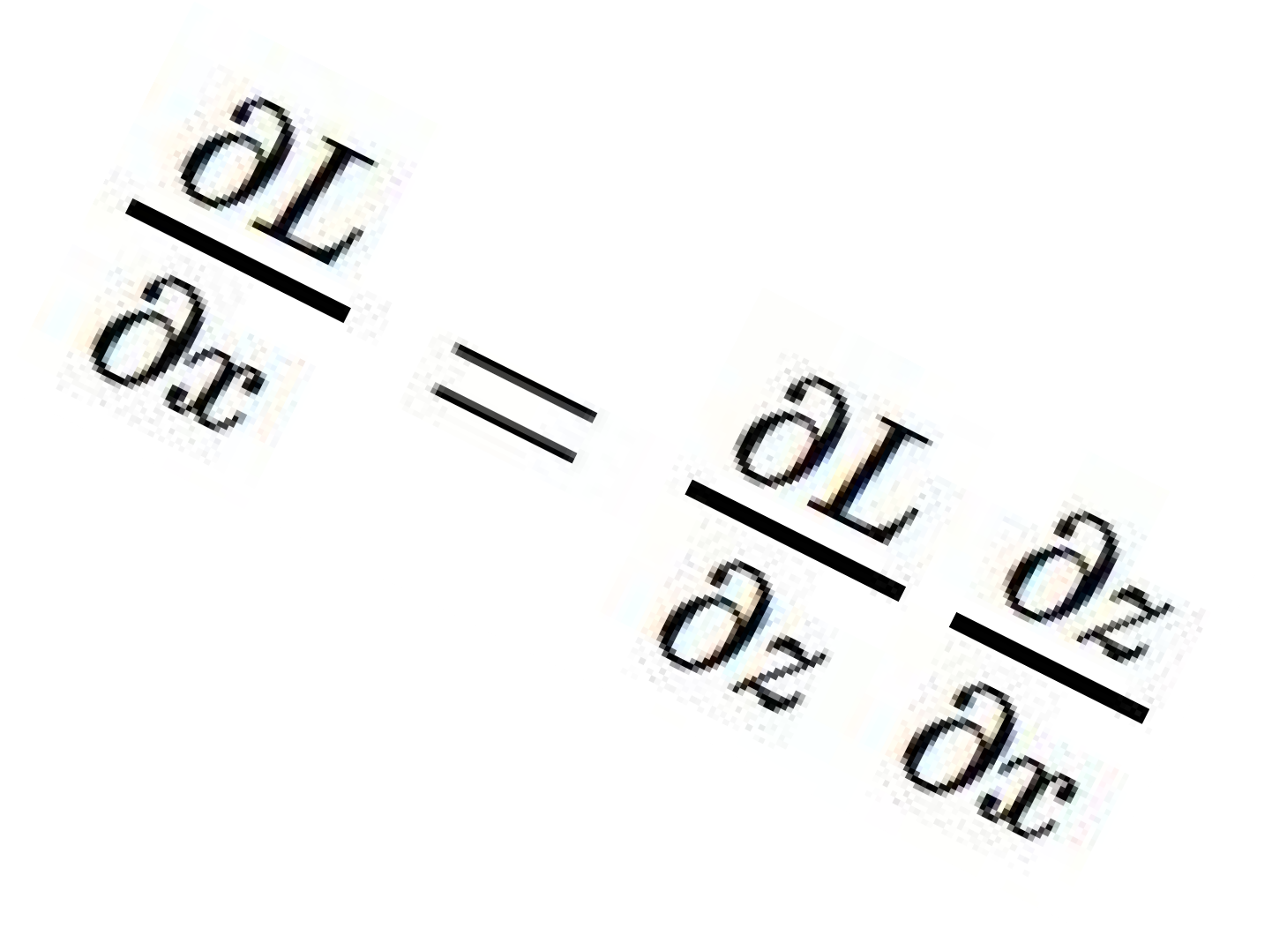
activations
“local gradient”
f
gradients
Fei-Fei Li & Andrej Karpathy & Justin Johnson Lecture 4 - 13 Jan 2016
Lecture 4 - 25
Andrej Karpathy
Notes:
And use the chain rule to chain the gradient flowing back in with the local gradient to compute dL/dx. This gives the influence of x on the final output, which is the loss L.

Slide 68
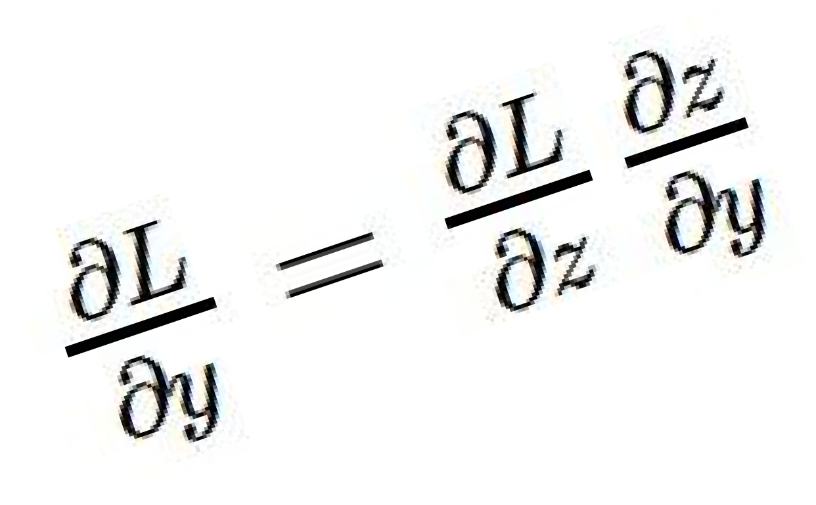
activations
“local gradient”
f
gradients
Fei-Fei Li & Andrej Karpathy & Justin Johnson Lecture 4 - 13 Jan 2016
Lecture 4 - 26
Andrej Karpathy
Notes:
Thi

Slide 69
activations
“local gradient”
f
gradients
Fei-Fei Li & Andrej Karpathy & Justin Johnson Lecture 4 - 13 Jan 2016
Lecture 4 - 27
Andrej Karpathy
Notes:
This process happens recursively through the entire computational graph to compute the influence of every intermediate value on the final output. This is backpropagation.

Slide 70
Backpropagation: another example
Andrej Karpathy

