Slide 1
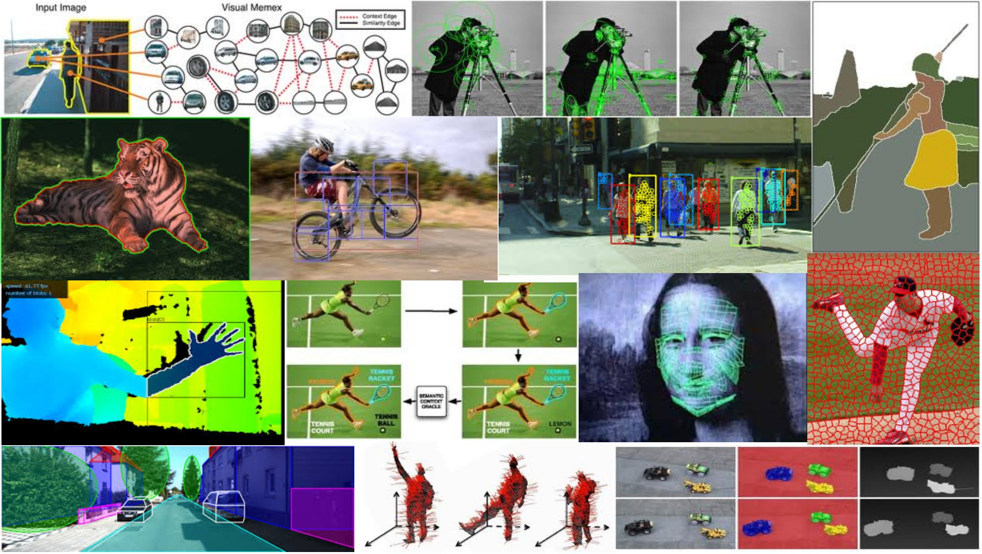
Deep neural networks III June 5th, 2018
Yong Jae Lee
UC Davis
Many slides from Rob Fergus, Svetlana Lazebnik, Jia-Bin Huang, Derek Hoiem, Adriana Kovashka, Andrej Karpathy

Slide 2
Announcements
PS3 due 6/7 (Thurs), 11:59 pm
Review session during Thurs lecture
Post questions on piazza

Slide 3
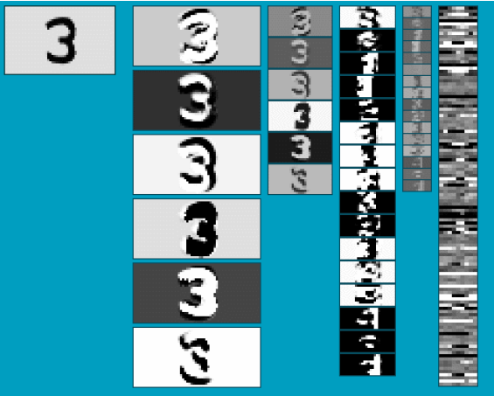
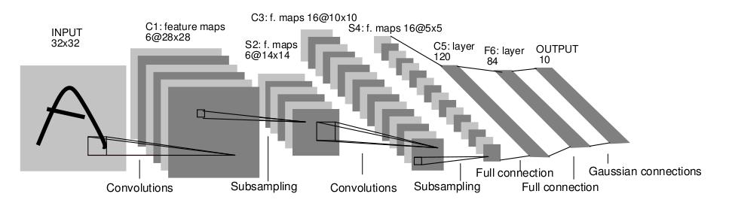
Convolutional Neural Networks (CNN)
Neural network with specialized connectivity structure
Stack multiple stages of feature extractors
Higher stages compute more global, more invariant, more abstract features
Classification layer at the end
Y. LeCun, L. Bottou, Y. Bengio, and P. Haffner, Gradient-based learning applied to document recognition, Proceedings of the IEEE 86(11): 2278–2324, 1998.
Adapted from Rob Fergus

Slide 4
Convolutional Neural Networks (CNN)
Feed-forward feature extraction:
Convolve input with learned filters
Apply non-linearity
Spatial pooling (downsample)
Supervised training of convolutional filters by back-propagating classification error
Output (class probs)
…
Spatial pooling
Non-linearity
Convolution (Learned)
Input Image
Adapted from Lana Lazebnik

Slide 5
Convolutions: More detail
32x32x3 image
32
height
32
depth
width
3
Andrej Karpathy

Slide 6
Convolutions: More detail
32x32x3 image
5x5x3 filter
32
Convolve the filter with the image
i.e. “slide over the image spatially, computing dot products”
32
3
Andrej Karpathy

Slide 7


Convolution Layer
Convolutions: More detail
32x32x3 image 5x5x3 filter
32
1 number:
the result of taking a dot product between the filter and a small 5x5x3 chunk of the image
(i.e. 5*5*3 = 75-dimensional dot product + bias)
32
3
Andrej Karpathy

Slide 8
Convolution Layer
Convolutions: More detail
activation map
32x32x3 image
5x5x3 filter
32
28
convolve (slide) over all spatial locations
32
28
3
1
Andrej Karpathy

Slide 9
consider a second, green filter
Convolutions: More detail
Convolution Layer
32x32x3 image 5x5x3 filter
activation maps
32
28
convolve (slide) over all spatial locations
32
28
3
1
Andrej Karpathy

Slide 10
For example, if we had 6 5x5 filters, we’ll get 6 separate activation maps:
Convolutions: More detail
activation maps
32
28
Convolution Layer
32
28
3
6
We stack these up to get a “new image” of size 28x28x6!
Andrej Karpathy

Slide 11
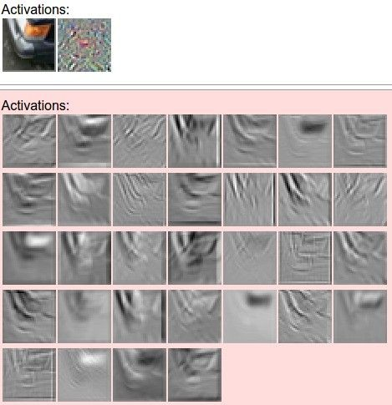
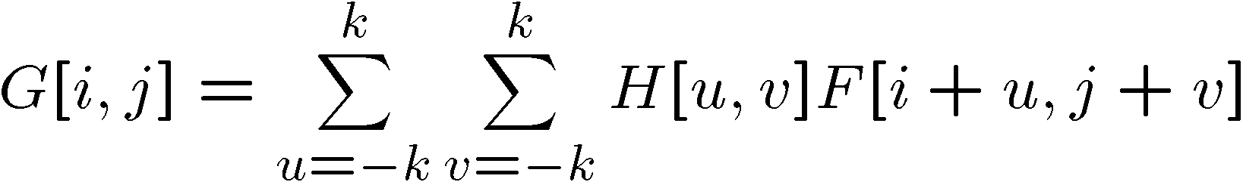
one filter =>
one activation map
Convolutions: More detail
example 5x5 filters
(32 total)
We call the layer convolutional because it is related to convolution of two signals:
Element-wise multiplication and sum of a filter and the signal (image)
Adapted from Andrej Karpathy, Kristen Grauman

Slide 12
Preview: ConvNet is a sequence of Convolution Layers, interspersed with activation functions
Convolutions: More detail
32
28
CONV, ReLU
e.g. 6 5x5x3 filters
32
28
3
6
Andrej Karpathy

Slide 13
Preview: ConvNet is a sequence of Convolutional Layers, interspersed with activation functions
Convolutions: More detail
32
28
24
….
CONV, ReLU
e.g. 6 5x5x3 filters
CONV, ReLU
e.g. 10 5x5x6 filters
CONV, ReLU
32
28
24
3
6
10
Andrej Karpathy

Slide 14
A closer look at spatial dimensions:
Convolutions: More detail
activation map
32x32x3 image
5x5x3 filter
32
28
convolve (slide) over all spatial locations
32
28
3
1
Andrej Karpathy

Slide 15
A closer look at spatial dimensions:
Convolutions: More detail
7
7x7 input (spatially) assume 3x3 filter
7
Andrej Karpathy

Slide 16
A closer look at spatial dimensions:
Convolutions: More detail
7
7x7 input (spatially) assume 3x3 filter
7
Andrej Karpathy

Slide 17
A closer look at spatial dimensions:
Convolutions: More detail
7
7x7 input (spatially) assume 3x3 filter
7
Andrej Karpathy

Slide 18
A closer look at spatial dimensions:
Convolutions: More detail
7
7x7 input (spatially) assume 3x3 filter
7
Andrej Karpathy

Slide 19
A closer look at spatial dimensions:
Convolutions: More detail
7
7x7 input (spatially) assume 3x3 filter
=> 5x5 output
7
Andrej Karpathy

Slide 20
A closer look at spatial dimensions:
Convolutions: More detail
7
7x7 input (spatially) assume 3x3 filter applied with stride 2
7
Andrej Karpathy

Slide 21
A closer look at spatial dimensions:
Convolutions: More detail
7
7x7 input (spatially) assume 3x3 filter applied with stride 2
7
Andrej Karpathy

Slide 22
A closer look at spatial dimensions:
Convolutions: More detail
7
7x7 input (spatially) assume 3x3 filter applied with stride 2
=> 3x3 output!
7
Andrej Karpathy

Slide 23
A closer look at spatial dimensions:
Convolutions: More detail
7
7x7 input (spatially) assume 3x3 filter applied with stride 3?
7
Andrej Karpathy

Slide 24
A closer look at spatial dimensions:
Convolutions: More detail
7
7x7 input (spatially) assume 3x3 filter applied with stride 3?
7
doesn’t fit!
cannot apply 3x3 filter on 7x7 input with stride 3.
Andrej Karpathy

Slide 25
Convolutions: More detail
N
Output size:
(N - F) / stride + 1
 |  |  | F
 | F
e.g. N = 7, F = 3:
stride 1 => (7 - 3)/1 + 1 = 5
stride 2 => (7 - 3)/2 + 1 = 3
stride 3 => (7 - 3)/3 + 1 = 2.33 :\
N
Andrej Karpathy

Slide 26
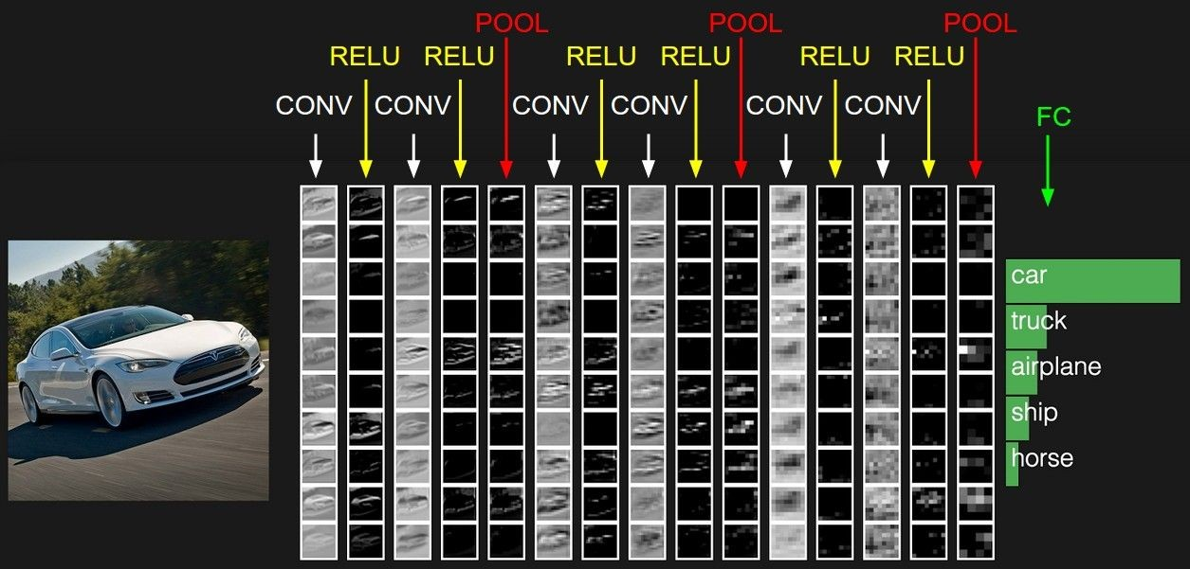
preview:
Convolutions: More detail
Andrej Karpathy

Slide 27
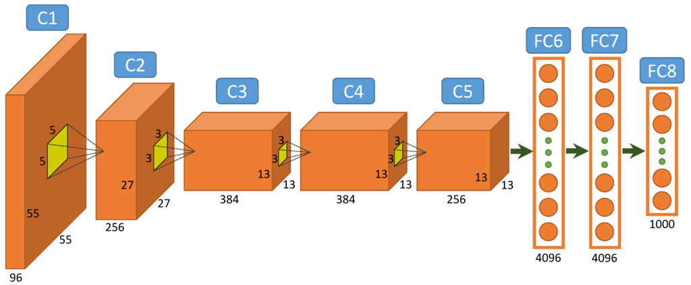
A Common Architecture: AlexNet
Figure from http://www.mdpi.com/2072-4292/7/11/14680/htm

Slide 28
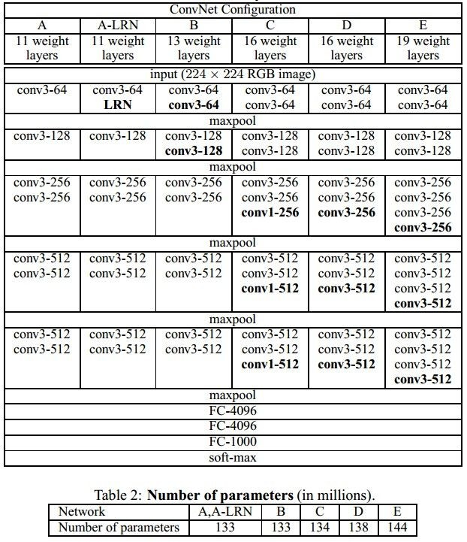
Case Study: VGGNet
[Simonyan and Zisserman, 2014]
Only 3x3 CONV stride 1, pad 1 and 2x2 MAX POOL stride 2
best model
11.2% top 5 error in ILSVRC 2013
->
7.3% top 5 error
Andrej Karpathy

Slide 29
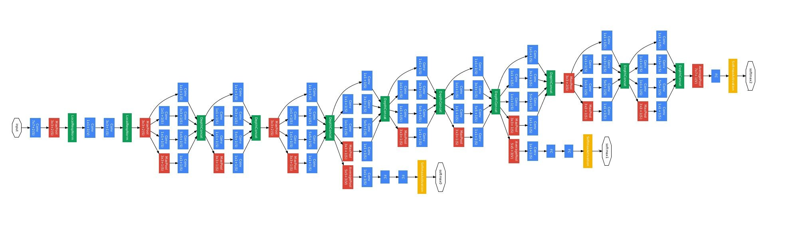
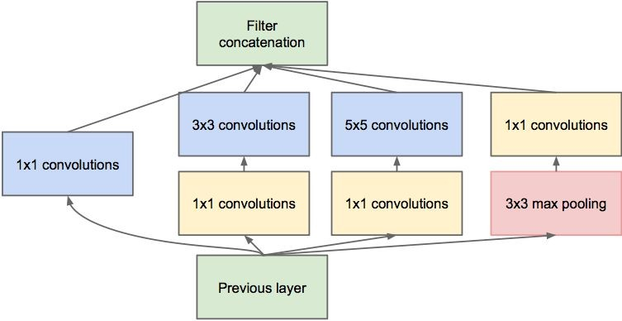
Case Study: GoogLeNet
[Szegedy et al., 2014]
Inception module
ILSVRC 2014 winner (6.7% top 5 error)
Andrej Karpathy

Slide 30
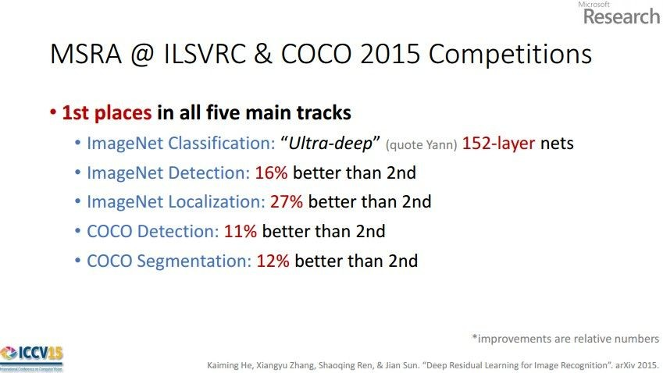
Case Study: ResNet
[He et al., 2015]
ILSVRC 2015 winner (3.6% top 5 error)
Slide from Kaiming He’s recent presentation https://www.youtube.com/watch?v=1PGLj-uKT1w
Andrej Karpathy

Slide 31
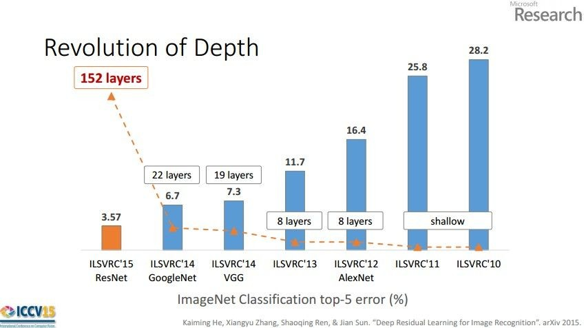
Case Study: ResNet
(slide from Kaiming He’s recent presentation)
Andrej Karpathy

Slide 32
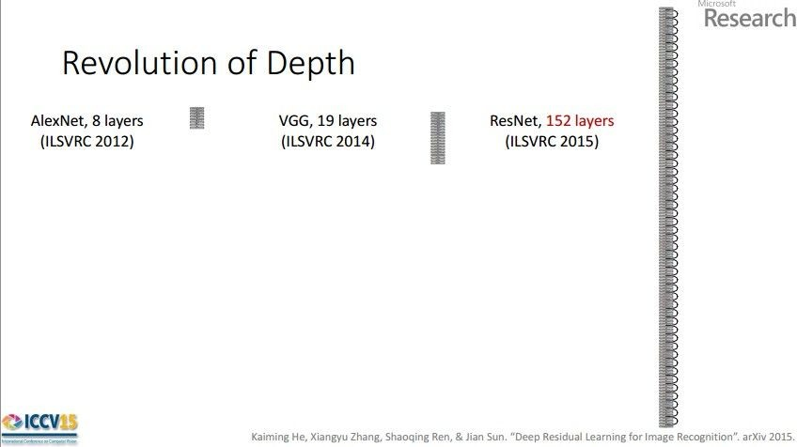
Case Study: ResNet
[He et al., 2015]
ILSVRC 2015 winner (3.6% top 5 error)
2-3 weeks of training on 8 GPU machine
(slide from Kaiming He’s recent presentation)
Andrej Karpathy

Slide 33
Practical matters

Slide 34
Comments on training algorithm
Not guaranteed to converge to zero training error, may converge to local optima or oscillate indefinitely.
However, in practice, does converge to low error for many large networks on real data.
Thousands of epochs (epoch = network sees all training data once) may be required, hours or days to train.
To avoid local-minima problems, run several trials starting with different random weights (random restarts), and take results of trial with lowest training set error.
May be hard to set learning rate and to select number of hidden units and layers.
Neural networks had fallen out of fashion in 90s, early 2000s; back with a new name and significantly improved performance (deep networks trained with dropout and lots of data).
Ray Mooney, Carlos Guestrin, Dhruv Batra

Slide 35
Over-training prevention
Running too many epochs can result in over-fitting.
Keep a hold-out validation set and test accuracy on it after every epoch. Stop training when additional epochs actually increase validation error.
error
on test data
on training data
0
# training epochs
Adapted from Ray Mooney

Slide 36
Training: Best practices
Use mini-batch
Use regularization
Use cross-validation for your parameters
Use RELU or leaky RELU, don’t use sigmoid
Center (subtract mean from) your data
Learning rate: too high? too low?

Slide 37
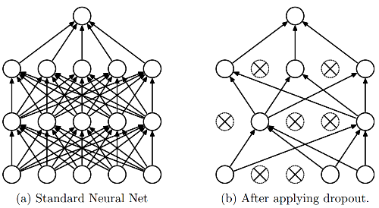
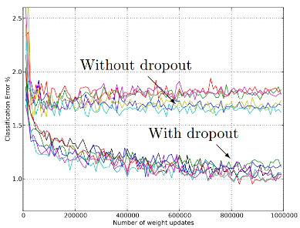
Regularization: Dropout
Randomly turn off some neurons
Allows individual neurons to independently be responsible for performance
Dropout: A simple way to prevent neural networks from overfitting [Srivastava JMLR 2014]
Adapted from Jia-bin Huang

Slide 38
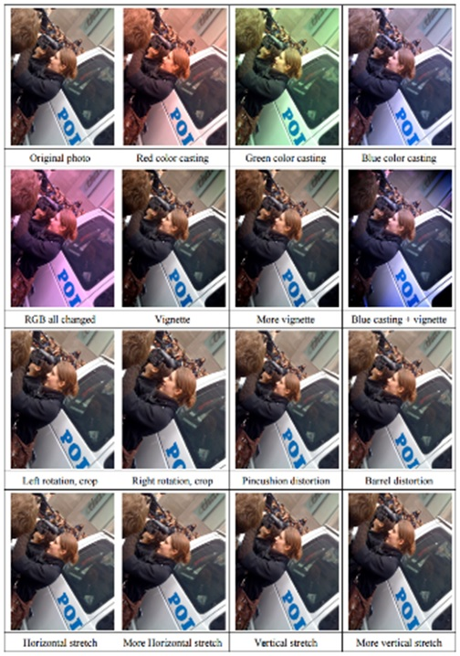
Data Augmentation (Jittering)
Create virtual training samples
Horizontal flip
Random crop
Color casting
Geometric distortion
Deep Image [Wu et al. 2015]
Jia-bin Huang

Slide 39
Transfer Learning
“You need a lot of a data if you want to train/use CNNs”
BUSTED
Andrej Karpathy

Slide 40
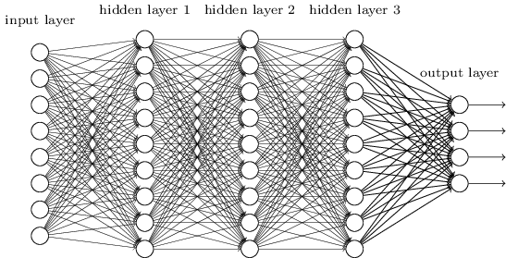
Transfer Learning with CNNs
The more weights you need to learn, the more data you need
That’s why with a deeper network, you need more data for training than for a shallower network
One possible solution:
Set these to the already learned
weights from another network
Learn these on your own task

Slide 41
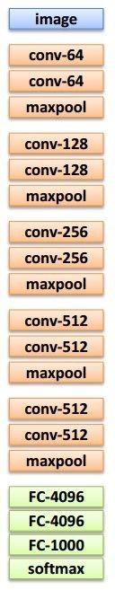
Transfer Learning with CNNs
Source: classification on ImageNet Target: some other task/data
1. Train on ImageNet
2. Small dataset:
3. Medium dataset:
finetuning
more data = retrain more of the network (or all of it)
Freeze these
Freeze these
Train this
Train this
Lecture 11 - 29
Adapted from Andrej Karpathy

Slide 42
Summary
We use deep neural networks because of their strong performance in practice
Convolutional neural networks (CNN)
Convolution, nonlinearity, max pooling
Training deep neural nets
We need an objective function that measures and guides us towards good performance
We need a way to minimize the loss function: stochastic gradient descent
We need backpropagation to propagate error through all layers and change their weights
Practices for preventing overfitting
Dropout; data augmentation; transfer learning

