Slide 1
SOFTWARE DEFINED SECURITY · END-TERM PROJECT · PHASE 1–3
Explainable AI-Based SDN Intrusion Detection
and Automated Flow Response
XAI-SDN-IDS: Ryu + Mininet/OVS · Random Forest · SHAP · Confidence-Gated Response Engine
Team: <names / roll numbers>
Faculty: Dr. Sumit Badotra · 15 October 2026

Slide 2
PHASE 1 · PROBLEM
Why SDN intrusion detection needs explanations and guard-rails
• SDN gives the controller a global, programmable view, so IDS/IPS can run as a controller app
• ML-based SDN IDSs report ≥ 99% accuracy, but:
  – Black box: operators cannot see why a host was flagged, so they cannot trust or audit it
  – Trigger-happy: most install a DROP on the first positive. A false positive becomes a self-inflicted DoS
  – Offline: evaluated on CSV datasets whose features a controller cannot actually measure
• Problem #15: collect OVS flow stats → ML IDS → feature-level explanations → install mitigation only when defined confidence/security conditions are satisfied
XAI-SDN-IDS · Software Defined Security · Problem Statement #15

Slide 3
PHASE 1 · OBJECTIVES
Objectives & scope
• O1 Multi-switch Mininet/OVS testbed with benign traffic + 4 attack classes
• O2 Ryu app: poll OpenFlow flow stats every 2 s → 14 per-source features
• O3 Train & compare multi-class detectors (Acc, P, R, F1, FPR, FNR)
• O4 SHAP feature-level explanations: local per alert, global per model
• O5 Confidence-Gated Response Engine: alert → meter rate-limit → self-expiring DROP
• O6 Evaluate detection/mitigation latency, victim QoS, controller overhead, gating ablation
• Scope: emulated SDN (OF1.3), volumetric + recon attacks from identifiable sources. Out of scope: payload/DPI, spoofed-source attribution
XAI-SDN-IDS · Software Defined Security · Problem Statement #15

Slide 4
PHASE 1 · LITERATURE
Literature review: 16 verified papers (2020–2026)
Work | Approach | XAI | Auto-mitigation | Gating
[1] Elsayed 2020 | InSDN dataset (ONOS testbed) | – | – | –
[2] Novaes 2020 | LSTM + fuzzy, Floodlight | – | ✓ | statistical τ
[3] Tan 2020 | trigger + KMeans/KNN | – | ✓ | 2-stage filter
[5] Alashhab 2024 | online ensemble, Ryu | – | ✓ | n/r
[6] El Kamel 2022 | DNN rate limiting | – | ✓ | trust score
[7] Wang 2020 | SHAP for IDS (NSL-KDD) | ✓ | – | –
[11] Saykat 2026 | OptiXGB, InSDN, SHAP/LIME | ✓ | – | –
[12] Ahmad 2026* | XAI-SDN: RF + SHAP, Ryu | ✓ | offline | single τ=0.70
Ours | RF + SHAP + CGRE, live Ryu | ✓ | ✓ graduated | G1–G4
* preprint. Full table, synthesis and DOIs: docs/research/literature_review.md
XAI-SDN-IDS · Software Defined Security · Problem Statement #15

Slide 5
PHASE 1 · GAPS
Research gaps → our response
• RG1 Explanations never drive mitigation (offline [10][11] or analyst-only [12]) → SHAP is an input to the policy
• RG2 No multi-condition safety gate in SDN controllers → confidence + persistence + XAI + asset gates
• RG3 Explanation quality only scored offline [9][13] → per-alert runtime consistency check
• RG4 Graduated, self-expiring response is rare [6] → alert → meter → DROP with hard_timeout
• RG5 SDN XAI is mostly binary/offline → 5-class model on controller-native OpenFlow features
• RG6 Per-flow SHAP is ~31× slower [12] → explain only flagged per-source windows
XAI-SDN-IDS · Software Defined Security · Problem Statement #15

Slide 6
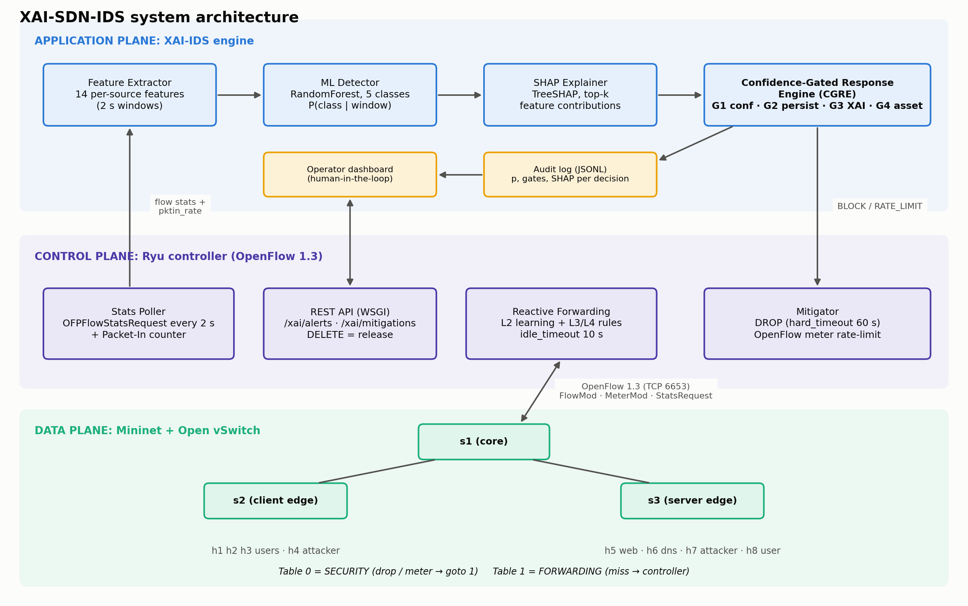
PHASE 2 · DESIGN
System architecture
XAI-SDN-IDS · Software Defined Security · Problem Statement #15

Slide 7
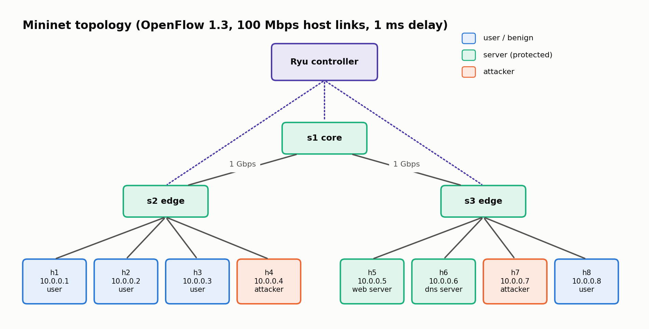
PHASE 2 · DESIGN
Topology & OpenFlow pipeline
• Table 0 SECURITY: DROP / meter rules, default goto 1
• Table 1 FORWARDING: L2 learning + L3/L4 rules, miss → controller
• Match = (src, dst, proto, service port). Random source ports don't explode the flow table
• idle_timeout 10 s; stats polled every 2 s
• h5/h6 are protected assets (G4)
XAI-SDN-IDS · Software Defined Security · Problem Statement #15

Slide 8
PHASE 2 · FEATURES
14 interpretable per-source features (2 s window)
Feature(s) | Attack signal
pkt_rate, byte_rate | volume: floods
avg_pkt_size | tiny packets: SYN/ICMP flood
n_flows, new_flows | flow churn: scans
n_dst_ips, n_dst_ports | fan-out: sweeps/scans
frac_tcp / frac_udp / frac_icmp | protocol mix
pkts_per_flow | low: scan · high: flood/bulk
frac_small_flows | half-open / probe flows
mean_flow_duration | short vs persistent flows
pktin_rate | control-plane pressure
Classes:
benign
icmp_flood
syn_flood
udp_flood
port_scan
Benign includes heavy iperf3 transfers, so the model cannot learn 'rate = attack'.
XAI-SDN-IDS · Software Defined Security · Problem Statement #15

Slide 9
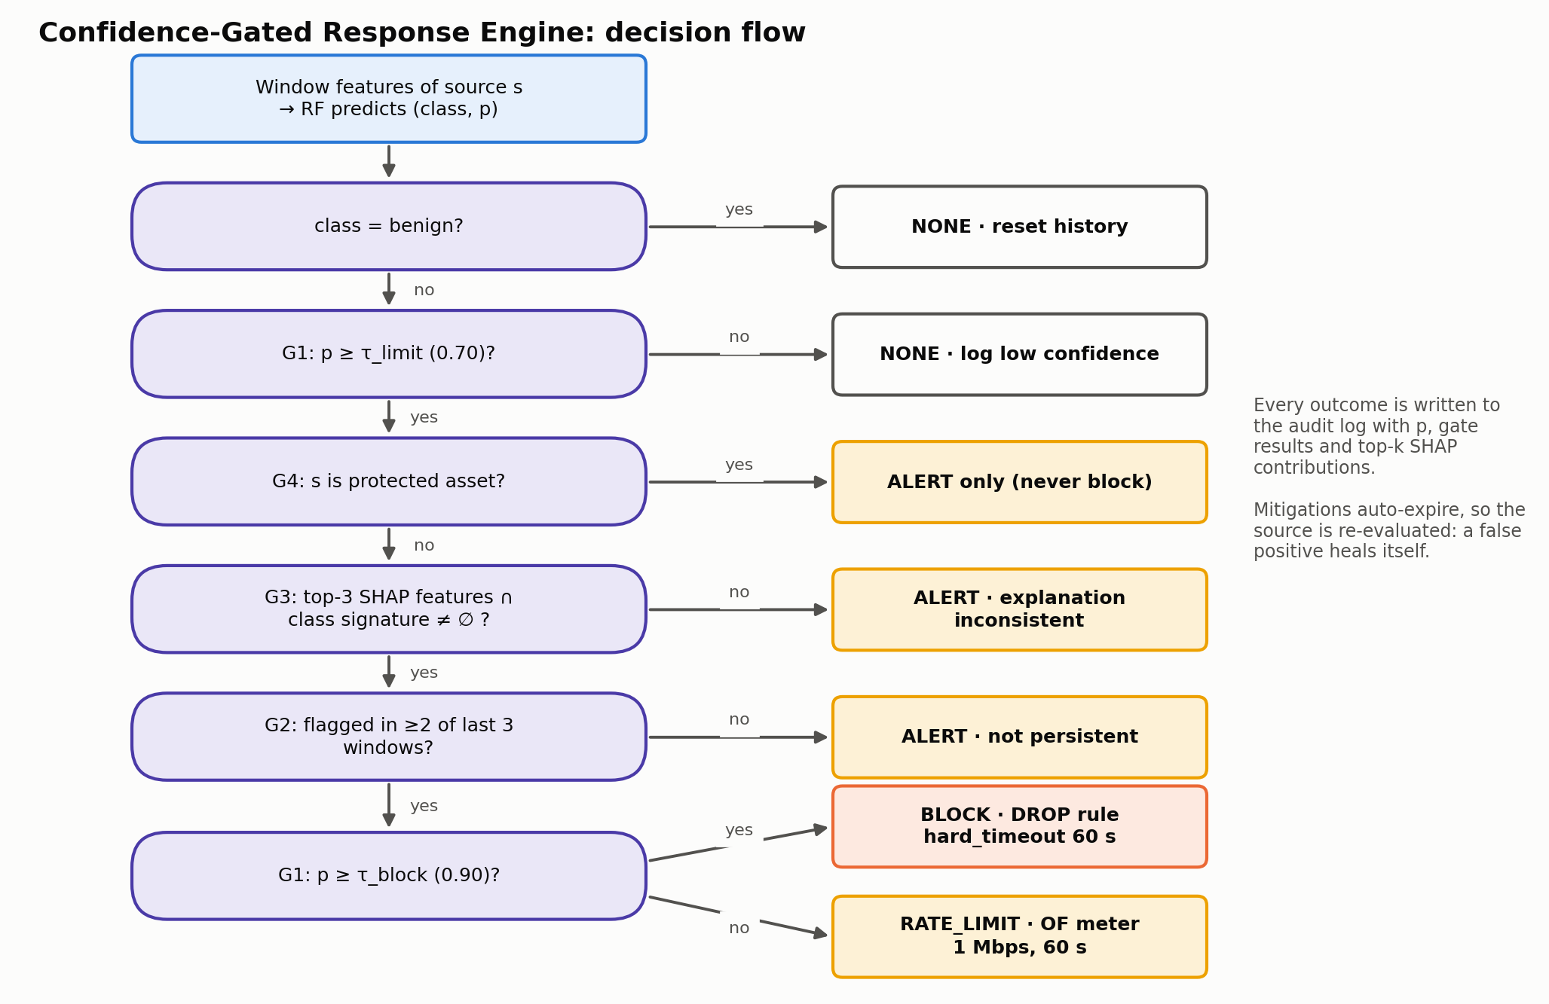
PHASE 2 · SECURITY MECHANISM
Innovation: Confidence-Gated Response Engine
• G1 p ≥ 0.70 to act, ≥ 0.90 to block
• G2 ≥ 2 of last 3 windows
• G3 top-3 SHAP ∩ class signature
• G4 never block protected assets
• Rules auto-expire (60 s): a false positive heals itself
• Audit log + REST override (human-in-the-loop)
XAI-SDN-IDS · Software Defined Security · Problem Statement #15

Slide 10
PHASE 2 · JUSTIFICATION
Technology choices
Choice | Why
Ryu 4.34 (Python) | ML/SHAP in-process; simple OF1.3 stats, meters, multi-table (ODL/ONOS: Java, heavy)
OpenFlow 1.3 | meters for rate-limiting, multiple tables, per-flow counters
Mininet 2.3 + OVS 2.17 | course standard, real OVS kernel datapath
Random Forest | best accuracy/latency trade-off on tabular data; exact fast TreeSHAP
SHAP TreeExplainer | additive, consistent, local + global; ms per alert
Docker Compose | reproducible on all laptops; Ryu needs Python 3.9
XAI-SDN-IDS · Software Defined Security · Problem Statement #15

Slide 11
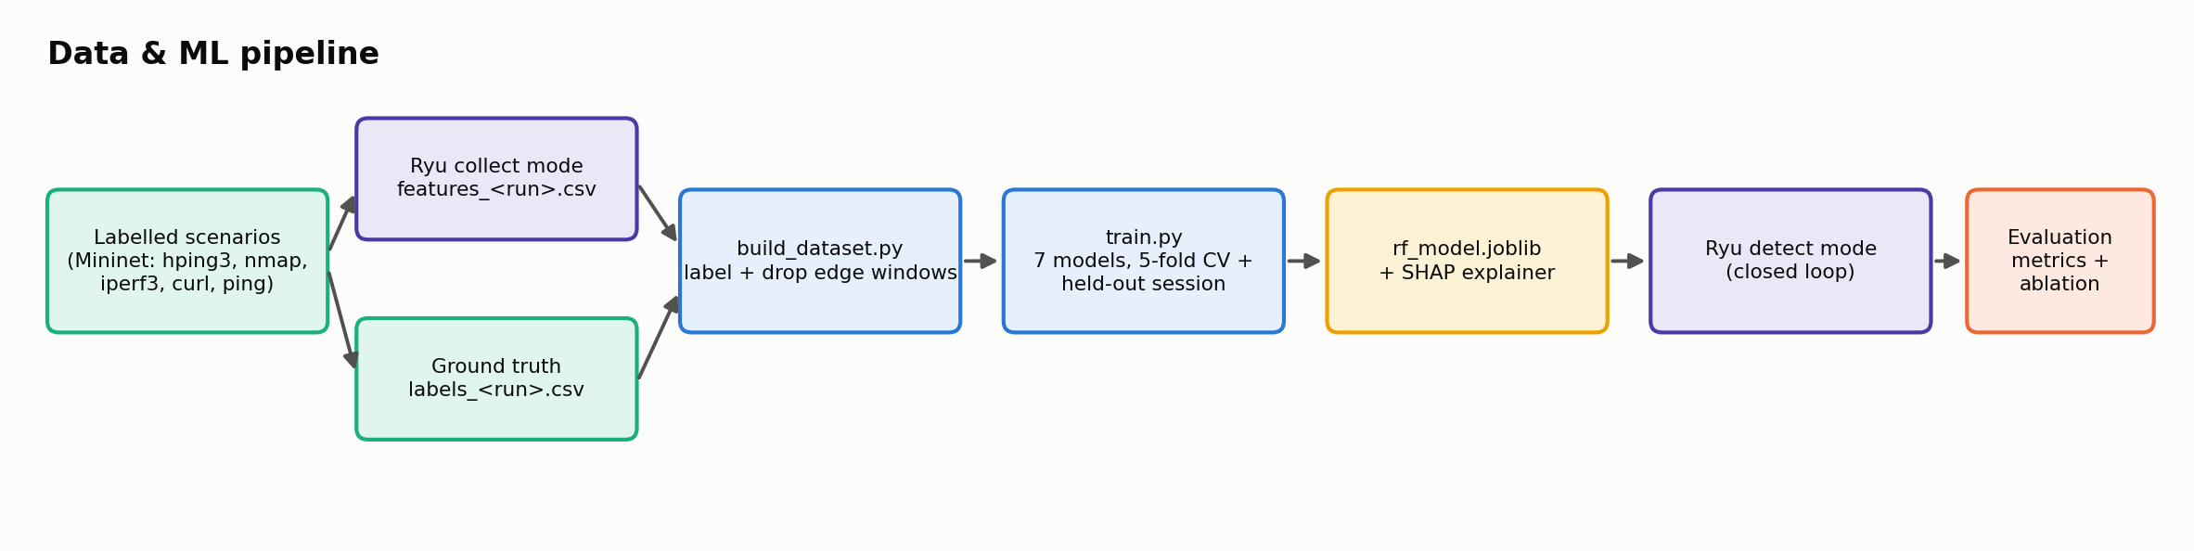
PHASE 3 · IMPLEMENTATION
Implementation status
• Docker testbed: controller (Py3.9, Ryu, sklearn, SHAP) + privileged Mininet/OVS container
• controller/xai_ids_app.py: two-table pipeline, reactive forwarding, stats poller, mitigator (DROP + meters), REST API
• ids/: feature extractor, detector, SHAP explainer, response engine (policy.py), config
• traffic/scenarios.py: randomised labelled episodes (hping3 ICMP/SYN/UDP floods, nmap -sS/-sT, iperf3, curl, ping)
• ml/: dataset labelling, 7-model comparison, SHAP figures, audit/latency summary
• Unit tests for feature extraction and every CGRE gate (9/9 passing)
• Three modes: collect (dataset) · monitor (explain, never act) · detect (closed loop)
XAI-SDN-IDS · Software Defined Security · Problem Statement #15

Slide 12
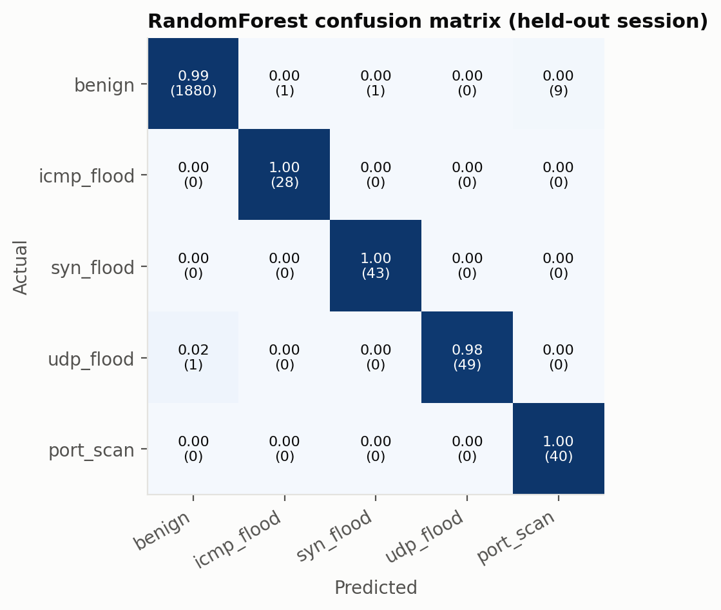
PHASE 3 · RESULTS
Preliminary results: held-out session
Model | Acc | Prec | Rec | F1 | FPR | FNR | µs/sample
RandomForest | 0.994 | 0.952 | 0.995 | 0.971 | 0.006 | 0.006 | 37.2
ExtraTrees | 0.989 | 0.914 | 0.994 | 0.950 | 0.011 | 0.006 | 34.7
HistGradientBoosting | 0.984 | 0.868 | 0.993 | 0.922 | 0.016 | 0.006 | 33.7
DecisionTree | 0.962 | 0.833 | 0.988 | 0.881 | 0.041 | 0.000 | 0.6
KNN | 0.925 | 0.735 | 0.865 | 0.755 | 0.070 | 0.106 | 89.9
MLP | 0.882 | 0.662 | 0.921 | 0.701 | 0.123 | 0.068 | 8.1
LogisticRegression | 0.822 | 0.639 | 0.957 | 0.682 | 0.193 | 0.000 | 1.3
Trained on session 1, tested on an independent session 2 (different seed, rates, attackers, victims). FPR/FNR = benign-vs-attack view. Macro metrics over 5 classes.
XAI-SDN-IDS · Software Defined Security · Problem Statement #15

Slide 13
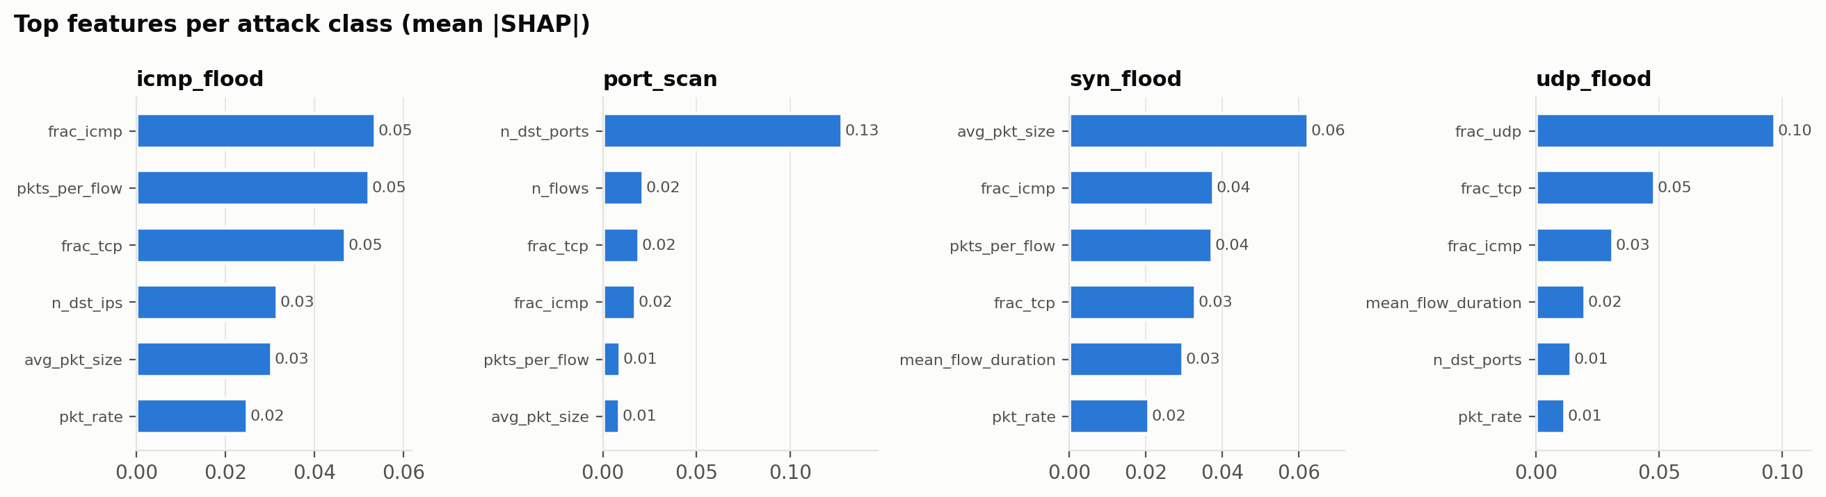
PHASE 3 · XAI
Explanations: what drives each attack class
Real alert from the demo audit log:
10.0.0.4 → syn_flood p=0.95
because frac_tcp=1 (+0.18), avg_pkt_size=54 (+0.12), frac_icmp=0 (+0.11)
→ gates passed → BLOCK (auto-expires)
Per-class top features also validate the CGRE signatures (G3).
XAI-SDN-IDS · Software Defined Security · Problem Statement #15

Slide 14
PHASE 3 · SECURITY RESULTS
Gating works: no innocent host blocked, every attack stopped
Policy | Innocent hosts impaired | Attacks mitigated | Mean time to mitigate
Naive (block on label) | 2 (h6 server, h8 user) | 12/12 | 5.1 s
G1 confidence | 0 | 12/12 | 5.1 s
G1+G2 persistence | 0 | 12/12 | 5.9 s
Full CGRE (G1-G4) | 0 | 12/12 | 5.9 s
Replay of held-out session. Naive blocking hit flood victims whose replies looked like floods.
Live closed-loop demo | Flagged | Mitigated | Action · SHAP reason
Heavy benign 10 Mbps UDP (h1) | – | – | none (correct)
SYN flood h4 → h5 | 2.2 s | 6.4 s | ALERT → BLOCK · frac_tcp=1, avg_pkt_size=54 B
Port scan h7 → h6 | 3.8 s | 6.1 s | ALERT → BLOCK · n_dst_ports=538
UDP flood h4 → h8 | 2.3 s | 2.4 s | RATE_LIMIT (p=.89) → BLOCK (p=.97) · frac_udp=1
Inference 9–31 ms, SHAP explanation ≈2.5 ms per alert. OVS meters verified (OF1.3, kbps, drop band).
XAI-SDN-IDS · Software Defined Security · Problem Statement #15

Slide 15
PHASE 3 · ANALYSIS
What we learned: limitations that shape Phase 4
• Same-session CV overstates performance: CV F1 0.97–0.99 for all models, but 0.68–0.97 on an independent session
  – we always report held-out-session metrics
• Victim reflection: a host answering an ICMP flood emits an equal-rate ICMP stream
  – a 2,400 pps ICMP flood was detected with p < 0.70 (confidence gate held it back)
  – Phase 4: ICMP-type feature + reflection-aware gate G5
• Statistics lag up to 2 polling intervals → detection latency floor ≈ 2–4 s
• Labelling bug found and fixed: looping scans outlived their episode (now killed by process group)
• G2–G4 did not change outcomes in this session → adversarial/edge scenarios planned for Phase 5
XAI-SDN-IDS · Software Defined Security · Problem Statement #15

Slide 16
ROADMAP
Plan for Phases 4–7 (final evaluation 16–19 Nov)
When | Work
16–22 Oct | More sessions & intensities (incl. low-rate), tuning, InSDN cross-check
23–29 Oct | Closed-loop CGRE hardening, meters, audit log, REST API
30 Oct–5 Nov | Experiments: detection/mitigation latency, throughput/RTT/loss, CPU/mem, ablation naive vs gated, SHAP vs LIME
6–12 Nov | Operator dashboard, final report & figures
13–15 Nov | Demo rehearsal, viva preparation, backup recording
XAI-SDN-IDS · Software Defined Security · Problem Statement #15

Slide 17
Thank you. Questions?
• Code: xai-sdn-ids/ (README → quick start)
• Key references: [1] InSDN (IEEE Access 2020) · [6] El Kamel (Comp. Comm. 2022) · [7] Wang (IEEE Access 2020) · [12] XAI-SDN (arXiv 2026) · [13] Alquliti (arXiv 2025)
• Full IEEE-style reference list in the Phase 1–3 report
XAI-SDN-IDS · Software Defined Security · Problem Statement #15

