Slide 1
OBJECT ORIENTED PROGRAMMING CONCEPTS USING JAVA (CA101B)
Ms. Sonam jain

Slide 2
Introduction to Java
Java is a high-level, object-oriented programming language developed by Sun Microsystems in 1995.
It was later acquired by Oracle Corporation.
Java is renowned for its "write once, run anywhere" (WORA) capability, achieved through the Java Virtual Machine (JVM).

Slide 3
Key characteristics of Java
Object-Oriented
Platform Independent
Simple and Familiar
Robust and Secure
High Performance
Multi-threaded and Dynamic
Notes:
Key characteristics of Java include:
Object-Oriented:
Java is built upon the principles of object-oriented programming (OOP), including encapsulation, inheritance, polymorphism, and abstraction, which promote modular and reusable code.
Platform Independent:
Java code is compiled into an intermediate bytecode, which can then be executed on any device or operating system that has a compatible Java Virtual Machine (JVM). This ensures broad compatibility across different platforms.
Simple and Familiar:
Java's syntax is designed to be relatively straightforward and familiar to developers with experience in languages like C and C++.
Robust and Secure:
Java incorporates features for exception handling and memory management (via garbage collection), enhancing application robustness. Its security features are also a key aspect, especially for network-based applications.
High Performance:
While interpreted by the JVM, Just-In-Time (JIT) compilation in modern JVMs helps optimize performance, making Java suitable for demanding applications.
Multi-threaded and Dynamic:
Java supports multi-threading, allowing concurrent execution of multiple parts of a program, and is designed for dynamic environments where code can be loaded and linked at runtime.

Slide 4
First Java Program
public class HelloWorld { public static void main(String[] args) { System.out.println("Hello, World!"); } }

Slide 5
Class and Object
A class is a blueprint from which individual objects are created.
In Java, everything is related to classes and objects.
Each class has its methods and attributes that can be accessed and manipulated through the objects.
Properties of Java Classes
A class does not take any byte of memory.
A class is just like a real-world entity, but it is not a real-world entity. It's a blueprint where we specify the functionalities.
A class contains mainly two things: Methods and Data Members.
A class can also be a nested class.
Classes follow all of the rules of OOPs such as inheritance, encapsulation, abstraction, etc.

Slide 6
Creating (Declaring) a Java Class
To create (declare) a class, you need to use access modifiers followed by class keyword and class_name.
Syntax to create a Java class
Use the below syntax to create (declare) class in Java:
access_modifier class class_name{
data members;
constructors;
methods;
...;
}

Slide 7
Example of a Java Class
// Creating a Java class
class Dog {
// Declaring and initializing the attributes
String breed;
int age;
String color;
// methods to set breed, age, and color of the dog
public void setBreed(String breed) {
this.breed = breed;
}
public void setAge(int age) {
this.age = age;
}
public void setColor(String color) {
this.color = color;
}
// method to print all three values
public void printDetails() {
System.out.println("Dog detials:");
System.out.println(this.breed);
System.out.println(this.age);
System.out.println(this.color);
}
}

Slide 8
What are Java Objects?
An object is a variable of the type class,
it is a basic component of an object-oriented programming system.
A class has the methods and data members (attributes), these methods and data members are accessed through an object.
Thus, an object is an instance of a class.
Creating (Declaring) a Java Object
There are three steps when creating an object from a class −
Declaration − A variable declaration with a variable name with an object type.
Instantiation − The 'new' keyword is used to create the object.
Initialization − The 'new' keyword is followed by a call to a constructor. This call initializes the new object.

Slide 9
Syntax to Create a Java Object
Consider the below syntax to create an object of the class in Java:
Class_name object_name = new Class_name([parameters]);

Slide 10
Example
class Dog {
// Declaring and initializing the attributes
String breed;
int age;
String color;
// methods to set breed, age, and color of the dog
public void setBreed(String breed) {
this.breed = breed;
}
public void setAge(int age) {
this.age = age;
}
public void setColor(String color) {
this.color = color;
}
// method to print all three values
public void printDetails() {
System.out.println("Dog detials:");

Slide 11
Example
System.out.println(this.breed);
System.out.println(this.age);
System.out.println(this.color);
}
}
public class Main {
public static void main(String[] args) {
// Creating an object of the class Dog
Dog obj = new Dog();
// setting the attributes
obj.setBreed("Golden Retriever");
obj.setAge(2);
obj.setColor("Golden");
// Printing values
obj.printDetails();
}
}

Slide 13
Accessing Instance Variables and Methods
/* First create an object */
ObjectReference = new Constructor();
/* Now call a variable as follows */
ObjectReference.variableName;
/* Now you can call a class method as follows */
ObjectReference.MethodName();

Slide 14
Operators
Java operators are special symbols that perform operations on variables or values.
Types of Operators in Java
Arithmetic Operators
Unary Operators
Assignment Operator
Relational Operators
Logical Operators
Ternary Operator
Bitwise Operators
Shift Operators

Slide 15
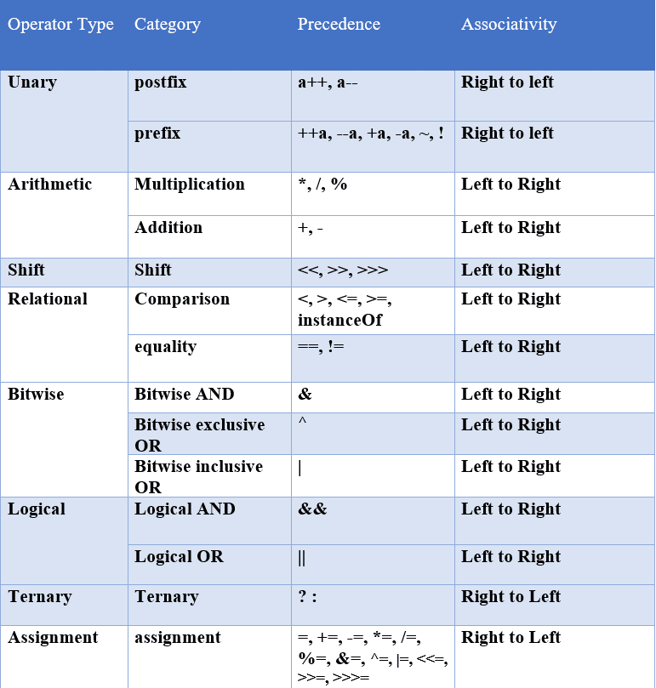
.

Slide 16
Class and Objects programs
Write a Java program to create a class Student with data members name and age. Create two objects of this class, assign values, and display them using a method display().
Write a Java program to create a class Student with data members name and age.Create an object of the class in the main() method.Assign values to the object’s data members.Display the details using a method display().
Write a Java program to create a class Calculator with methods add(int a, int b) and multiply(int a, int b). Create an object of Calculator and use it to find the sum and product of two numbers.

Slide 17
Control Structures and Looping
Have you ever wondered how Java manages the flow of its programs so efficiently?
The three types of control statements, namely decision-making statements, looping statements, and jump statements.
It allow Java programs to execute different code paths based on conditions, loop through blocks of code multiple times, and manage the flow of execution.

Slide 18
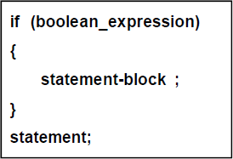
Simple if Statement
The if statement enables our program to selectively execute other statements, based on some criteria. The syntax of if statement is:
For example,
if (percentage>=40)
{
System.out.println(“Pass “);
}

Slide 19
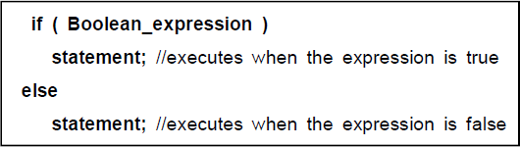
If… Else Statement

Slide 20
Nesting of If Else Statement
Nesting of If Else Statement
if(i == 10)
{
if(j < 20) a = b;
if(k > 100) c = d; // this if is
else a = c; // associated with this else
}
else a = d; // this else refers to if(i == 10)

Slide 21
The Else If Ladder
if(condition)
statement;
else if(condition)
statement;
else if(condition)
statement;
.
.
.
else
statement;

Slide 22
.
class IfElse
{
public static void main(String args[])
{
int month = 4; // April String season;
if(month == 12 || month == 1 || month == 2) season = "Winter";
else if(month == 3 || month == 4 || month == 5) season = "Spring";
else if(month == 6 || month == 7 || month == 8) season = "Summer";
else if(month == 9 || month == 10 || month == 11) season = "Autumn";
else
season = "Bogus Month"; System.out.println("April is in the " + season + ".");
}
}

Slide 23
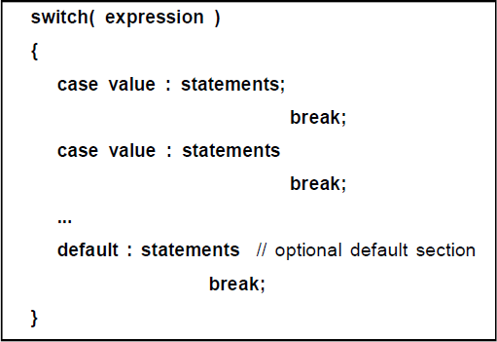
The switch Statement
The switch statement provides variable entry points to a block.
It tests the value of a given variable or expression against a list of case values and when a match is found.
a block of statements associated with that case is executed.

Slide 24
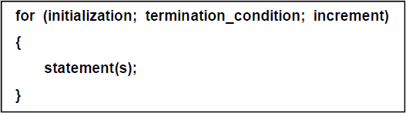
Looping Statement
The for Statement
The for statement provides a compact way to iterate over a range of values. The general form of the for statement can be expressed like this:
for (; ; )
{
// infinite loop
}

Slide 25
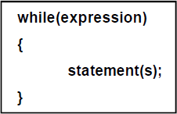
The while Statement
In looping, a sequence of statements are executed until some conditions for the termination of the loop are satisfied.
Java does not support goto statement.
The general syntax of the while statement is:

Slide 26
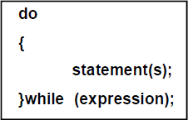
The do-while statement.
The general syntax of do-while is:

Slide 27
Example
public class Main {
public static void main(String[] args) { int i = 0;
do { System.out.println(i); i++;
}
while (i < 5);
}
}

Slide 28
For-Each Loop in Java
The for-each loop in Java (also called the enhanced for loop) was introduced in Java 5 to simplify iteration over arrays and collections.
Example: Using a for-each loop to print each element of an array in Java.
class Demo {
public static void main(String[] args) {
// Array declaration
int arr[] = { 1, 2, 3, 4, 5 };
// Using for-each loop to
// print each element
for (int e : arr) {
System.out.print(e + " ");
}
}
}

Slide 29
Break & Continue Statement
When the break statement is encountered inside a loop, the loop is immediately exited and the program continues with the statement immediately following the loop.
When the loop is nested, the break would only exit from the loop containing it. This means, the break will exit only a single loop.

Slide 30
Example
public class BreakExample1 {
public static void main(String args[]){ int num =0;
while(num<=100)
{
System.out.println("Value of variable is: "+num); if (num==2)
{
break;
}
num++;
}
System.out.println("Out of while-loop");
}
}

Slide 31
Continue Statement
The continue statement causes an immediate branch to the end of the innermost loop that encloses it, skipping over any intervening statements. It is written as: continue ;

Slide 32
Scanner class /Input from User
In Java, the Scanner class is present in the java.util package is used to obtain input for primitive types like int, double, etc., and strings.
class Demo
{
public static void main(String[] args) {
Scanner sc = new Scanner(System.in);
System.out.println("Enter your name:");
String name = sc.nextLine();
System.out.println("Hello, " + name + " Welcome to the GeeksforGeeks.");
}
}

Slide 33
System is a built-in class in Java.It has 3 important objects:
System.out → for printing output (screen).
System.err → for error messages.
System.in → for taking input (keyboard).

Slide 34
.
Method | Description
nextBoolean() | Used for reading Boolean value
nextByte() | Used for reading Byte value
nextDouble() | Used for reading Double value
nextFloat() | Used for reading Float value
nextInt() | Used for reading Int value
nextLine() | Used for reading Line value
nextLong() | Used for reading Long value
nextShort() | Used for reading Short value

