Slide 1
Hotel Recommendation Engine
Review 1
September 1, 2017
Shivani Patel (14BCE118)
Kavi Sanghavi (14BCE103)

Slide 2

Workflow and progress
Feasibility study, getting access to data sources
Visualisation of data, showing trends
Distance Metrics - deciding which to use
Model selection - and the approach (ongoing)
Iteratively improving (possibly even changing) to achieve acceptable benchmark*

Slide 3
Problem Statement
For each search →
build a prediction engine that ranks hotels/properties (like on AirBnB) with the most likely to be booked on the top.

Slide 4
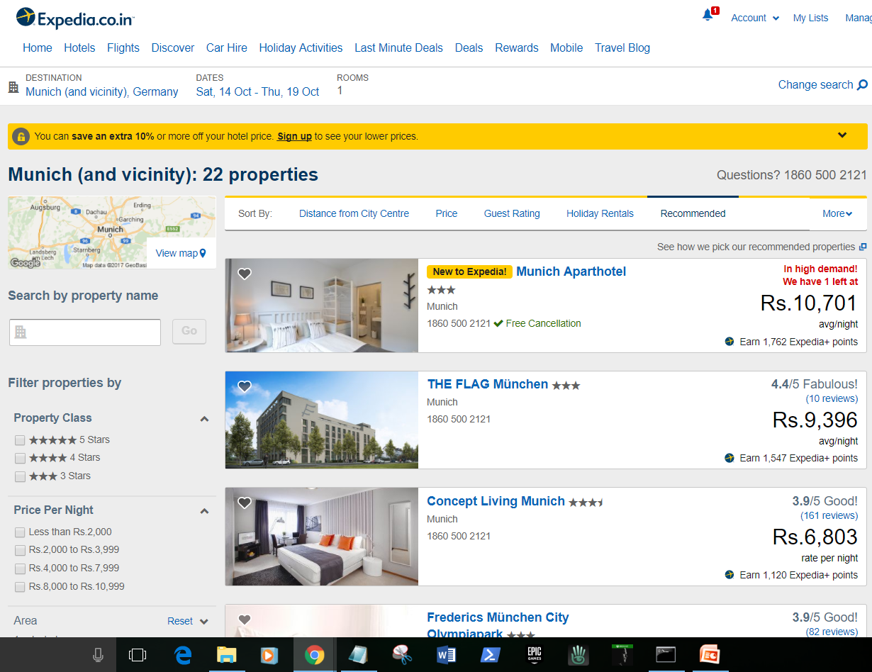
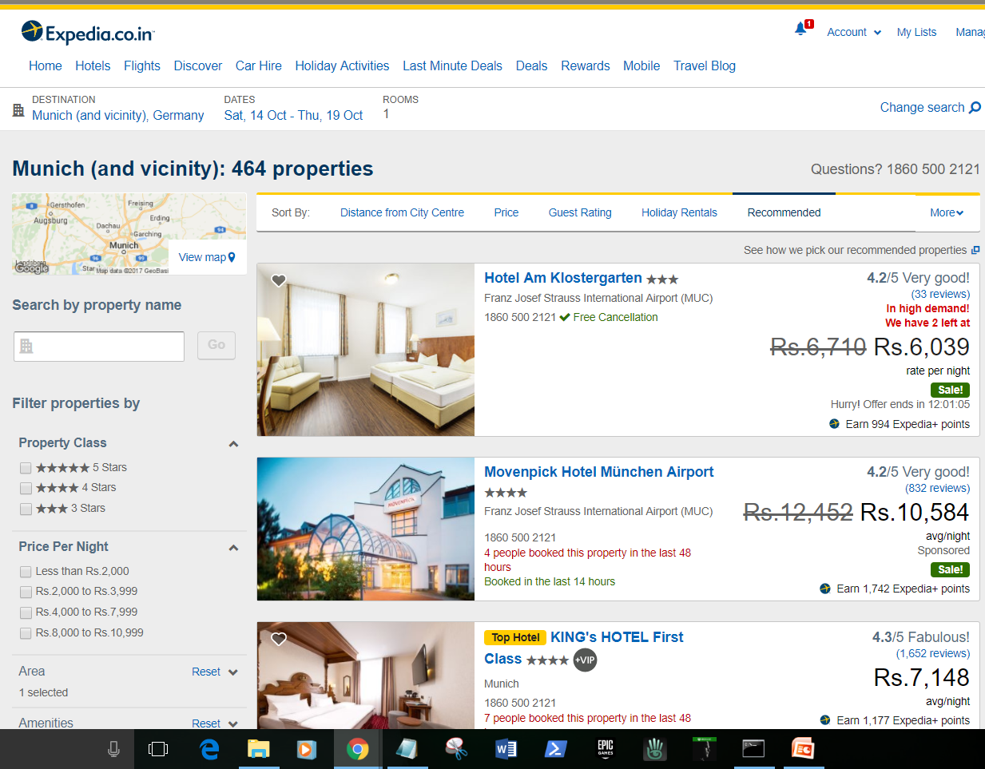
Personalised Search

Slide 5
Evaluating parameters*
Take into consideration each search parameter
+ user profile history
+ historical booking data & trends
+ user browsing habits (“implicit parameters”)
+ competitor data
+ property parameters (“attractiveness to user”)
*Complete list of parameters used are specified in report

Slide 6
Distance Metrics:
(used when)
Euclidean almost in all clustering algorithms
Manhattan when a grid-like path is followed
PCC similarity for linear and continuously related variables
Chebychev differences in individual dimensions are more pronounced
Canberra data centered around origin; detecting deviations/outliers
Cosine information retrieval systems; ranking of documents’ relevancy
Comparison referred from: http://www.ijettcs.org/NCASG-2013/NCASG%2038.pdf

Slide 7
Clustering algorithms
(explored till now)
K Nearest Neighbours
DBScan
OPTICS (enhancement to DBScan, uses Priority Queue instead of set; dendograms for varying density)

