Slide 1
Hotel Recommendation Engine
Minor Project - Final Review
November 30, 2017
Guided by:
Dr. K P Agrawal
Developed by:
Shivani Patel (14BCE118)
Kavi Sanghavi (14BCE103)

Slide 2
PRESENTATION FLOW
Problem statement
Dataset explanation
Challenges faced
Code explanation - a demo
Evaluation of results
Further scope

Slide 3
Build a recommendation engine that ranks & displays hotel/property clusters for each search by each user - in the decreasing order of likeability to be booked.

Slide 4
THE (massive) DATASET^{[1]}
Provided and anonymised by Expedia for the Kaggle competition at https://www.kaggle.com/c/expedia-hotel-recommendations/

Slide 5
CHALLENGES FACED
Which Distance Metric to use?^{[2]}
Preliminary data analysis by visualising trends in the dataset; libraries used: seaborn, matplotlib and sklearn.
Dataset too huge to be handled by a single CPU/GPU
Batching, combined with Ensemble methods as Random Forest to aggregate the performance^{[3]}.
Dimensionality
149 features to identify just the hotel/property!
Resolved by performing a PCA and reducing it to 3 features.

Slide 6
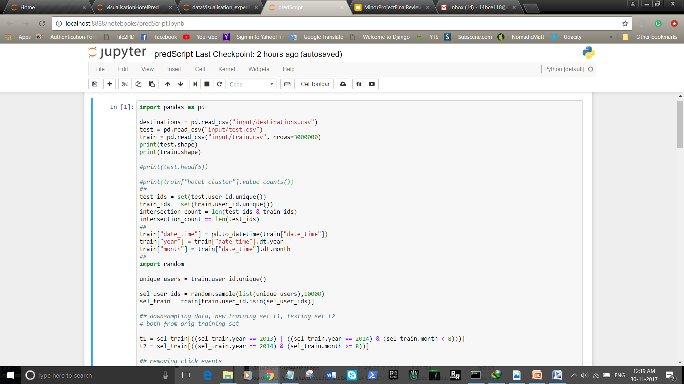
CODE EXPLANATION
A DEMO

Slide 7
EVALUATION - SOME NUMBERS
Competition Leaderboards^{[4]} vs. Our Score
GIT username | MAP@5 score
idle_speculation | 0.60218
beluga | 0.53218
Victor | 0.53134
Ala Mode | 0.52994
Medrr | 0.52585
0.515422
GIT project link: https://github.com/shivani-1/hotel-cluster-recommendation
https://www.kaggle.com/c/expedia-hotel-recommendations/leaderboard; last checked on Nov 29, 2017

Slide 8

FUTURE SCOPE
Parallelising operations over multiple cores, increase batch size and improve results.
Using tools like SPARK for multithreading.
Investigating over other ensemble methods like Bootstrap Aggregation.
Developing frontend for the recommender engine.

Slide 9
Thank You
Presented by:
Shivani Patel (14BCE118)
Kavi Sanghavi (14BCE103)

Slide 10
References
Understanding the Expedia Dataset - https://www.dataquest.io/blog/kaggletutorial/
Comparative study of distance metrics - http://www.ijettcs.org/NCASG-2013/NCASG%2038.pdf
Predicting results to user search queries - http://cs229.stanford.edu/proj2016spr/report/065.pdf
Expedia Kaggle competition Leaderboards - https://www.kaggle.com/c/expedia-hotel-recommendations/leaderboard

