Slide 1


P-332 (Group No. 6) Book recommendation system

Slide 2
Group Members :
Shivani Pawar
Shilpi Kumari
Prafull Ahirrao
Sneha
Masumvali Shaikh
Vaishakh Chandran TV
Madesh B

Slide 3
Presentation Outline :
Problem Statement
Data Overview
Tools and Technologies used
Data preprocessing
Exploratory Data Analysis
Recommender Systems
Evaluation Metrics
Deployment
Conclusion

Slide 4
1) Problem Statement :
Business objective- Generate the features from the dataset and use them to recommend the books according to the users

Slide 5
2) Data Overview :
Users
User-ID: A unique identification number for each user
Location: It contains city, state and country to which the user belongs ,separated by commas
Age: The age of the user
Books
ISBN: International Standard Book Number unique to each edition of the book
Book-Title: Title of the book
Book-Author: Author of the book (encase of several authors only the first is provided)
Year-of-Publication: The year in which the particular edition of the book was published
Publisher: Name of the Book Publishing company
Image-URL-S: URL link to a small version of the book cover displayed on the Amazon website
Image-URL-M: URL link to Medium version image of the book cover displayed on the Amazon website
Image-URL-L: URL link to Large sized image of the book cover displayed on the Amazon website
Ratings
User-ID:as mentioned above
ISBN:as mentioned above
Book-Rating: The rating given by the user (identified by User-ID) for the book (identified by ISBN). It is either explicit expressed on a scale from 1-10 (higher values denoting higher appreciation), or implicit expressed by 0.

Slide 6
3) Tools and Technologies Used :
The programming language used in this project is Python . The following libraries were used for data analysis and data visualization and to build a recommender model to recommend a book as per user-id.
Pandas : For loading the dataset and performing data wrangling
Matplotlib: For data visualization.
Seaborn: For advance data visualization.
NumPy: For some math operations in predictions.
Statsmodels: For statistical computations
Sklearn: For the purpose of analysis,prediction and evaluation.
Streamlit: For the purpose of deployment of the model to get recommendation
as per user-id.

Slide 7
4) Data Preprocessing :
Data preprocessing involves handling missing values, encoding categorical features, and ensuring data quality.
Additionally, we have split the data into training and testing sets for model development and evaluation.
Checked for outliers, incorrect values, missing values, duplicate, performed data type correction and string formatting.

Slide 8
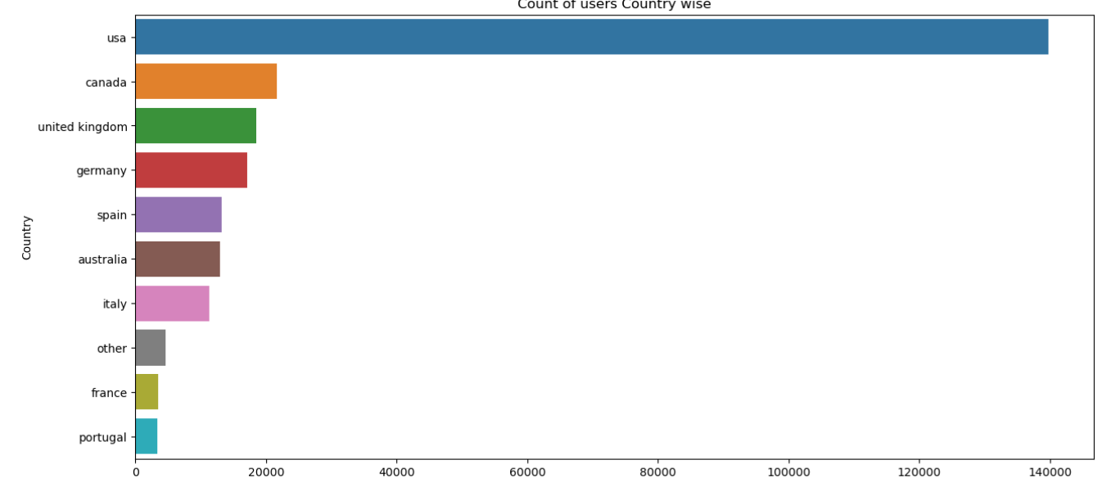
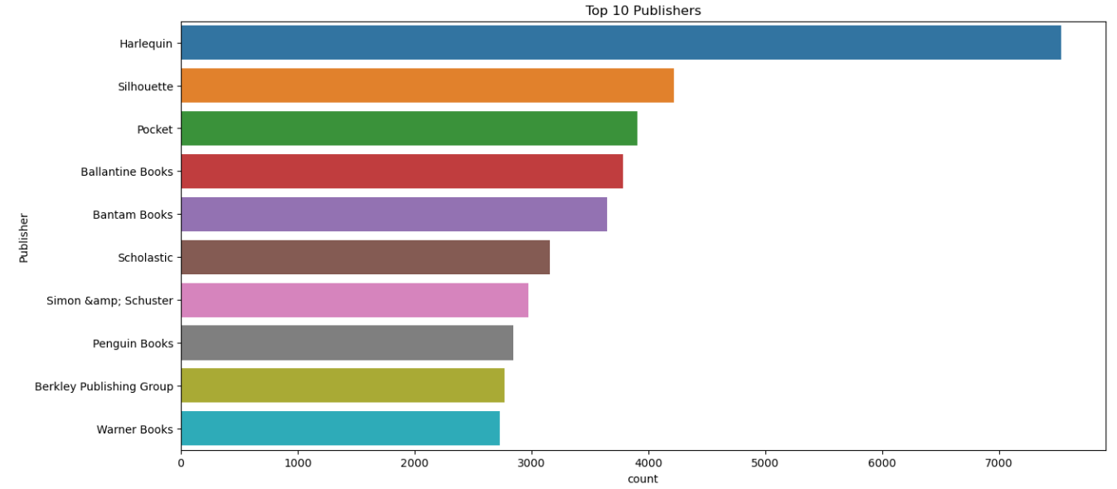
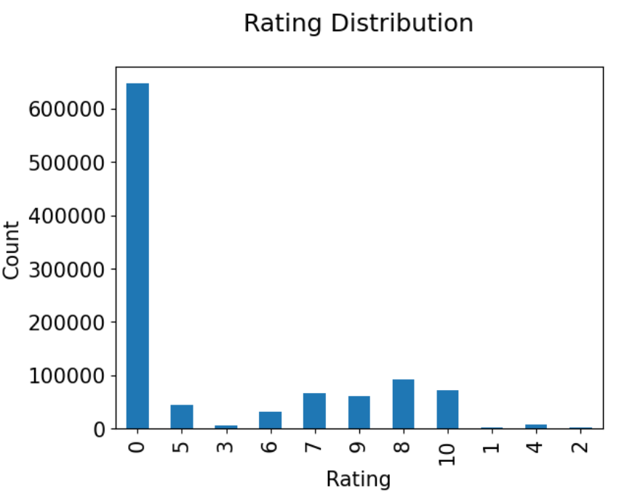
5) Exploratory Data Analysis :
Analytics for every dataset (i.e book, users, ratings) has helped to understand user-item interactions for book recommendation.
Viewed top books as per ratings.
Analysis based on top authors with highest number of books, top publishers with highest number of books, number of books published in yearly, users age distributions, top books as per ratings, different various user’s ratings

Slide 9
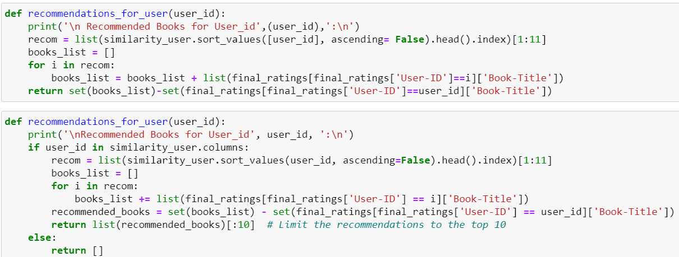
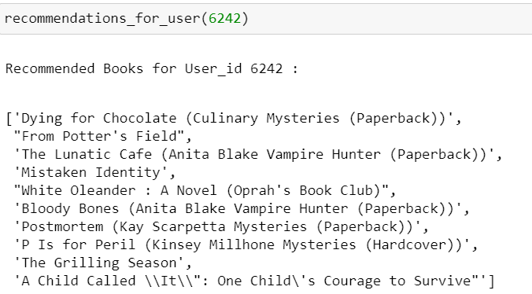
6) Recommender Systems :
This project explores various recommendation algorithms, including Popularity Based Filtering, Collaborative Filtering based Recommendation System–(User-User based), and Collaborative Filtering based Recommendation System–(Item-Item Based).
These algorithms consider user behaviour, book attributes, and user preferences to generate personalized book recommendations.

Slide 10
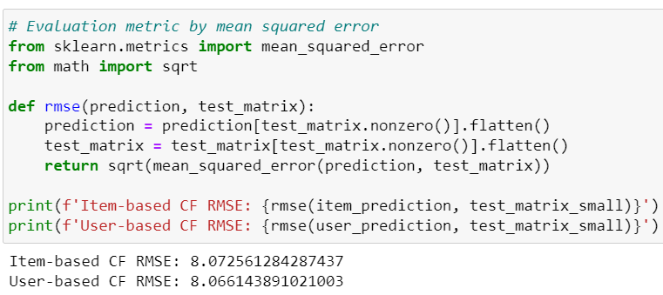
7) Evaluation Metrics :
Model evaluation metrics is important to distinguish the best collaborative filtering – either by memory based or model based approach.
The memory based approach – Cosine Similarity shows RMSE score for item based CF is 8.07 and for user based CF it shows 8.06. The score is slightly similar.
Model based collaborative filtering made it better score with Latent Factor Model called SVD.
The score improved to 1.49 for both SVD RMSE and accuracy score.

Slide 11
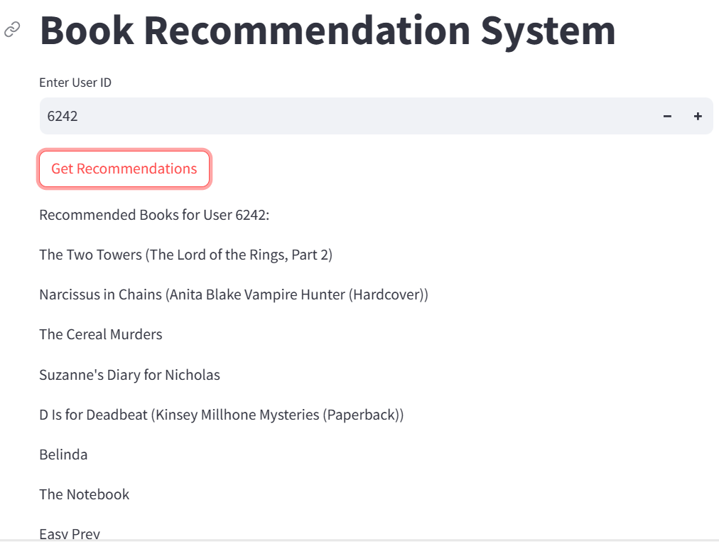
8) Deployment :
After model building and model evaluation next import key point is deployment.
We have done deployment of recommender system by using streamlit tool and spyder app.
Following links are used to shows us the interface of the model and get recommendation of books as per user –id.
Local URL: http://localhost:8501
Network URL: http://192.168.208.127:8501

Slide 12
9) Conclusion :
It's all done! We reached the end of exercise. Starting with loading the data so far we have done data cleaning and feature engineering, null values treatment, some univariate analysis. Collaborative Filtering was among best method to approach recommendation system for this project. Model based approach like Latent Factor Model called SVD and Memory based approach with cosine similarity was model building approach. The comparison of RMSE score between model and memory based approach was quite different. Model Evaluation metrics shows better recommendation with model based CF. The RMSE score varies in both the model but optimal model we can find is in SVD.
Model evaluation metrics is important to distinguish the best collaborative filtering – either by memory based or model based approach. The memory based approach – Cosine Similarity shows RMSE score for item based CF is 8.07 and for user based CF it shows 8.06. The score is slightly similar. Model based collaborative filtering made it better score with Latent Factor Model called SVD. The score improved to 1.49 for both SVD RMSE and accuracy score.

Slide 13
SVD with RMSE score is the best model with 1.49 for this dataset. This performance could be due to various reasons : pattern of data, different model give different accuracy score, business understanding, machine learning approach etc. Finally Singular Value Decomposition (SVD) is an optimal model for book recommendation system of this dataset.

Slide 14
THANKS !

